Slide 1
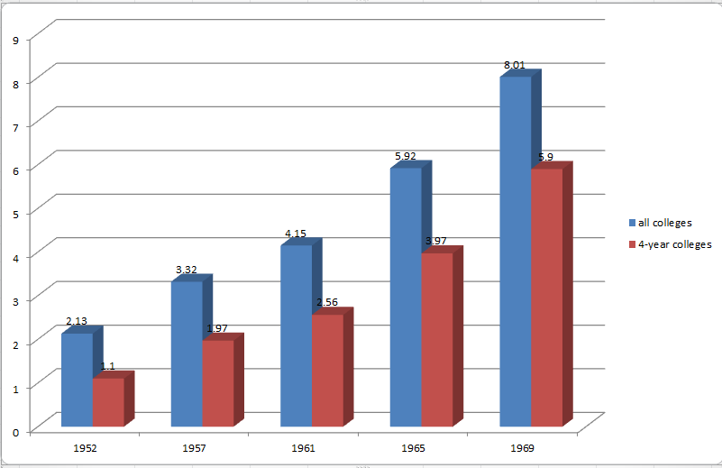
Growing College Enrollment (in millions)

Slide 2
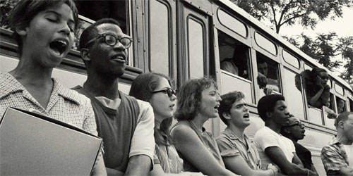
Notes:
Cal students freedom summer

Slide 3
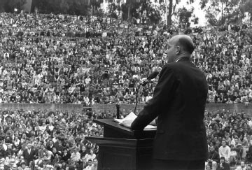

Slide 4
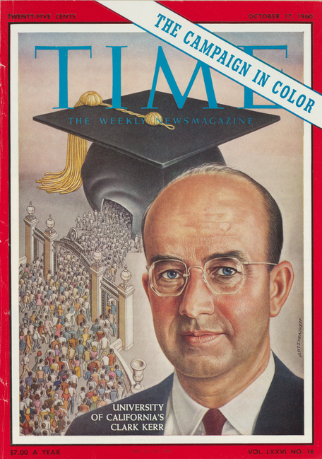

Slide 5


Slide 6
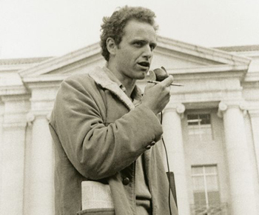

Slide 7


Slide 8


Slide 9
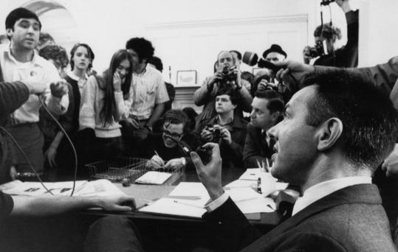

Slide 10
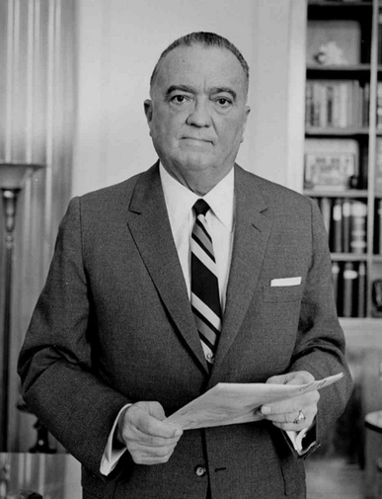

Slide 11
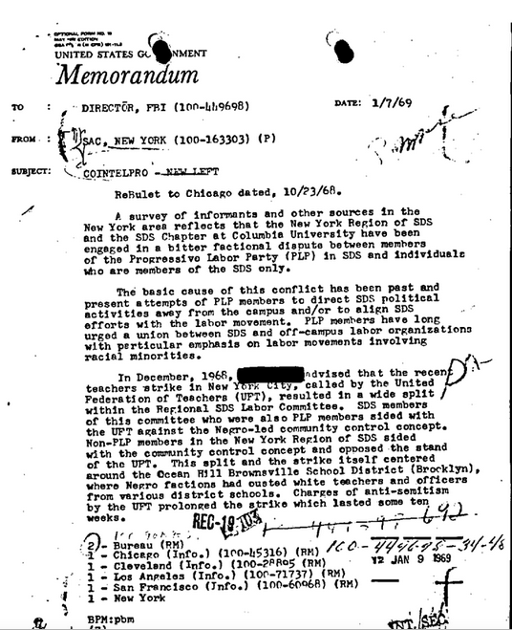

Slide 12


Slide 13
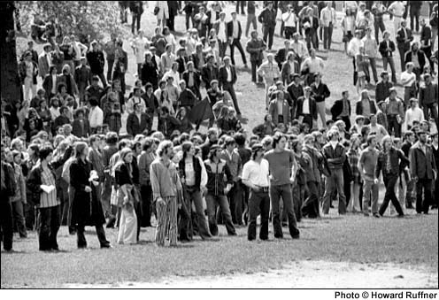

Slide 14
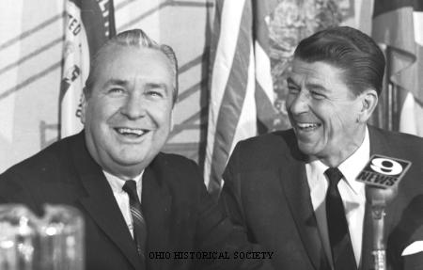

Slide 15
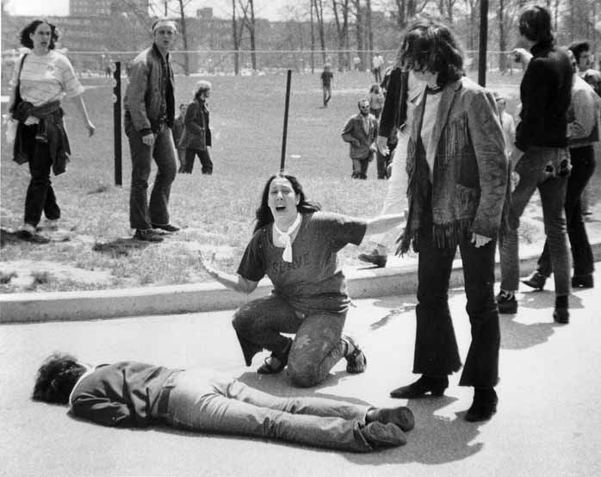

Slide 16
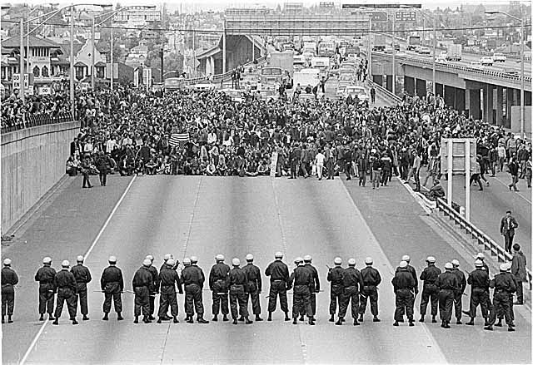
Notes:
Kent state

Slide 17


Slide 18
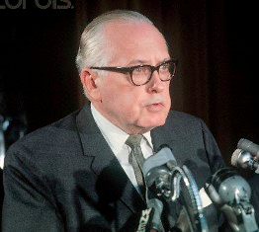
Notes:
Grayson kirk

Slide 19
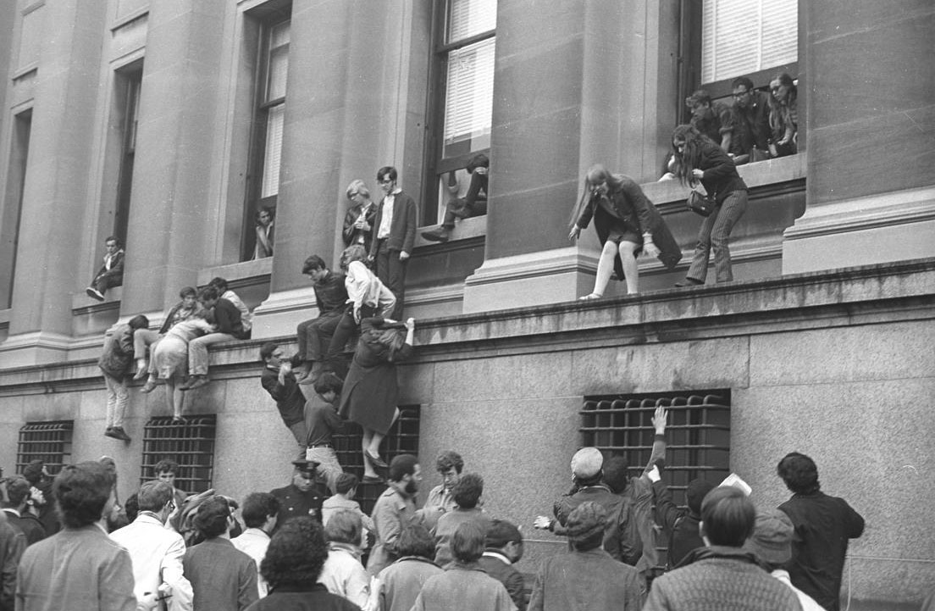

Slide 20


Slide 21
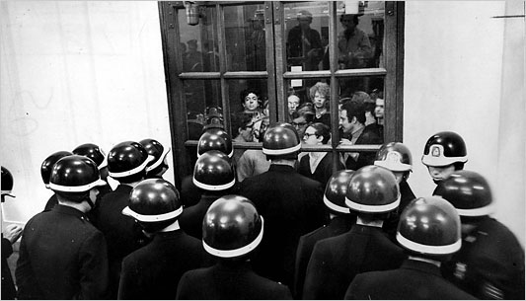

Slide 22


Slide 23
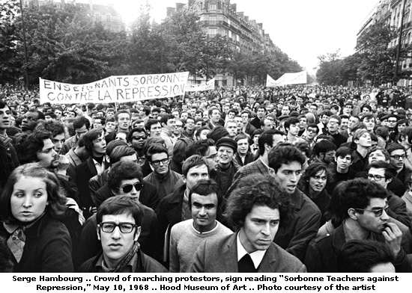

Slide 24


Slide 25
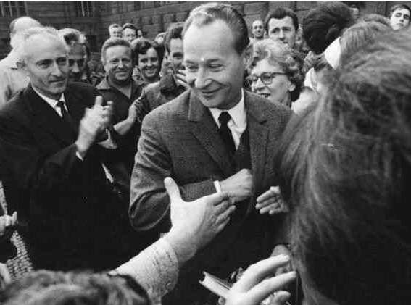

Slide 26


Slide 27


Slide 28


Slide 29

Notes:
Jan palach

Slide 30


Slide 31
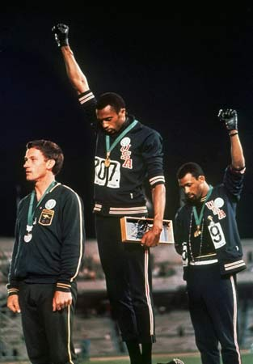
Notes:
Tommie smith and john carlos

Slide 32


Slide 33
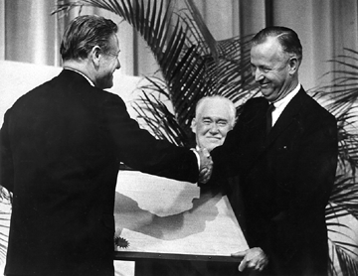
Notes:
James perkins

Slide 34
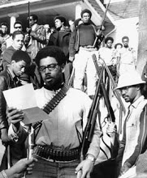

Slide 35
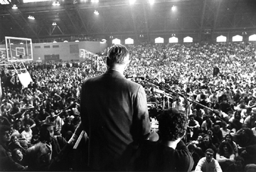
Notes:
perkins

Slide 36
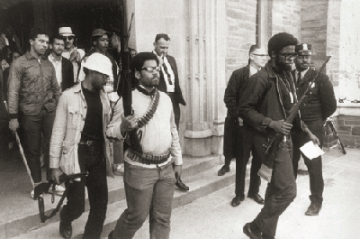

Slide 37
Lyndon Johnson: Executive Order 11246 (1965)
SUBPART B — CONTRACTORS’ AGREEMENTS
Sec. 202 . . . During the performance of this contract, the contractor agrees as follows:
(1) The contractor will not discriminate against any employee or applicant for employment because of race, creed, color, or national origin. The contractor will take affirmative action to ensure that applicants are employed, and that employees are treated during employment, without regard to their race, creed, color, or national origin. Such action shall include, but not be limited to the following: employment, upgrading, demotion, or transfer; recruitment or recruitment advertising; layoff or termination; rates of pay or other forms of compensation; and selection for training, including apprenticeship. The contractor agrees to post in conspicuous places, available to employees and applicants for employment, notices to be provided by the contracting officer setting forth the provisions of this nondiscrimination clause.

Slide 38


Slide 39


Slide 40
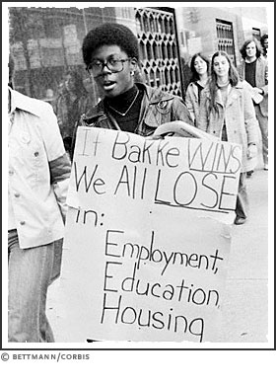

Slide 41
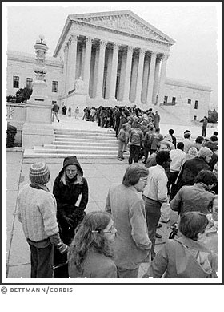

Slide 42
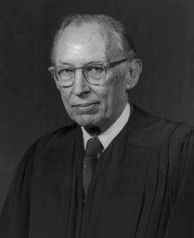

Slide 43
Bakke (1978)
We have never approved a classification that aids persons perceived as members of relatively victimized groups at the expense of other innocent individuals in the absence of judicial, legislative, or administrative findings of constitutional or statutory violations . . .
Hence, the purpose of helping certain groups whom the faculty of the Davis Medical School perceived as victims of “societal discrimination” does not justify a classification that imposes disadvantages upon persons like respondent, who bear no responsibility for whatever harm the beneficiaries of the special admissions program are thought to have suffered. To hold otherwise would be to convert a remedy heretofore reserved for violations of legal rights into a privilege that all institutions throughout the Nation could grant at their pleasure to whatever groups are perceived as victims of societal discrimination.

Slide 44
Bakke (1978)
The fourth goal asserted by petitioner is the attainment of a diverse student body. This clearly is a constitutionally permissible goal for an institution of higher education. Academic freedom, though not a specifically enumerated constitutional right, long has been viewed as a special concern of the First Amendment. The freedom of a university to make its own judgments as to education includes the selection of its student body . . .
Thus, in arguing that its universities must be accorded the right to select those students who will contribute the most to the “robust exchange of ideas,” petitioner invokes a countervailing constitutional interest, that of the First Amendment. In this light, petitioner must be viewed as seeking to achieve a goal that is of paramount importance in the fulfillment of its mission . . .
In enjoining petitioner from ever considering the race of any applicant, however, the courts below failed to recognize that the State has a substantial interest that legitimately may be served by a properly devised admissions program involving the competitive consideration of race and ethnic origin.

Slide 45


