Slide 1
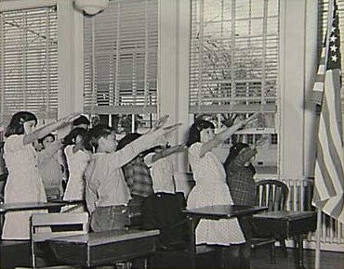

Slide 2
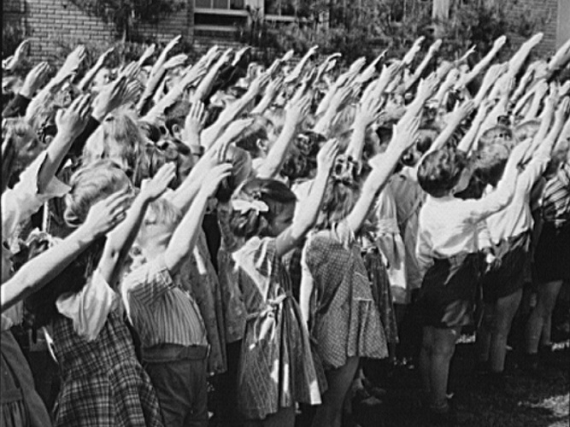

Slide 3
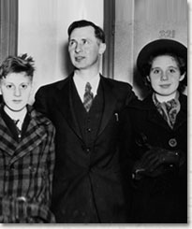
Notes:
Walter gobitis & two children

Slide 4
Minersville School District v. Gobitis (1940)
But the manifold character of man's relations may bring his conception of religious duty into conflict with the secular interests of his fellow-men. When does the constitutional guarantee compel exemption from doing what society thinks necessary for the promotion of some great common end, or from a penalty for conduct which appears dangerous to the general good? …
National unity is the basis of national security. To deny the legislature the right to select appropriate means for its attainment presents a totally different order of problem from that of the propriety of subordinating the possible ugliness of littered streets to the free expression opinion through handbills….
The ultimate foundation of a free society is the binding tie of cohesive sentiment. Such a sentiment is fostered by all those agencies of the mind and spirit which may serve to gather up the traditions of a people, transmit them from generation to generation, and thereby create that continuity of a treasured common life which constitutes a civilization. 'We live by symbols.' The flag is the symbol of our national unity, transcending all internal differences, however large, within the framework of the Constitution…

Slide 5
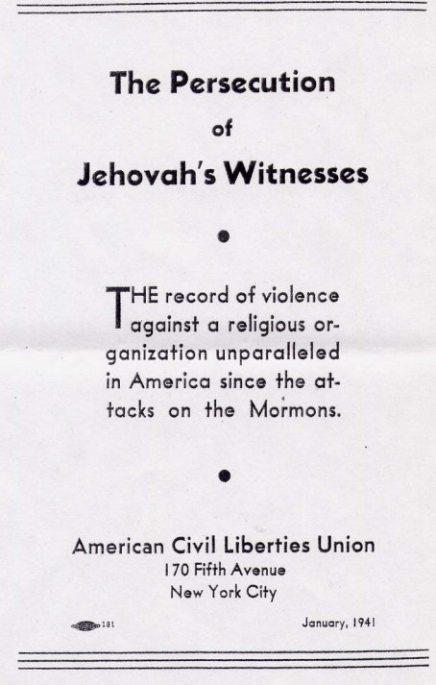

Slide 6
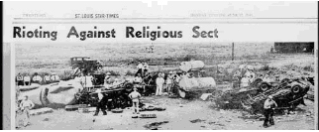
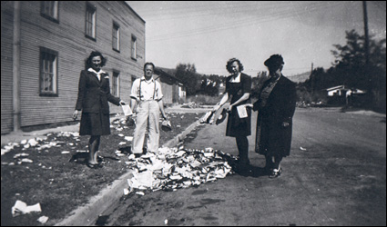

Slide 7
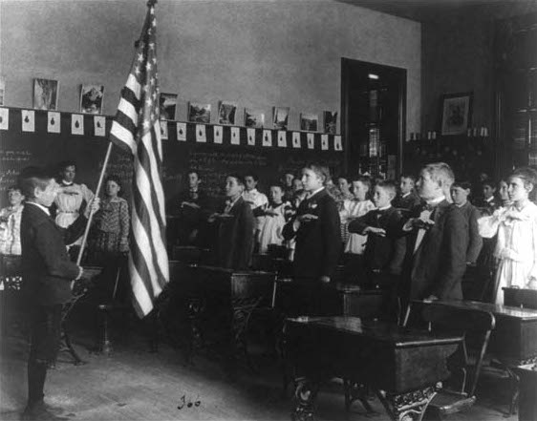

Slide 8
West Virginia Board of Education v. Barnette (1943)
To believe that patriotism will not flourish if patriotic ceremonies are voluntary and spontaneous instead of a compulsory routine is to make an unflattering estimate of the appeal of our institutions to free minds. We can have intellectual individualism and the rich cultural diversities that we owe to exceptional minds only at the price of occasional eccentricity and abnormal attitudes. When they are so harmless to others or to the State as those we deal with here, the price is not too great. But freedom to differ is not limited to things that do not matter much. That would be a mere shadow of freedom. The test of its substance is the right to differ as to things that touch the heart of the existing order.
If there is any fixed star in our constitutional constellation, it is that no official, high or petty, can prescribe what shall be orthodox in politics, nationalism, religion, or other matters of opinion or force citizens to confess by word or act their faith therein. If there are any circumstances which permit an exception, they do not now occur to us.

Slide 9
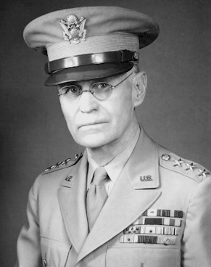
Notes:
John dewitt

Slide 10
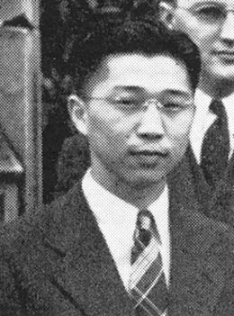
Notes:
Gordon hirabiyashi

Slide 11
Hirabiyashi v. United States (1943)
There is support for the view that social, economic and political conditions which have prevailed since the close of the last century, when the Japanese began to come to this country in substantial numbers, have intensified their solidarity and have in large measure prevented their assimilation as an integral part of the white population . . .
Viewing these data in all their aspects, Congress and the Executive could reasonably have concluded that these conditions have encouraged the continued attachment of members of this group to Japan and Japanese institutions…
Because racial discriminations are in most circumstances irrelevant, and therefore prohibited, it by no means follows that, in dealing with the perils of war, Congress and the Executive are wholly precluded from taking into account those facts and circumstances which are relevant to measures for our national defense and for the successful prosecution of the war, and which may, in fact, place citizens of one ancestry in a different category from others . . .

Slide 12
EXECUTIVE ORDER 9066
February 19, 1942
Whereas, the successful prosecution of the war requires every possible protection against espionage and against sabotage to national-defense material, national-defense premises and national defense utilities . . .
Now therefore, by virtue of the authority vested in me as President of the United States, and Commander in Chief of the Army and Navy, I hereby authorize and direct the Secretary of War, and the Military Commanders whom he may from time to time designate, whenever he or any designated Commander deems such action to be necessary or desirable, to prescribe military areas in such places and of such extent as he or the appropriate Military Commander may determine, from which any or all persons may be excluded, and with respect to which, the right of any persons to enter, remain in, or leave shall be subject to whatever restriction the Secretary of War or the appropriate Military Commander may impose in his discretion.

Slide 13


Slide 14
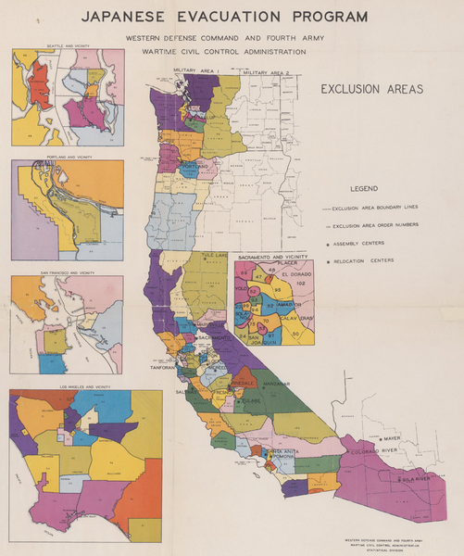

Slide 15
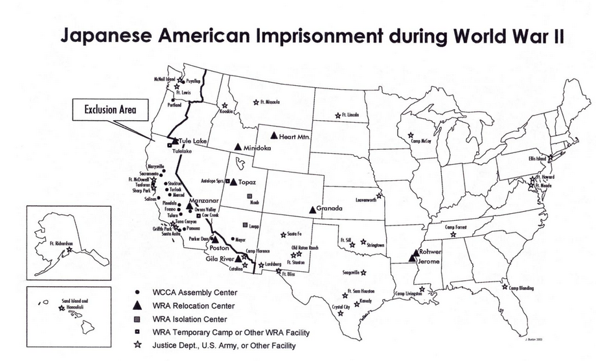

Slide 16
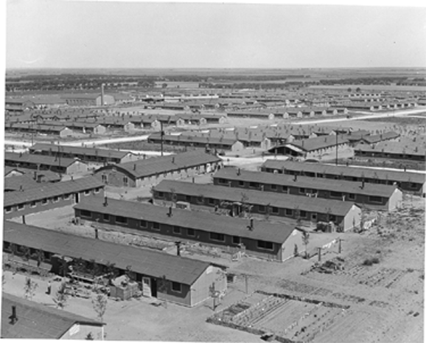
Notes:
Colorado internment camps

Slide 17
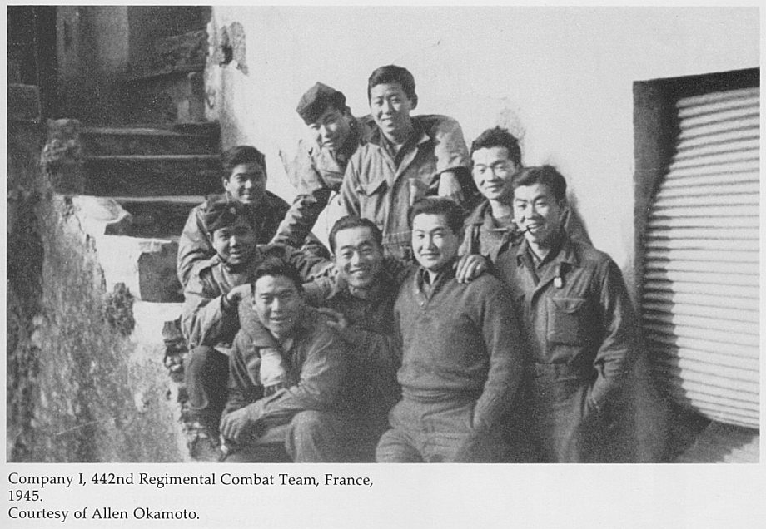

Slide 18
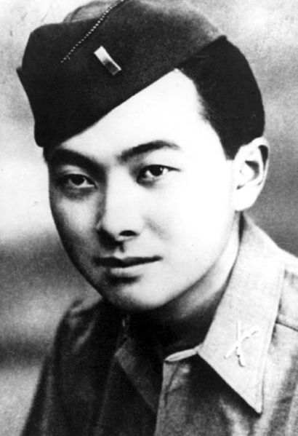
Notes:
inouye

Slide 19
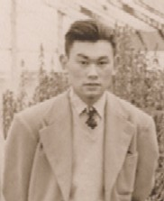

Slide 20
Korematsu v. United States (1944)
To cast this case into outlines of racial prejudice, without reference to the real military dangers which were presented, merely confuses the issue. Korematsu was not excluded from the Military Area because of hostility to him or his race. He was excluded because we are at war with the Japanese Empire, because the properly constituted military authorities feared an invasion of our West Coast and felt constrained to take proper security measures, because they decided that the military urgency of the situation demanded that all citizens of Japanese ancestry be segregated from the West Coast temporarily, and, finally, because Congress, reposing its confidence in this time of war in our military leaders -- as inevitably it must -- determined that they should have the power to do just this. There was evidence of disloyalty on the part of some, the military authorities considered that the need for action was great, and time was short. We cannot -- by availing ourselves of the calm perspective of hindsight -- now say that, at that time, these actions were unjustified.

Slide 21
Korematsu —Murphy dissent
Justification for the exclusion is sought, instead, mainly upon questionable racial and sociological grounds not ordinarily within the realm of expert military judgment, supplemented by certain semi-military conclusions drawn from an unwarranted use of circumstantial evidence . . .
I dissent, therefore, from this legalization of racism. Racial discrimination in any form and in any degree has no justifiable part whatever in our democratic way of life. It is unattractive in any setting, but it is utterly revolting among a free people who have embraced the principles set forth in the Constitution of the United States.

Slide 22
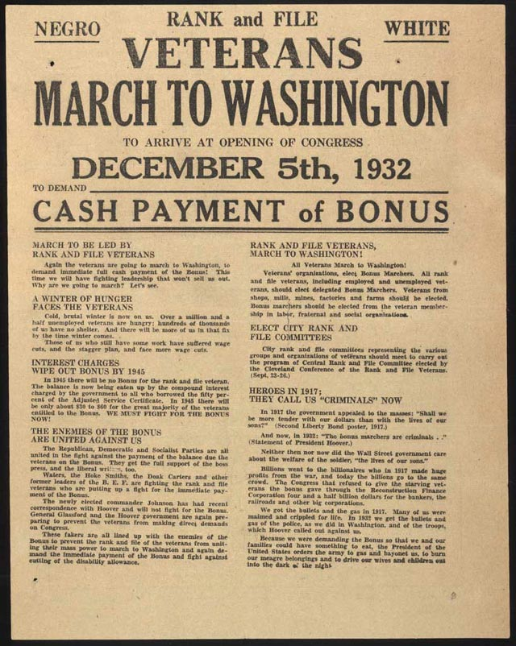

Slide 23
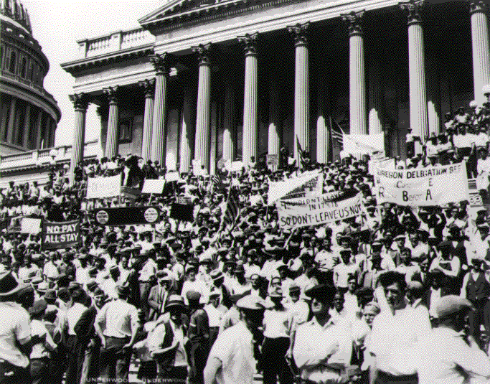

Slide 24
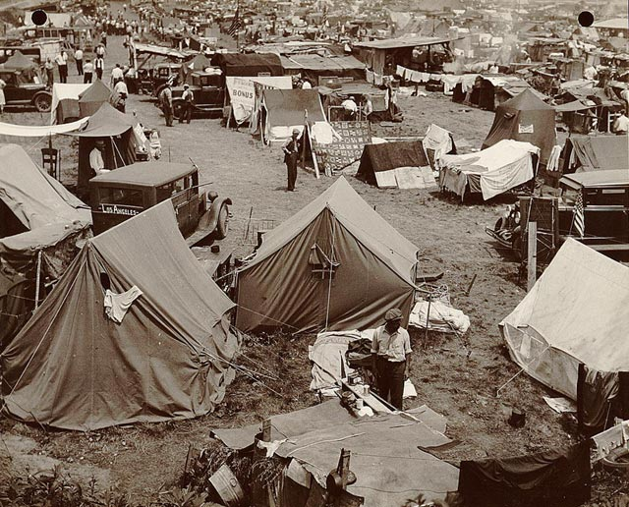

Slide 25
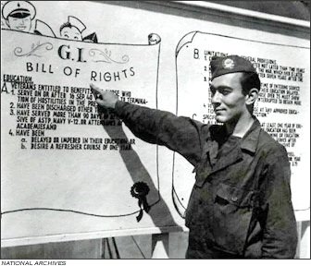
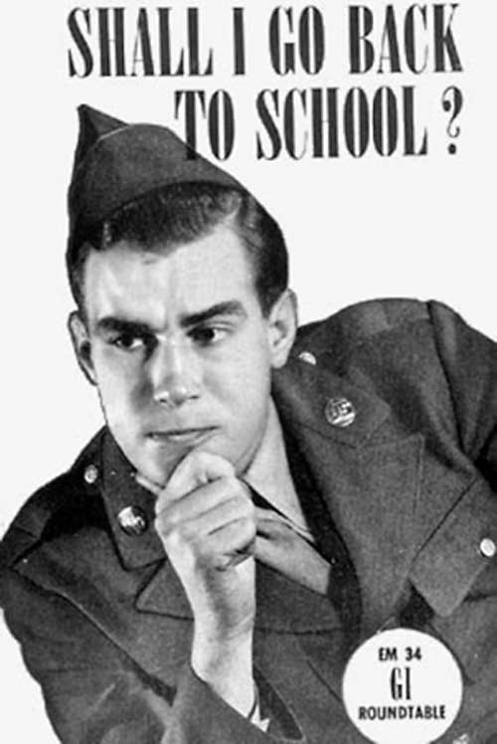
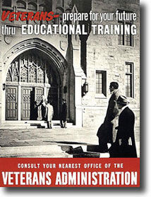

Slide 26
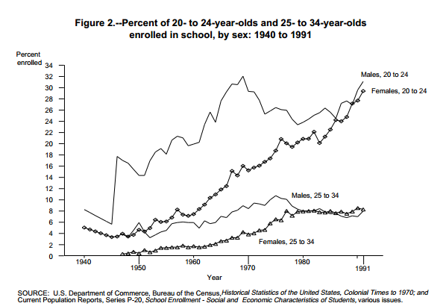

Slide 27
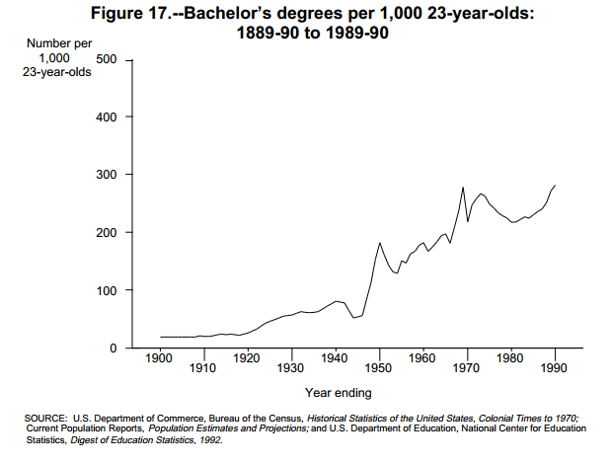

Slide 28
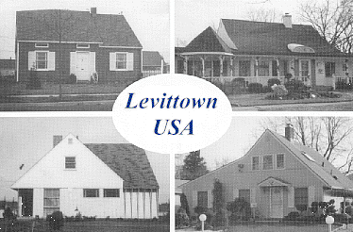

Slide 29
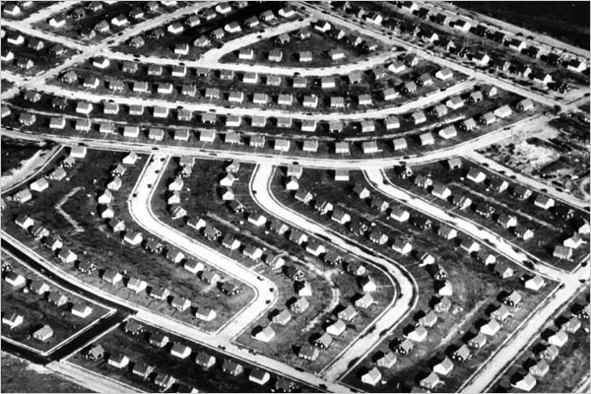

Slide 30
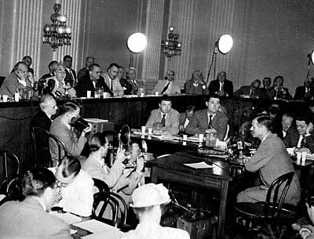

Slide 31
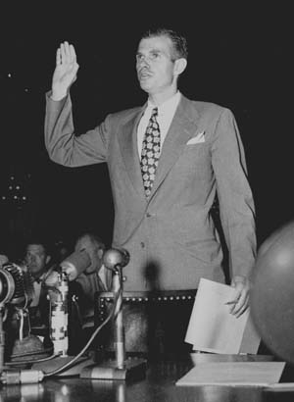

Slide 32
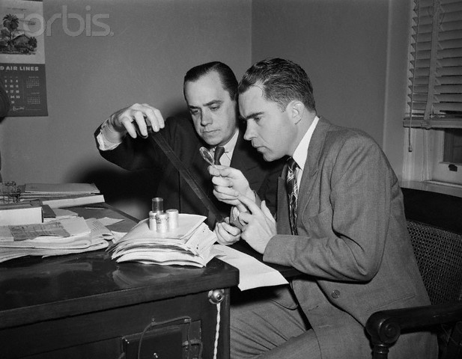

Slide 33
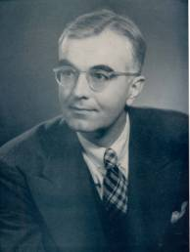
Notes:
gideonse

Slide 34
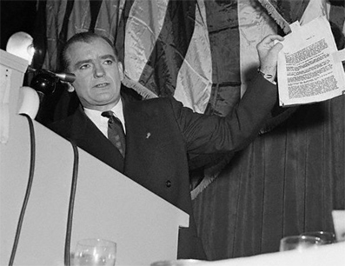

Slide 35
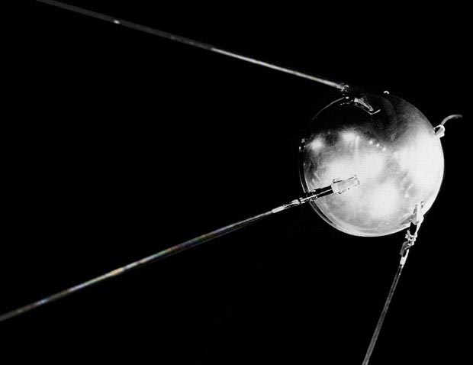
Notes:
sputnik

Slide 36
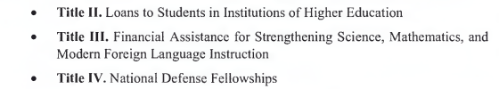
Nothing contained in this Act shall be construed to authorize any department, agency, officer or employee of the United States to exercise any direction, supervision, or control over the curriculum, program of instruction, administration, or personnel of any educational institution or school system.

Slide 37
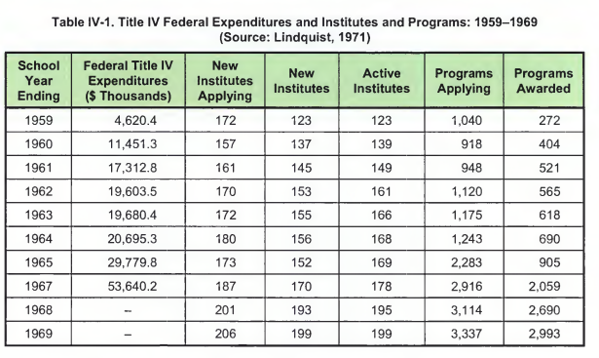

Slide 38


Slide 39
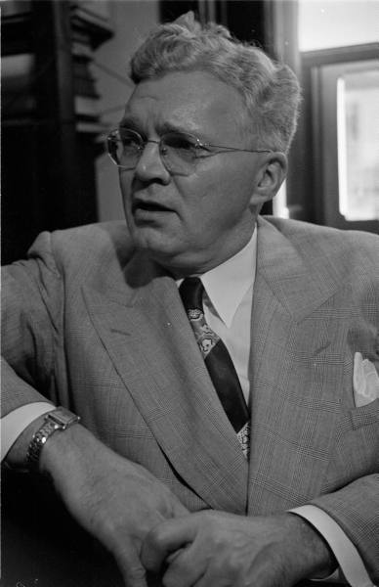
Notes:
Rep charles oakman (R-MI)

Slide 40


Slide 41
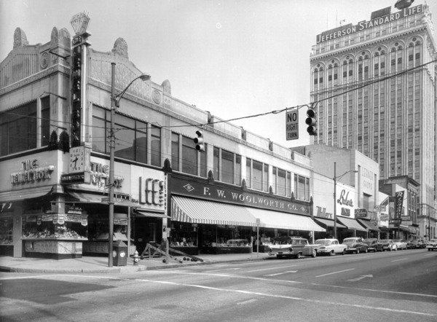

Slide 42
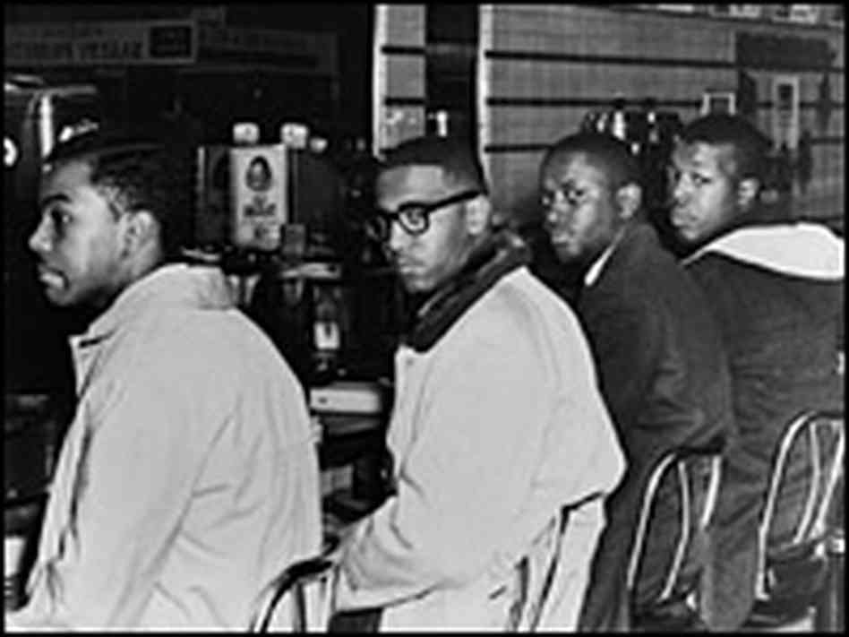

Slide 43
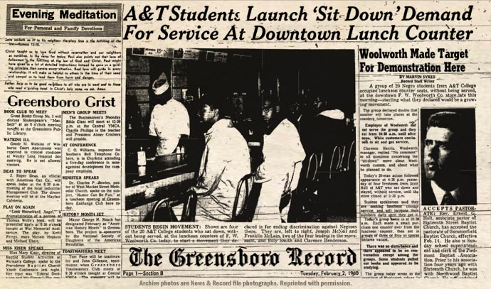

Slide 44
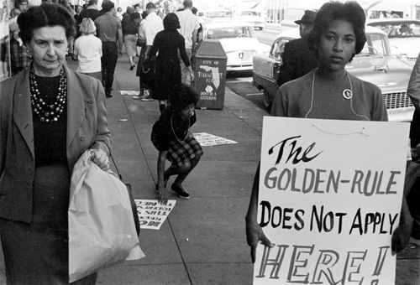

Slide 45


Slide 46
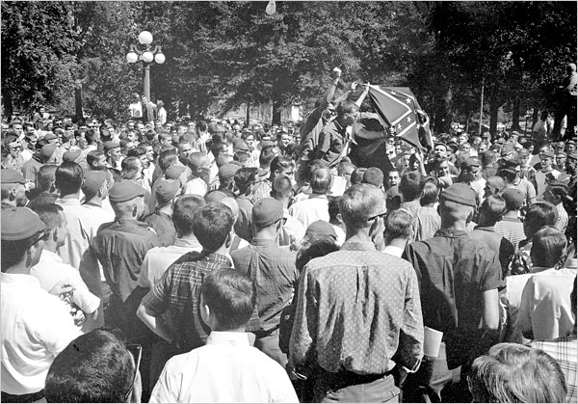

Slide 47
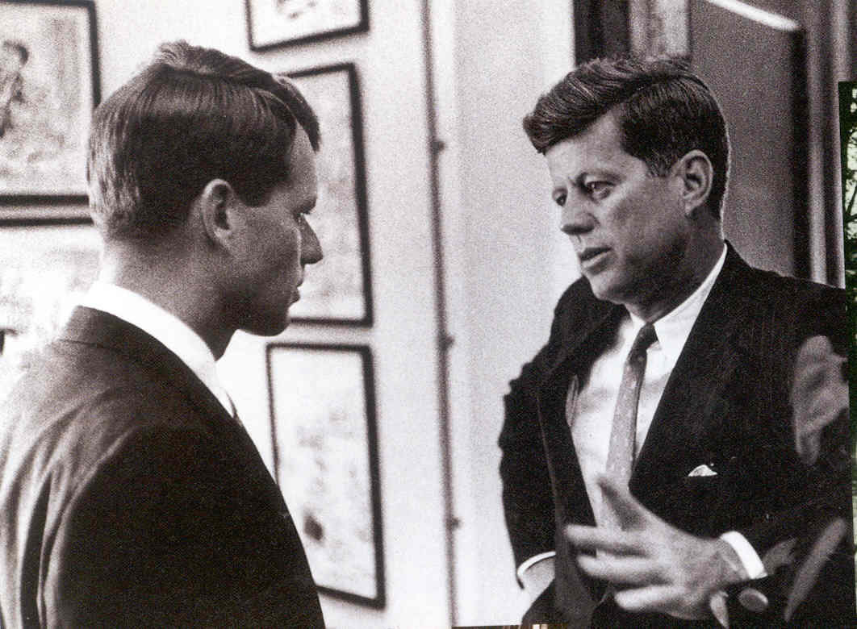

Slide 48
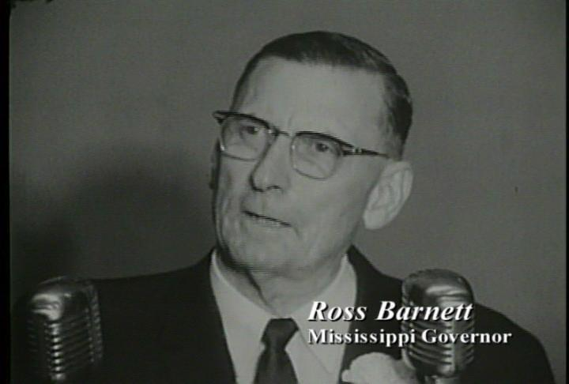

Slide 49
Robert Kennedy: I think, Governor, that the President had some questions that he wanted answers to—
Ross Barnett: Well—
Robert Kennedy: —to make his own determination.
Barnett: That’s right. He wanted to know if I would obey the orders of the court, and I told him I’d have to give some . . . study that over. That’s a serious thing.
I’ve taken an oath to abide by the laws of this state and our state constitution and the constitution of the United States. And, General, how can I violate my oath of office? How can I do that, and live with the people of Mississippi? You know, they’re expecting me to keep my word. That’s what I’m up against—
President Kennedy: Oh, Governor—
Barnett: —and I don’t understand why the court wouldn’t understand that—
President Kennedy: Governor, this is the President speaking.
Barnett: Yes, sir, Mr. President.
President Kennedy: Now, it’s—I know that your feeling about the law of Mississippi, and the fact that you don’t want to carry out that court order.
What we really want to have from you, though, is some understanding about whether the state police will maintain law and order. We understand your feeling about the court order—

Slide 50
Barnett: Yes.
President Kennedy: —and your disagreement with it. But what we’re concerned about is how much violence there’s going to be and what kind of action we’ll have to take to prevent it. And I’d like to get assurances from you that the state police down there will take positive action to maintain law and order. Then we’ll know what we have to do.
Barnett: They’ll take positive action, Mr. President, to maintain law and order as best we can.
President Kennedy: And, now, how good is—
Barnett: We’ll have 220 highway patrolmen—
President Kennedy: Right.
Barnett: And they’ll absolutely be unarmed.
President Kennedy: Right—
Barnett: Not a one of them will be armed.
President Kennedy: Well, no—but the problem is—well, what can they do to maintain law and order and prevent the gathering of a mob and action taken by the mob? What can they do? Can they stop that?
Barnett: Well, they’ll do their best to. They’ll do everything in their power to stop it.
President Kennedy: Now, what about the suggestions made by the Attorney General in regard to not permitting people to congregate and start a mob?

Slide 51
Barnett: Well, we’ll do our best to keep ‘em from congregating, but that’s hard to do, you know.
President Kennedy: Well, just tell them to move along.
Barnett: When they start moving up on the sidewalks and different sides of the streets, what are you going to do about it?
President Kennedy: Well, now, as I understand it, Governor, you would do everything you can to maintain law and order.
Barnett: I’ll do everything in my power to maintain order—
President Kennedy: Right. Now—
Barnett: —and peace. We don’t want any shooting down here.
President Kennedy: I understand. Now, Governor, what about—can you maintain this order?
Barnett: Well, I don’t know.
President Kennedy: Yes.
Barnett: That’s what I’m worried about.
President Kennedy: I see.
Barnett: I don’t know whether I can or not.
President Kennedy: Right.
Barnett: I couldn’t have the other afternoon. [On Sept. 27, 1962, 2000 people, including students, farmers, and self-styled vigilantes, converged on Oxford to stop Meredith from registering.]

Slide 52
President Kennedy: You couldn’t have?
Barnett: There was such a mob there, it would have been impossible.
President Kennedy: I see.
Barnett: There were men in there with trucks and shotguns, and all such as that. Not a lot of ‘em, but some, we saw, and certain people were just—they were just enraged.
President Kennedy: Well, now, will you talk—
Barnett: You just don’t understand the situation down here.
President Kennedy: Well, the only thing is I got my responsibility.
Barnett: I know you do.
President Kennedy: This is not my order; I just have to carry it out. So I want to get together and try to do it with you in a way which is the most satisfactory and causes the least chance of damage to people in Mississippi. That’s my interest.
Barnett: That’s right. Would you be willing to wait awhile and let the people cool off on the whole thing?
President Kennedy: Until how long?
Barnett: Couldn’t you make a statement to the effect, Mr. President, Mr. [Attorney] General, that under the circumstances existing in Mississippi, that there’ll be bloodshed; you want to protect the life of, of James Meredith, and all other people.
And under the circumstances at this time, it just wouldn’t be fair to him or others to try to register him—

Slide 53
President Kennedy: Well, then at what time would it be fair?
Barnett: Well, we, we could wait a—I don’t know.
President Kennedy: Yeah.
Barnett: It might be in two or three weeks, it might cool off a little.
President Kennedy: Well, would you undertake to register him in two weeks?
Barnett: Well, now, you know I can’t undertake to register him myself—
President Kennedy: I see.
Barnett: —but you all might make some progress that way, you know.
President Kennedy: [Laughs sarcastically.] Yeah. Well, we’d be faced with—unless we had your support and assurance, we’d be—
Barnett: I say I’m going to, I’m going to cooperate. I might not know when you’re going to register him, you know.
President Kennedy: I see.

Slide 54
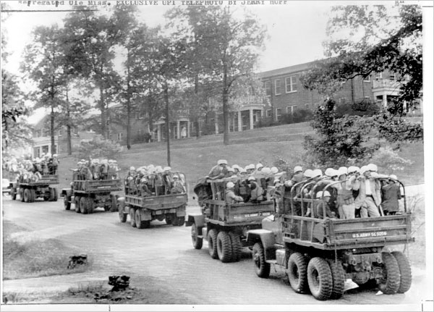

Slide 55


