Slide 1


Slide 2
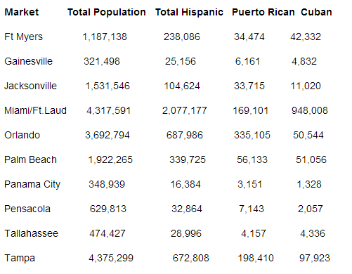

Slide 3


Slide 4


Slide 5
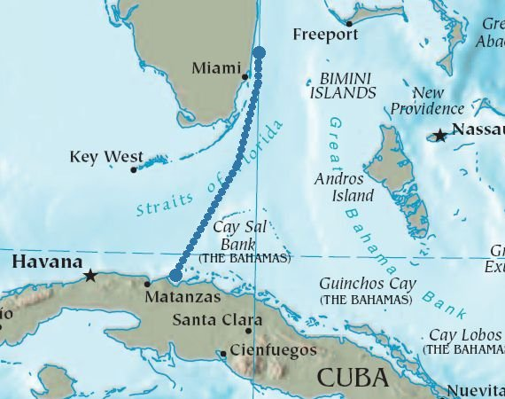

Slide 6

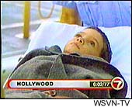

Slide 7



Slide 8
Gonzalez v. Reno (2000)
In this case, because the law -- particularly section 1158 -- is silent about the validity of Plaintiff’s purported asylum applications, it fell to the INS to make a discretionary policy choice. The INS, exercising its gap-filling discretion, determined these things: (1) six-year-old children lack the capacity to sign and to submit personally an application for asylum; (2) instead, six-year-old children must be represented by an adult in immigration matters; (3) absent special circumstances, the only proper adult to represent a six-year-old child is the child’s parent, even when the
parent is not in this country; and, (4) that the parent lives in a communist-totalitarian state (such as Cuba), in and of itself, does not constitute a special circumstance requiring the selection of a non-parental representative…
We are not untroubled by the degree of obedience that the INS policy appears to give to the wishes of parents, especially parents who are outside this country’s jurisdiction.

Slide 9
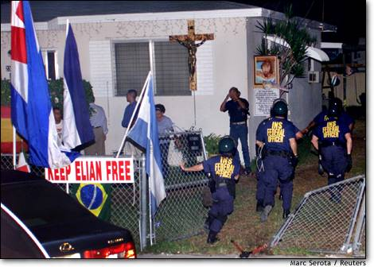

Slide 10


Slide 11


Slide 12


Slide 13


Slide 14
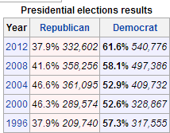
Miami-Dade County Presidential Results

Slide 15
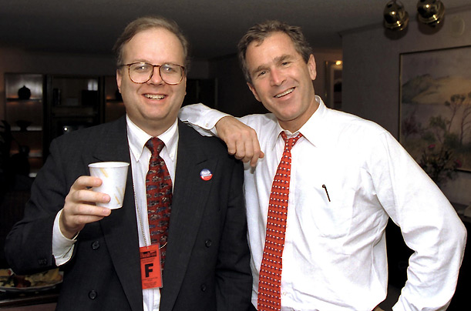

Slide 16


Slide 17
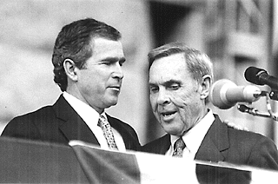

Slide 18


Slide 19
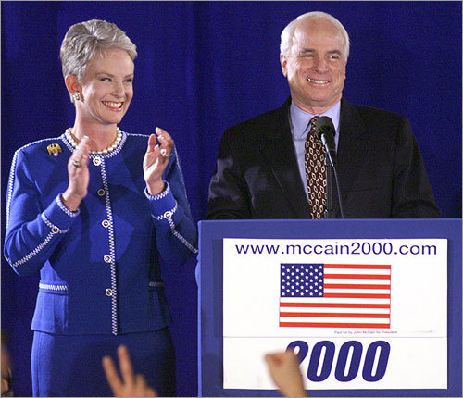

Slide 20


Slide 21
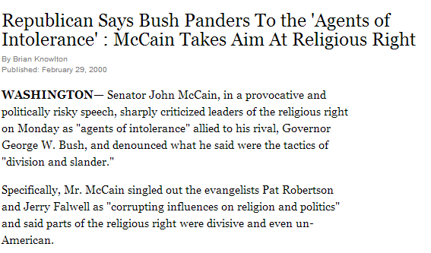

Slide 22
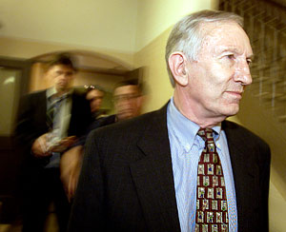

Slide 23


Slide 24
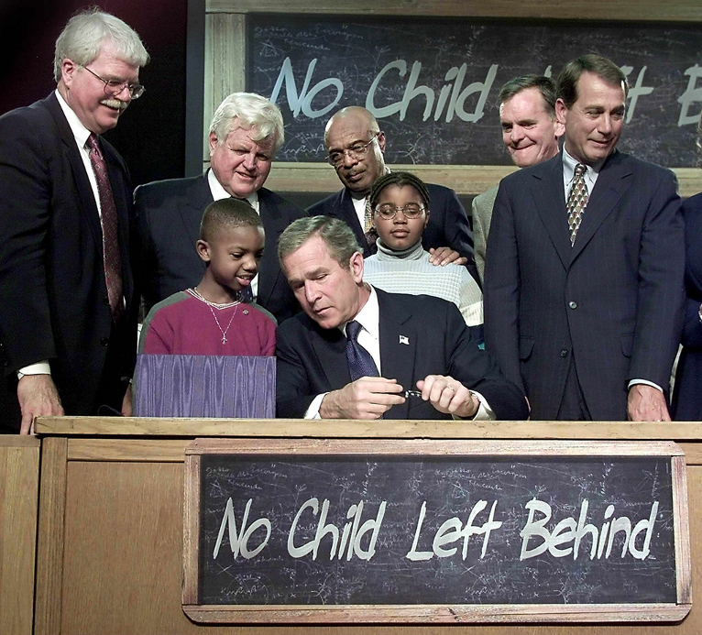

Slide 25
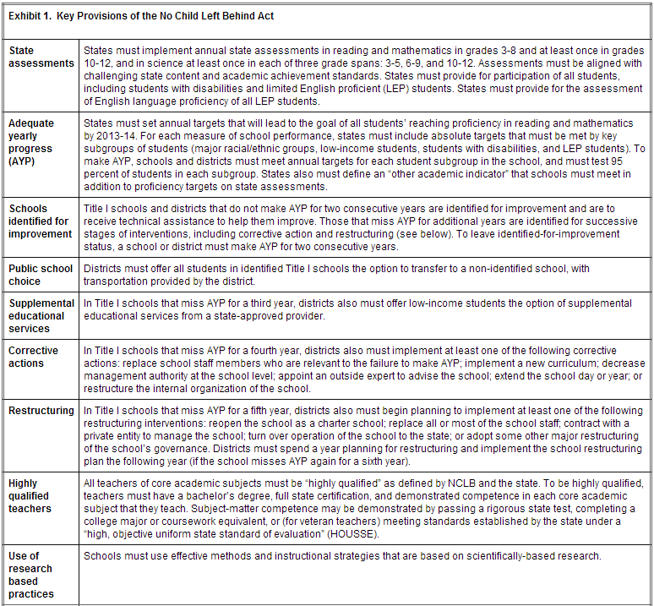

Slide 26

Notes:
Dover PA

Slide 27
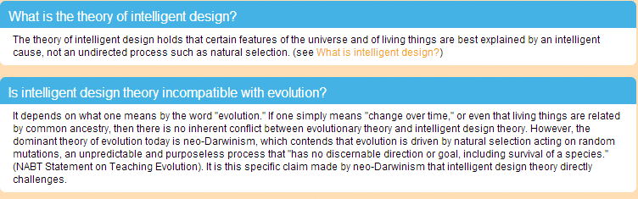

Slide 28
Kitzmiller v. Dover School District (2005)
Although proponents of the IDM occasionally suggest that the designer could be a space alien or a time-traveling cell biologist, no serious alternative to God as the designer has been proposed by members of the IDM, including Defendants’ expert witnesses…
A significant aspect of the IDM is that despite Defendants’ protestations to the contrary, it describes ID as a religious argument. In that vein, the writings of leading ID proponents reveal that the designer postulated by their argument is the God of Christianity…
In summary, the disclaimer singles out the theory of evolution for special treatment, misrepresents its status in the scientific community, causes students to doubt its validity without scientific justification, presents students with a religious alternative masquerading as a scientific theory, directs them to consult a creationist text as though it were a science resource, and instructs students to forego scientific inquiry in the public school classroom and instead to seek out religious instruction elsewhere.

Slide 29


Slide 30


Slide 31
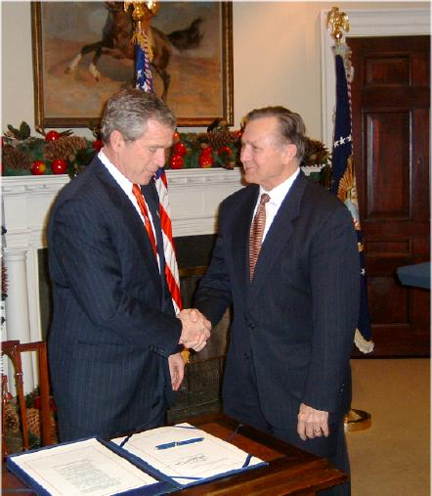
Notes:
Nick smith

Slide 32
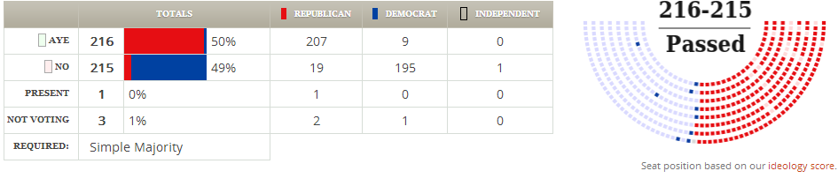
Medicare Part D Vote

Slide 33
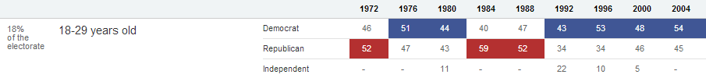
The Generation Gap Begins (2004)

Slide 34
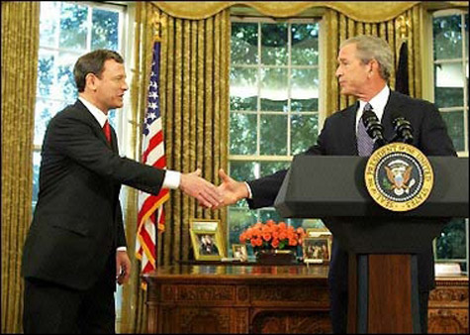

Slide 35
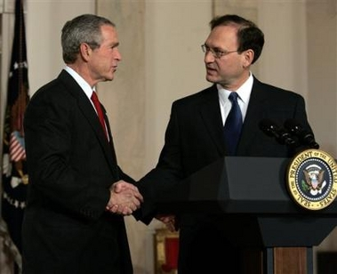

Slide 36


Slide 37


Slide 38


Slide 39
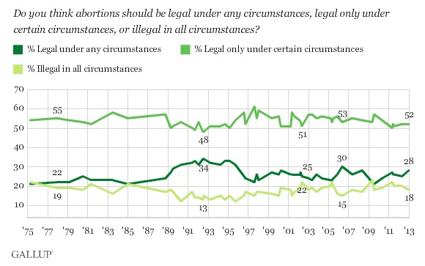

Slide 40
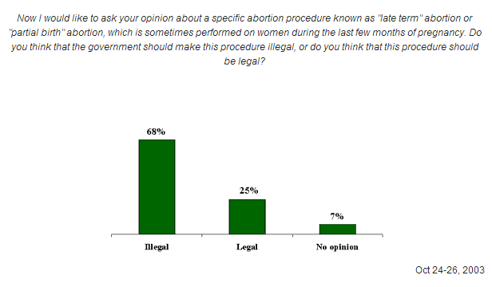

Slide 41
Stenberg v. Carhart (2000)
We again consider the right to an abortion. We understand the controversial nature of the problem. Millions of Americans believe that life begins at conception and consequently that an abortion is akin to causing the death of an innocent child; they recoil at the thought of a law that would permit it. Other millions fear that a law that forbids abortion would condemn many American women to lives that lack dignity, depriving them of equal liberty and leading those with least resources to undergo illegal abortions with the attendant risks of death and suffering. Taking account of these virtually irreconcilable points of view, aware that constitutional law must govern a society whose different members sincerely hold directly opposing views, and considering the matter in light of the Constitution’s guarantees of fundamental individual liberty, this Court, in the course of a generation, has determined and then redetermined that the Constitution offers basic protection to the woman’s right to choose.

Slide 42
Justice Thomas says that the cases just cited limit this principle to situations where the pregnancy itself creates a threat to health. He is wrong.
The cited cases, reaffirmed in Casey, recognize that a State cannot subject women’s health to significant risks both in that context, and also where state regulations force women to use riskier methods of abortion. Our cases have repeatedly invalidated statutes that in the process of regulating the methods of abortion, imposed significant health risks. They make clear that a risk to a women’s health is the same whether it happens to arise from regulating a particular method of abortion, or from barring abortion entirely. Our holding does not go beyond those cases, as ratified in Casey.

Slide 43
Gonzales v. Carhart (2007)
Whatever one’s views concerning the Casey joint opinion, it is evident a premise central to its conclusion—that the government has a legitimate and substantial interest in preserving and promoting fetal life—would be repudiated were the Court now to affirm the judgments of the Courts of Appeals [and overturn the law]…
The Act’s ban on abortions that involve partial delivery of a living fetus furthers the Government’s objectives. No one would dispute that, for many, D&E is a procedure itself laden with the power to devalue human life. Congress could nonetheless conclude that the type of abortion proscribed by the Act requires specific regulation because it implicates additional ethical and moral concerns that justify a special prohibition

Slide 44


Slide 45
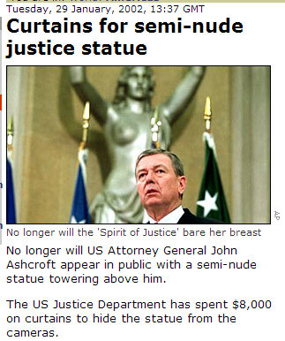

Slide 46
