Slide 1
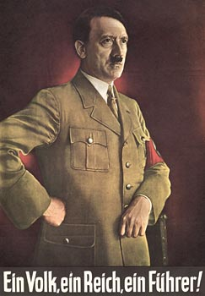

Slide 2
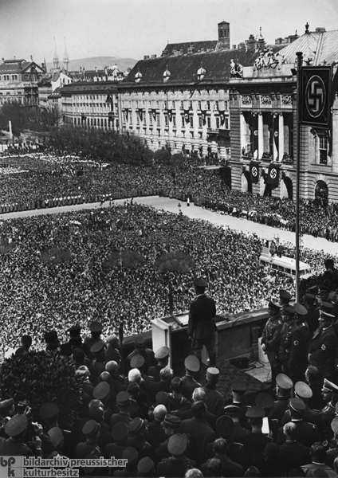

Slide 3
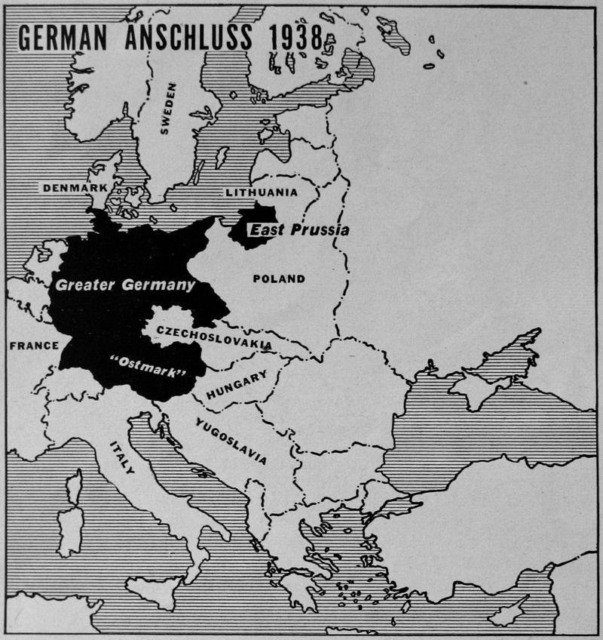

Slide 4
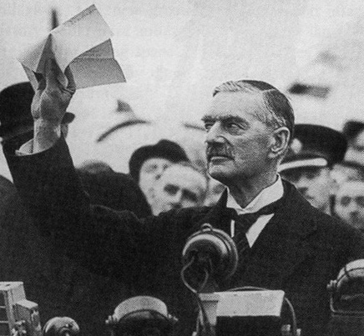

Slide 5
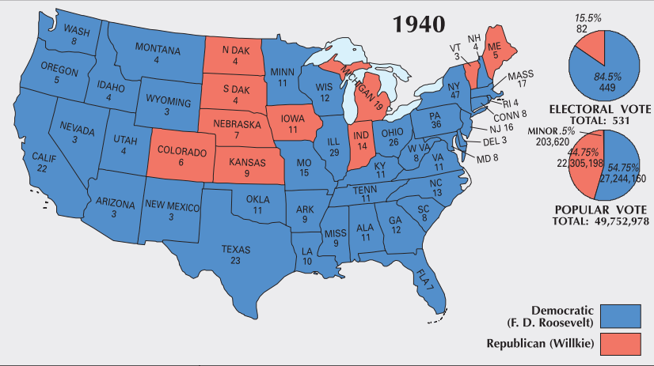

Slide 6


Slide 7
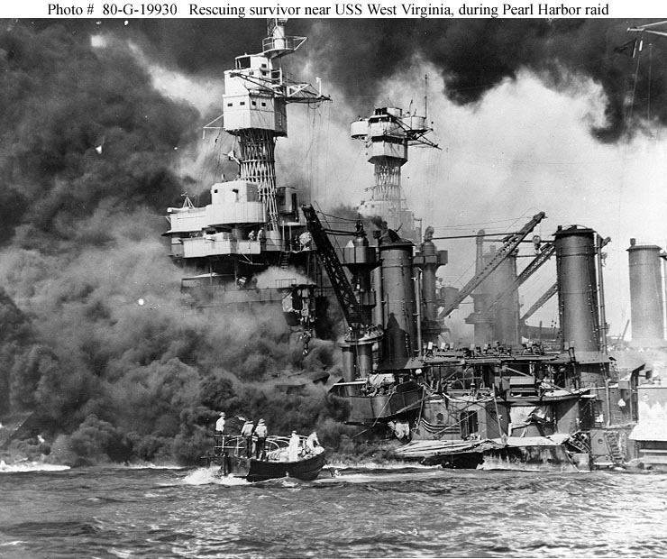

Slide 8
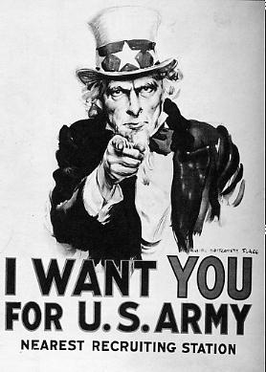

Slide 9


Slide 10
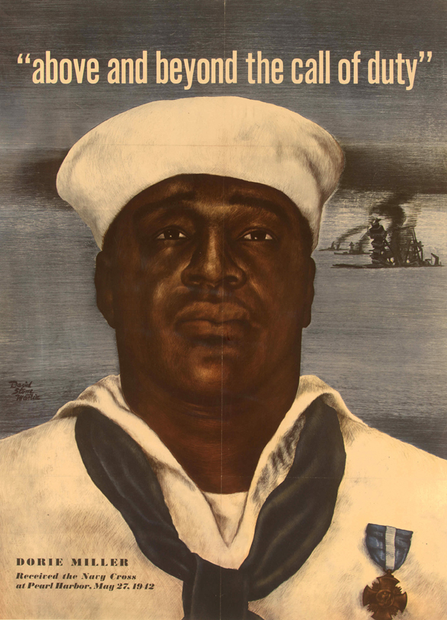
Notes:
Dorie Miller—first afam Navy Cross—heroism at Pearl Harbor

Slide 11
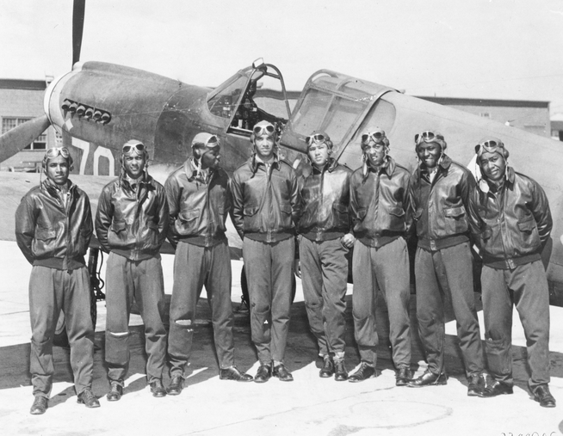
Notes:
Tuskeegee airmen

Slide 12
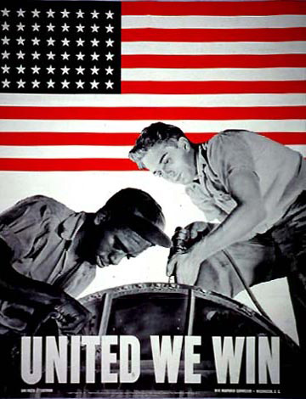

Slide 13
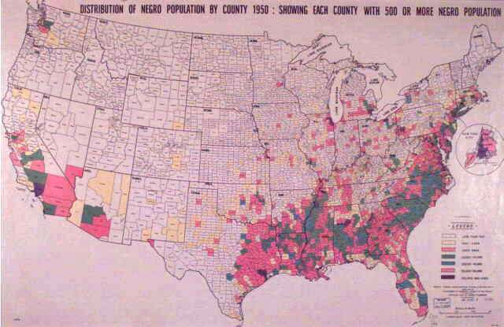

Slide 14
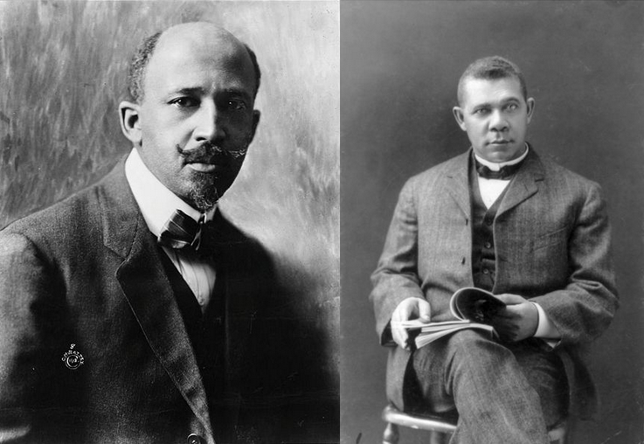

Slide 15
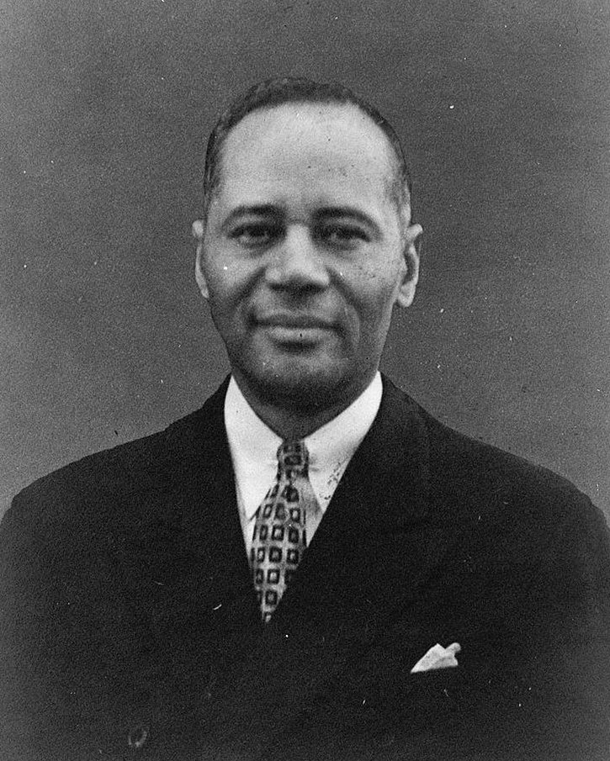

Slide 16
Plessy v. Ferguson (1896)
The object of the [14th] amendment was undoubtedly to enforce the absolute equality of the two races before the law, but, in the nature of things, it could not have been intended to abolish distinctions based upon color, or to enforce social, as distinguished from political, equality, or a commingling of the two races upon terms unsatisfactory to either. Laws permitting, and even requiring, their separation in places where they are liable to be brought into contact do not necessarily imply the inferiority of either race to the other, and have been generally, if not universally, recognized as within the competency of the state legislatures in the exercise of their police power. The most common instance of this is connected with the establishment of separate schools for white and colored children…
Legislation is powerless to eradicate racial instincts or to abolish distinctions based upon physical differences, and the attempt to do so can only result in accentuating the difficulties of the present situation. If the civil and political rights of both races be equal, one cannot be inferior to the other civilly or politically. If one race be inferior to the other socially, the Constitution of the United States cannot put them upon the same plane.

Slide 17
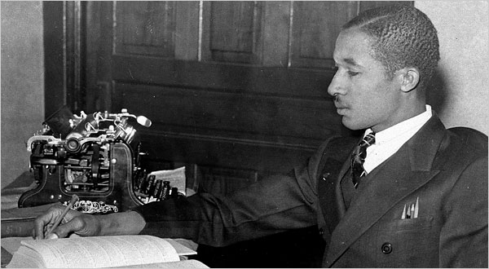
Notes:
Lloyd gaines

Slide 18
Missouri ex rel Gaines v. Canada (1938, 6-2 decision)
In answering petitioner's contention that this discrimination constituted a denial of his constitutional right, the state court has fully recognized the obligation of the State to provide negroes with advantages for higher education substantially equal to the advantages afforded to white students. The State has sought to fulfill that obligation by furnishing equal facilities in separate schools, a method the validity of which has been sustained by our decisions…
The basic consideration is not as to what sort of opportunities other States provide, or whether they are as good as those in Missouri, but as to what opportunities Missouri itself furnishes to white students and denies to negroes solely upon the ground of color. The admissibility of laws separating the races in the enjoyment of privileges afforded by the State rests wholly upon the equality of the privileges which the laws give to the separated groups within the State.

Slide 19
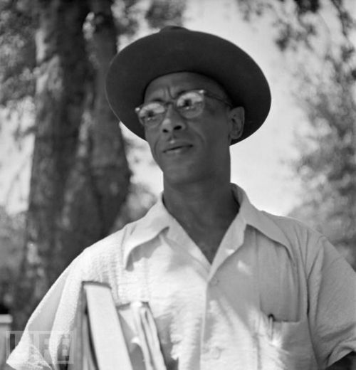
Notes:
Heman marion sweatt

Slide 20
Sweatt v. Painter (1950, unanimous decision)
Whether the University of Texas Law School is compared with the original or the new law school for Negroes, we cannot find substantial equality in the educational opportunities offered white and Negro law students by the State. In terms of number of the faculty, variety of courses and opportunity for specialization, size of the student body, scope of the library, availability of law review and similar activities, the University of Texas Law School is superior. What is more important, the University of Texas Law School possesses to a far greater degree those qualities which are incapable of objective measurement but which make for greatness in a law school. Such qualities, to name but a few, include reputation of the faculty, experience of the administration, position and influence of the alumni, standing in the community, traditions and prestige. It is difficult to believe that one who had a free choice between these law schools would consider the question close.

Slide 21
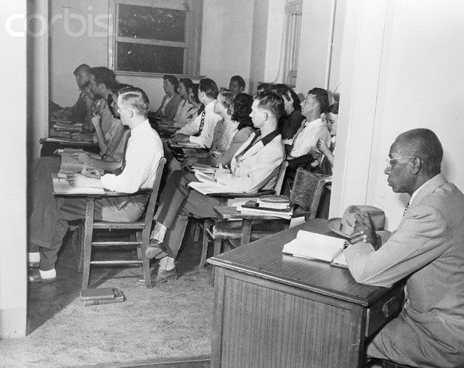
Notes:
Sep facilities—incl. desk in hallway, own table in library and cafeteria

Slide 22
McLaurin v. Oklahoma State Regents (1950, unanimous decision)
It is said that the separations imposed by the State in this case are in form merely nominal. McLaurin uses the same classroom, library and cafeteria as students of other races; there is no indication that the seats to which he is assigned in these rooms have any disadvantage of location. He may wait in line in the cafeteria, and there stand and talk with his fellow students, but while he eats, he must remain apart . . . The result is that appellant is handicapped in his pursuit of effective graduate instruction. Such restrictions impair and inhibit his ability to study, to engage in discussions and exchange views with other students, and, in general, to learn his profession.
[McLaurin] is attempting to obtain an advanced degree in education, to become, by definition, a leader and trainer of others. Those who will come under his guidance and influence must be directly affected by the education he receives. Their own education and development will necessarily suffer to the extent that his training is unequal to that of his classmates. State-imposed restrictions which produce such inequalities cannot be sustained.

Slide 23
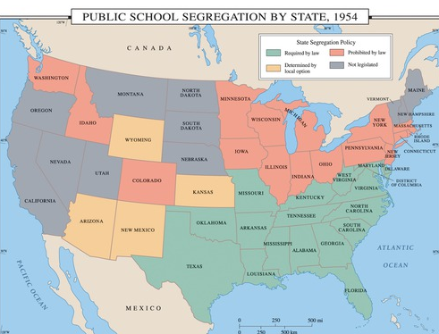

Slide 24
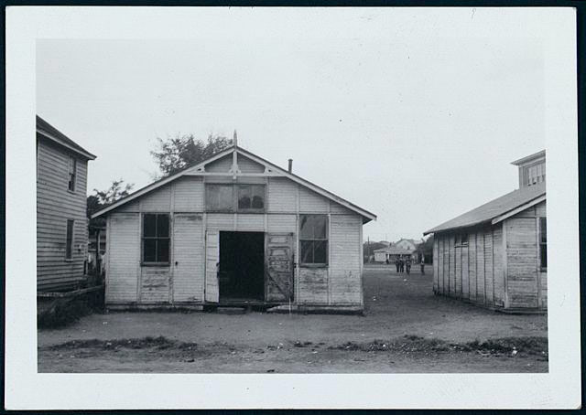

Slide 25
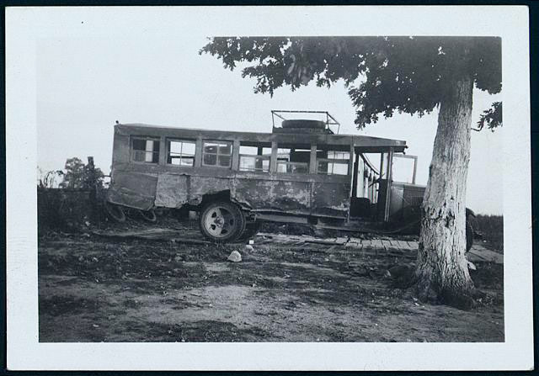

Slide 26
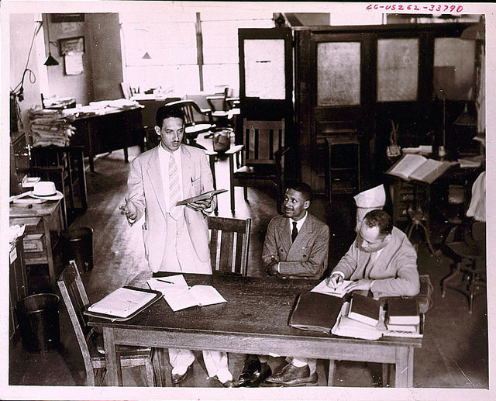

Slide 27
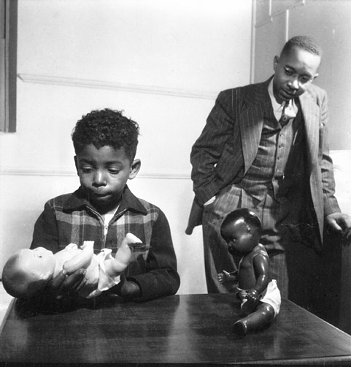

Slide 28
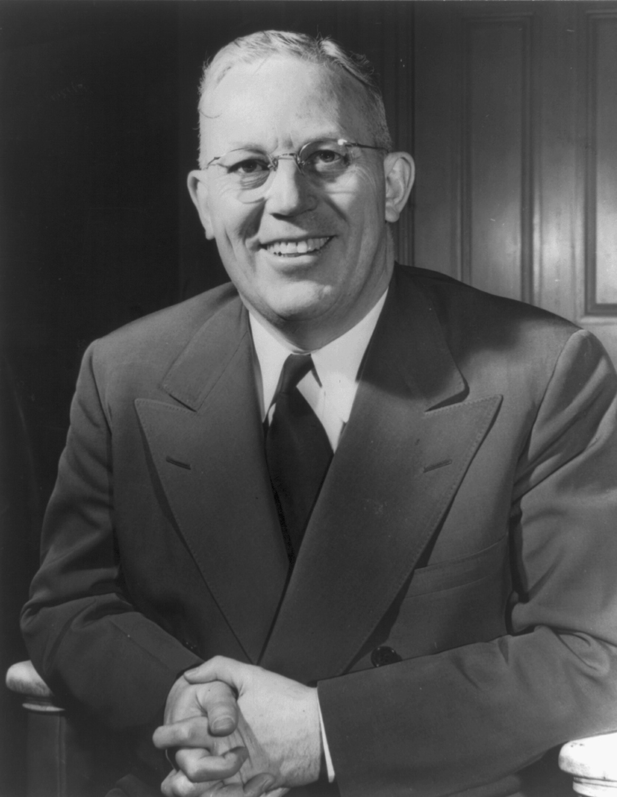

Slide 29
Brown v. Board of Education (1954, unanimous decision)
Does segregation of children in public schools solely on the basis of race, even though the physical facilities and other "tangible" factors may be equal, deprive the children of the minority group of equal educational opportunities? We believe that it does... Segregation of white and colored children in public schools has a detrimental effect upon the colored children. The impact is greater when it has the sanction of the law, for the policy of separating the races is usually interpreted as denoting the inferiority of the negro group. A sense of inferiority affects the motivation of a child to learn. Segregation with the sanction of law, therefore, has a tendency to [retard] the educational and mental development of negro children and to deprive them of some of the benefits they would receive in a racial[ly] integrated school system... We conclude that, in the field of public education, the doctrine of "separate but equal" has no place. Separate educational facilities are inherently unequal. Therefore, we hold that the plaintiffs and others similarly situated for whom the actions have been brought are, by reason of the segregation complained of, deprived of the equal protection of the laws guaranteed by the Fourteenth Amendment.

Slide 30
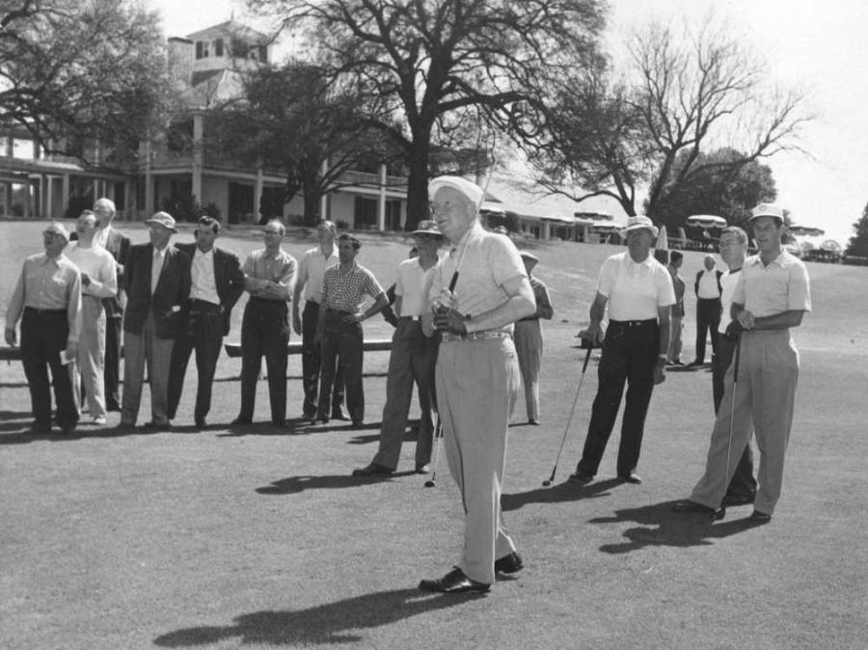
Notes:
Dde at augusta

Slide 31
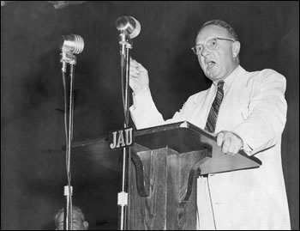
Notes:
byrd

Slide 32


Slide 33
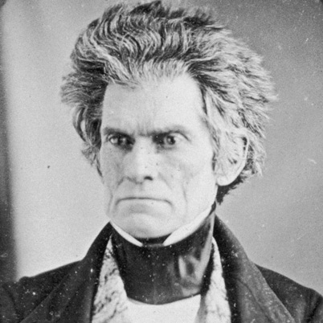

Slide 34
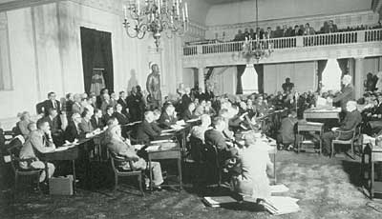
Notes:
Va state legis 1956—”interposition”

Slide 35
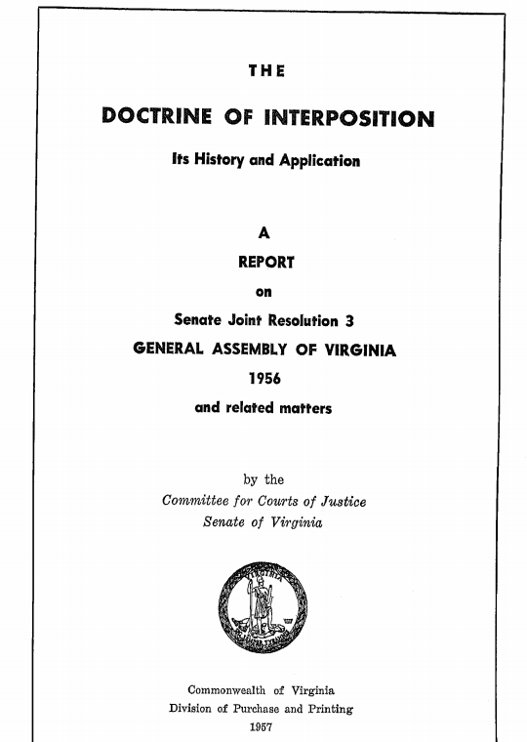
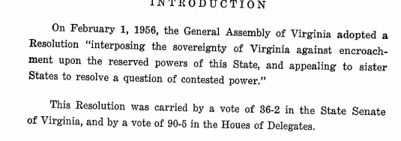

Slide 36
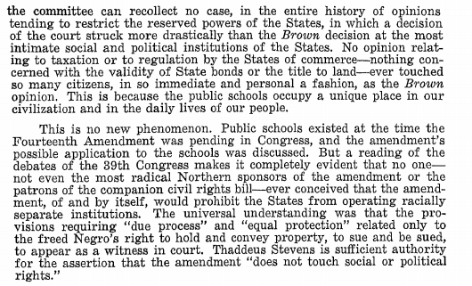

Slide 37
Griffin v. County School Board of Prince Edward County (1964)
Closing Prince Edward's schools bears more heavily on Negro children in Prince Edward County since white children there have accredited private schools which they can attend, while colored children until very recently have had no available private schools, and even the school they now attend is a temporary expedient. Apart from this expedient, the result is that Prince Edward County school children, if they go to school in their own county, must go to racially segregated schools which, although designated as private, are beneficiaries of county and state support…
The time for mere "deliberate speed" has run out, and that phrase can no longer justify denying these Prince Edward County school children their constitutional rights to an education equal to that afforded by the public schools in the other parts of Virginia.

Slide 38
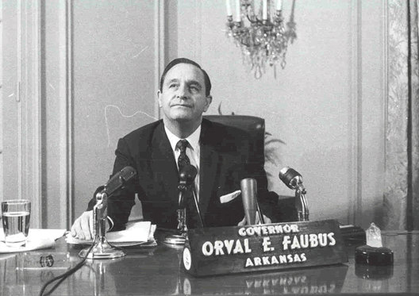

Slide 39
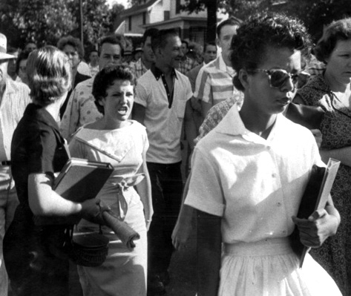

Slide 40


Slide 41
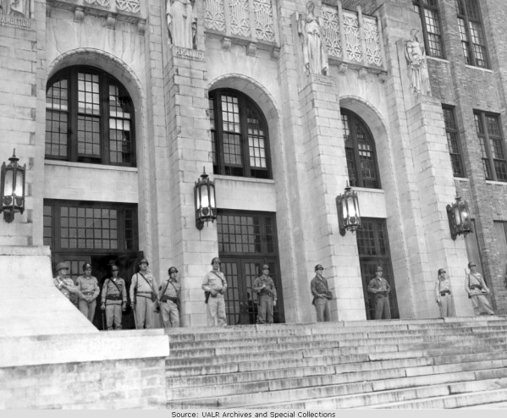
Notes:
101ST AIRBORNE

Slide 42
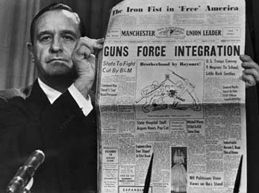

Slide 43
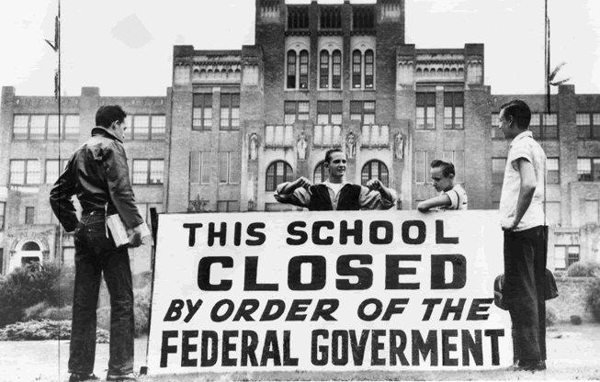

Slide 44
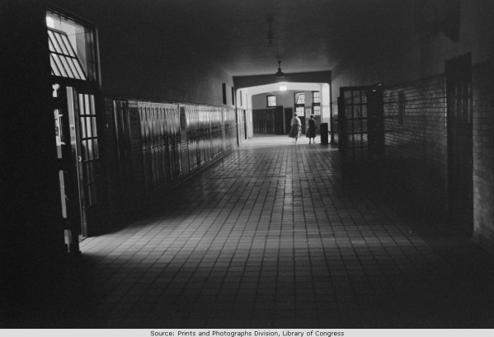
Notes:
PHOTO INSIDE LOST YEAR

Slide 45
