Slide 1


Slide 2
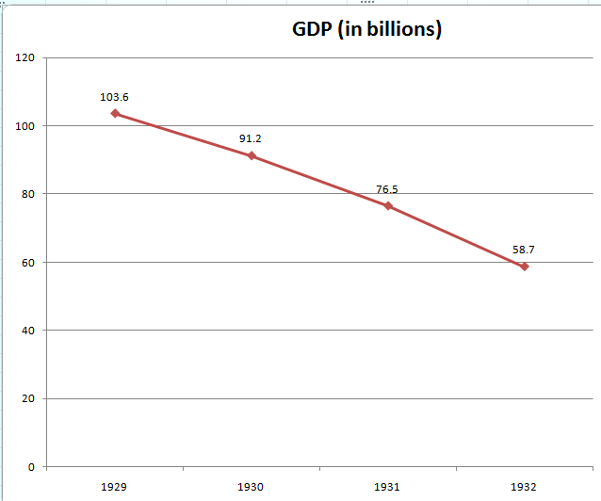

Slide 3
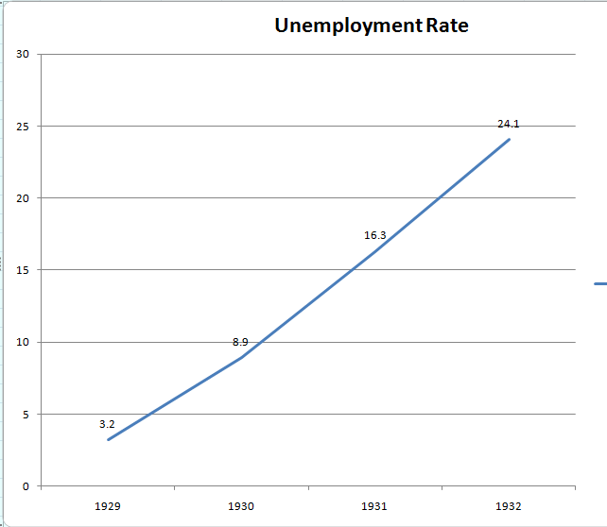

Slide 4
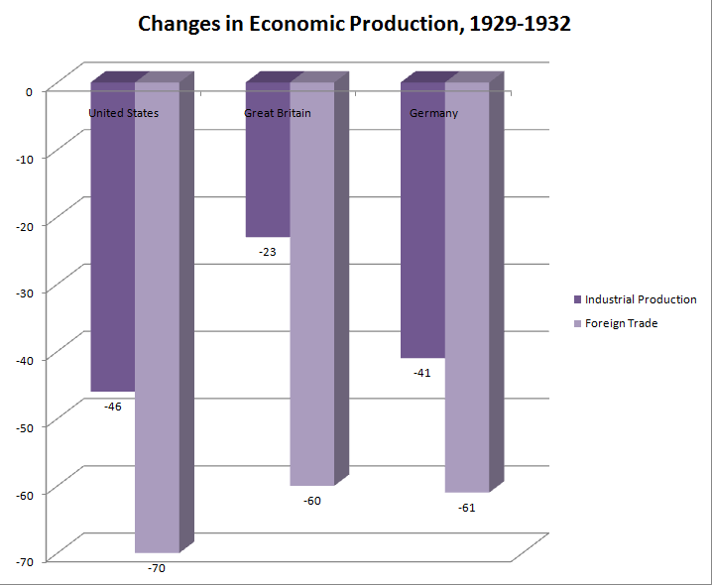

Slide 5
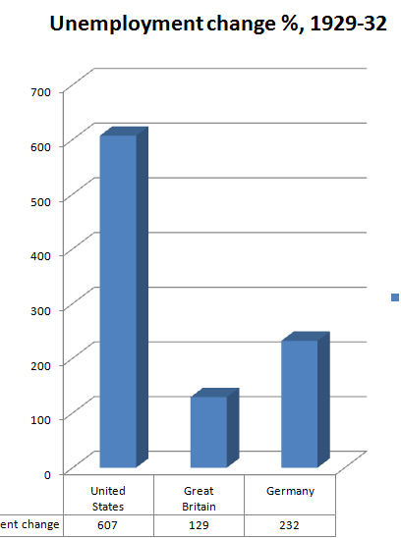

Slide 6

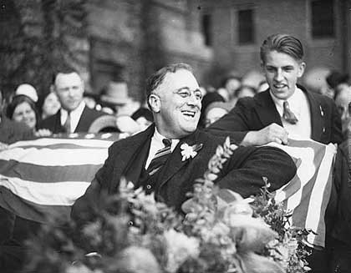

Slide 7
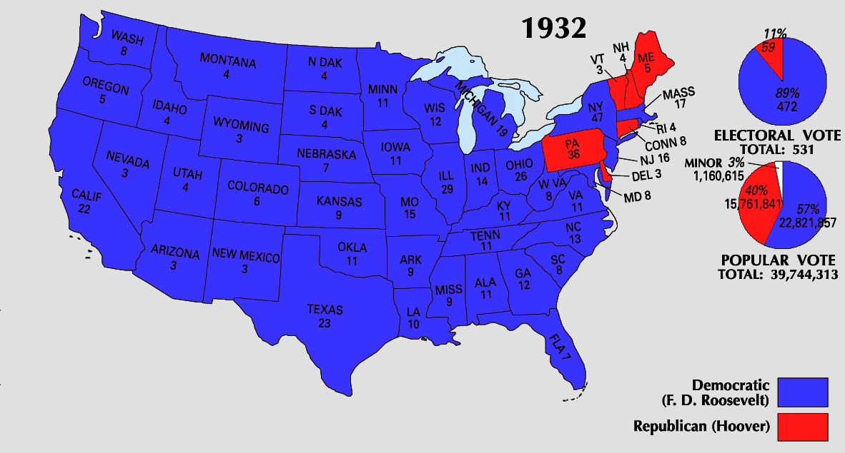

Slide 8
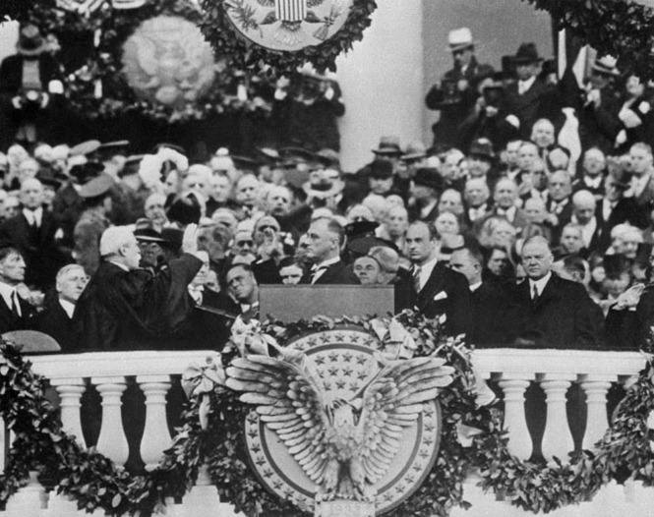

Slide 9
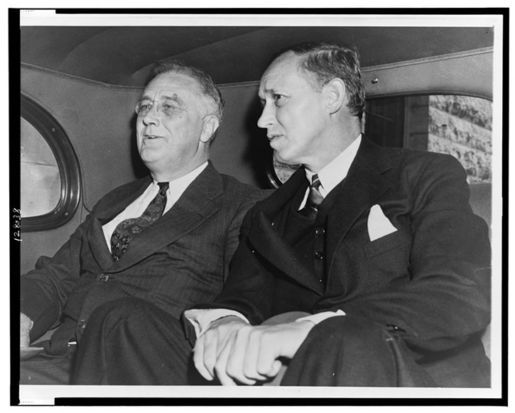

Slide 10
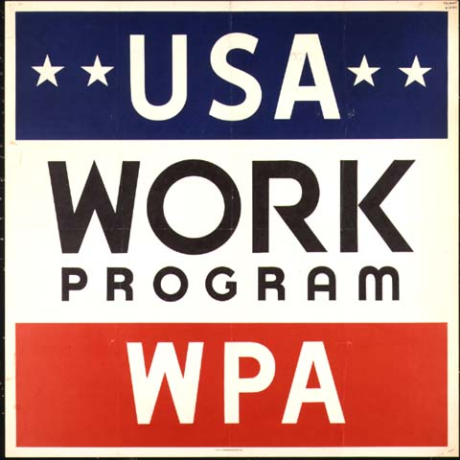

Slide 11
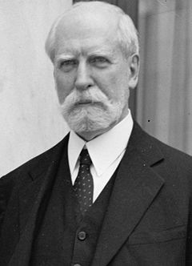
Notes:
hughes

Slide 12
Schecter Poultry Co. v. United States (1935)
It is not the province of the Court to consider the economic advantages or disadvantages of such a centralized system. It is sufficient to say that the Federal Constitution does not provide for it. Our growth and development have called for wide use of the commerce power of the federal government in its control over the expanded activities of interstate commerce and in protecting that commerce from burdens, interferences, and conspiracies to restrain and monopolize it. But the authority of the federal government may not be pushed to such an extreme as to destroy the distinction, which the commerce clause itself establishes, between commerce 'among the several States' and the internal concerns of a state.

Slide 13


Slide 14
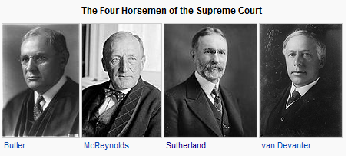

Slide 15
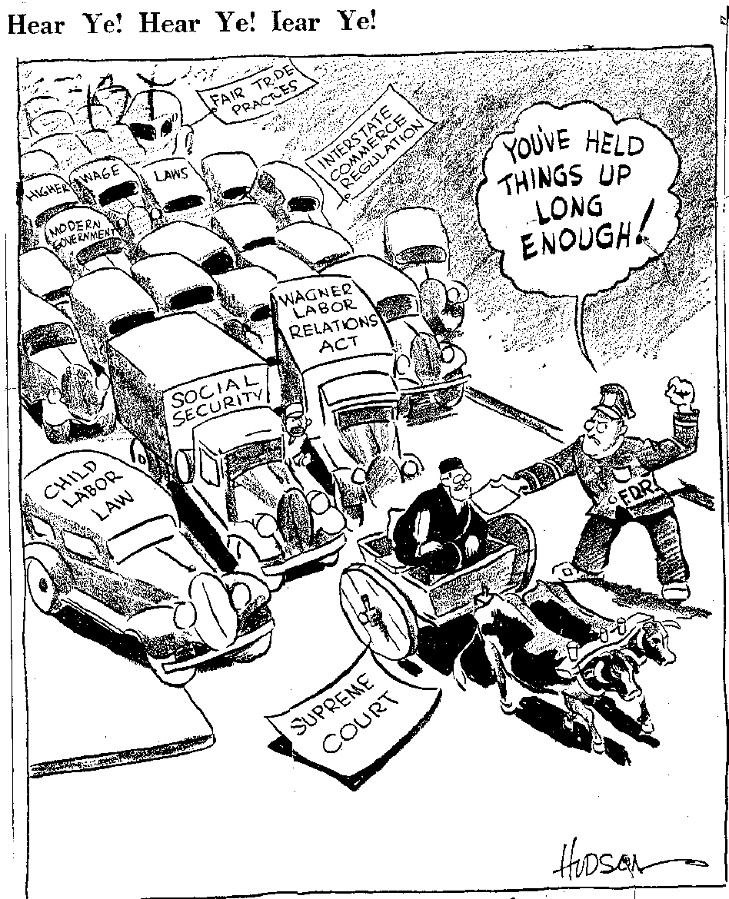

Slide 16
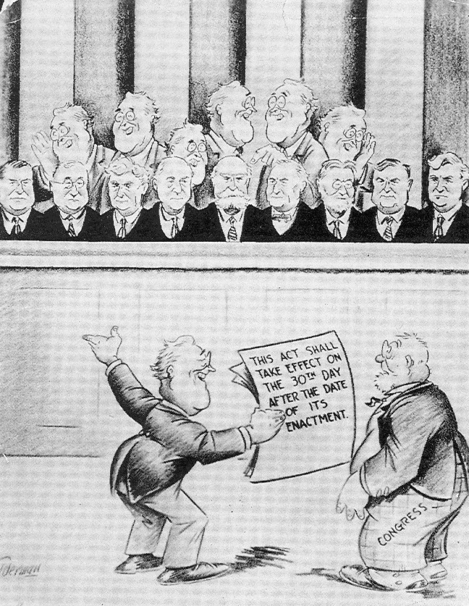

Slide 17
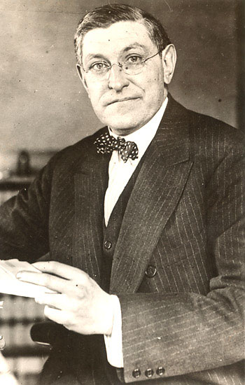

Slide 18
West Coast Hotel v. Parrish (1937)
The constitutional provision invoked is the due process clause of the Fourteenth Amendment governing the states, as the due process clause invoked in the Adkins Case governed Congress. In each case the violation alleged by those attacking minimum wage regulation for women is deprivation of freedom of contract. What is this freedom? The Constitution does not speak of freedom of contract. It speaks of liberty and prohibits the deprivation of liberty without due process of law. In prohibiting that deprivation, the Constitution does not recognize an absolute and uncontrollable liberty. Liberty in each of its phases has its history and connotation. But the liberty safeguarded is liberty in a social organization which requires the protection of law against the evils which menace the health, safety, morals, and welfare of the people. Liberty under the Constitution is thus necessarily subject to the restraints of due process, and regulation which is reasonable in relation to its subject and is adopted in the interests of the community is due process . . .
We think that the views thus expressed are sound and that the decision in the Adkins Case was a departure from the true application of the principles governing the regulation by the state of the relation of employer and employed.

Slide 19
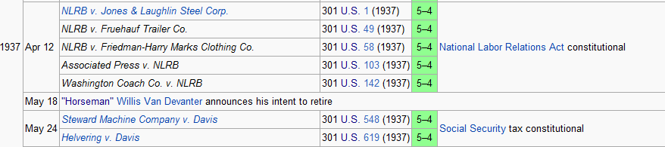

Slide 20
United States v. Carolene Products Co. (1938)
^{4.} There may be narrower scope for operation of the presumption of constitutionality when legislation appears on its face to be within a specific prohibition of the Constitution, such as those of the first ten amendments, which are deemed equally specific when held to be embraced within the Fourteenth.
It is unnecessary to consider now whether legislation which restricts those political processes which can ordinarily be expected to bring about repeal of undesirable legislation is to be subjected to more exacting judicial scrutiny under the general prohibitions of the Fourteenth Amendment than are most other types of legislation . . .
Nor need we enquire whether similar considerations enter into the review of statutes directed at particular religious, or national, or racial minorities: whether prejudice against discrete and insular minorities may be a special condition, which tends seriously to curtail the operation of those political processes ordinarily to be relied upon to protect minorities, and which may call for a correspondingly more searching judicial inquiry.

Slide 21
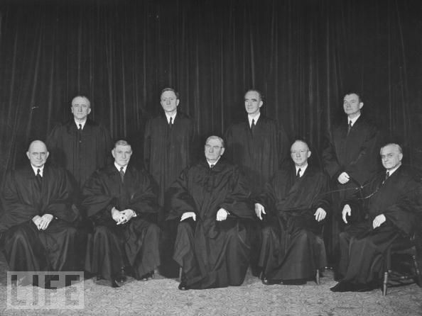

Slide 22



Slide 23
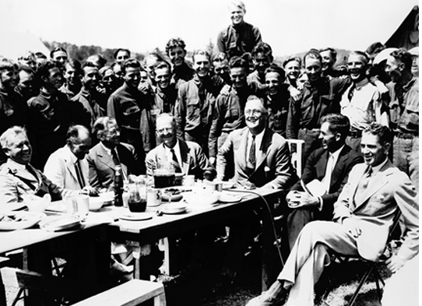
Notes:
Fdr with ccc camp in VA

Slide 24
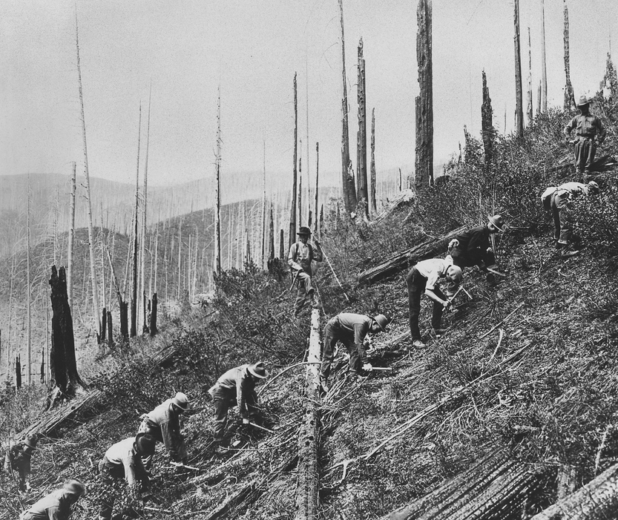

Slide 25
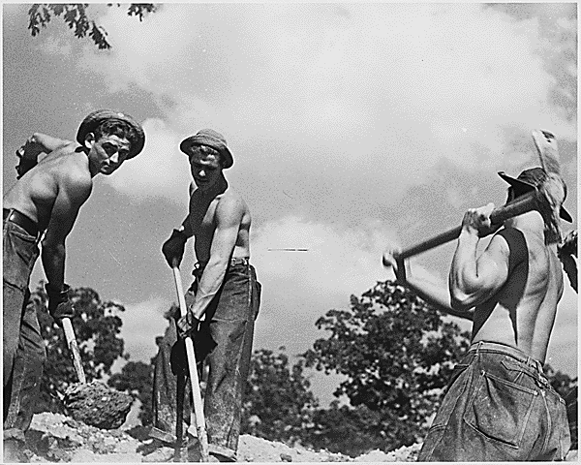

Slide 26
National Youth Administration (June 1935)
To initiate and administer a program of approved projects which shall provide relief, work relief, and employment for persons between the ages of sixteen and twenty-five years who are no longer in regular attendance at a school requiring full time, and who are not regularly engaged in remunerative employment.

Slide 27


Slide 28
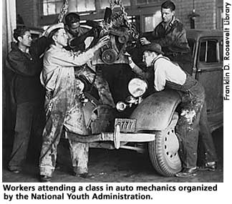
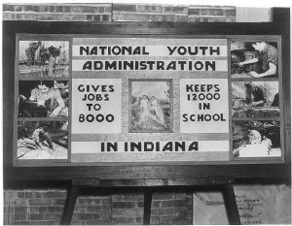

Slide 29
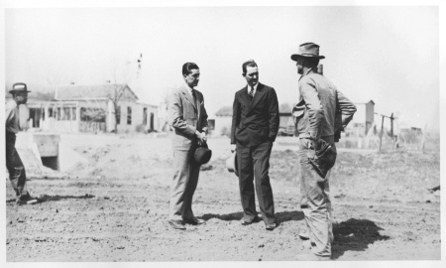
Notes:
lbj

Slide 30
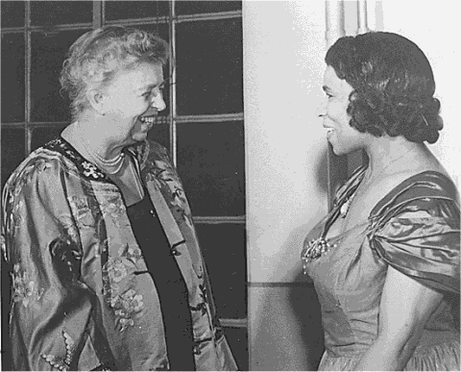

Slide 31
Fair Labor Standards Act (1938), § 212
(a) Restrictions on shipment of goods; prosecution; conviction
No producer, manufacturer, or dealer shall ship or deliver for shipment in commerce any goods produced in an establishment situated in the United States in or about which within thirty days prior to the removal of such goods therefrom any oppressive child labor has been employed.
(c) Oppressive child labor
No employer shall employ any oppressive child labor in commerce or in the production of goods for commerce or in any enterprise engaged in commerce or in the production of goods for commerce.
(d) Proof of age
In order to carry out the objectives of this section, the Secretary may by regulation require employers to obtain from any employee proof of age.

Slide 32


Slide 33


Slide 34
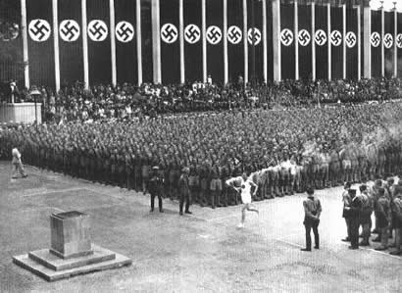

Slide 35
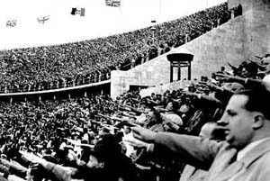

Slide 36
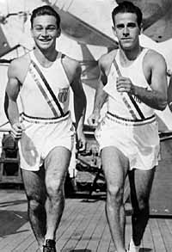
Notes:
Marty glickman and sam stoller

Slide 37

Notes:
Avery brundage

Slide 38
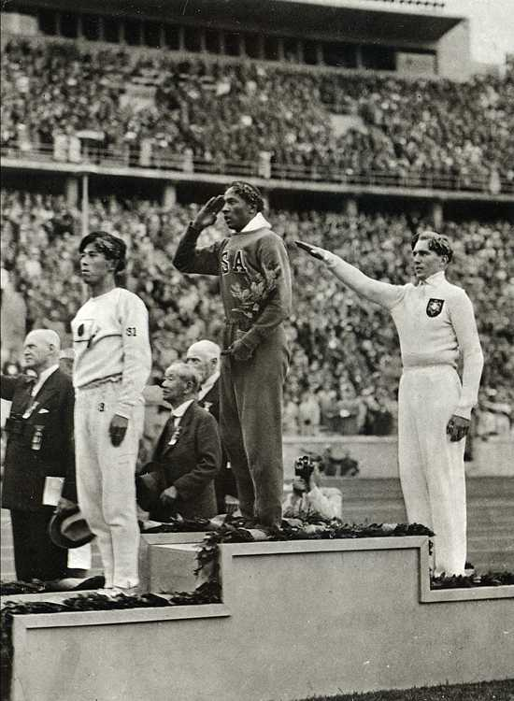

Slide 39


Slide 40
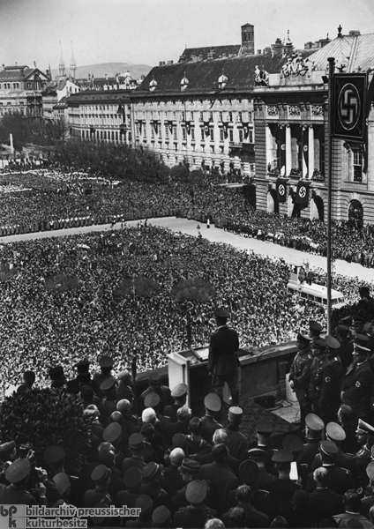

Slide 41
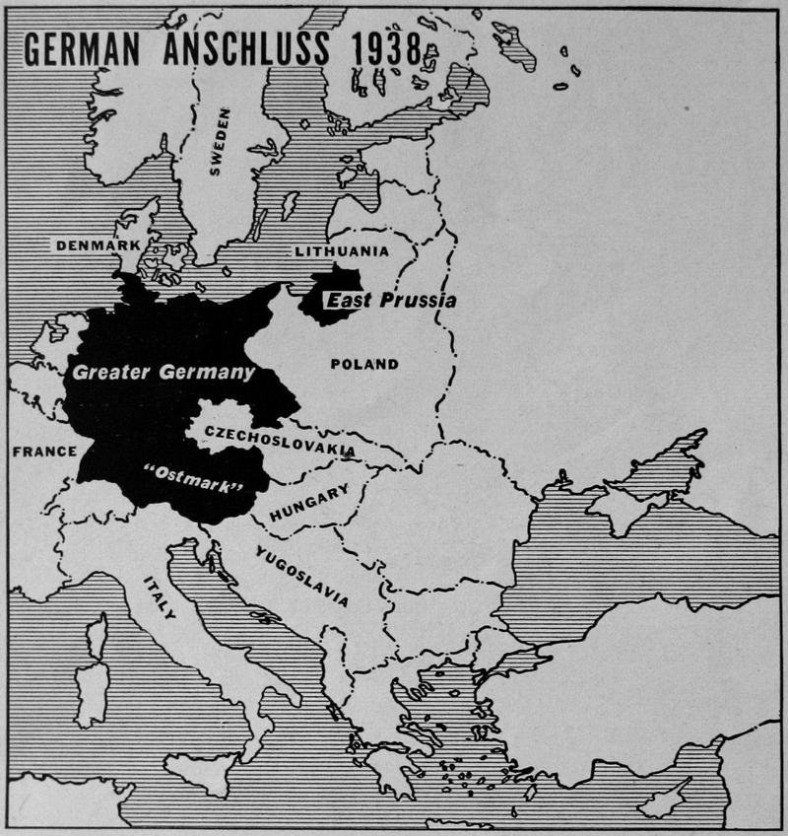

Slide 42


Slide 43


Slide 44
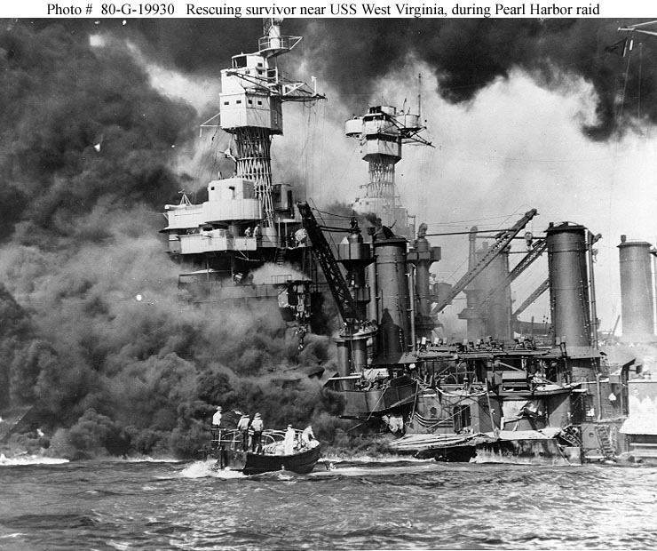

Slide 45


Slide 46


Slide 47


