Slide 1
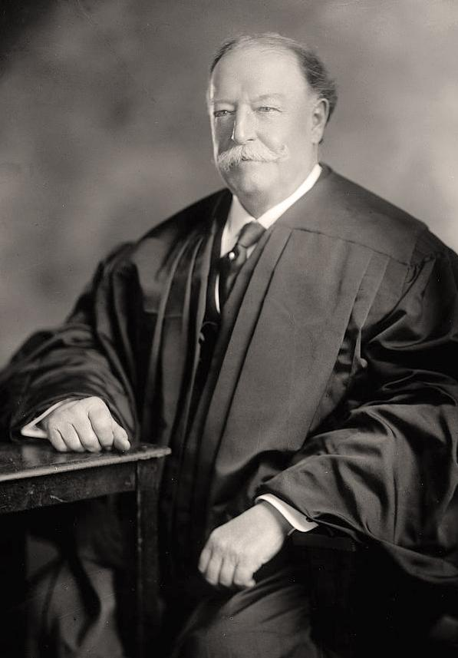

Slide 2
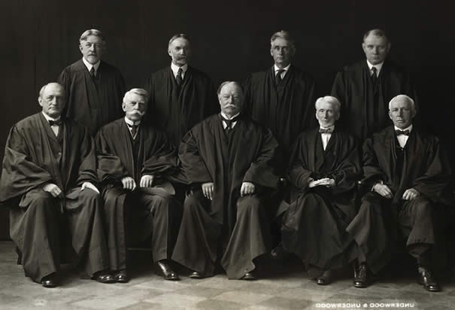

Slide 3
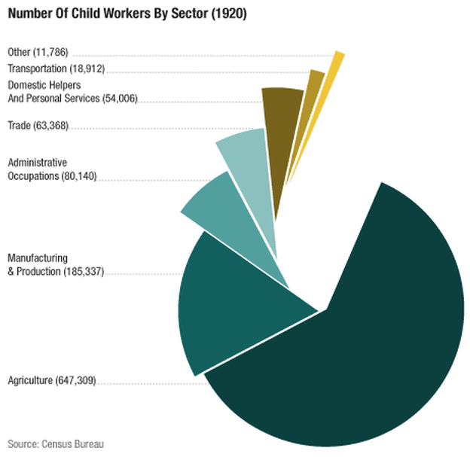

Slide 4
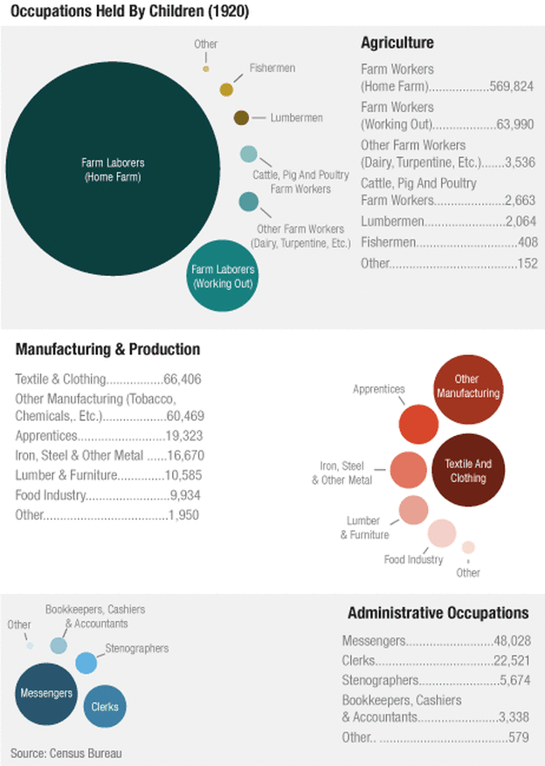

Slide 5
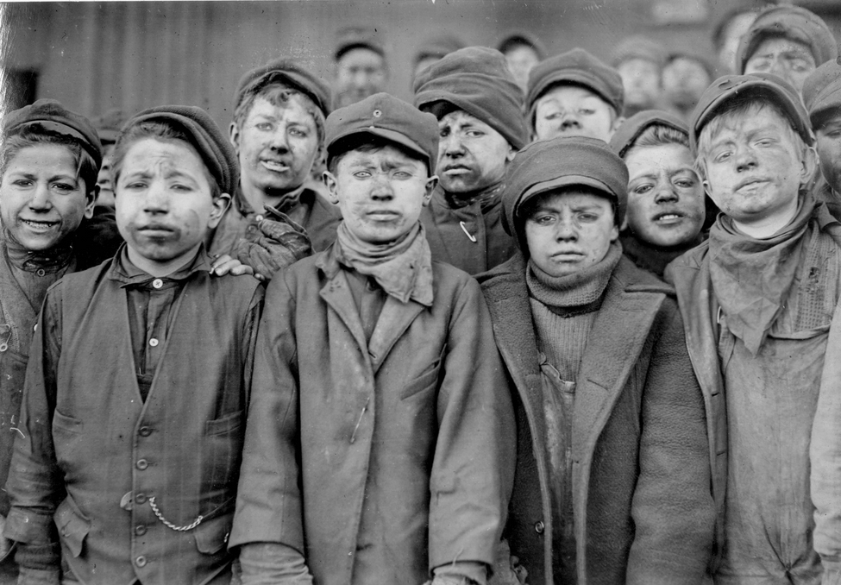
Notes:
14-hr days PA coal mines

Slide 6
Hammer v. Dagenhart (1918)
In our view the necessary effect of this act is, by means of a prohibition against the movement in interstate commerce of ordinary commercial commodities, to regulate the hours of labor of children in factories and mines within the states, a purely state authority.
Bailey v. Drexel Furniture (1922)
The good sought in unconstitutional legislation is an insidious feature, because it leads citizens and legislators of good purpose to promote it, without thought of the serious breach it will make in the ark of our covenant, or the harm which will come from breaking down recognized standards. In the maintenance of local self-government, on the one hand, and the national power, on the other, our country has been able to endure and prosper for near a century and a half

Slide 7
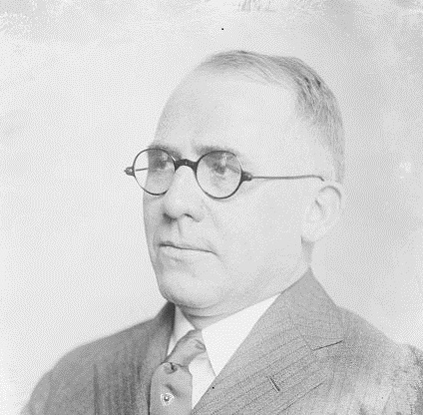
Child Labor Amendment (1924)
Section 1. The Congress shall have power to limit, regulate, and prohibit the labor of persons under eighteen years of age.
Section 2. The power of the several States is unimpaired by this article except that the operation of State laws shall be suspended to the extent necessary to give effect to legislation enacted by the Congress.
Passes House, 297-69; passes Senate, 61-23
Ratified by 28 states.
Notes:
Israel moore foster (R-OH)

Slide 8
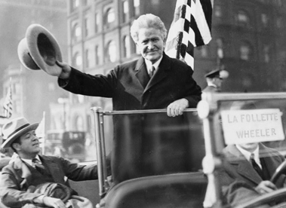
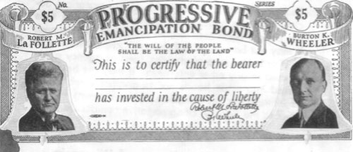

Slide 9
Siman Act (1919)
Section 1. No person, individually or as a teacher, shall, in any private, denominational, parochial or public school, teach any subject to any person in any language other than the English language.
Sec. 2. Languages, other than the English language, may be taught as languages only after a pupil shall have attained and successfully passed the eighth grade as evidenced by a certificate of graduation issued by the county superintendent of the county in which the child resides.
Nebraska Supreme Court decision
The salutary purpose of the statute is clear. The Legislature had seen the baneful effects of permitting foreigners, who had taken residence in this country, to rear and educate their children in the language of their native land. The result of that condition was found to be inimical to our own safety. To allow the children of foreigners, who had emigrated here, to be taught from early childhood the language of the country of their parents was ... to educate them so that they must always think in that language, and, as a consequence, naturally inculcate in them the ideas and sentiments foreign to the best interests of this country.

Slide 10
Meyer v. Nebraska (1923)
That the State may do much, go very far, indeed, in order to improve the quality of its citizens, physically, mentally and morally, is clear; but the individual has certain fundamental rights which must be respected. The protection of the Constitution extends to all, to those who speak other languages as well as to those born with English on the tongue. Perhaps it would be highly advantageous if all had ready understanding of our ordinary speech, but this cannot be coerced by methods which conflict with the Constitution — a desirable end cannot be promoted by prohibited means.

Slide 11
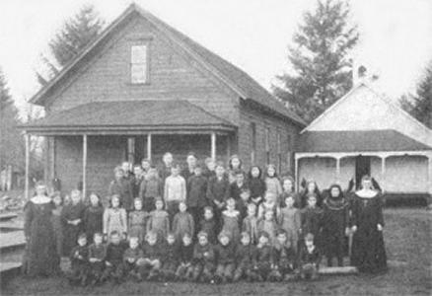
Pierce v. Society of Sisters (1925)
The fundamental liberty upon which all governments in this Union repose excludes any general power of the State to standardize its children by forcing them to accept instruction from public teachers only.

Slide 12
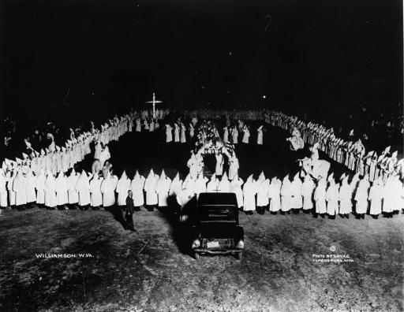
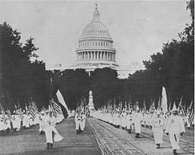

Slide 13
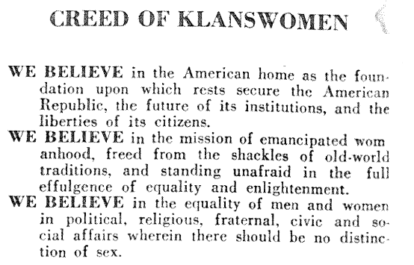

Slide 14
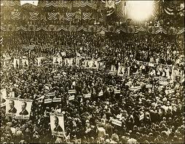

Slide 15
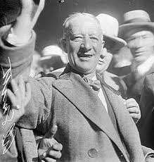
Notes:
Al smith

Slide 16
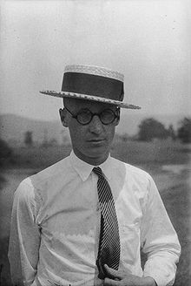
Notes:
John scopes

Slide 17
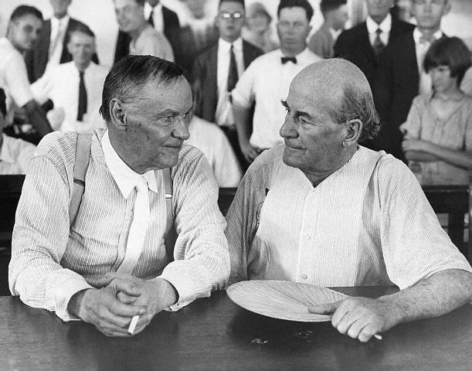

Slide 18
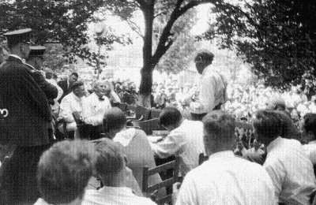
Darrow: "We have the purpose of preventing bigots and ignoramuses from controlling the education of the United States."
Notes:
Darrow and bryan

Slide 19
Scopes v. State (1927): TN Supreme Court
We are not able to see how the prohibition of teaching the theory that man has descended from a lower order of animals gives preference to any religious establishment or mode of worship. So far as we know, there is no religious establishment or organized body that has in its creed or confession of faith any article denying or affirming such a theory. So far as we know, the denial or affirmation of such a theory does not enter into any recognized mode of worship. Since this cause has been pending in this court, we have been favored, in addition to briefs of counsel and various amici curiae, with a multitude of resolutions, addresses, and communications from scientific bodies, religious factions, and individuals giving us the benefit of their views upon the theory of evolution. Examination of these contributions indicates that Protestants, Catholics, and Jews are divided among themselves in their beliefs, and that there is no unanimity among the members of any religious establishment as to this subject. Belief or unbelief in the theory of evolution is no more a characteristic of any religious establishment or mode of worship than is belief or unbelief in the wisdom of the prohibition laws. It would appear that members of the same churches quite generally disagree as to these things.

Slide 20
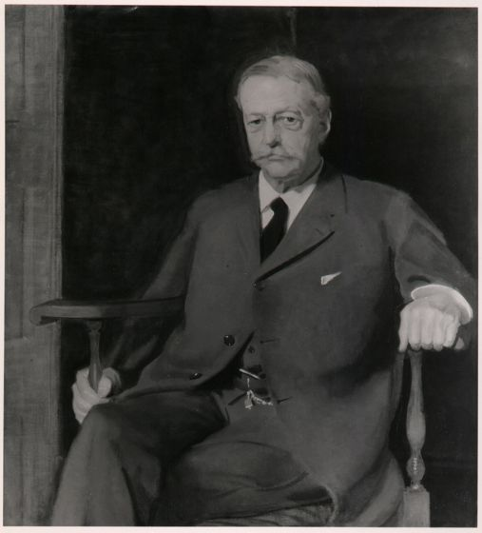

Slide 21
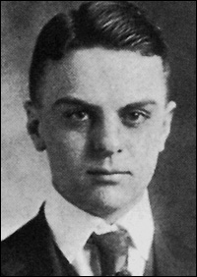
Notes:
Cyril wilcox

Slide 22
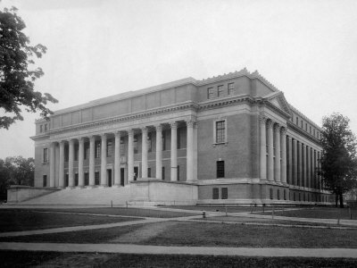

Slide 23
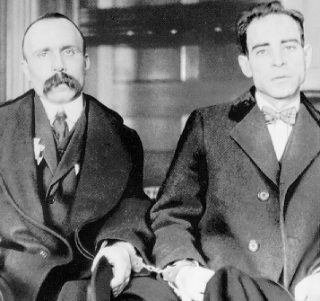

Slide 24
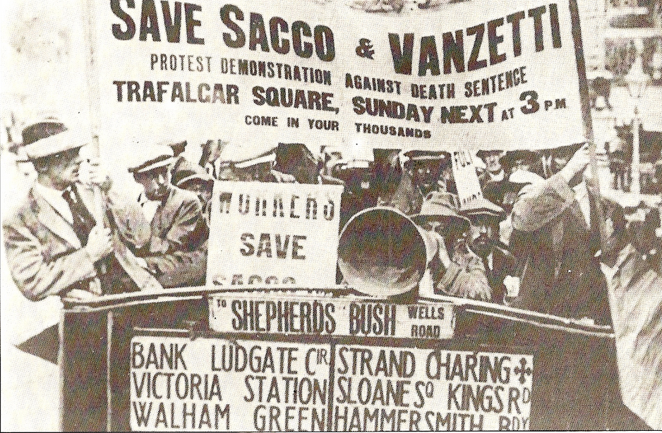

Slide 25
