Slide 1
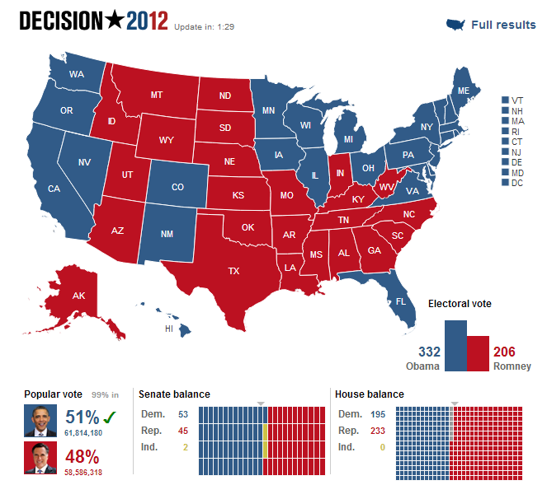

Slide 2
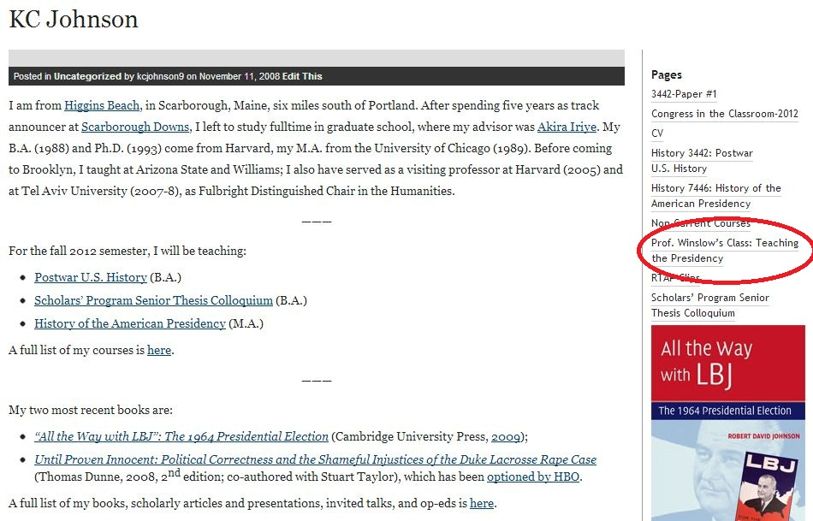

Slide 3
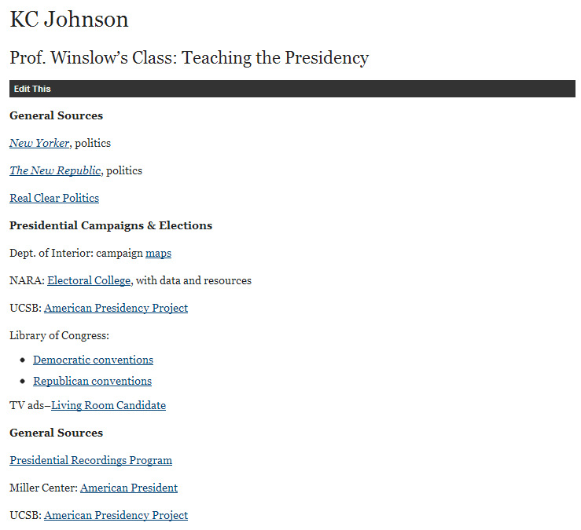

Slide 4
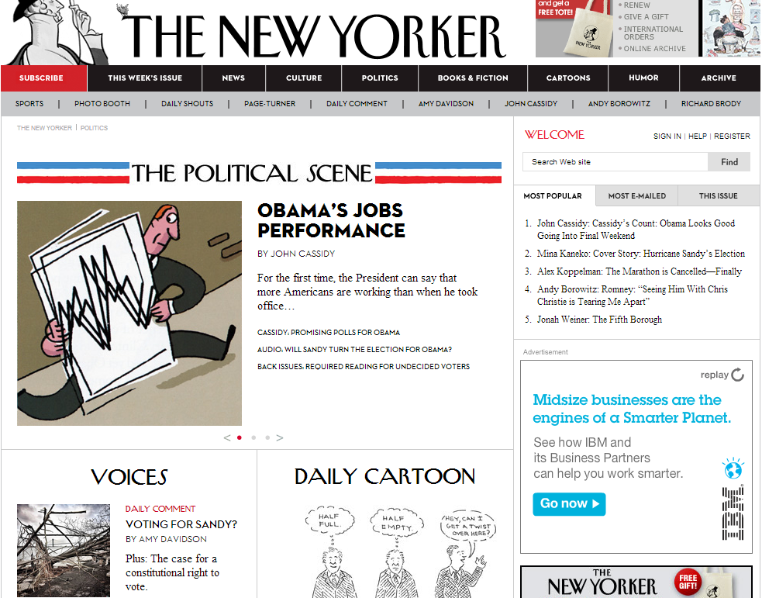

Slide 5
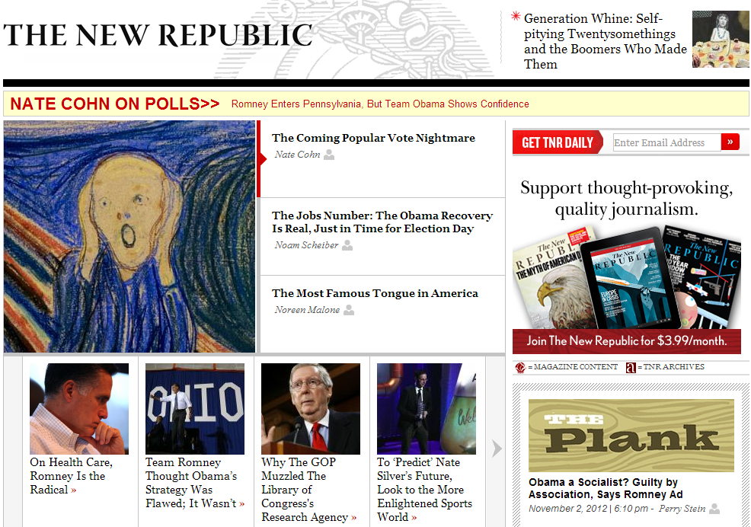

Slide 6
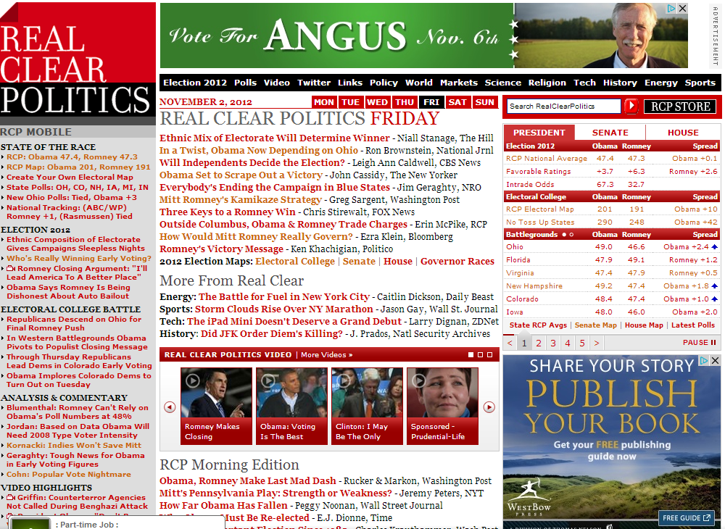

Slide 7


Slide 8
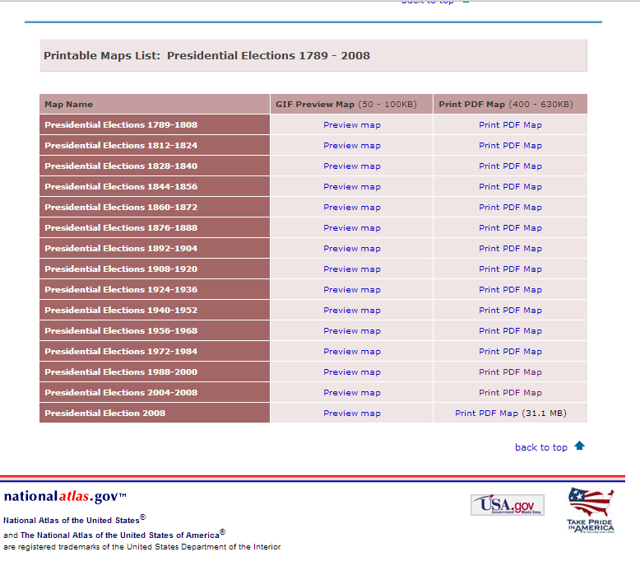

Slide 9
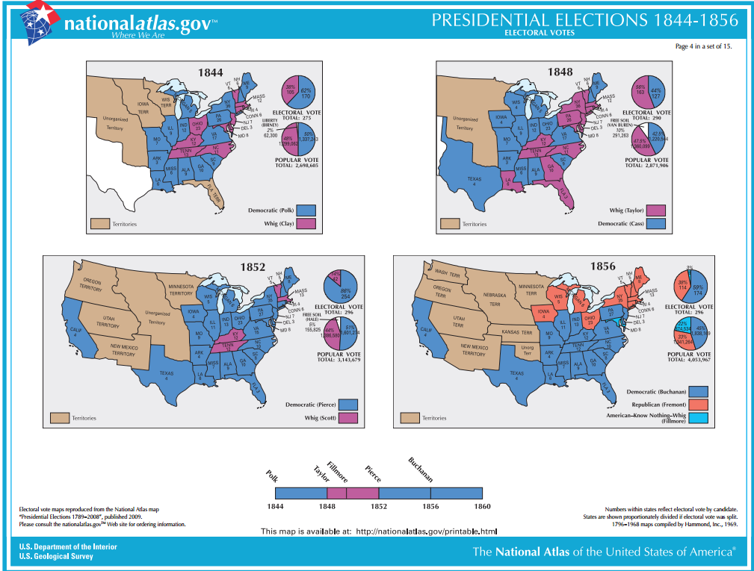

Slide 10
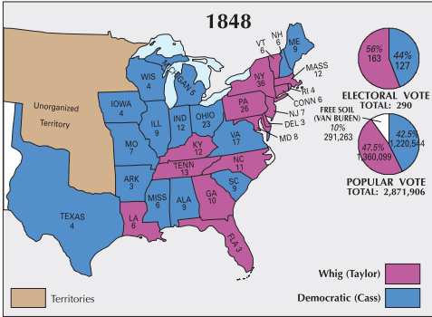

Slide 11
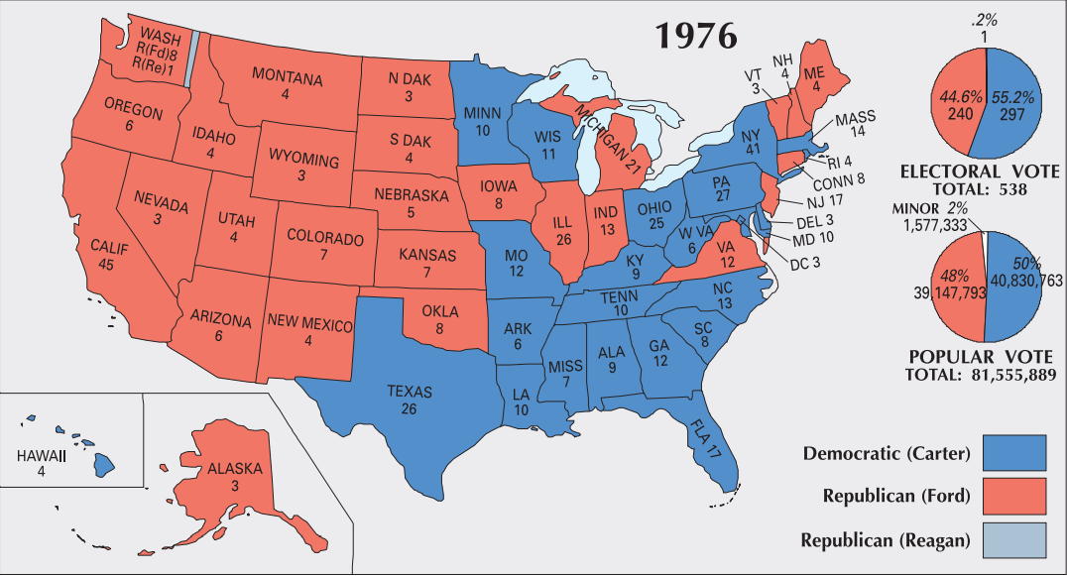

Slide 12
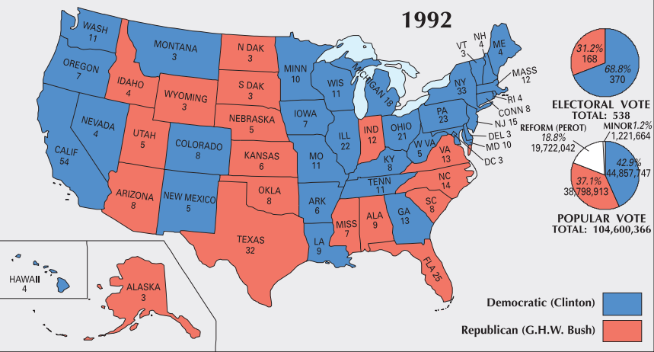

Slide 13
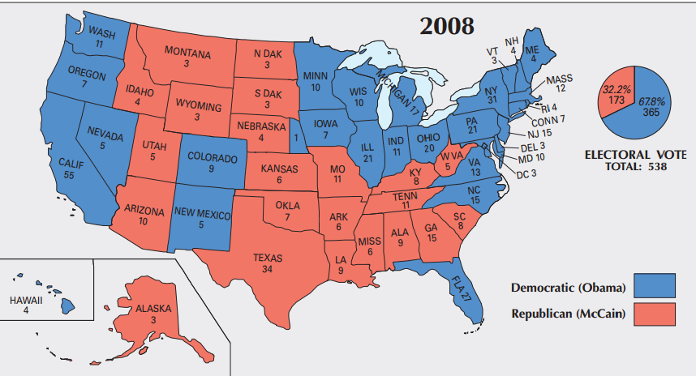

Slide 14
Electoral College
U.S. Constitution: Article II
Section 1. The executive Power shall be vested in a President of the United States of America. He shall hold his Office during the Term of four Years, and, together with the Vice President, chosen for the same Term, be elected, as follows:
Each State shall appoint, in such Manner as the Legislature thereof may direct, a Number of Electors, equal to the whole Number of Senators and Representatives to which the State may be entitled in the Congress: but no Senator or Representative, or Person holding an Office of Trust or Profit under the United States, shall be appointed an Elector . . .
The Congress may determine the Time of choosing the Electors, and the Day on which they shall give their Votes; which Day shall be the same throughout the United States.

Slide 15

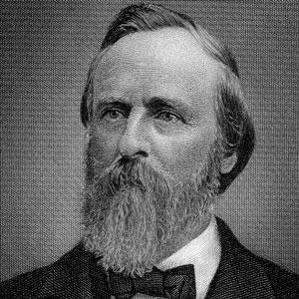
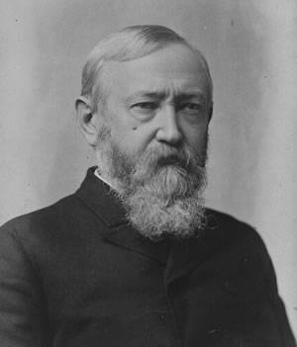

Slide 16
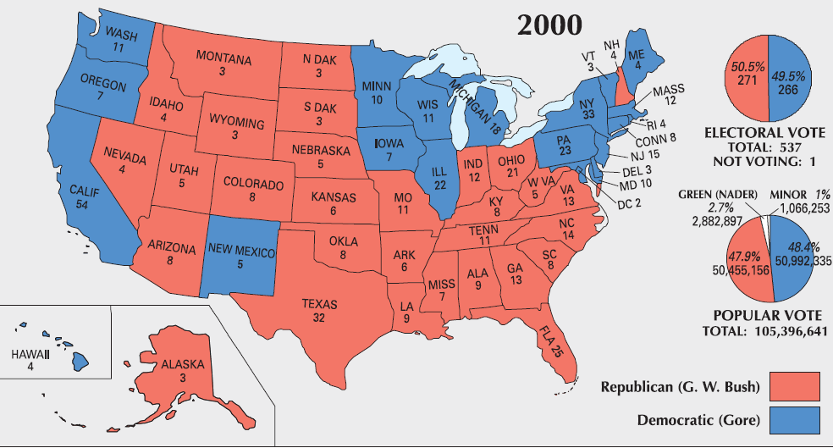

Slide 17
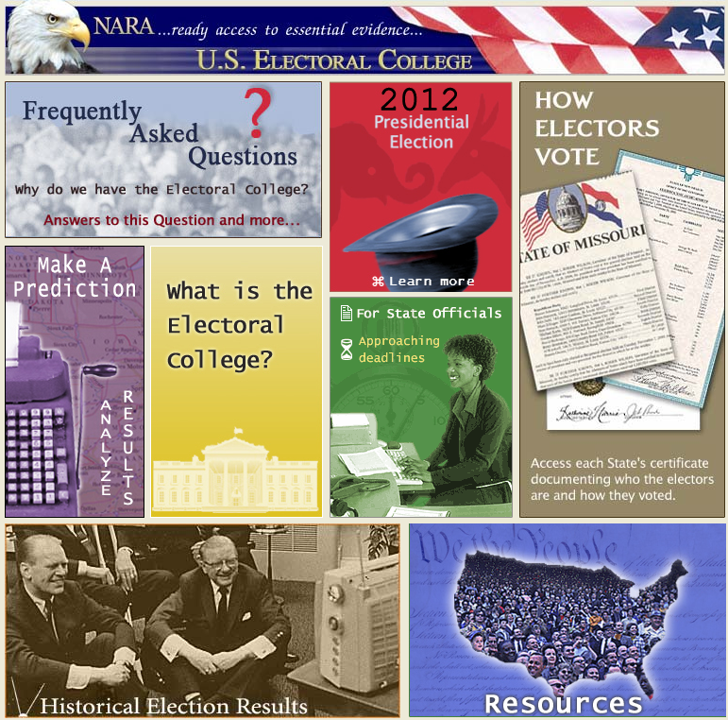

Slide 18
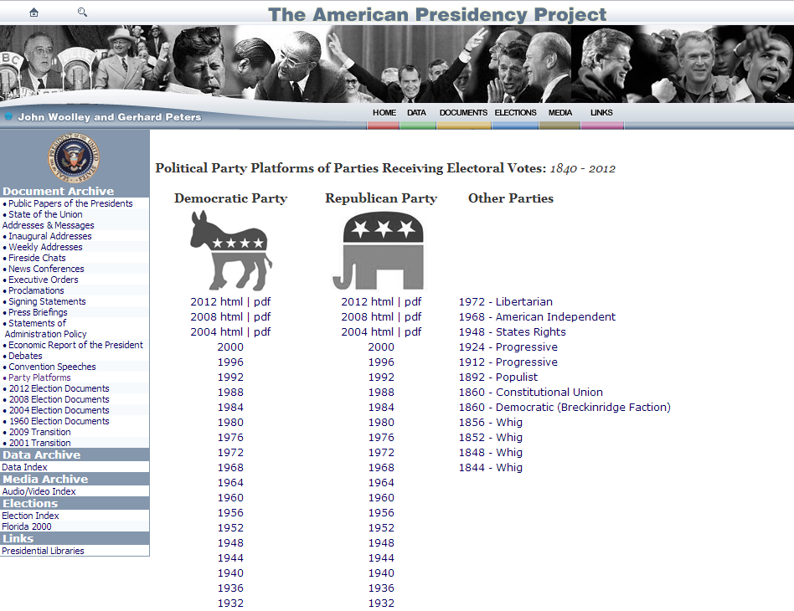

Slide 19
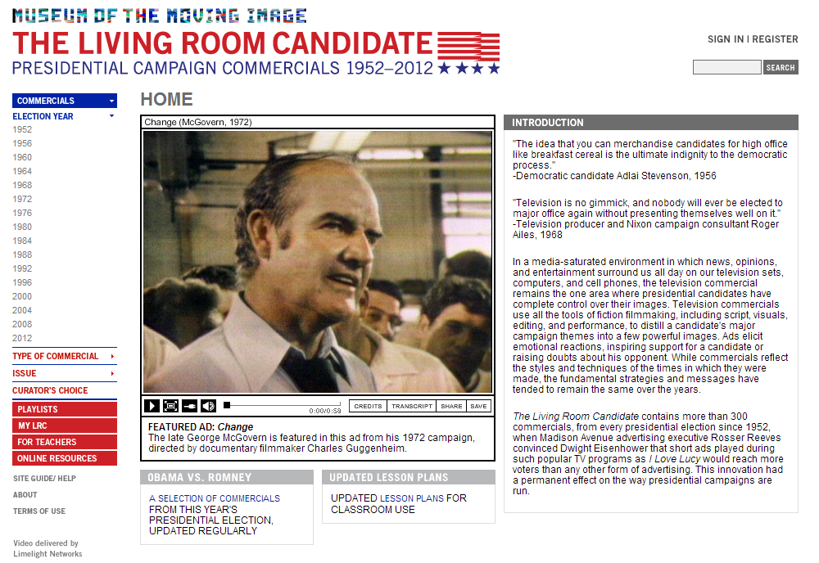

Slide 20


Slide 21

President Johnson: Do you-all understand that what I want is to saturate any way we can with sports with women, with real names, with scientists, with former heads of the American Bar (like [Moorfield B.] Storey can be in the South)—why they’re for Johnson.
And never for “Lyndon B. Johnson.” Always for, “Our great President Johnson.”
And I think that where we can, we ought to have these scientists and others saying, “He’s carrying on the program with President Kennedy.” I think we can pull a lot of people, hold ‘em, that way.
Bill Moyers: The best investment of money, Mr. President, would be full-page ads in most of the metropolitan newspapers, signed by the prominent Nobel Prize scientists that we have on our committee.
President Johnson: Well, get an ad up. I think TV reaches more than the papers, but if you-all think the papers, all right.
Moyers: Well, we use TV, too, but—
President Johnson: All right.
Moyers: You got—
President Johnson: It looks like you ain’t got enough money to do both of ‘em, I don’t think. But if you can, just go on and do it.
I got—somebody gave me five little things from [Nat’l. Security Advisor McGeorge] Bundy that could be run in a full-page ad. The trouble is, you get an ad, and some son-of-a-bitch just puts a scoopful of dictionary in it. And I can’t read our ads. I haven’t seen an ad of ours that I’d read.
[Int’l. Ladies Garment Workers’ Union head] David Dubinsky just had a scoopful that I saw down at the bottom, and I never read any of the rest of it. Ain’t nobody going to read it. You’ve got to have some white stuff in there, Bill.
Moyers: Right.
President Johnson: We always say “right,” but we don’t do it.

Slide 22
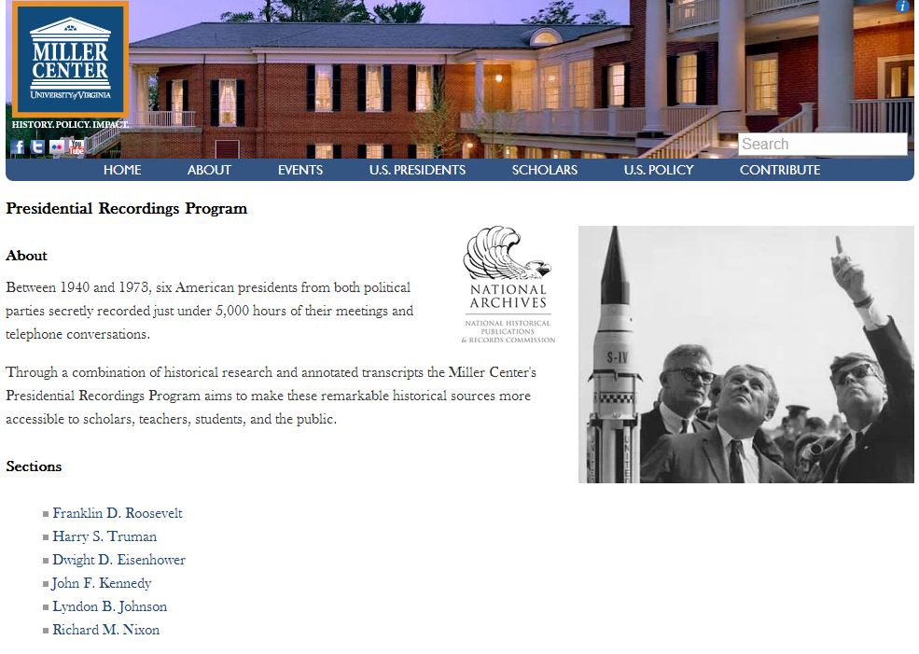

Slide 23
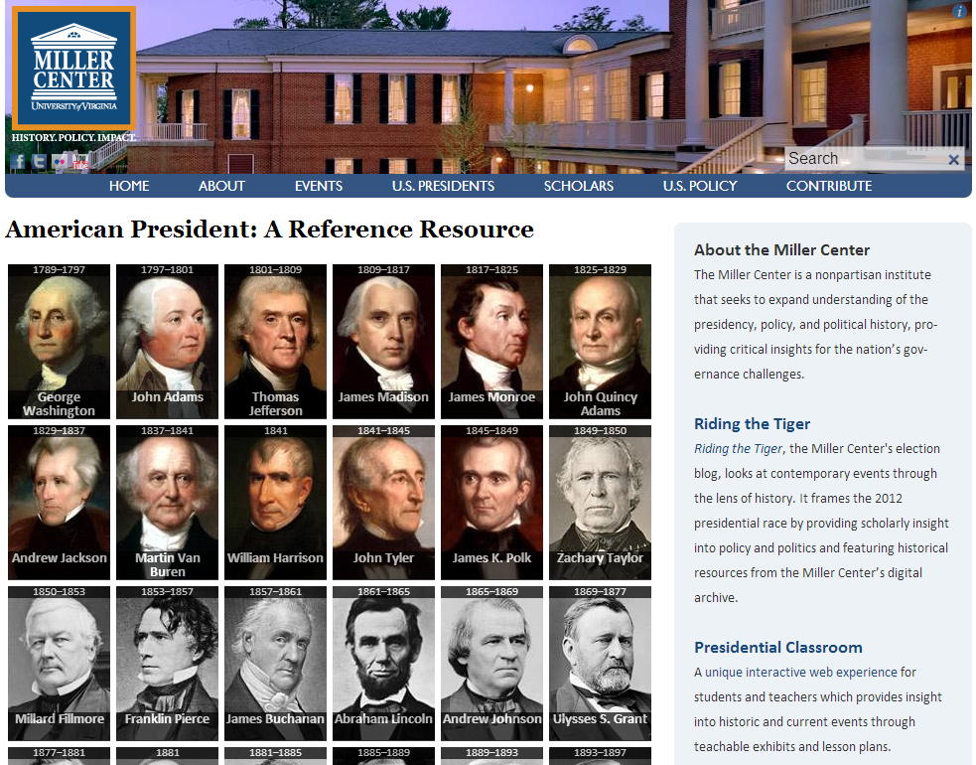

Slide 24
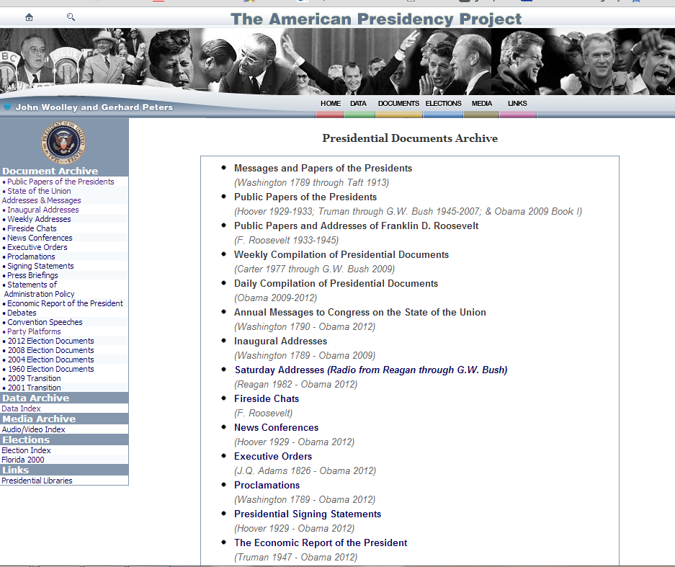

Slide 25
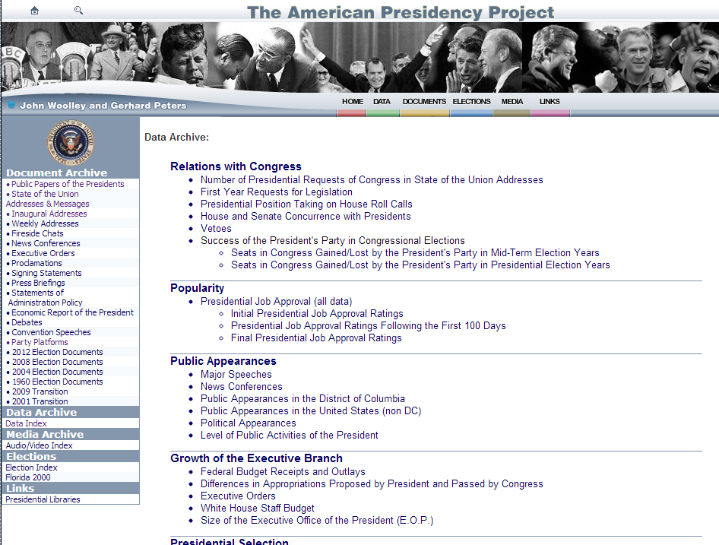

Slide 26
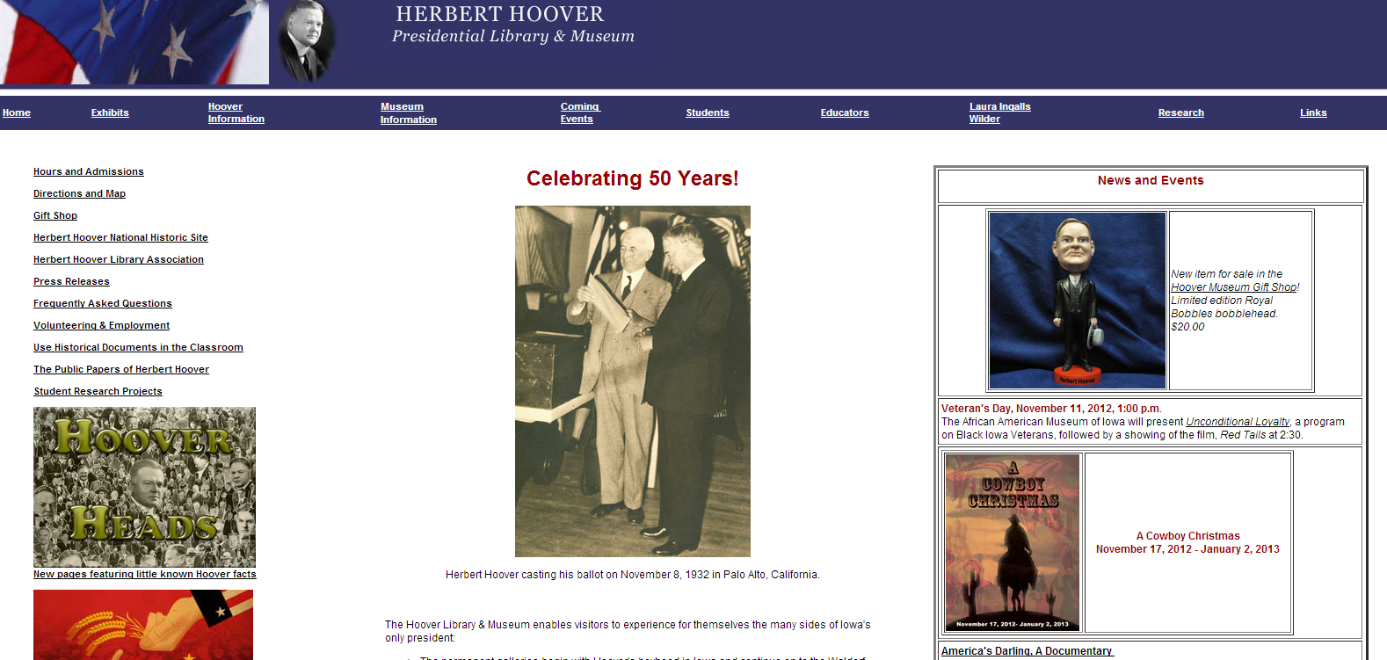

Slide 27
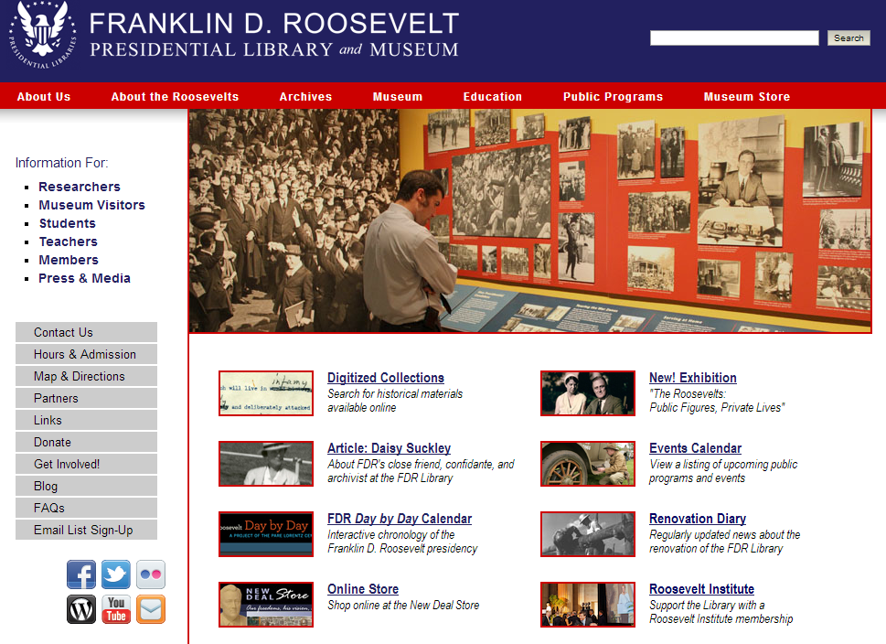

Slide 28
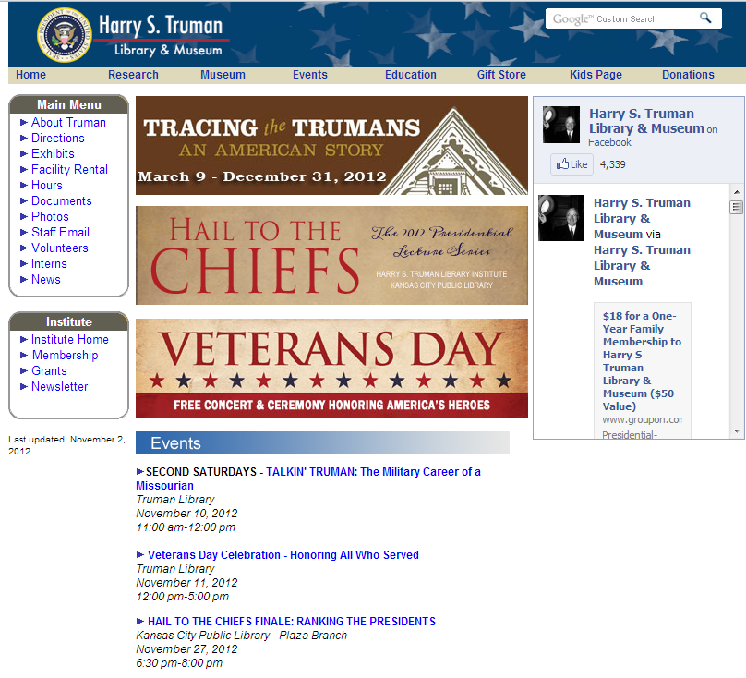

Slide 29
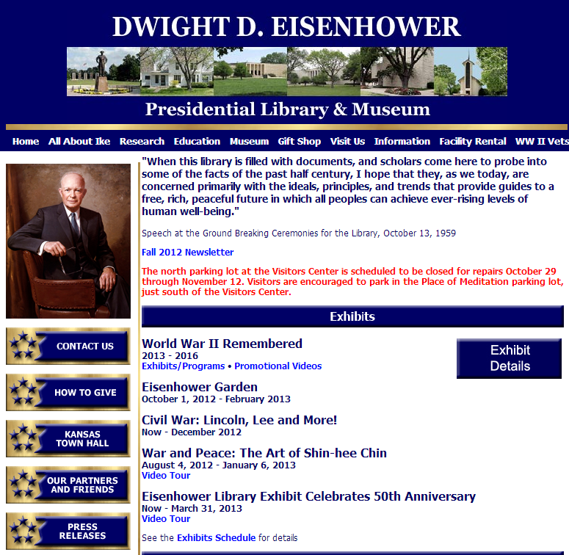

Slide 30
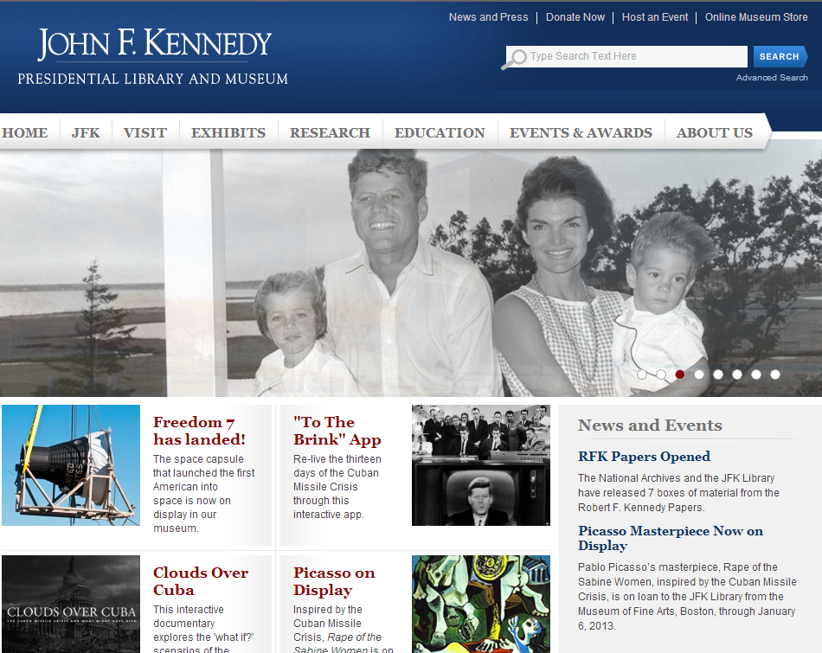

Slide 31


Slide 32
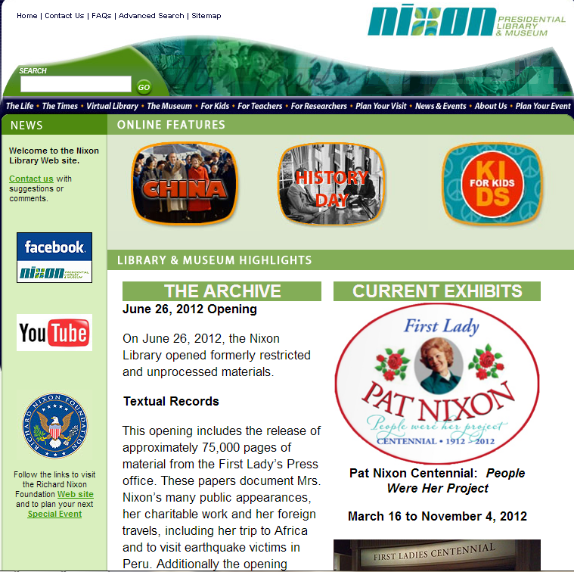

Slide 33
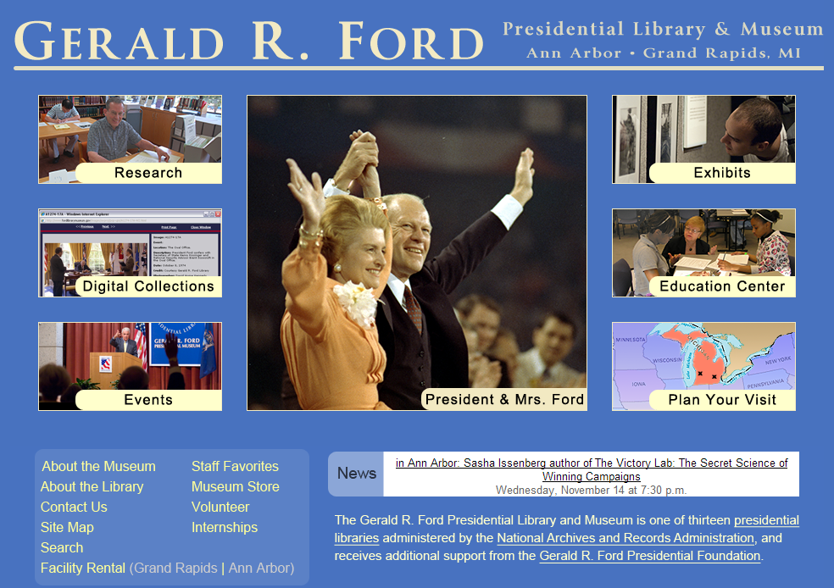

Slide 34
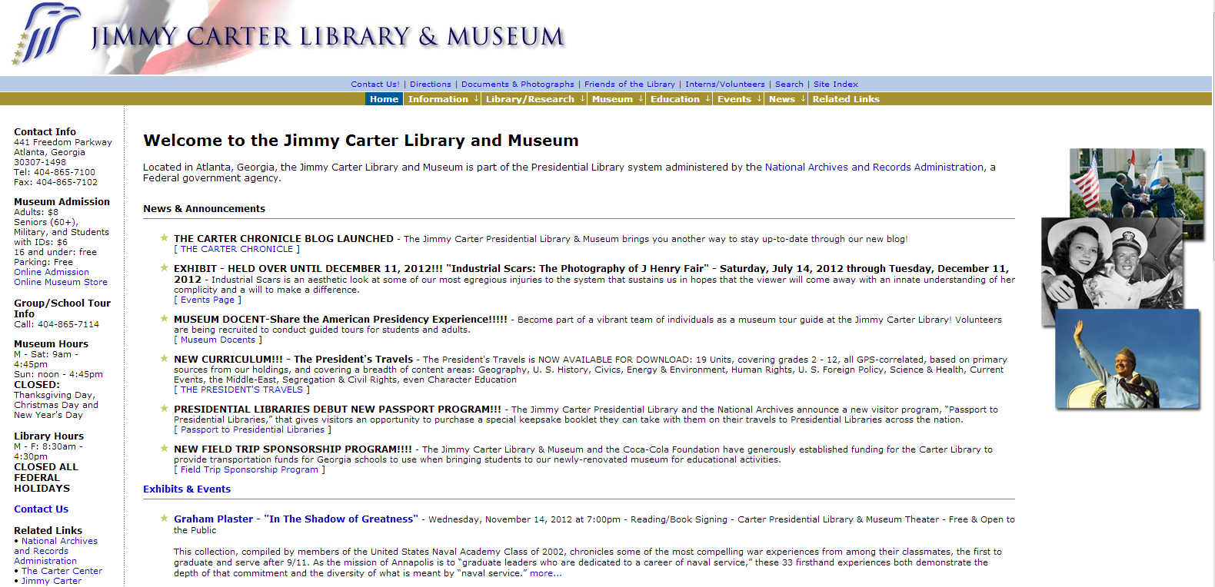

Slide 35
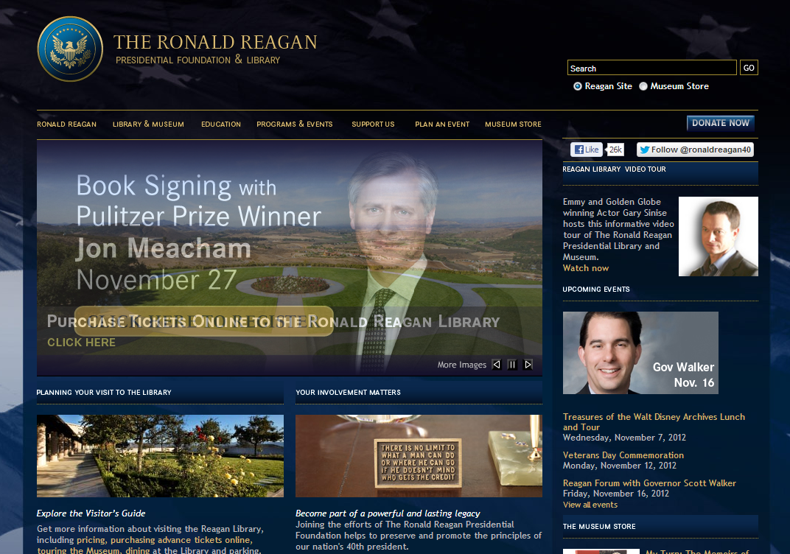

Slide 36
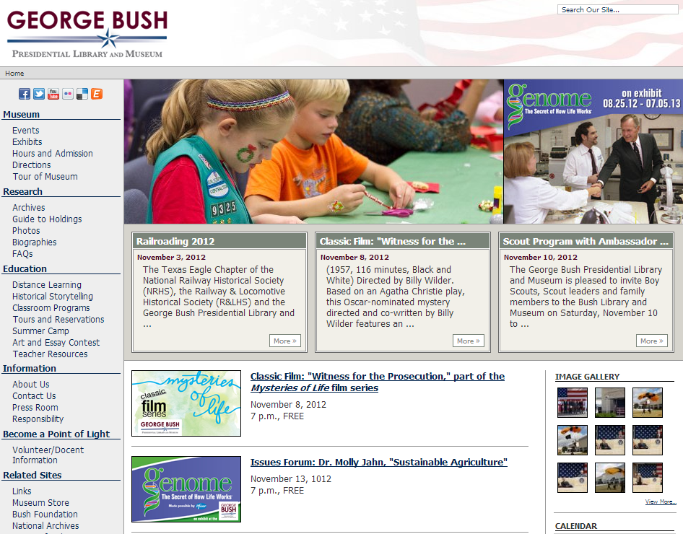

Slide 37
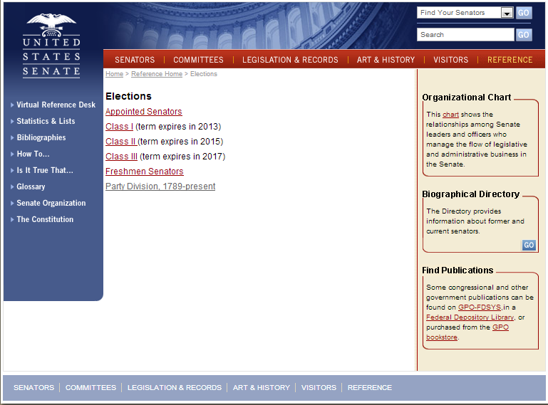

Slide 38
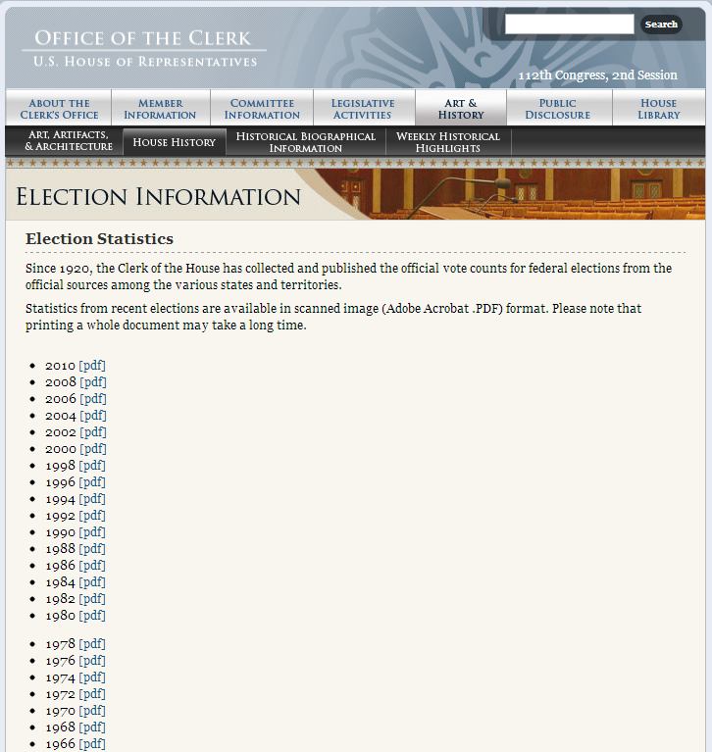

Slide 39
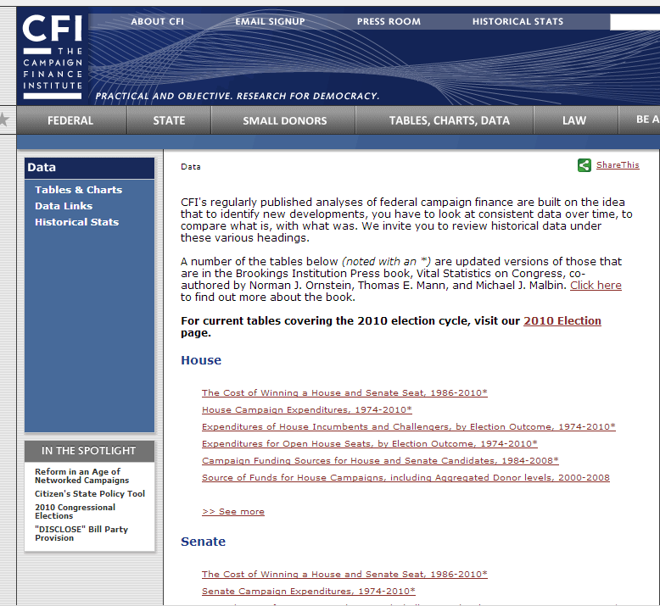

Slide 40
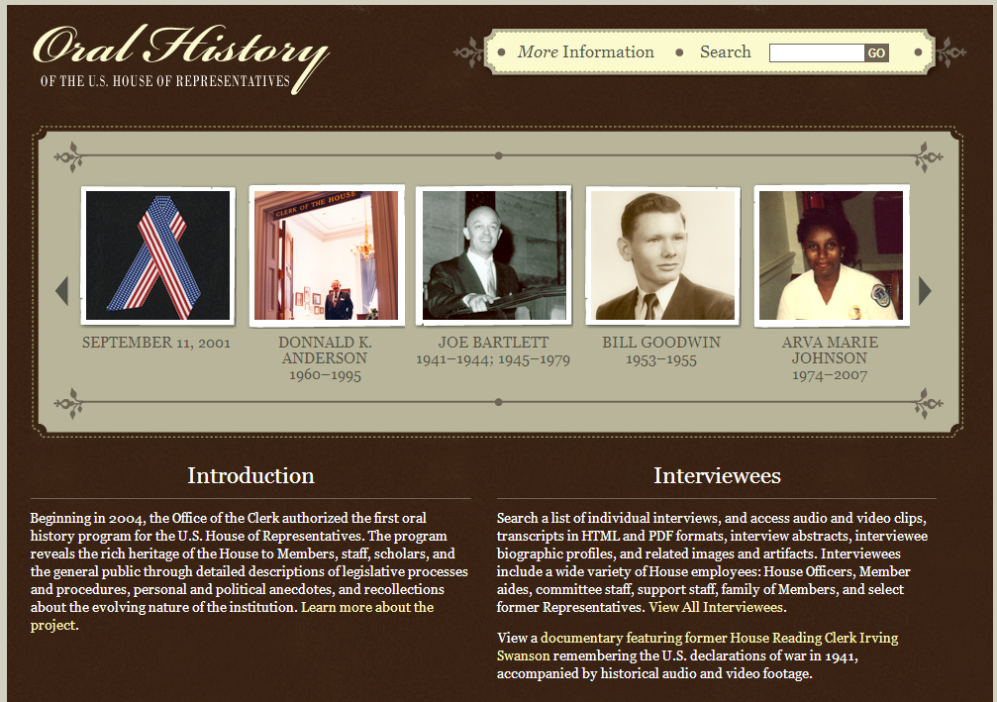

Slide 41
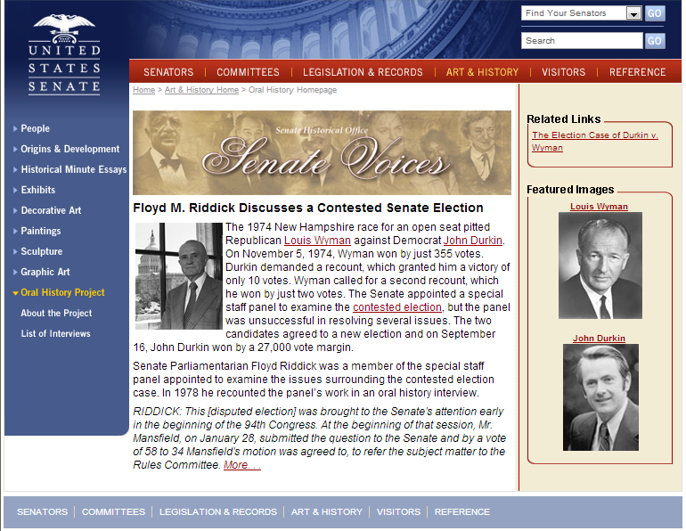

Slide 42
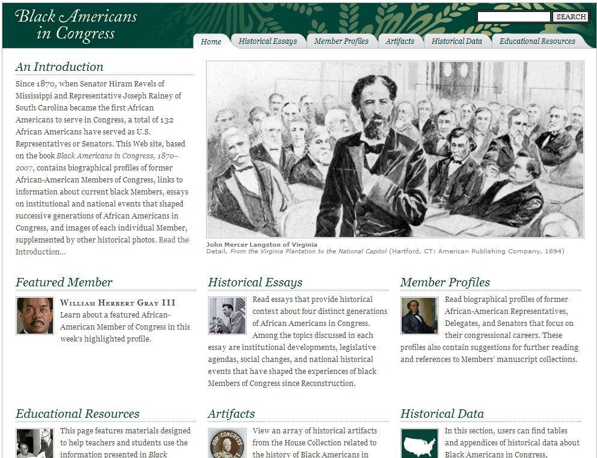

Slide 43
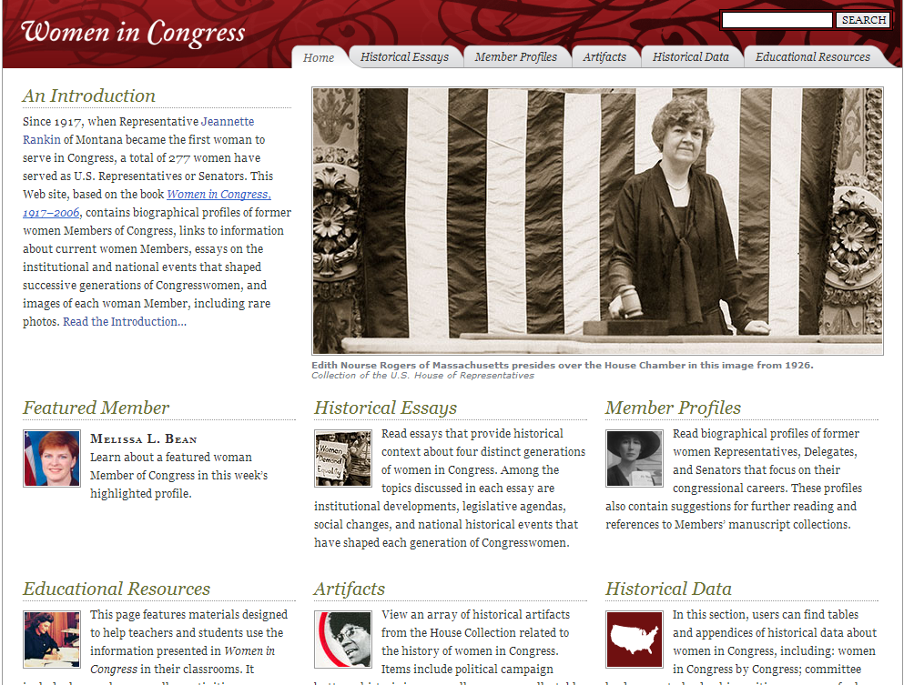

Slide 44
