Slide 1
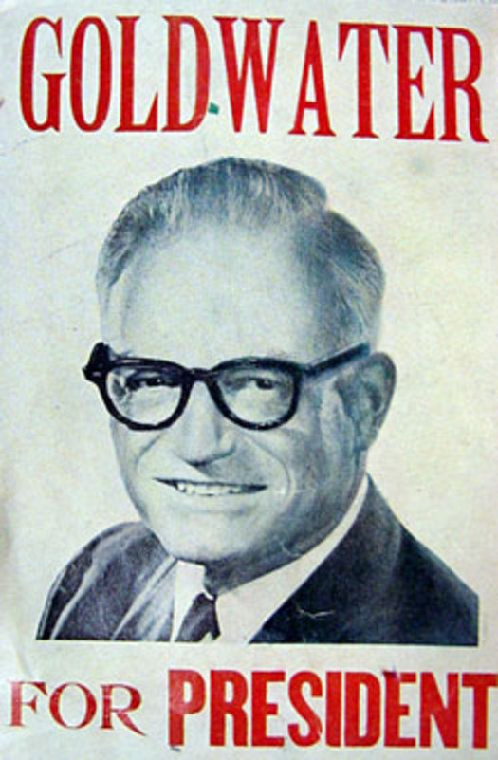

Slide 2
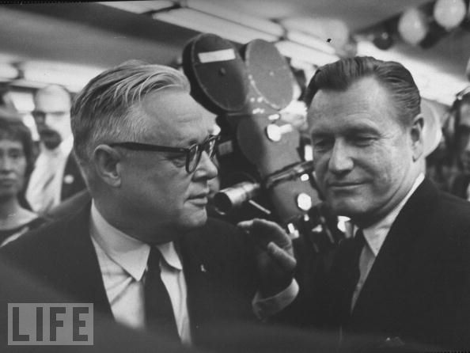

Slide 3
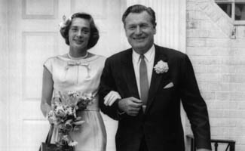

Slide 4
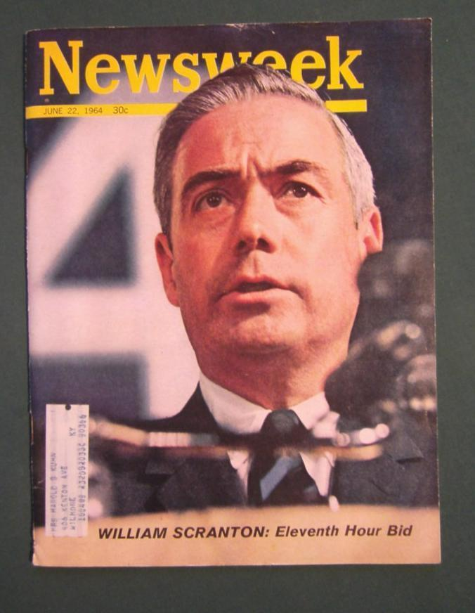

Slide 5
President Johnson: I don’t see that they [the Republicans] got anybody, though, that’s appealing to people much. Goldwater has gone crazy. He wanted to pour in the Marines [to Cuba] yesterday. He’s just nutty as a fruitcake.
John Connally: Yeah.
President Johnson: [New York governor Nelson] Rockefeller’s wife ain’t going to let him get off the ground.
Connally: That’s right.
President Johnson: So I guess that Time magazine and the big ones that are really doing this job—I guess they’re going to have to go with [Pennsylvania governor William] Scranton. I don’t believe he’s appealing enough, or attractive enough, or . . . I don’t think they can make image of him enough. Get over all the—
Connally: No, I don’t either—
President Johnson: All he did was a 5 percent sales tax in Pennsylvania.
Connally: Mm. I don’t see that. I don’t know how they’re going to get off the ground. I think they’ll probably go back to Nixon. Nixon or Scranton. But I don’t think any one of them can do any good.

Slide 6
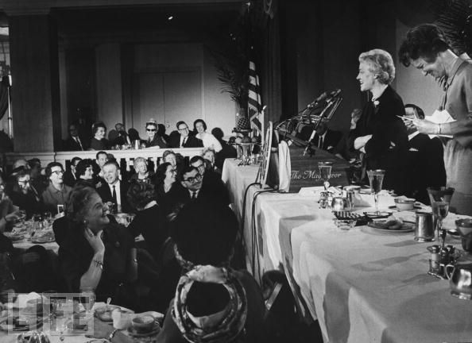

Slide 7
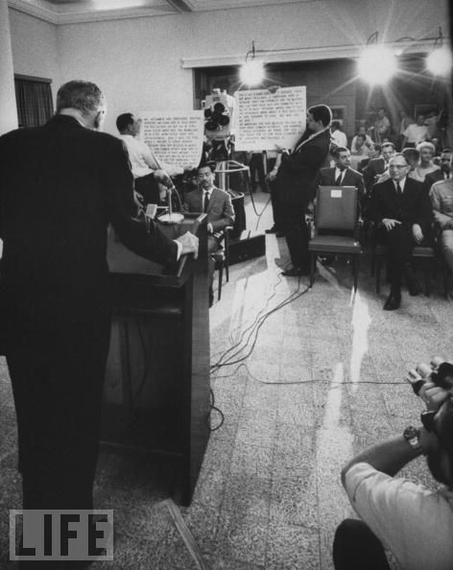

Slide 8
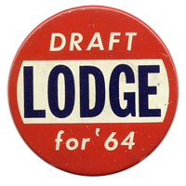

Slide 9
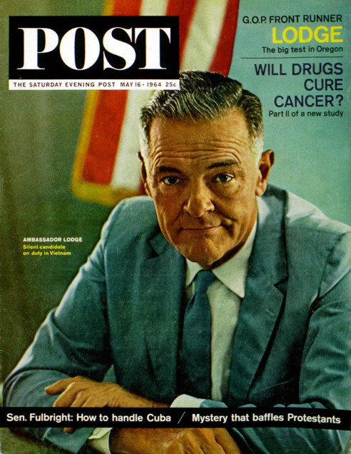

Slide 10
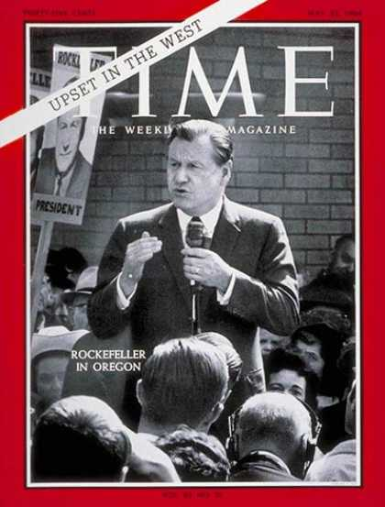

Slide 11
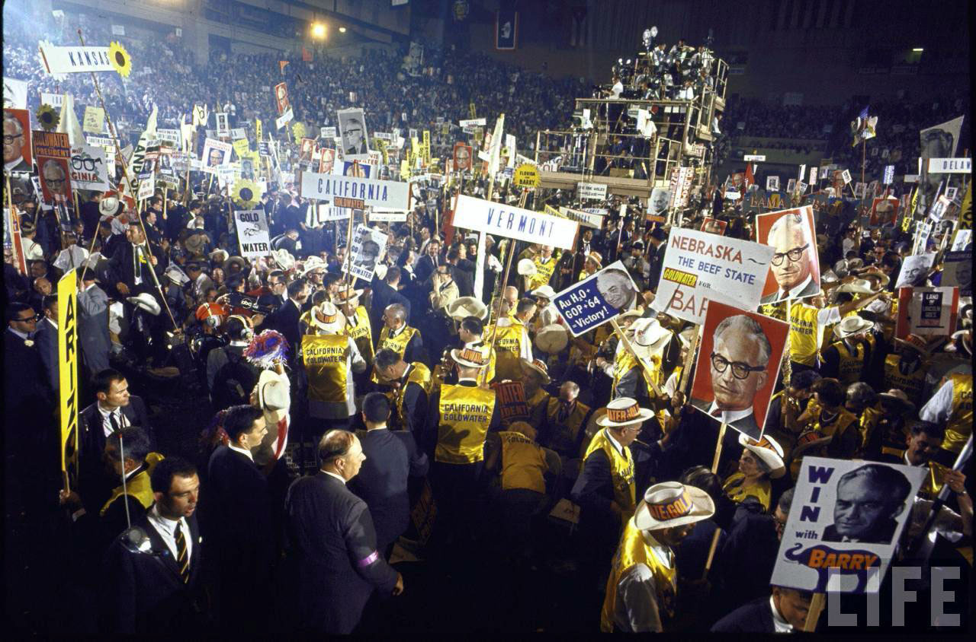

Slide 12
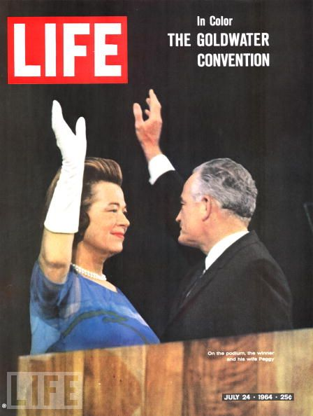

Slide 13
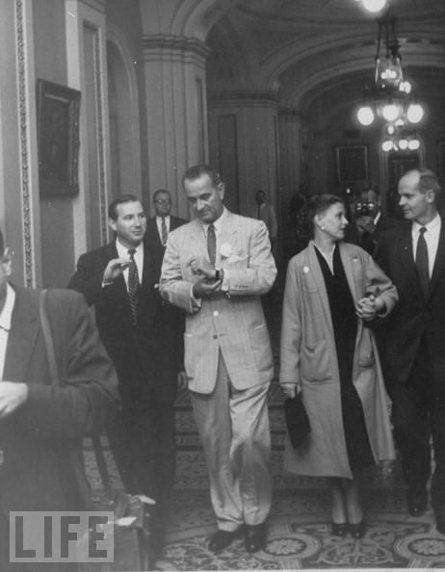

Slide 14


Slide 15
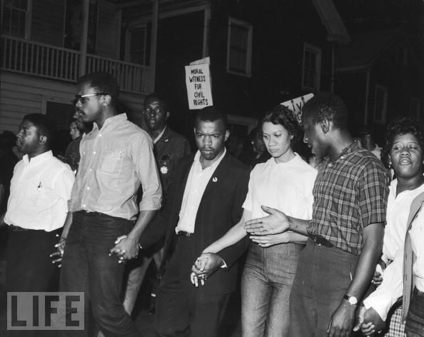

Slide 16
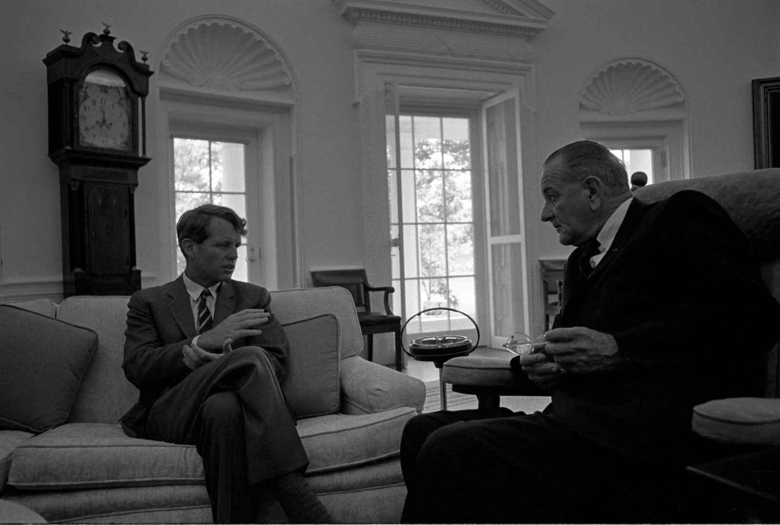

Slide 17
President Johnson: Now, I have about come to the conclusion, that it is just as positive as we’re sitting here that he [Kennedy] is going to force a roll call on his name for this place or the other place [the vice presidency].
John Connally: Hmm.
President Johnson: I think probably the vice presidency, at the moment.
He will have some people in every delegation that have been friendly, or some way or the other, and he’ll be in touch with ‘em. And they’re going to have an emotional thing with this film [about President Kennedy], and Mrs. Kennedy, and all of them. Then he’s going to really make the pitch.
[Break.]

Slide 18
President Johnson: Most of ‘em think that he is determined that he wants this job, and he’ll do anything in the world he can to get it; and if by causing a fight, he thinks that he can probably make me throw the election. And he’d like to see me a defeated man like [Adlai] Stevenson.
Connally: Mm-hmm.
President Johnson: That’s one reason he’s not unhappy about what’s happening in the South.
[Break.]
Connally: And I don’t think there’s any question but what he’ll try—he would be delighted to see you defeated. Ain’t no question about that in my mind.
He’s an arrogant, an egotistical, a selfish person that feels like he’s almost anointed. He is so power-mad that it’s unbelievable. And that’s the very reason you can’t take him on this ticket—because most people know it.

Slide 19


Slide 20
President Johnson: What’s happening is we’re doing four or five things. Number one: we’re coming in there and seating the state of Mississippi. Every damn one of them. Now, they oughtn’t to be, Carl. They oughtn’t to …
Carl Sanders: I don’t—
President Johnson: You and I just can’t survive our political modern life with these goddamned fellows down there [white Mississippi leaders] that are eating them for breakfast every morning. They’ve got to quit that. And they’ve got to let them [African-Americans] vote. And they’ve got to let them shave. And they’ve got to let them eat, and things like that. And they don’t do it.
However much we love [Democratic Senators] Jim Eastland and John Stennis, they get a governor like Ross Barnett, and he’s messing around there with [George] Wallace, and they won’t let one [black] man go in a precinct convention. We’ve got to put a stop to that, because that’s just like the old days, by God, when they wouldn’t let them go in and cast a vote of any kind.
You’ve put a stop to it in your state. But we’re going to ignore that. We’re going to say, “Hell, yes, you did it. You’re wrong. You violated the ’57 [civil rights] law, and you violated the ’60 [civil rights] law, and you violated the ’64 [civil rights] law, but we’re going to seat you—every damn one of you. [dripping with sarcasm] You lily white babies, we’re going to salute you.”

Slide 21
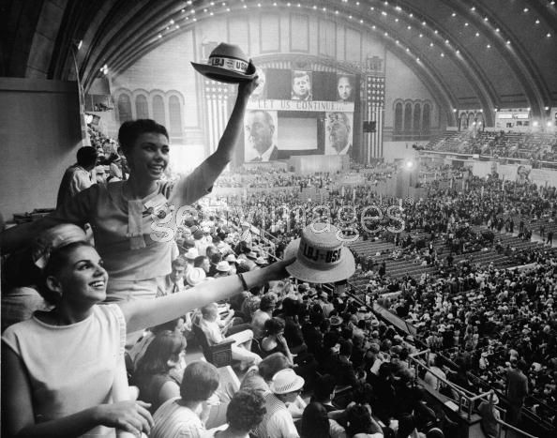

Slide 22
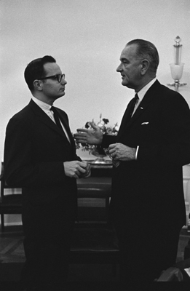

Slide 23
President Johnson: [The speech should stress that] we have a right to wish what we want to, think what we want to, worship where we want to, sleep where we want to.
Everything like . . . the basic fundamentals that—that Declaration of Independence, Bill of Rights, Constitution thing, wrapped up in one paragraph.
Do you remember the paragraph I’m talking about?
Bill Moyers: Yes, sir. I sure do.
President Johnson: But I want it elaborated on a little bit—“A mind to be trained, a child’s mind to be trained. A church to pray in. A home to sleep in. A job to work in.”
Moyers: All right.
President Johnson: Let’s get education, religion, free speech, free press—“read what he pleases”—that will round him out as a well-balanced, tolerant, understanding individual.
Moyers: All right.
President Johnson: Instead of one of these kooks.

Slide 24
Moyers: OK.
President Johnson: [chuckling] Do you follow me there, now?
Moyers: Gotcha.
President Johnson: I want that one paragraph so that I can have all the Johnson philosophy.
He [Reuther] said, “Now, you’ve got to speak some on poverty. You’ve got to speak some on education. You’ve got to speak some on Medicare.” Somebody’s told him it’s going to be a high level speech. And he wants it a party hack speech.
I said, “Well, I’m going to refer to all of them.” I want it in one paragraph—my philosophy. So that when you quote what I had in that Southwest Quarterly [article]—“I’m a free man, an American, and a senator, in that order, and so forth.” Do you remember?
Moyers: Right.
President Johnson: I want something that you can quote like this the rest of our lives. You can put it up in the preface of your book. “I see a . . . I have a vision . . . dash . . . a vision of a land where a child can [pauses for nine seconds] have a home to live in.”
[quickly] And then repeat what I just said to you.
Moyers: OK.

Slide 25
President Johnson: “Can read what he wants to, and can wishwhat he wants to, and can dream what he wants to.” Put in the words, “I have a vision.” Let’s get a little bit of this holy-rolly populist stuff. [voice rising] “I have a vision of a land where every child [pauses] can have training to fit his abilities, a home to protect him from the elements, a church to kneel in.”
Throw at least two biblical quotations in, that are very simple, that every one of them have heard—these working [men], these auto mechanics.
Moyers: All right.
President Johnson: It’s what you Baptists just pour to them all the time.
Moyers: [chuckling] All right.
President Johnson: Make it simple; don’t give me one of these long ones.
Moyers: Right.
President Johnson: Just go back and get me one of the commandments. These Baptists preachers—don’t get on that adultery one. Get some of these, “Thou shalt not [pauses] lie on thy brother.” [Chuckles.]
Moyers: All right. OK.
President Johnson: OK.

Slide 26
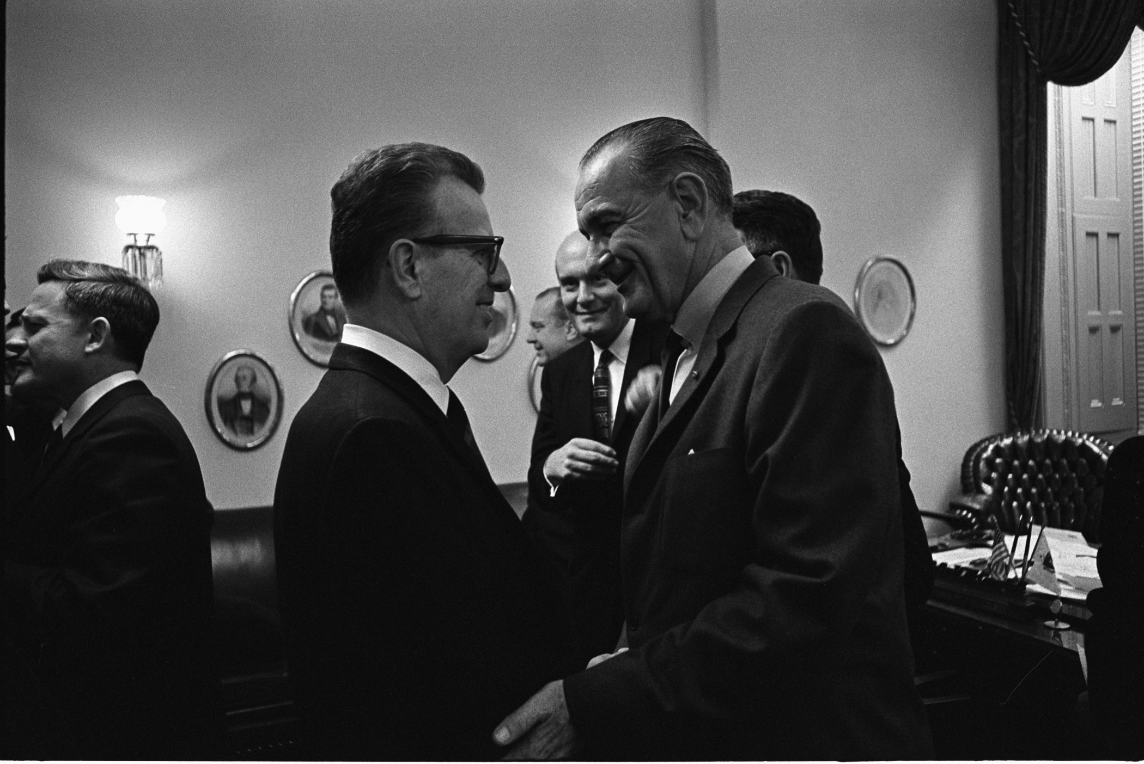

Slide 27
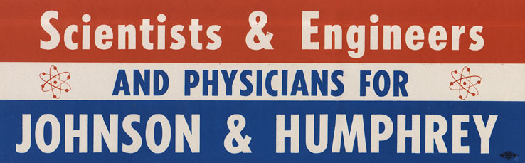

Slide 28
President Johnson: Do you-all understand that what I want is to saturate any way we can with sports with women, with real names, with scientists, the former heads of the American Bar (like [former ABA head Moorfield] Storey can be in the South)—why they’re for Johnson.
And never for “Lyndon B. Johnson.” Always for, “Our great President Johnson.”
And I think that where we can, we ought to have these scientists and others saying, “He’s carrying on the program of President Kennedy.” I think we can pull a lot of people, hold ‘em, that way.
Bill Moyers: The best investment of money, Mr. President, would be full-page ads in most of the metropolitan newspapers, signed by the prominent Nobel Prize scientists that we have on our committee.
President Johnson: Well, get an ad up. I think TV reaches more than the papers, but if you-all think the papers, all right.

Slide 29
Moyers: Well, we use TV, too, but—
President Johnson: All right.
Moyers: You got—
President Johnson: It looks like you ain’t got enough money to do both of ‘em, I don’t think. But if you can, just go on and do it.
I got—somebody gave me five little things from [National Security Advisor McGeorge] Bundy that could be run in a full-page ad. The trouble is, you get an ad, [and] some son-of-a-bitch just puts a scoopful of dictionary in it. And I can’t read our ads. I haven’t seen an ad of ours that I’d read.
[International Ladies’ Garment Workers’ Union head] David Dubinsky just had a scoopful that I saw down at the bottom, and I never read any of the rest of it. Ain’t nobody going to read it. You’ve got to have some white stuff in there, Bill.
Moyers: Right.
President Johnson: We always say “right,” but we don’t do it.

Slide 30
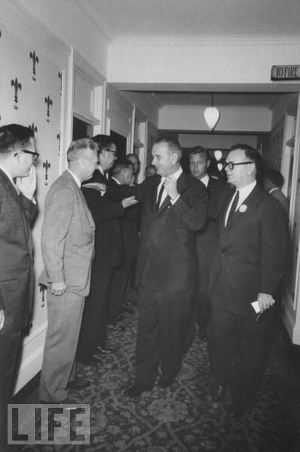

Slide 31
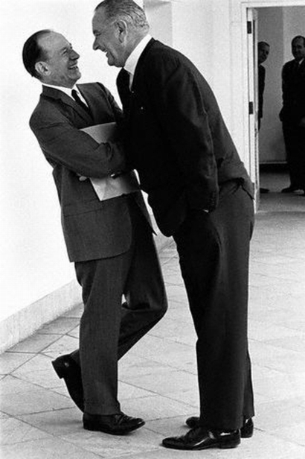

Slide 32
Lady Bird Johnson: I will try to be discreet, but it is my strong feeling that a gesture of support to Walter [Jenkins] on our part is best.
President Johnson: I’d make all the gestures I could, but I don’t think that I would put myself in the position of defending what we say in the public in a situation like this, because we just can’t win it.
The average farmer just can’t understand you’re knowing it [Jenkins’ behavior] and approving it, or condoning it—any more than he can [Dean] Acheson not turning his back [on Alger Hiss].
[Break; the First Lady suggests offering Jenkins a job at KTBC.]

Slide 33
President Johnson: I don’t think the job is the important thing. I think we can—the finances is the minimum thing, honey.
Lady Bird Johnson: I think a gesture of support on some of our part is necessary to hold our own forces together.
President Johnson: [wearily] Well, talk to [aides] Abe [Fortas] and Clark [Clifford] about it, and . . .
Lady Bird Johnson: My poor darling, my heart breaks for you, too.
President Johnson: Well, I know it, honey, and—
Lady Bird Johnson: And I suppose I’ll let you go now. But if I get questioned, what I’m going to say is that I cannot believe this picture that’s put before me.
[Break. The First Lady passes along a report that Jenkins’ wife, Marjorie, is blaming the President for her husband’s downfall.]

Slide 34
President Johnson: I’ve got to go; they’re holding the plane with the mayor [of New York City] and everybody on it.
Lady Bird Johnson: All right.
President Johnson: We’re an hour late now.
Lady Bird Johnson: My love, my love, I pray for you, along with Walter. Good-bye.
President Johnson: [ignoring her] And I think I would get Abe, right quick, and Clark, and have Abe go see her [Mrs. Jenkins] go see her if he could—or have her priest go talk to her.
Lady Bird Johnson: All right. You’re a brave, good guy; and if you read where I said some things in Walter’s support, they’ll be along the line that I’ve just said to you—this man, who I’ve known all these years, and then you heard the adjectives I used.

Slide 35
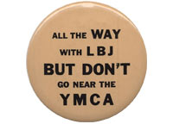

Slide 36
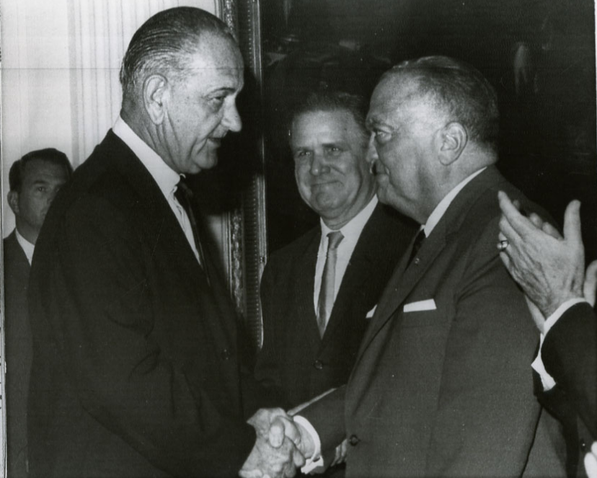

Slide 37
President Johnson: No, I read that. What they said was that—they raised the question of the way he [an unidentified cabinet aide] combed his hair, or the way he did something else, but they had no act of his, or he had done nothing—
J. Edgar Hoover: No. It was just the suspicion that his mannerisms and so forth were such that they were suspicious.
President Johnson: Yeah. He [Jenkins] worked for me for four or five years, but he wasn’t even suspicious to me.
But I guess you’re going to have to teach me something about this stuff!
Hoover: Well, you know, I often wonder what the next crisis is going to be. [An awkward pause ensues.]
President Johnson: I’ll swear I can’t recognize them. I don’t know anything about it.
Hoover: It’s a thing that you just can’t tell. Sometimes, just like in the case of this poor fellow Jenkins . . .
President Johnson: Yes.
Hoover: [continuing] There was no indication in any way.
President Johnson: No.

Slide 38
Hoover: [continuing] And I knew him pretty well, and [FBI White House liaison Deke] DeLoach did also, and there was no suspicion, no indication.
There are some people who walk kind of funny and so forth, that you might kind of think are little bit off, or maybe queer. But there was no indication of that in Jenkins’ case.
President Johnson: That’s right.
[Break.]
Hoover: So far, I haven’t been able to get any more detail than was given to me yesterday, namely that this man [the alleged closeted homosexual] was a cabinet officer, and will be exposed today.
Now, I thought of all the cabinet officers that we have—and whom I don’t know personally—but there are none of them that raise any suspicion in my mind.
President Johnson: None in mine.

Slide 39
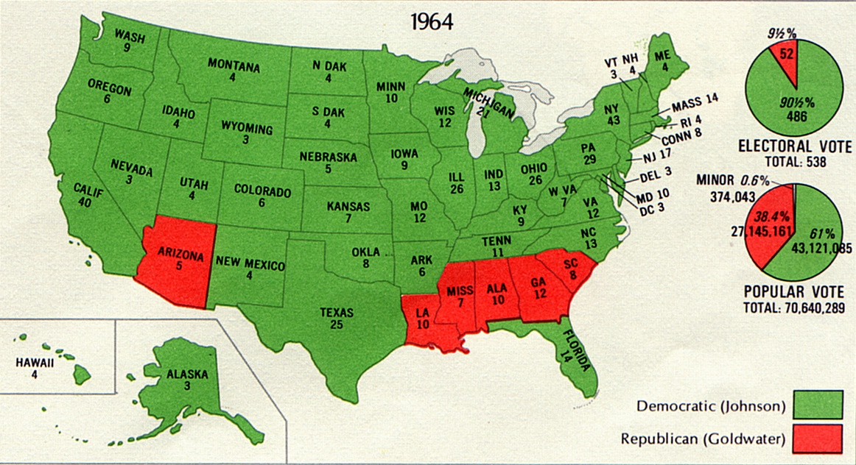

Slide 40
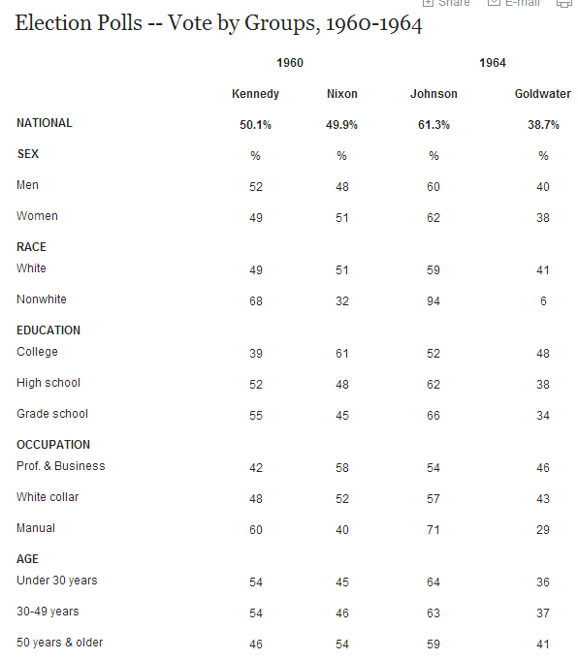

Slide 41
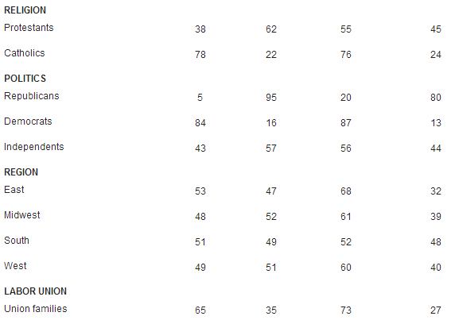

Slide 42
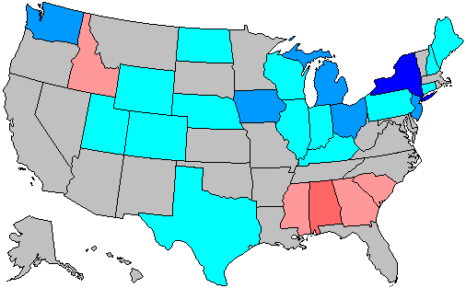

Slide 43
President Johnson: Eddie, you’ve got to do this, and you’re the only one that can do it. You’re the one that can get things done, like this Walter [Jenkins] report. The rest of them just talk about it.
We don’t have any propaganda machine, and we don’t have anybody that can get out our stuff.
Now, Ray Moley [of Newsweek] started this story that they were just voting against Goldwater, and they didn’t like either one of us, and that Johnson didn’t have any rapport [with the people], and he didn’t have any style, and he was a buffoon, and he was full of corn, and . . .
[Break.]

Slide 44
President Johnson: So the Bobby Kennedy group—they kind of put out this stuff, and the little Kennedy folks around, that nobody loves Johnson.
They’re going to have it built up by January that I didn’t get any mandate at all, that I was just the lesser of two evils, and people didn’t care, and so on.
[Break.]
President Johnson: Somebody’s got to try to get the Times to give us a little approach. Because the first thing they’re going to do is they’re going to try and make a Warren Harding out of us on account of [Bobby] Baker and Jenkins—
Eddie Weisl: Yeah.

Slide 45
President Johnson: Second thing they’re going to do is say there’s no mandate.
Third thing they’re going to do is try and have the Southern coalition—they’re already working at it—to combine with the Republicans and not let us get anything.
If we don’t show that—even Roosevelt in ’36 never captured the number of people, and never had ‘em jumping in the air, and yelling, and giving the loyalty that we did.
In Iowa, I beat five of the six [Republican] congressmen! I had twice the crowd Eisenhower ever had. Now, they wrote about Eisenhower for eight years, but they’ve never written one word about us.

Slide 46
President Johnson: They’ve got to say something about the auditorium at Austin, Texas being filled at 2:30 in the morning, just waiting to see me—the people that knew me best. That they voted for me six and eight-to-one in my home boxes, that [William] Miller was losing. And the love, and the affection they had for 30 years.
Now, all they write about is not love and affection. They write, “Well, the lesser of two evils. Corn pone. Southern.”

