Slide 1
Great Society
Civil rights laws: Civil Rights Act (1964), Voting Rights Act (1965)
Anti-poverty laws: War on Poverty (1964), food stamps (1964)
Health care: Medicare (1965), Medicaid (1965)
Other liberal aims: model cities, education, arts, environmentalism (1965)

Slide 2
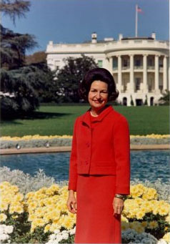

Slide 3
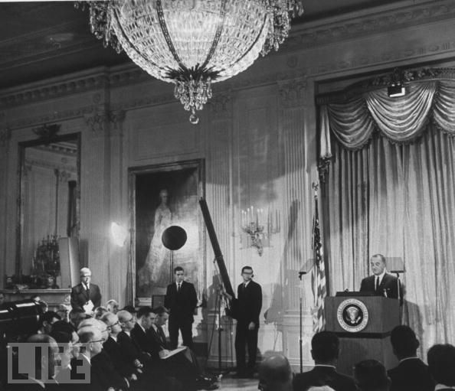

Slide 4
Lady Bird Johnson: You want to listen for about one minute to—
President Johnson: Yes, ma’am.
Lady Bird Johnson: —my critique, or would you rather wait till tonight?
President Johnson: Yes, ma’am. I’m willing now.
Lady Bird Johnson: I thought that you looked strong, firm, and like a reliable guy. Your looks were splendid. The close-ups were much better than the distance ones.
President Johnson: Well, you can’t get ‘em [the TV producers] to do it . . . the distance ones.
Lady Bird Johnson: Well, I would say this: there were more close-ups than there were distance ones.
During the statement, you were a little breathless and there was too much looking down and I think it was a little too fast. Not enough change of pace, a drop in voice at the end of sentence.
There was a considerable pick-up in drama and interest when the questioning began. Your voice was noticeably better, and your facial expressions noticeably better.
[Break.]

Slide 5
Lady Bird Johnson: When you’re going to have a prepared text, you need to have the opportunity to study it a little bit more, and to read it with a little more conviction, and interest, and change of pace. Because—
President Johnson: Well, the trouble is that they [the White House media] criticize you for taking so much time. They want to use it all for questions. Then their questions don’t produce any news, and if you don’t give ‘em news, you catch hell.
So my problem was trying to get through before 10 minutes, and I still ran 10 minutes today.
[Break.]
Lady Bird Johnson: I believe if I’d had that choice, I would have said use 13 minutes, or 14, for the statement.
In general, I’d say it was a good B+. How do you feel about it?
President Johnson: [quickly] I thought it was much better than last week.
Lady Bird Johnson: [unconvinced] Well, I heard last week, [you] see, and didn’t see it. And didn’t hear all of it.

Slide 6
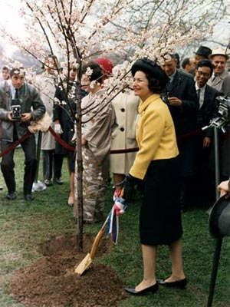

Slide 7
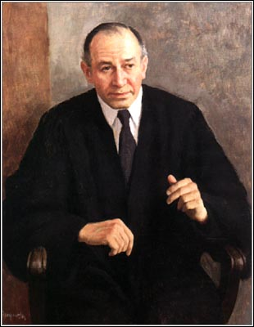

Slide 8
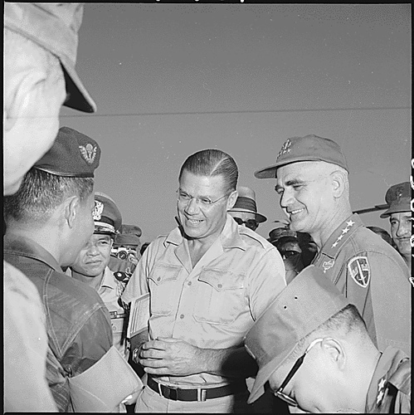

Slide 9
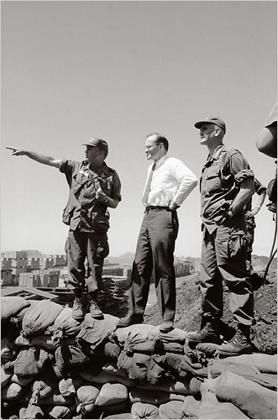
Notes:
Bundy and westnmireland after pleiku

Slide 10
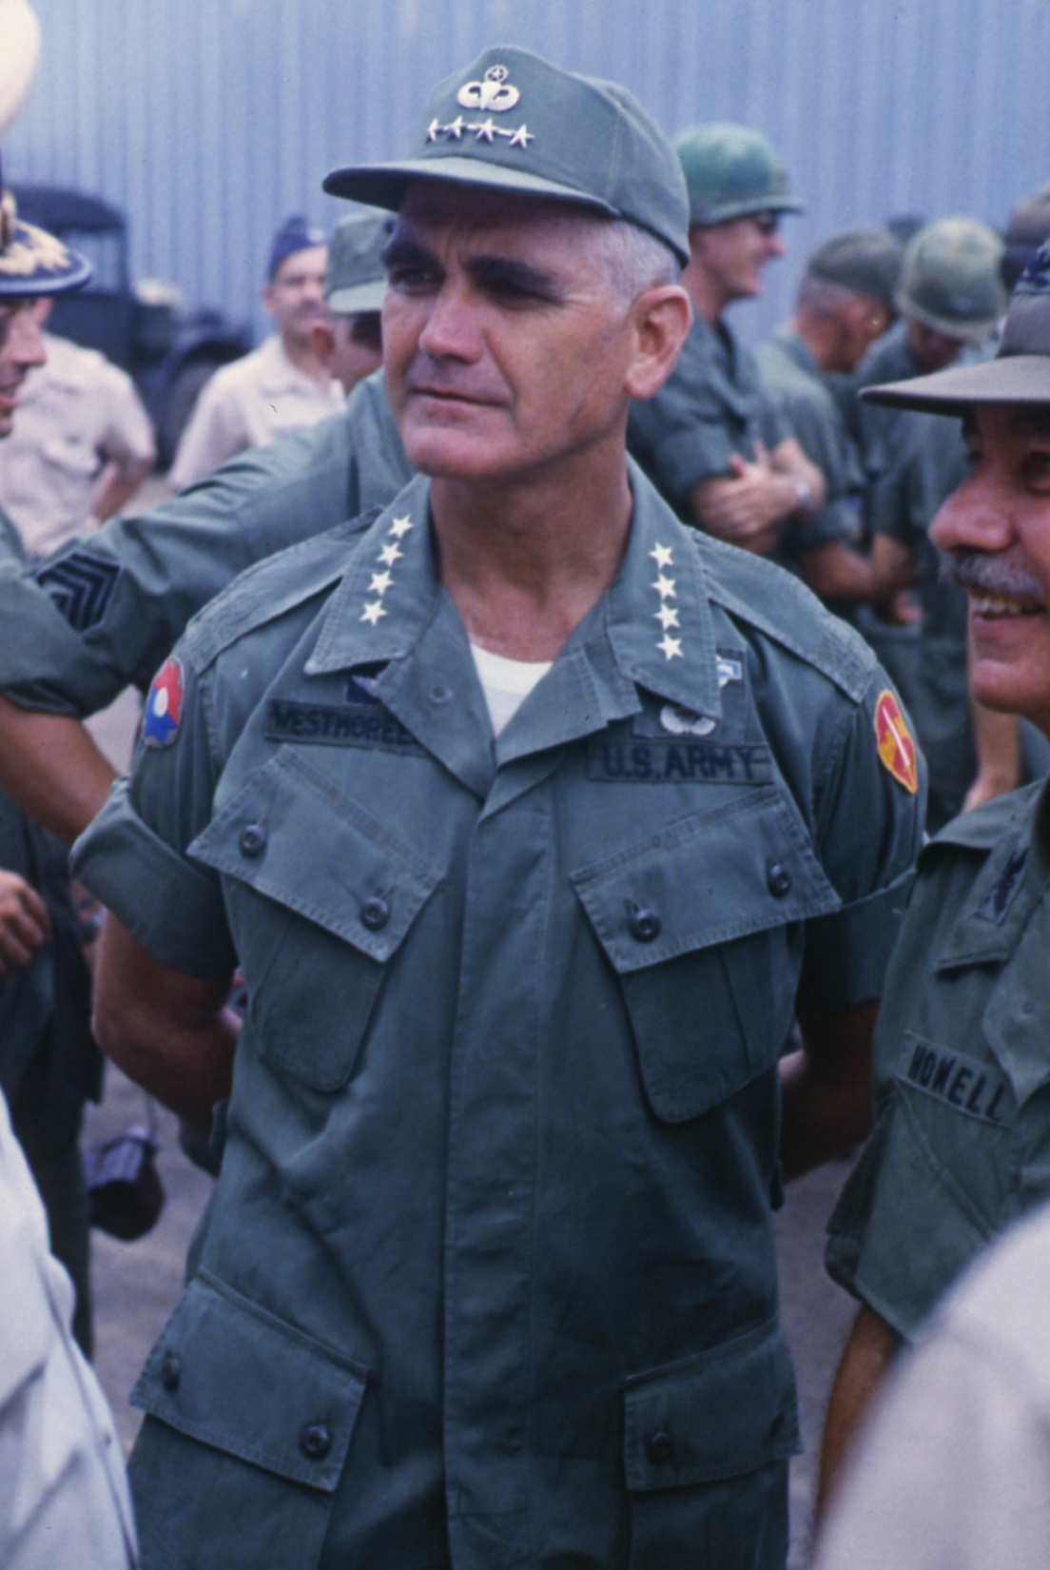

Slide 11


Slide 12
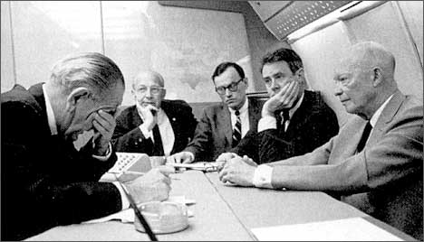
Notes:
Lbj rostow

Slide 13
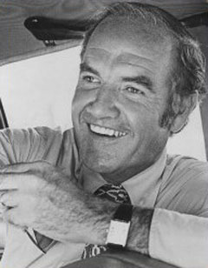

Slide 14
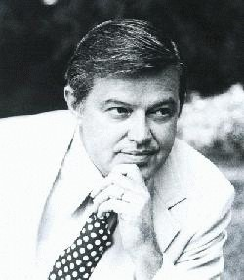

Slide 15


Slide 16
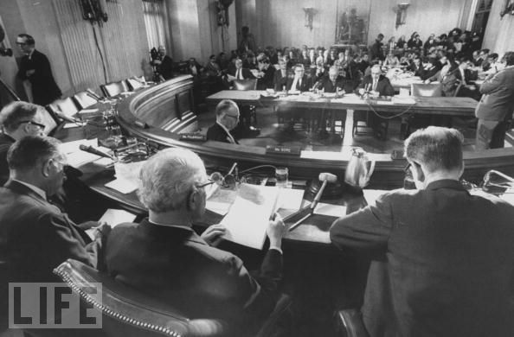

Slide 17
President Johnson: What they [adherents to the Bull Fulbright line on Vietnam] really think is that we oughtn’t to be there, and we ought to get out.
Well, I know we oughtn’t to be there, but I can’t get out. I just can’t be the architect of surrender. And don’t see—I’m trying every way in the world I can to find a way to . . . thing.
But they [the North Vietnamese] don’t have the pressure to bring them to the table as of yet. We don’t know whether they ever will.
I’m willing to do damn near anything. If I told you what I was willing to do, I wouldn’t have any program. [Senate Minority Leader Everett] Dirksen wouldn’t give me a dollar to operate the war. I just can’t operate in a glass bowl with all these things. But I’m willing to do nearly anything a human can do, if I can do it with any honor at all. But . . .
They started with me on Diem, you remember?
Eugene McCarthy: Yeah.
President Johnson: That he was corrupt and he ought to be killed. So we killed him. We all got together and got a goddamned bunch of thugs and we went in and assassinated him. Now, we’ve really had no political stability since then.
McCarthy: Yeah.

Slide 18
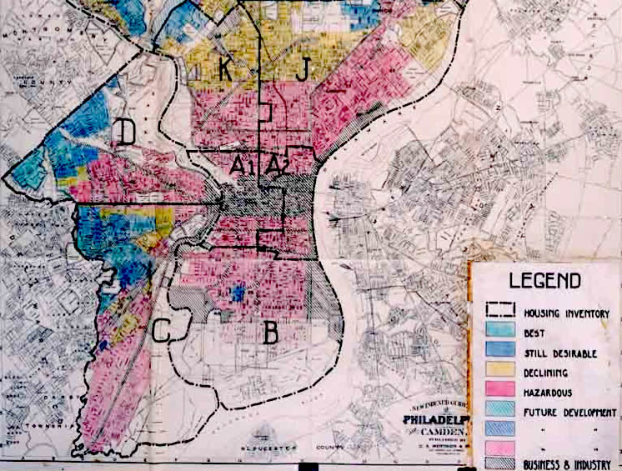

Slide 19


Slide 20
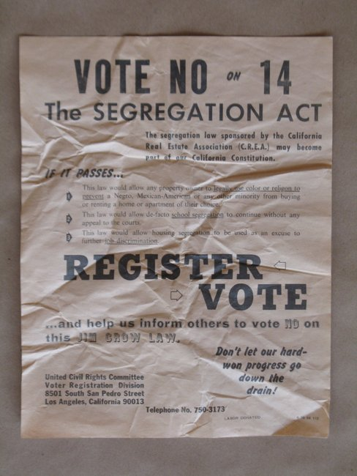

Slide 21


Slide 22
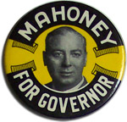

Slide 23
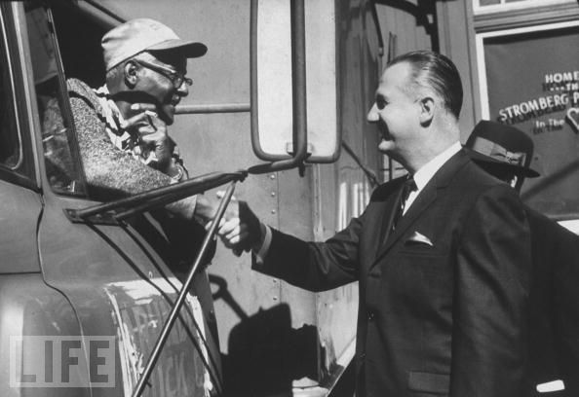

Slide 24
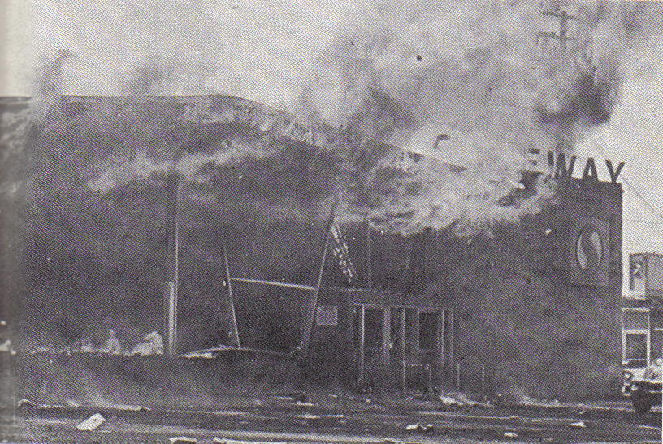

Slide 25
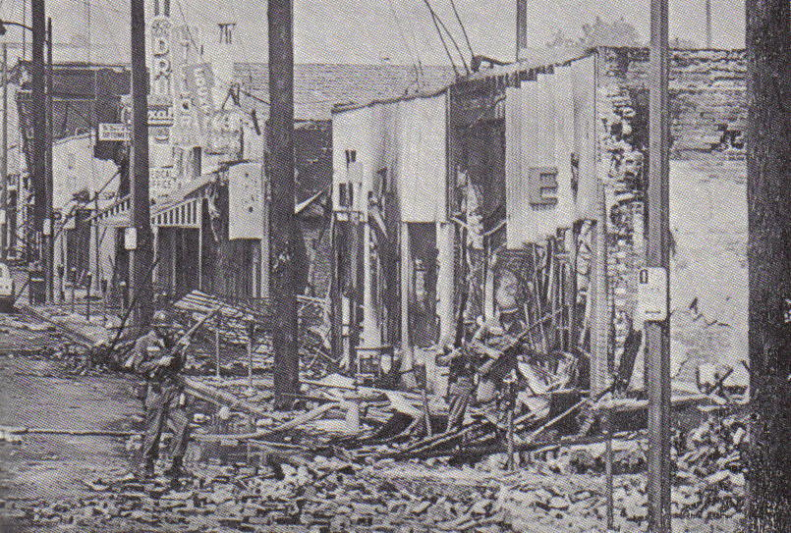

Slide 26
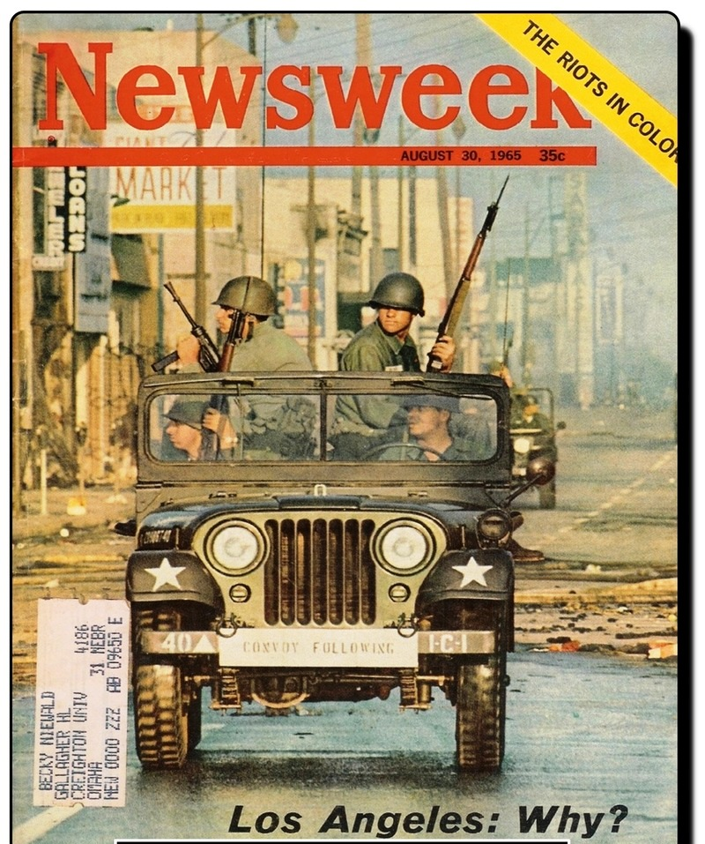

Slide 27
President Johnson: We are on powder kegs in a dozen places.
John McCone: Is that right?
President Johnson: What we’re ultimately going to have to do . . . You just have no idea of the depth of the feeling of these people [African-Americans]. You see . . . I see some of the boys [that have] worked for me that have had 2000 years of persecution [Jews] and how they suffer from it.
But these groups, they got really absolutely nothing to live for. Forty percent of ‘em are unemployed. These youngsters—they live with rats, and they’ve got no place to sleep. They start—they are all from broken homes, and illegitimate families, and all the . . . Narcotics are circulating around ‘em. And we’ve [whites] isolated them, and they are all in one area, and when they move in, why, we move out.
[Break.]
President Johnson: We’ve just got to find a way to wipe out these ghettoes.
McCone: Yeah.
President Johnson: And find someplace [for] housing, and put ‘em to work. We trained 12,000 last month, and found jobs for ‘em.

Slide 28
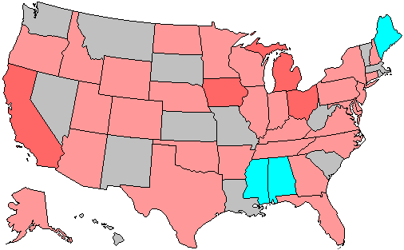
1966 House Elections
Red—Republican gains
Blue—Democrat gains

Slide 29
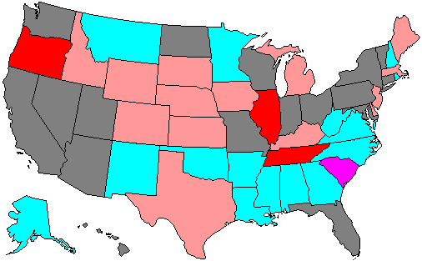
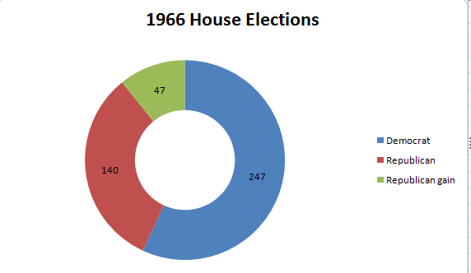

Slide 30
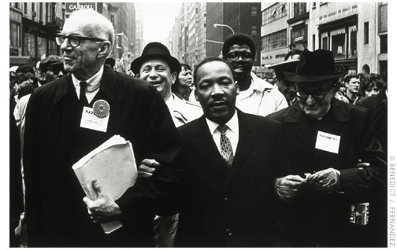

Slide 31
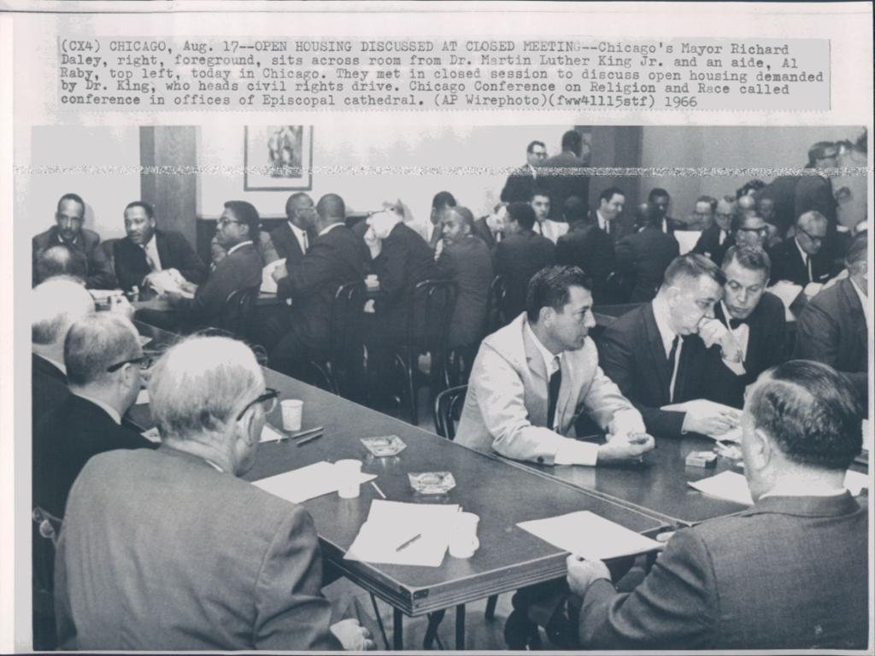

Slide 32
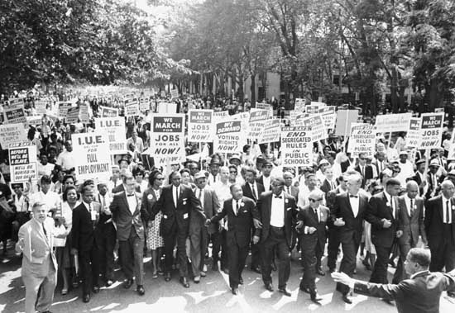

Slide 33
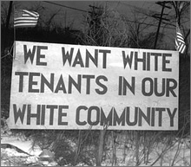

Slide 34
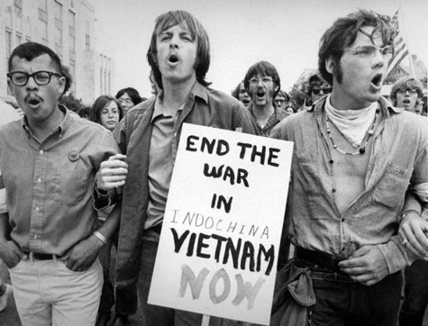

Slide 35
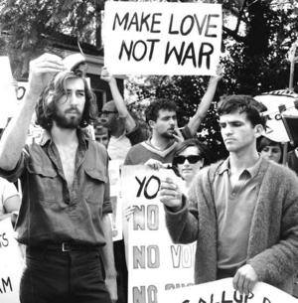

Slide 36
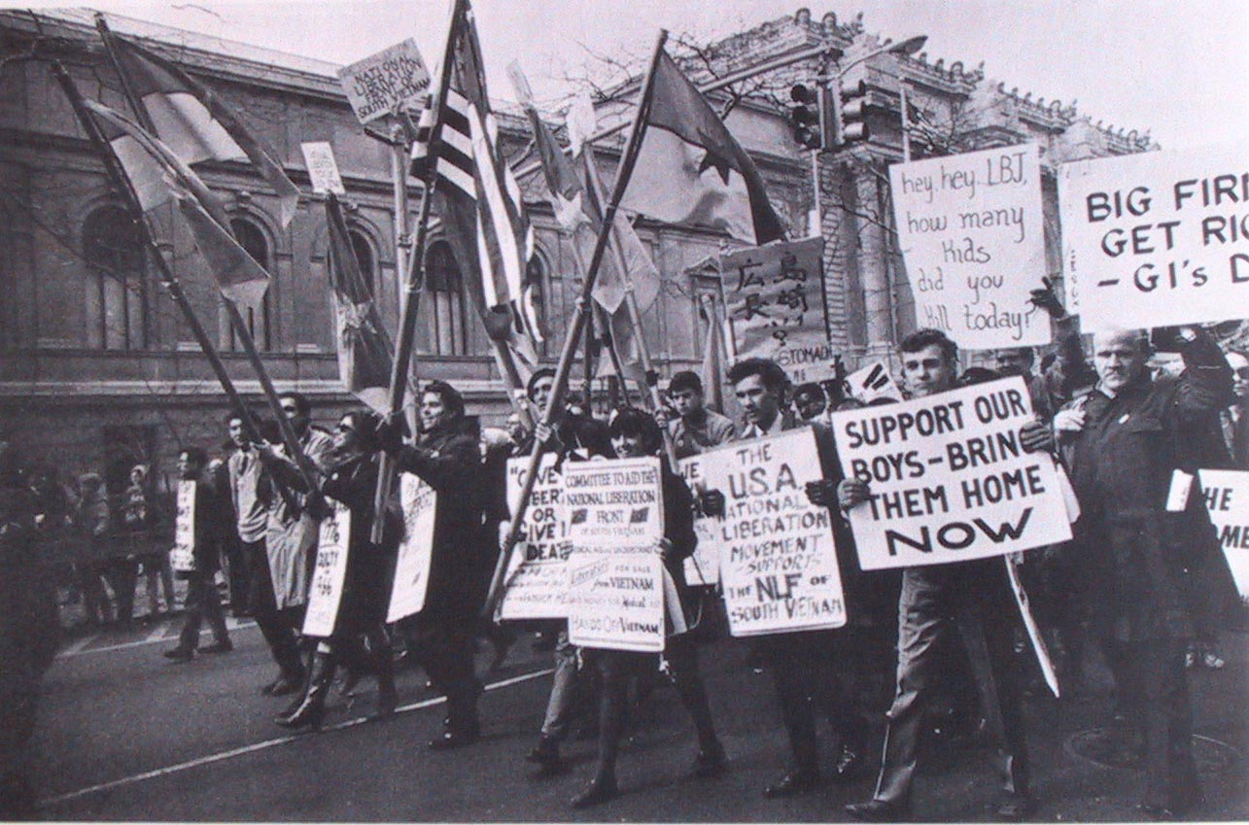

Slide 37
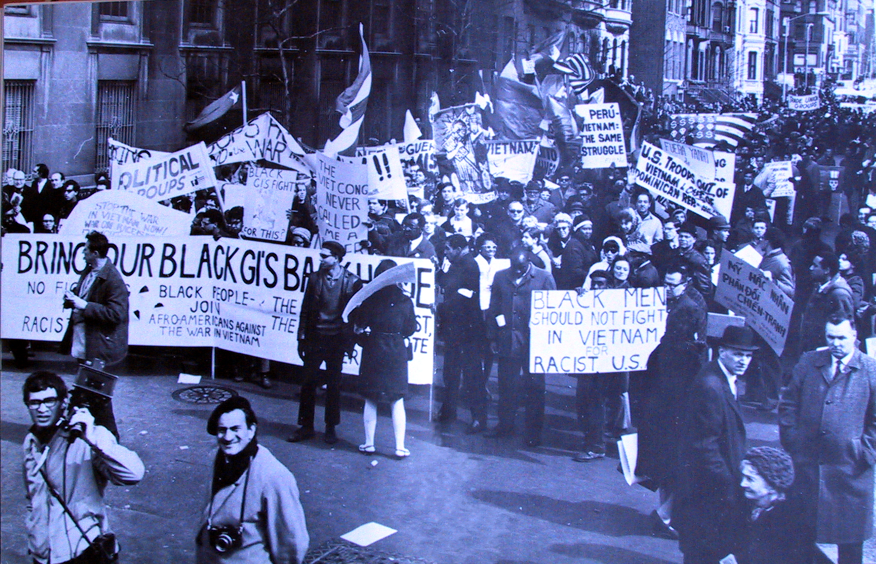

Slide 38
President Johnson: [Anti-war protesters] said give the money to poverty, and not Vietnam. And I think that’s hurting poverty more than anything in the world, is that these Commies are parading . . . and these kids with long-hairs . . . saying, you know, that they want poverty instead of Vietnam. And the Negroes. And I think that’s what people regard as the Great Society.
[Break.]
President Johnson: But in my judgment, the bigger request I make for poverty, the more danger it is being killed.

Slide 39
President Johnson: I don’t think they’re [Congress] just going to cut it; I think the same thing about [foreign] aid. I think if I ask for 2 billion or 3 billion for poverty, when I got 3 billion for jobs, and 24 billion [dollars] in other fields, I think they’d say, “Good God, it goes up: every time you get somebody a job, it costs you more.”
I think if we increase it a reasonable amount, that we have a much better chance of fighting and holding it [the administration request]. But I think that those boys over there [Shriver’s aides], who don’t know anything about legislative procedure, and these kids that give out these interviews—[Budget Director Charles] Schultze tells me that Shriver knows ‘em, but he doesn’t believe Shriver can control ‘em [his aides].
[Special Counsel] Harry [McPherson] tells me that he believes that other people in CAP [the Community Action Program] do this, and they override Shriver.

Slide 40


Slide 41
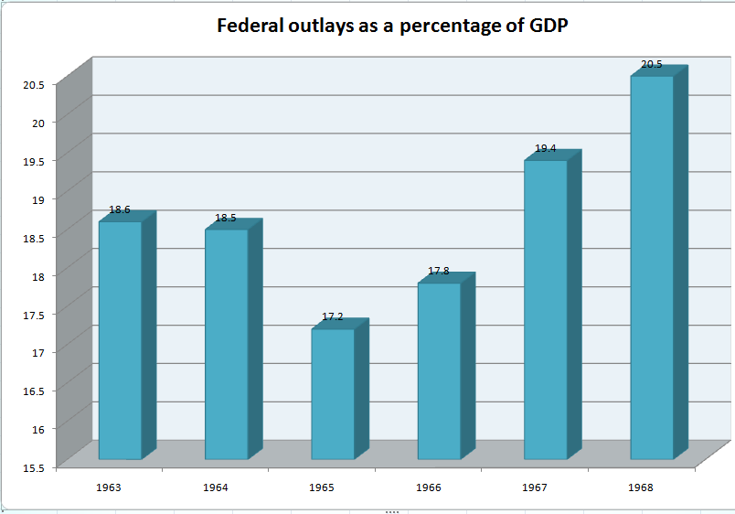

Slide 42
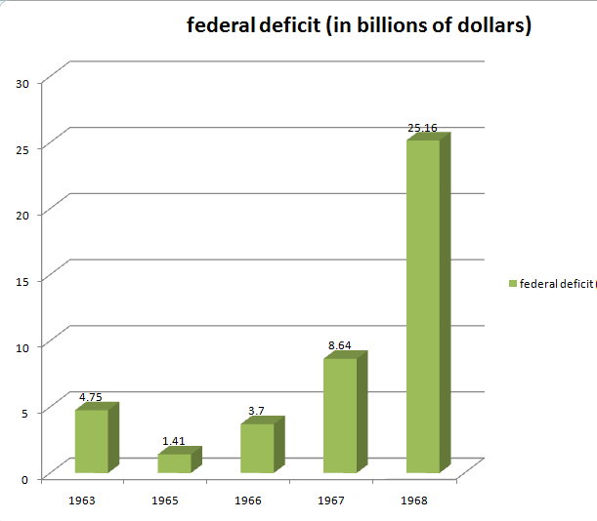

Slide 43
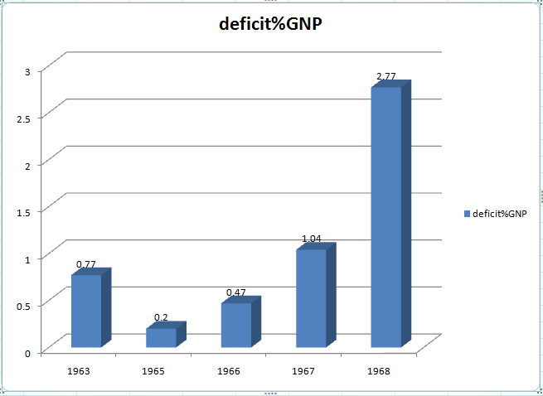

Slide 44
