Slide 1
Article I, Section 8 The Congress shall have Power: . . .
To regulate Commerce with foreign Nations, and among the several States, and with the Indian Tribes;
. . . To declare War, grant Letters of Marque and Reprisal, and make Rules concerning Captures on Land and Water;
To raise and support Armies, but no Appropriation of Money to that Use shall be for a longer Term than two Years;
To provide and maintain a Navy;
Article II, Section 2
[The President] shall have Power, by and with the Advice and Consent of the Senate, to make Treaties, provided two thirds of the Senators present concur;

Slide 2
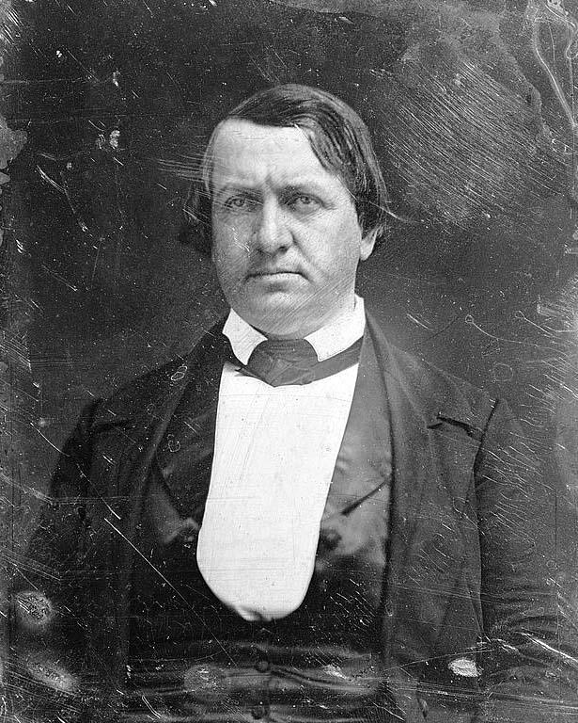

Slide 3
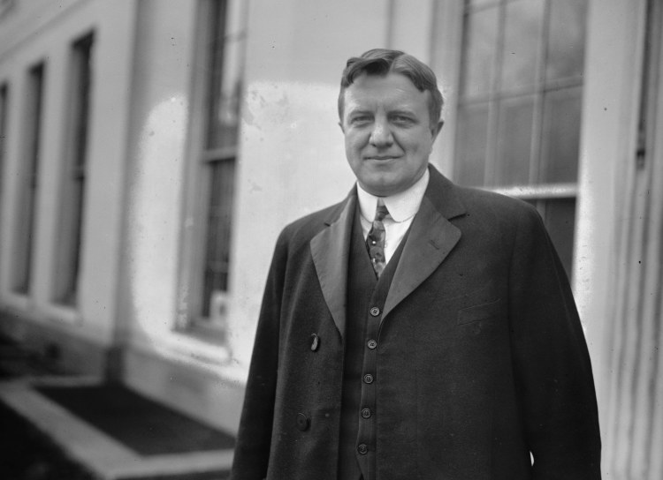

Slide 4
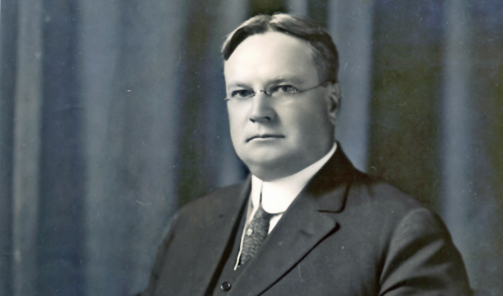

Slide 5
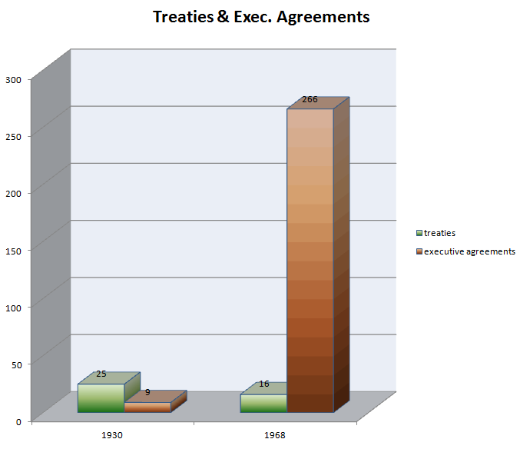

Slide 6


Slide 7
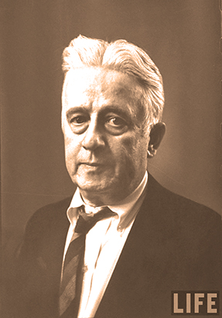

Slide 8


Slide 9
President Johnson: You want to know honestly how I feel?
Jack Brooks: Yeah.
President Johnson: I’m really humiliated that I’m President, and I’ve got a friendly [Democratic] Speaker, and I’ve got a friendly [Democratic] Majority Leader, and I’ve got a friendly [Texas congressman] Albert Thomas, I’ve got a friendly Jack Brooks, and Otto Passman is king. I think that’s disgraceful in this country.
Because I want to tell you when I see you the next time, confidentially—
Brooks: Mm-hmm.
President Johnson: —what we’re looking at in the world. And it’s a hell of a lot worse than it was last year. And you’re giving us 3 billion [dollars] to deal with, and you gave Kennedy 3.9 [billion dollars].
And I don’t think that’s fair, and I don’t think it’s right. I think it’s awful that a goddamned Cajun from the hills of Louisiana has got more power—
Brooks: He’s no Frenchman, though!
President Johnson: —has got more power than all of us. I just think that’s awful.
Brooks: Yes.

Slide 10
President Johnson: But that’s what you’ve got to do. And some day we’ll get our way, and if I ever walk up in the cold of night and a rattlesnake’s out there and about ready to get him, I ain’t going to pull him off—I’ll tell you that.
Brooks: No, I understand.
President Johnson: Now, you remember that.
Brooks: I want you to remember it. We’ve got some people from—
President Johnson: I remember it. Now, you just go and tell all these Texans that want to hit Russia that I want to put those sons of bitches in uniform.
Brooks: They ought to be.
President Johnson: Let ‘em go fight the Communists for a while. They like to talk a big game—
Brooks: Yeah.
President Johnson: —but they don’t want to do a damn thing about it.
Brooks: I’m with you.
President Johnson: OK.
Brooks: Good night. Bless your heart.

Slide 11
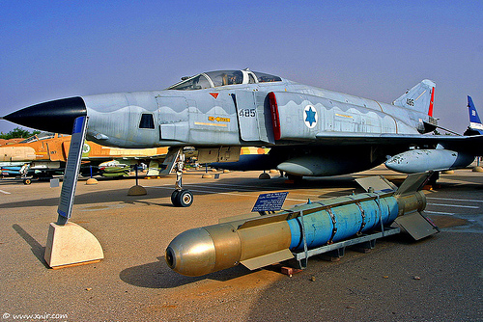

Slide 12
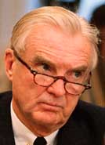

Slide 13
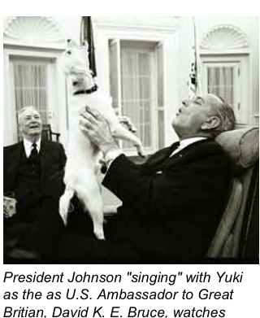

Slide 14
President Johnson: I’ve got to make a decision on those [Phantoms], and I want to make it as soon as—far enough ahead of time, before I go out [of office], not to be the last thing.
But I want the Russians to turn me down on disarmament. I’ve got a letter in his [Alexsey Kosygin’s] lap now.
And this idiot of a Symington has sent us word that if I don’t give Israel the Phantoms, that he’s going to kill our [foreign military] sale bill, where we can sell planes. If I don’t go ahead and give ‘em to ‘em [the Israelis].
And I can’t do it until Kosygin answers me. He’s not going to pee a drop with me: I know that. But I’ve got to have that behind me so I’ve got that as an excuse. [I can] say, “By God, I’ve tried everything. I tried a conference, I tried a proposal, I tried letters, I tried meetings, I pled with him. And finally he turned it down, and I just—there’s no other alternative. I have no course in the world except this.”
Abe Fortas: Yeah. That’s right.
President Johnson: And that’s what I’m trying to do.
Now, I never have told anybody I’m going to give ‘em to ‘em [the Israelis]. But I made up my mind a long time ago I was going to give ‘em to ‘em. But I’m not going to give ‘em to ‘em unless I can protect myself. I’m not going to be a goddamned arms merchant! I’m going to make them [the Soviets] to be the outlaws if I can.

Slide 15
Fortas: Sure. I think that’s very good.
President Johnson: Now, that’s what I’m trying to do.
And this little Effie [Ephraim Evron, minister in the Israeli embassy], is the only one I think in their organization that’s got sense enough to see it. He sees it all the time. He’s just as bright as that goddamned Yuki dog of mine. He catches everything that comes along without telling him. So he helps.
But Symington is just the biggest muddlehead I ever saw. I thought you and Clark Clifford could advise somebody. [teasingly] Are all of your clients muddleheads like me and Symington? [Fortas laughs heartily.] I don’t understand it.
Fortas: Well, Stuart is absolutely one. I don’t know—he’s just got . . . Hell, I don’t understand. Is this [issue] this fellow Salomon now?
President Johnson: No, no! [Sid] Salomon’s a smart cookie. He’s bound to have plenty of sense.
No, no. I think he [Symington] just wants to be head of the Israel—get credit for ‘em. And they think, you know—the ones that don’t know, think he ought to.

Slide 16
Foreign Aid Amendments
Symington amendment (1971, Pakistan)
Kennedy-Fraser amendments (1973-4, Chile)
Hughes-Ryan amendment (1974, intelligence oversight)
Eagleton amendment (1974, Turkey)
Nelson-Bingham amendment (1974, military sales)
Clark amendment (1976, Angola)
Koch amendment (1976, Uruguay)

Slide 17
Defense Appropriations Amendments
Mansfield amendment (1969-70, troops in Europe)
Byrd amendment (1971ff., Rhodesia)
Cooper-Church amendment (1971, Laos)
Cooper-Church amendment (1973, Cambodia)
Tunney amendment (1975, Angola)

Slide 18
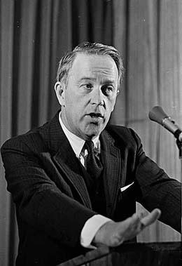
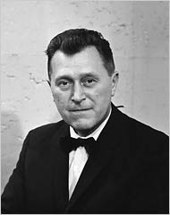

Slide 19
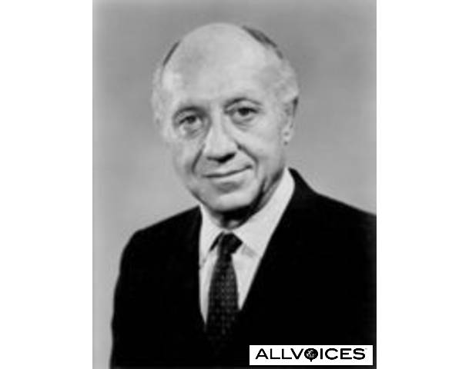

Slide 20
President Nixon: But it’s important to get across to them, Henry, and I hope you’ll talk to [New York senator Jacob] Javits and the rest of ‘em on this, even [Washington senator Henry] Jackson: by God, if the Jewish community in this country makes Israel exit permits the condition for the Russian initiative, listen, they’re going to be hurting. That will not work.
Henry Kissinger: [forcefully] Let’s face it: The emigration of Jews from the Soviet Union is not an objective of American foreign policy. And if they put Jews into gas chambers in the Soviet Union, it is not an American concern. It may be a humanitarian concern.
President Nixon: I know.
Kissinger: And . . .
President Nixon: Well, we can’t blow up the world because of it.
Kissinger: It’d be an outrage, but we cannot make out where gas chambers would go as far as I’m concerned.
President Nixon: I know.
Kissinger: There is no unrestricted right to emigration. If the Indians don’t let Farsis out, it would never occur to us to attach a rider to a foreign policy decision. And I think that the Jewish community in this country, on that issue, is behaving unconscionably. It’s behaving traitorously. I find—

Slide 21
President Nixon: Why can’t we get Jackson to get off of the damn thing? He feels it, though. He is. He’s close to the Jewish community; he’s close to the Israelis.
Kissinger: Although, I suppose—
President Nixon: Well, of course, he’s taken a lot of money from them, too.
Kissinger: Exactly. They’re financing his [presidential] campaign in ’76. But Javits . . . I’m going to have a talk with Javits, and I’m going to tell him that it is unconscionable for the Jewish community to . . .
President Nixon: You see, what they [the pro-Jewish emigration forces in Congress] will do is to work that way with the radical, the nuthead, basically the anti-semitic nutheads, say. Anti-communists in the Senate and the House—a lot of them are anti-semitic—who want to screw the Russians for other reasons. And between them . . . You know, we’ve got to get most-favored-nation [status for Russia, in trade relations], don’t we?
Kissinger: [forcefully] Mr. President, let’s face it: we have screwed Brezhnev.
I mean, you have outmaneuvered Brezhnev in a way that is almost pathetic.

Slide 22
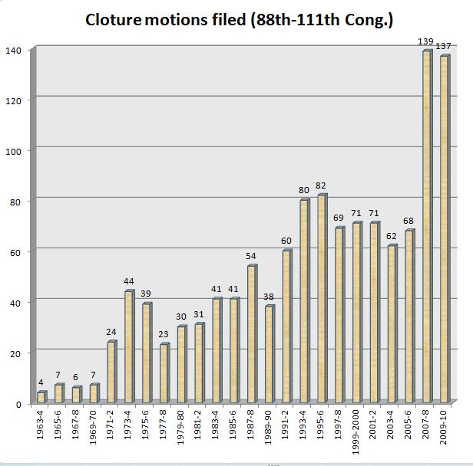

Slide 23
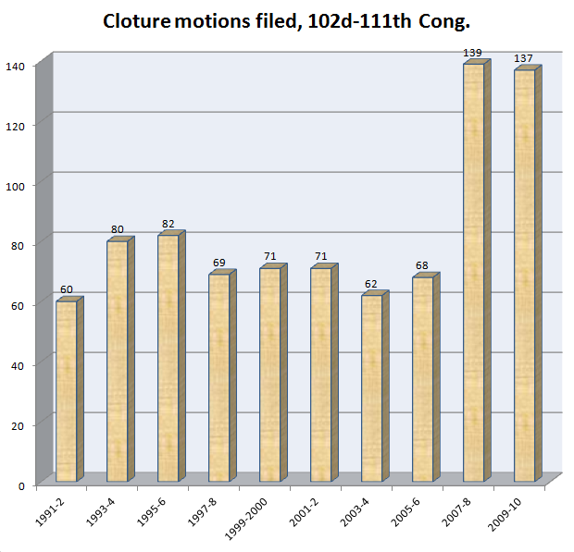

Slide 24
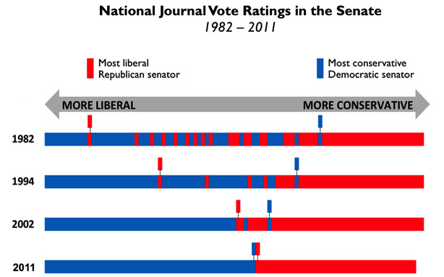

Slide 25
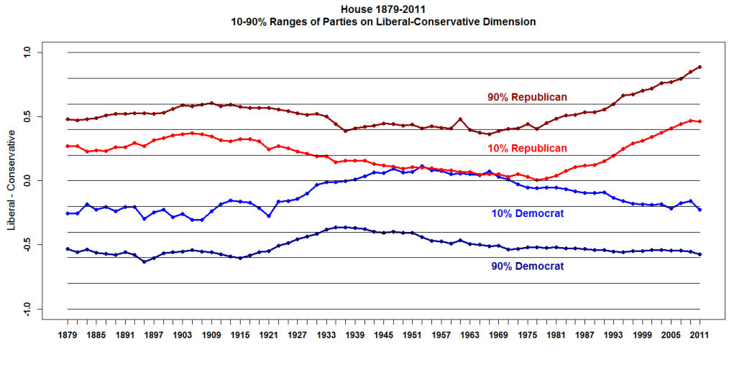
Keith Poole, @ http://voteview.com/blog/?p=349

Slide 26
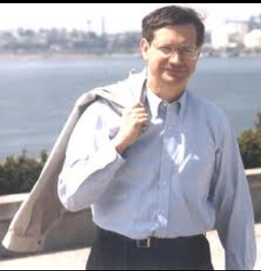

Slide 27
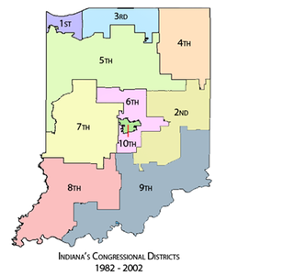

Slide 28
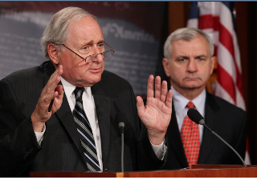

Slide 29
(D) the President should—
(i) expedite the transition of United States forces in Iraq to a limited presence and mission of training Iraqi security forces, providing logistic support of Iraqi security forces, protecting United States infrastructure and personnel, and participating in targeted counterterrorism activities;
(ii) after consultation with the Government of Iraq, begin the phased redeployment of United States forces from Iraq this year; and
(iii) submit to Congress a plan by the end of 2006 with estimated dates for the continued phased redeployment of United States forces from Iraq, with the understanding that unexpected contingencies may arise;
(2) during and after the phased redeployment of United States forces from Iraq, the United States will need to sustain a nonmilitary effort to actively support reconstruction, governance, and a durable political solution in Iraq; and
(3) the President should carefully assess the impact that ongoing United States military operations in Iraq are having on the capability of the United States Government to conduct an effective counterterrorism campaign to defeat the broader global terrorist networks that threaten the United States.

