Slide 1
Article I, Section 8 The Congress shall have Power: . . .
To regulate Commerce with foreign Nations, and among the several States, and with the Indian Tribes;
. . . To declare War, grant Letters of Marque and Reprisal, and make Rules concerning Captures on Land and Water;
To raise and support Armies, but no Appropriation of Money to that Use shall be for a longer Term than two Years;
To provide and maintain a Navy;
Article II, Section 2
[The President] shall have Power, by and with the Advice and Consent of the Senate, to make Treaties, provided two thirds of the Senators present concur;

Slide 2
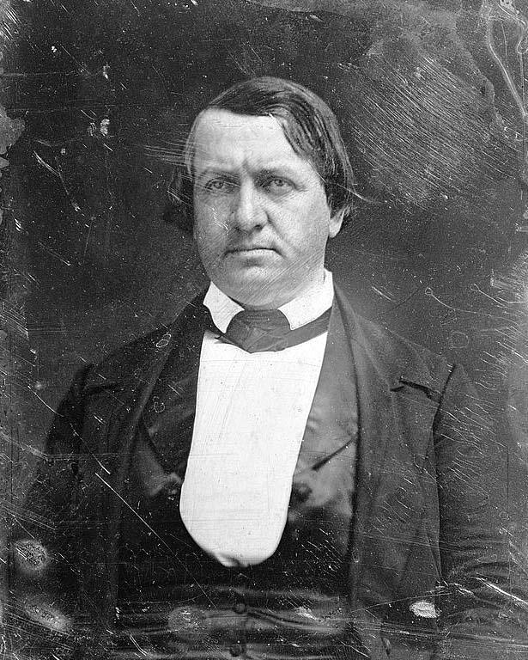

Slide 3
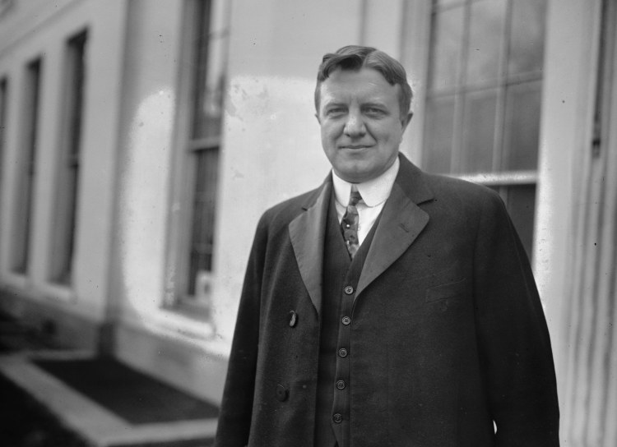

Slide 4
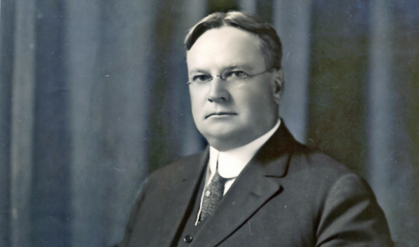

Slide 5
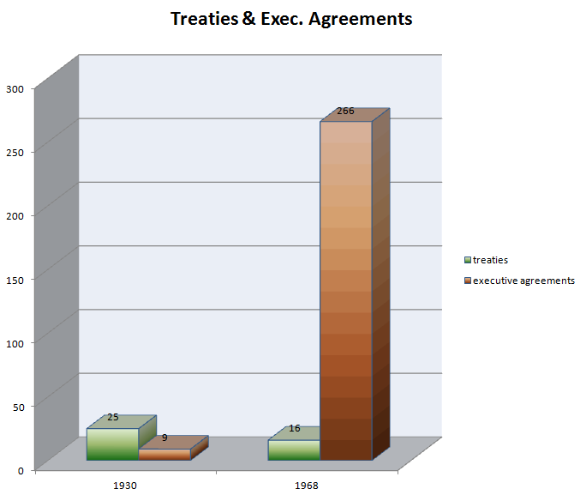

Slide 6


Slide 7
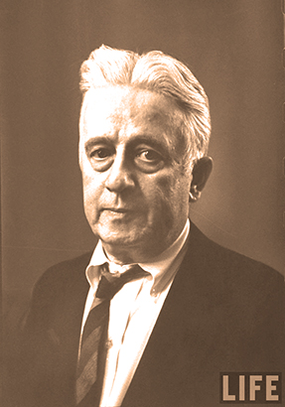

Slide 8


Slide 9
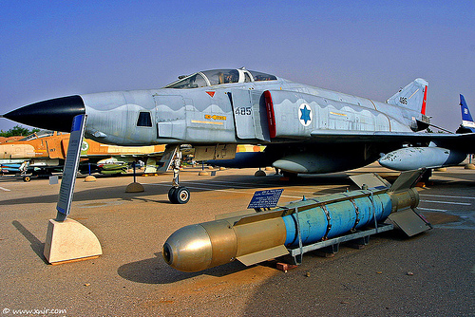

Slide 10
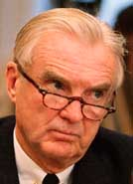

Slide 11
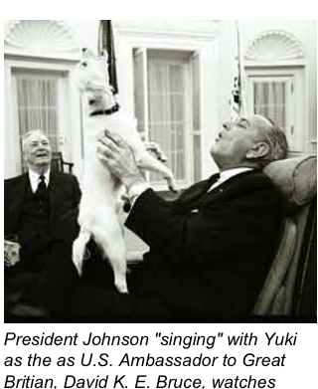

Slide 12
Foreign Aid Amendments
Symington amendment (1971, Pakistan)
Kennedy-Fraser amendments (1973-4, Chile)
Hughes-Ryan amendment (1974, intelligence oversight)
Eagleton amendment (1974, Turkey)
Nelson-Bingham amendment (1974, military sales)
Clark amendment (1976, Angola)
Koch amendment (1976, Uruguay)

Slide 13
Defense Appropriations Amendments
Mansfield amendment (1969-70, troops in Europe)
Byrd amendment (1971ff., Rhodesia)
Cooper-Church amendment (1971, Laos)
Cooper-Church amendment (1973, Cambodia)
Tunney amendment (1975, Angola)

Slide 14
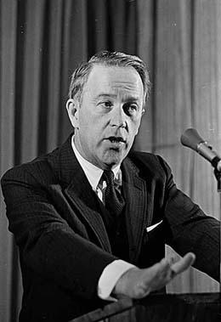
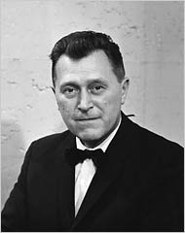

Slide 15
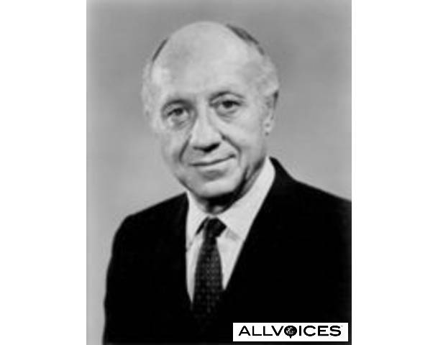

Slide 16
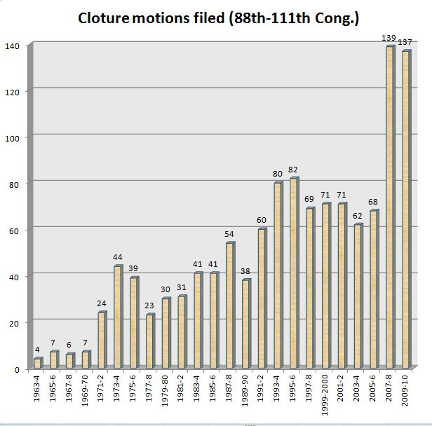

Slide 17
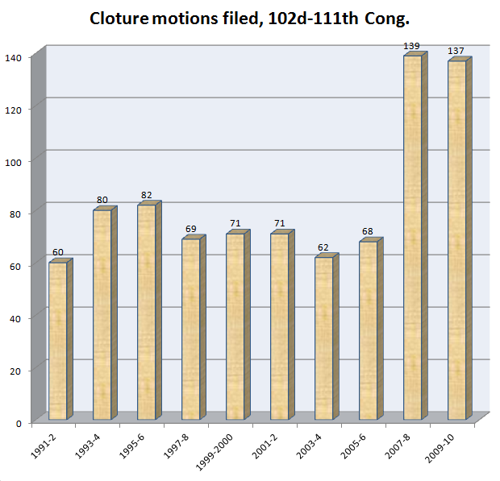

Slide 18
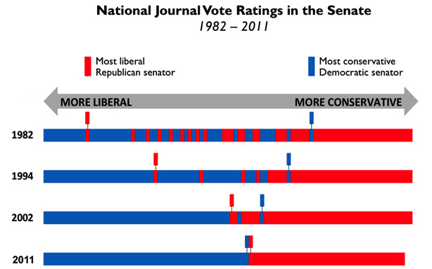

Slide 19
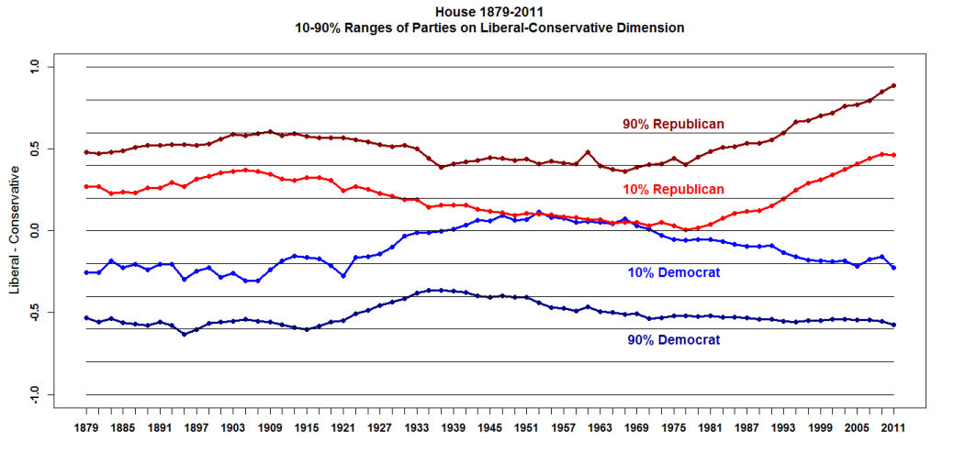
Keith Poole, @ http://voteview.com/blog/?p=349

Slide 20


Slide 21
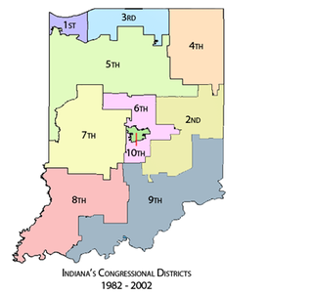

Slide 22
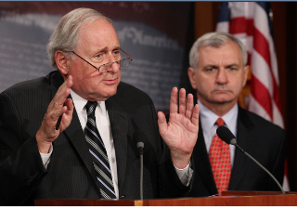

Slide 23
(D) the President should—
(i) expedite the transition of United States forces in Iraq to a limited presence and mission of training Iraqi security forces, providing logistic support of Iraqi security forces, protecting United States infrastructure and personnel, and participating in targeted counterterrorism activities;
(ii) after consultation with the Government of Iraq, begin the phased redeployment of United States forces from Iraq this year; and
(iii) submit to Congress a plan by the end of 2006 with estimated dates for the continued phased redeployment of United States forces from Iraq, with the understanding that unexpected contingencies may arise;
(2) during and after the phased redeployment of United States forces from Iraq, the United States will need to sustain a nonmilitary effort to actively support reconstruction, governance, and a durable political solution in Iraq; and
(3) the President should carefully assess the impact that ongoing United States military operations in Iraq are having on the capability of the United States Government to conduct an effective counterterrorism campaign to defeat the broader global terrorist networks that threaten the United States.

