Slide 1
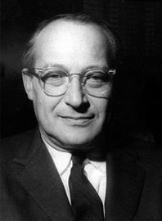
Notes:
rostow

Slide 2
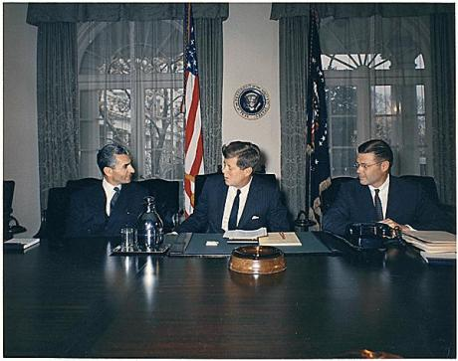

Slide 3
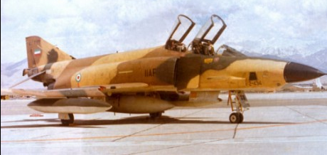
Notes:
RF-4

Slide 4
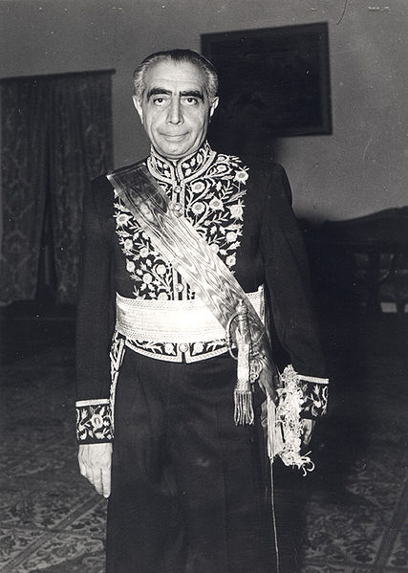
Notes:
Ali amini

Slide 5
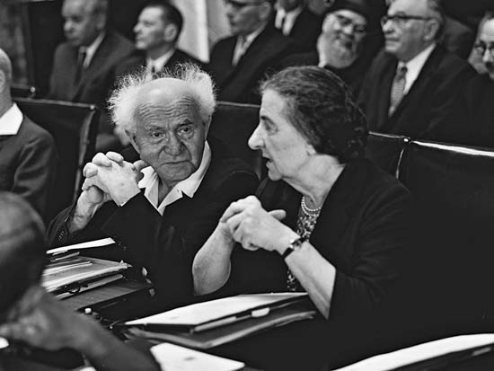

Slide 6
Wm. Bundy memo, 16 July 1962
The Joint Chiefs of Staff appraisal is inclosed. In summary, the Department of Defense views are:
Israel is vulnerable to UAR air attack and is becoming increasingly so with the arrival of additional Soviet TU-16's.
(b) The addition of the Hawk missile within Israel's air defense system would fill an important gap in their defense.
(c) Acquisition of the Hawk missile system by Israel would not alone act to shift the balance of military power between Israel and its neighbors.

Slide 7
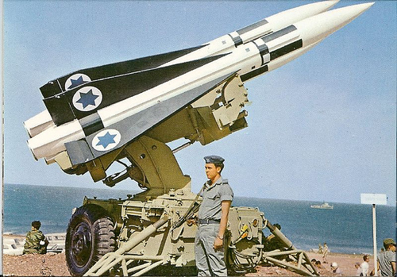
Notes:
Hawk missiles

Slide 8


Slide 9
US aid to Israel, Eisenhower & Kennedy administrations
 | Total | Military aid | Economic aid | Food for Peace
1954 | 74.7M | 0 | 54M | 20.7M
1955 | 52.7M | 0 | 41.5M | 11.2M
1956 | 50.8M | 0 | 24M | 26.8M
1957 | 40.9M | 0 | 26.8M | 14.1M
1958 | 61.2M | 0 | 24M | 37.2M
1959 | 50.3M | .4M | 19.2M | 30.7M
1960 | 55.7M | .5M | 23.9M | 31.3M
1961 | 45.1M | 0 | 24.5M | 23.6M
1962 | 83.9M | 13.2M | 45.4M | 25.3M
1963 | 76.7M | 13.3M | 45M | 18.4M

Slide 10
White House counselor Mike Feldman: As I said in my cable, the only time that I mentioned numbers was when they said, “We think they’ll [the Palestinian refugees] all take repatriation because of the pressures brought on them.” And I said, “This isn’t our own analysis. Our own analysis would indicate they don’t endanger your security.” And they said, “Well, what do you mean by that?”
I said, “Well, from the conversations that Dr. [Joseph] Johnson has had and from indications we’ve had from other people, it’s our best guess that not more than one in ten [refugees] would take repatriation,” and they accepted that. That’s all.
President Kennedy: What did they figure? It’s like a Negro wanting to go back to Mississippi, isn’t it? Or is that . . .
Feldman: It’s different because it’s as if the dominant doctrine were Black Muslim doctrine in a sense . . . [Laughs.]
President Kennedy: [Unclear.] Well, the whole question really is how much economic value they can get without [going back] . . . It’s quite a different thing to say that you want to go back as the only means of getting compensated . . . that you can get compensation without going back.
Of course, they both have a different view, don’t they? Nasser will think they [Palestinian refugees] all want to go back. He doesn’t think the Israelis will take them, so he thinks it’s going to collapse. The Israelis are . . .
Ass’t Secretary of State Robert Strong: They place a great deal of stress on the arguments that I made about—concerning the disincentives to going back.
Notes:
Ag 27 1962

Slide 11
President Kennedy: Yeah, but aren’t they . . . Isn’t one group going to be horribly disappointed, either the Israelis—
Strong: Yeah.
President Kennedy: —by a lot more than one out of ten coming back, or the Arabs when only one out of ten want to go back? Isn’t it going to blow up, then, the plan when this fact becomes a pattern?
Strong: I would think that’s a fair assumption.
National Security Advisor McGeorge Bundy: The problem is—and what I’d like Mr. Strong’s reaction on is whether—to what degree Nasser could stand still in the face of propaganda about repatriation from all the other Arabs. Was he saying, “I’m not going to start something but I’m not going to be caught in a non-Arab position here?” Or how do you interpret his position on that?
Strong: Well, this is a little hard to be certain of. All that I think we can conclude is that the—there was no turndown, that Nasser did state that he had been under attack from the Arabs and did not intend to change his policy nor to respond to such attacks—
President Kennedy: That’s sort of a self-serving statement. Has he really been under attack?
Strong: Yes, quite serious attack from the Saudis, and the Jordanians, and from the Syrians.
Feldman: Of course, this is about the only counterattack that these other countries have been able to devise yet, that we have seen, in response to the threat of Arab socialism that he [Nasser] has put forward as an ideal for the other Arab countries.

Slide 12
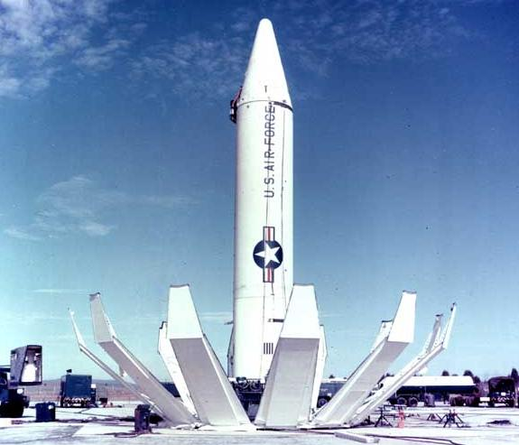
Notes:
jupiter

Slide 13
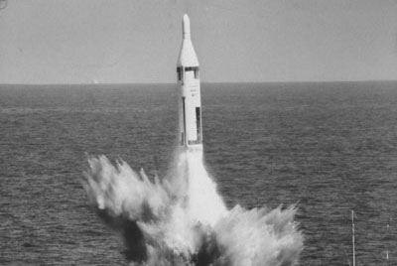
Notes:
polaris

Slide 14


Slide 15


Slide 16


Slide 17


Slide 18
Undersecretary of State George Ball: . . . Turkey creates more of a problem. We would have to work it out with the Turks on the basis of putting a Polaris in the water, and even that might not be enough, according to the judgments that we’ve had on the spot. We’ve got one paper on it already and we’re having more work done right now. It is a complicated problem because these [Jupiter missiles] were put in under a NATO decision and to the extent that they really now are . . .
Undersecretary of Defense Paul Nitze: The NATO requirement involves the whole question of whether we are going to denuclearize NATO. I would suggest that what you do is to say that we’re prepared only to discuss Cuba at this time. After the Cuban thing is settled and these things are out, we’re prepared to discuss anything.
President Kennedy: No, I don’t think we can . . .
How much negotiations have we had with the Turks this week? Who’s done it?
Unidentified: No, we have not.
Secretary of State Dean Rusk: We haven’t talked with the Turks. The Turks have talked with us.
President Kennedy: Where have they talked with us?
Rusk: In NATO.
President Kennedy: Yeah, but have we gone to the Turkish government before this came out this week? I’ve talked about it now [in ExComm meetings] for a week. Have we had any conversations in Turkey, with the Turks?

Slide 19
Rusk: Well, we’ve asked [US ambassador to Italy Thomas] Finletter and [US ambassador to Turkey Douglas] Hare to give us their judgments on it. We’ve not actually talked with the Turks.
Ball: We did it on a basis where, if we talked to the Turks, I mean, this would be an extremely unsettling business.
President Kennedy: Well, this is unsettling now, George, because he’s [Khrushchev’s] got us in a pretty good spot here. Because most people would regard this as not an unreasonable proposal, I’ll just tell you that. In fact, in many ways—
National Security Advisor McGeorge Bundy: But what “most people,” Mr. President?
President Kennedy: I think you’re going to have it very difficult to explain why we are going to take hostile military action in Cuba, against these sites, which is what we’re thinking about, when he’s [Khrushchev’s] saying, “If you’ll get yours out of Turkey, we’ll get ours out of Cuba.” I think you’ve got a very touchy point here . . .
Bundy: It isn’t as if we’d got the [Jupiter] missiles out, Mr. President. It would be different. Or if we had any understanding with the Turks that they ought to come out, it would be different. Neither of these is the case.

Slide 20
President Kennedy: I’d just like to know how much we’ve done about it; because, as I say, we talked about it—
Bundy: We decided not to, Mr. President. We decided not to play this directly with the Turks.
Rusk: Our own representative is—
Ball: If we talked to the Turks, they would bring it up in NATO. This thing would be all over Western Europe, and our position would have been undermined.
Bundy: That’s right.
Ball: Because immediately the Soviet Union would know that this thing was being discussed. The Turks feel very strongly about this. We persuaded them that this [stationing of missiles, in 1959] was an essential requirement, and they feel that it’s a matter of prestige and a matter of real—
Bundy: If we had talked to the Turks, it would already be clear that we were trying to sell our allies for our interests. That would be the view in all of NATO. Now, that’s irrational and it’s crazy, but it’s a terribly powerful fact.
Former ambassador to the USSR Tommy Thompson: Particularly in the case that this is a [Soviet] message to you and to [UN General Secretary] U Thant.

Slide 21
Ass’t Secretary of State U. Alexis Johnson: It seems to me we ought to get word to [UN ambassador Adlai] Stevenson that, if this is put out up there, he should immediately saw we will not discuss this question of the Turkish bases.
Bundy: The problem is Cuba. The Turks are not a threat to the peace. Nobody tells the Turks as—
President Kennedy: I think it would be better, rather than saying that, until we get some time to think about it, just saying: “Well, the fact of the matter is that we received a letter last night from Khrushchev and it’s an entirely different proposal.” So, therefore, we first ought to get clarification from the Soviet Union of what they’re talking, at least to give us a . . .
As I say, you’re going to find a lot of people who will find this is a rather reasonable position.
Bundy: That’s true.
President Kennedy: Let’s not kid ourselves.

Slide 22
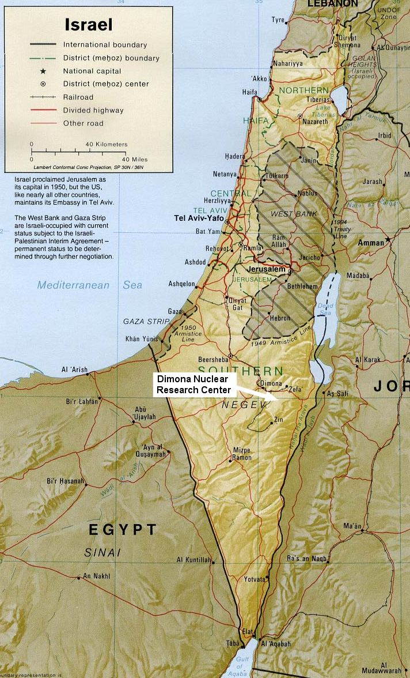

Slide 23
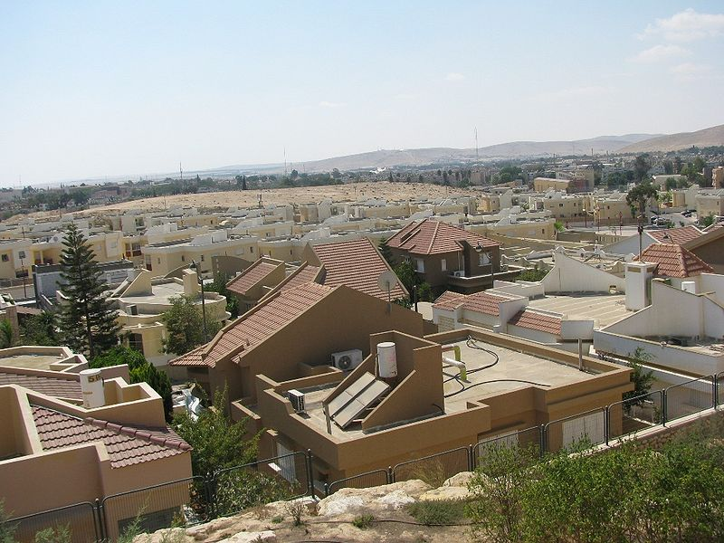

Slide 24
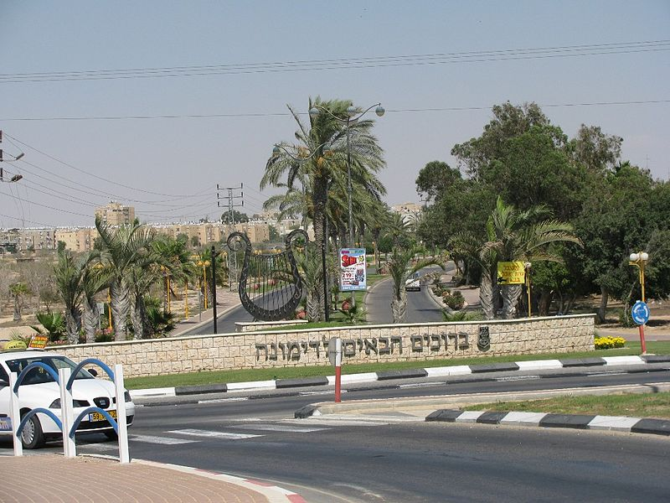

Slide 25
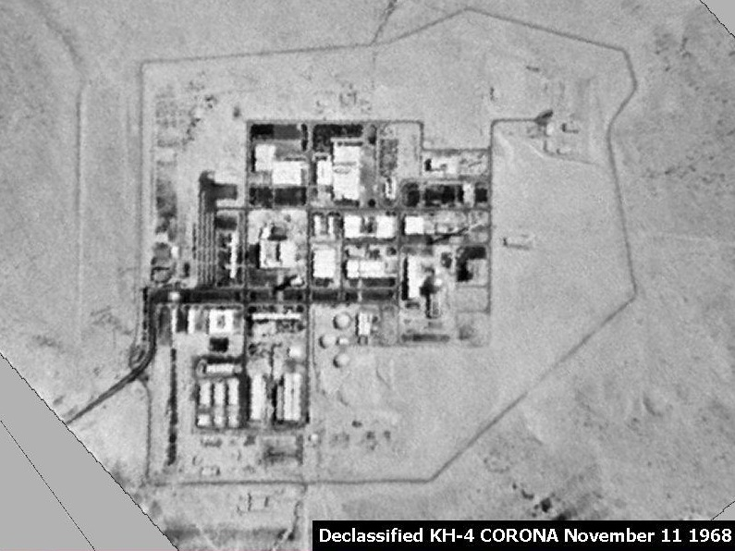

Slide 26
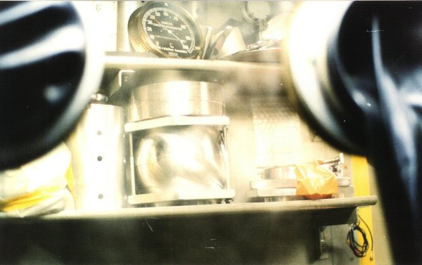
Notes:
Mordechai Vanunu bomb components

Slide 27
President Kennedy: My God, we wouldn’t continue our guarantee of [West] Germany if they started manufacturing nuclear weapons, which is really of vital importance to us compared to our position in Israel. Why should we guarantee Israel if they’re doing it? That’s . . .
Secretary of State Dean Rusk: A nuclear weapon explosion in Israel would drive the Arab world right into the Soviet arms. I can’t see that happening any other [way].
President Kennedy: It seems to me that if you’ve got this thing in there—a country, after all, who has received a good deal of assistance from us.
Is it fair to say the main source of foreign income is the United States?
Rusk: Without any question.
President Kennedy: Therefore, for them to do it—after all, they’re regarded as a very close associate of [ours], and a country which has been most recently the subject of a guarantee, of a commitment, by the President at a press conference—for there to be any question that this nation may be manufacturing nuclear weapons, and for this country, the United States, not to be concerned of that, places in my opinion, and the opinion of America, as well in the entire West—
Rusk: [Unclear] Middle East.
President Kennedy: If this should become public—we don’t want to sound threatening, but that’s the fact of the matter—it’s bound to have, I think, most adverse effects.
Rusk: [Unclear] lack of will.
Notes:
17 May 63

Slide 28
President Kennedy: And I think if he [Ben Gurion] doesn’t do it [agree to U.S. inspections] then, we ought to leak it out to some paper that there’s a suspicion they won’t permit inspections, and all the rest.
Because I think, for them, the damage is just . . .
I mean, not only were they allowed to get the thing [nuclear weapon] themselves; it could encourage and stimulate them [the Arabs] to launch a military action before your [Israeli] program is completed.
So, therefore, it increases the dangers of war, and we’re quite obviously involved.

Slide 29
Kennedy Letter to Ben Gurion, 18 May 1963
… The dangers in the proliferation of national nuclear weapons systems are so obvious that I am sure I need not repeat them here. It is because of our preoccupation with this problem that my Government has sought to arrange with you for periodic visits to Dimona . . .
We are concerned with the disturbing effects on world stability which would accompany the development of a nuclear weapons capability by Israel. I cannot imagine that the Arabs would refrain from turning to the Soviet Union for assistance if Israel were to develop a nuclear weapons capability--with all the consequences this would hold. But the problem is much larger than its impact on the Middle East. Development of a nuclear weapons capability by Israel would almost certainly lead other larger countries, that have so far refrained from such development, to feel that they must follow suit.
I can well appreciate your concern for developments in the UAR. But I see no present or imminent nuclear threat to Israel from there. I am assured that our intelligence on this question is good and that the Egyptians do not presently have any installation comparable to Dimona, nor any facilities potentially capable of nuclear weapons production . . .
I trust this message will convey the sense of urgency and the perspective in which I view your Government's early assent to the proposal first put to you by Ambassador Barbour on April 2.

Slide 30
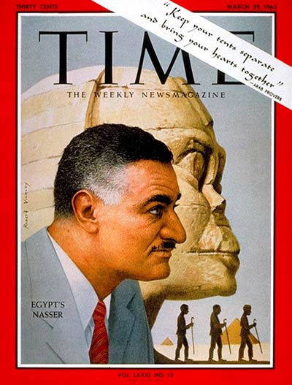

Slide 31
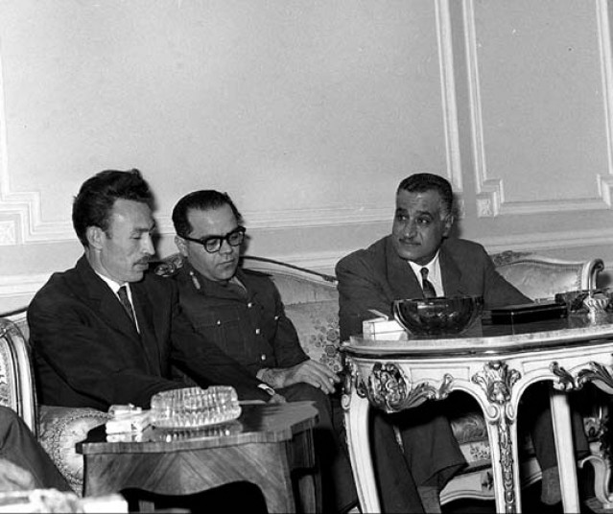
Notes:
w/ presidents of algeria, syria at cairo summit, 1963

Slide 32
President Kennedy: So let’s see what kind of a message we can get out to them, which carries some force to them, as if our concern is not totally the Israelis. It may be that we’ll want to come out with some sort of a guarantee next week, or reinforcement of the Tripartite [Agreement, between Britain, France, and the US]. But we want it to be understood in advance that it’s not just because of our concern about Israel.
Really our concern is mutual, because the peril is mutual—that the Israelis will move in a preemptive way at a time when they have the power; [and] that therefore, the fellow who’s really in more trouble is Nasser, not so much the Israelis. We would certainly want to get that point [across]—that that’s the way it looks to us, and that therefore any Tripartite guarantee would at least carry with it an appearance of, as I said, mutuality.
Now, the other thing is what we can do about the Jordanians—what we ought to try to do with the British. I think we ought to encourage the British to be more ready to move under some conditions. After all, this has been their traditional area: we’re not supposed to do everything.
So let’s get [British ambassador to the US] David Ormsby-Gore—
George Ball: I talked to David already this morning, and told him we’d [unclear], so I’ll get moving—
President Kennedy: Well, I think we can say that we could visualize a situation where we’d have to have somebody move in. it seems to me it ought to be the British.

Slide 33
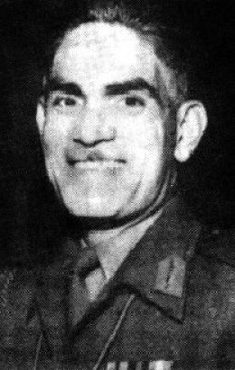

Slide 34
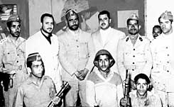
Notes:
Yemen oct 62 coup

Slide 35
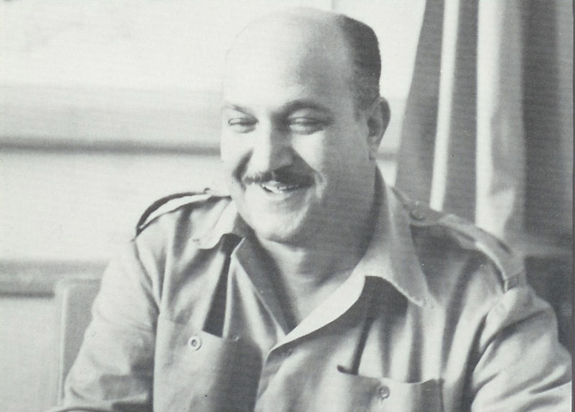
Notes:
Col hassan ali kamal—head of egy forces in yemen

Slide 36
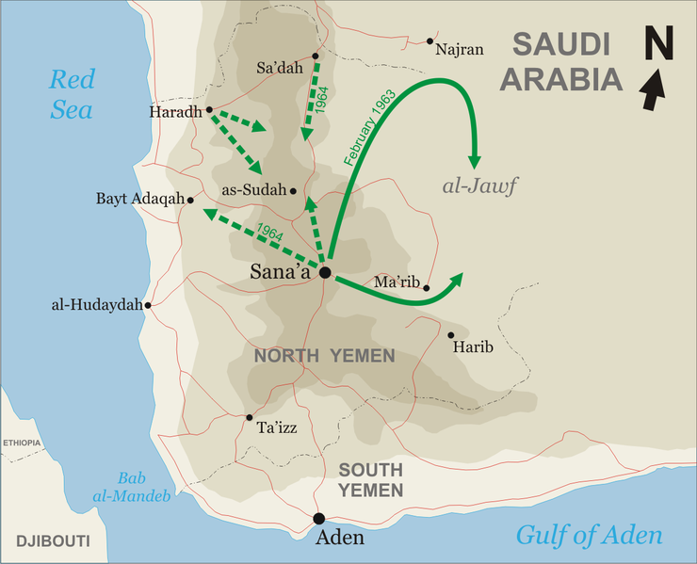

Slide 37
Ass’t Secretary of State Phillip Talbot: Mr. President, the problem, I think, remains, as it has been till now, which is how to get this disengagement started. The tension is growing very considerably; that letter [King] Faisal sent to you showed a man in a box, and feeling very strongly that he’s in a box—not only because of Yemen but because of the change [in government] in Iraq.
And this is a matter of concern to all of us, I think. We come at a time when the Soviets have had perhaps the most stunning defeat in recent years in the Middle East, and we assume that this means they will now shift to somewhat riskier efforts than they may have been prepared to do before they lost this major investment in Iraq. That both the Soviets and the UAR do have [unclear]. And it is important even more now to get this thing [in Yemen] moving as rapidly as we can.
The UAR, after a period of stalemate, has started a major drive to mop up in the Yemen [situation]. Nasser explained this to our ambassador, [John] Badeau, yesterday as an effort (which he, of course, said would be successful in a matter of two of three weeks) to interdict the Saudi supply lines going into the area. You know—

Slide 38
President Kennedy: So how far away from the border are they [the Egyptian forces]?
Talbot: Well, at the moment they’re some miles from the border; presumably, he’d come within two or three miles of the border in this process of moving forces up against the Najran supply base. (The Najran supply base is a Saudi base probably five miles outside the border, although this is a little in depth area through here.) And there will be more Egyptian military activity near Saudi Arabia in the next two or three weeks than there has been till now.
I think an awareness of this has disturbed Faisal; and our information today is that he is rather deeply depressed, and so are the [Yemeni] royalists, by these new attacks.

