Slide 1
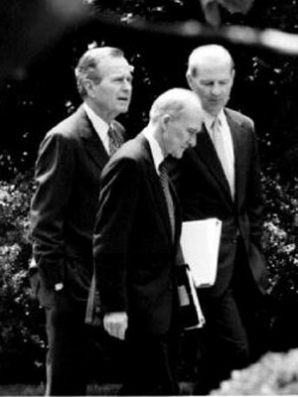

Slide 2
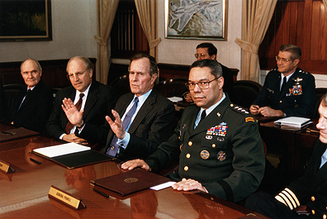

Slide 3
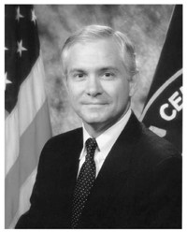

Slide 4
National Security Directive (NSD) 26
Access to Persian Gulf oil and the security of key friendly states in the area are vital to US national security. The United States remains committed to defend its vital interests in the region, if necessary and appropriate through the use of US military force, against the Soviet Union or any other regional power with interests inimical to our own. The United States also remains committed to support the individual and collective self-defense of friendly countries in the area to enable them to play a more active role in their own defense and thereby reduce the necessity for unilateral US military intervention.

Slide 5
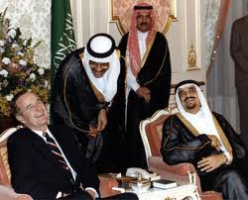

Slide 6
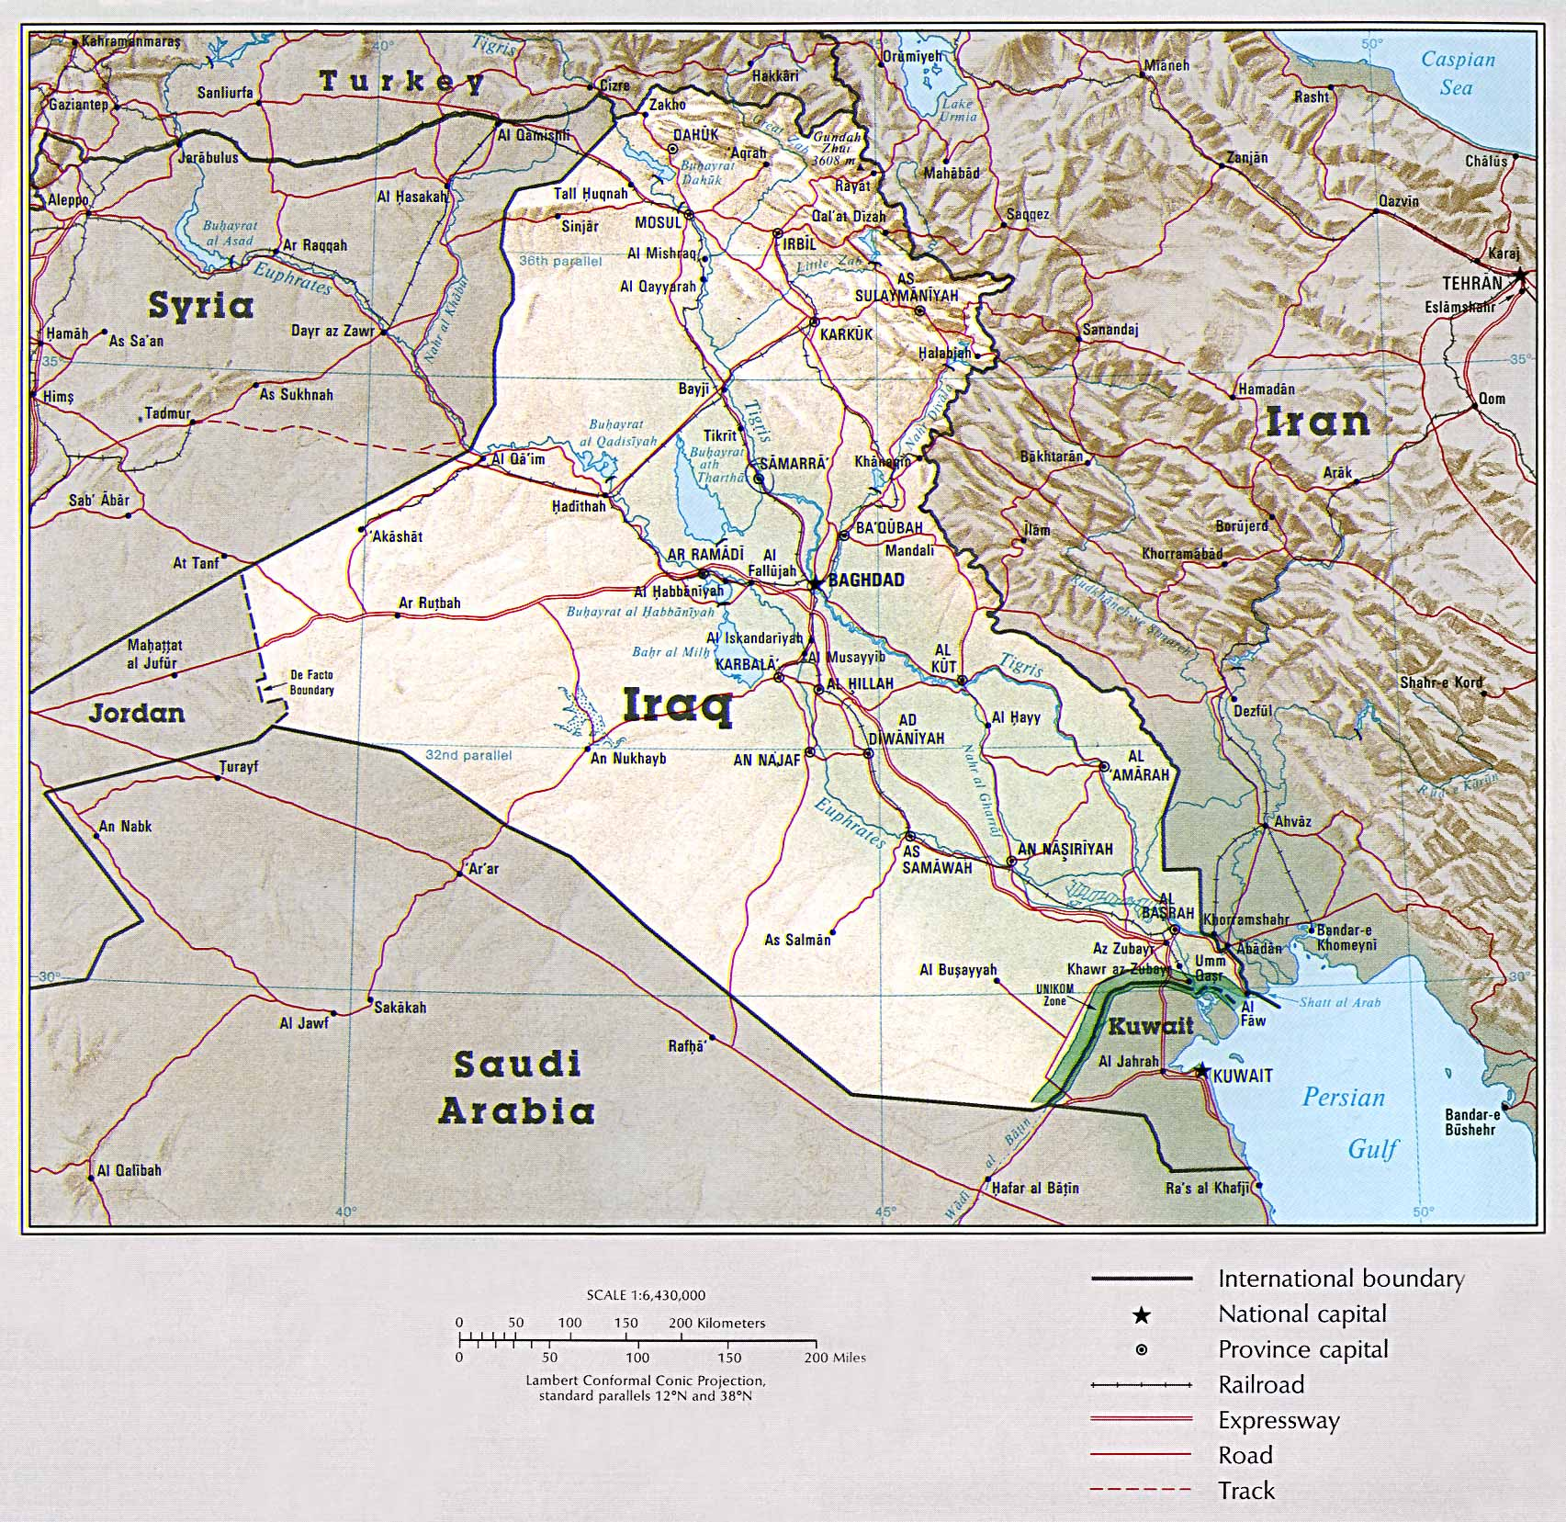

Slide 7
NSD 26—on Iraq
Normal relations between the US and Iraq would serve our longer-term interests and promote stability in both the Gulf and the Middle East. The United States government should propose economic and political incentives for Iraq to moderate its behavior and to increase our influence with Iraq.
But also:
Iraq would face economic and political sanctions if it continued to pursue biological and chemical weapons, and any breach by Iraq of IAEA safeguards in its nuclear program will result in a similar response.

Slide 8
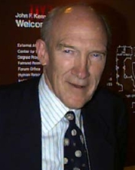
“Mr. President, I can see that what you have here isn’t really a policy problem; what you have is a public relations problem. You’ve got a problem with the haughty and pampered press. I know all about that, because I’ve got problems with the press back home. What you need is you need a good public relations person.”

Slide 9
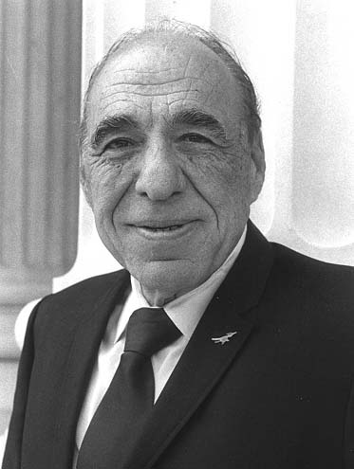

Slide 10
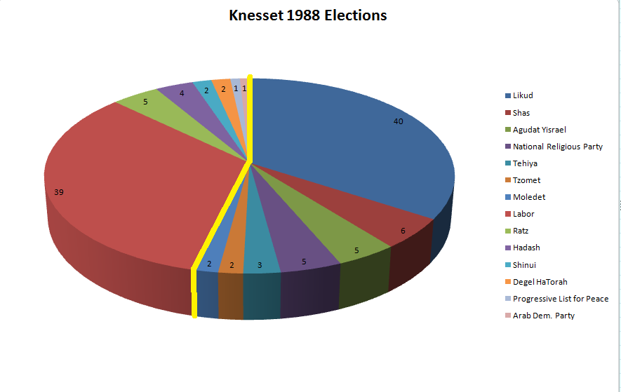

Slide 11
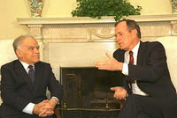

Slide 12
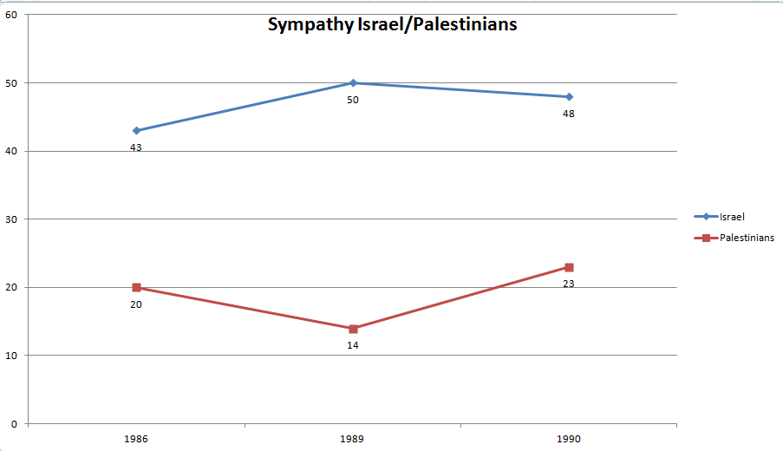

Slide 13
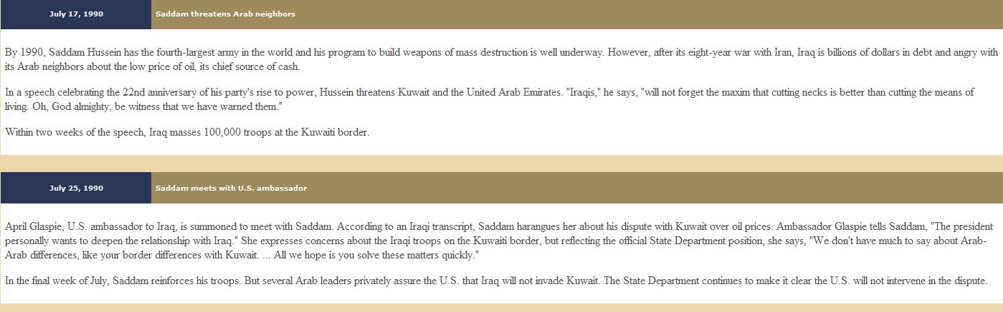

Slide 14
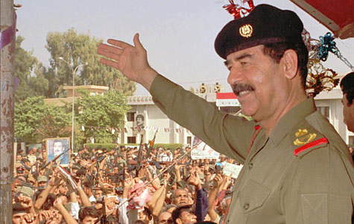

Slide 15
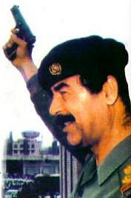

Slide 16
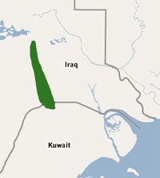
Notes:
Rumallah oil field

Slide 17
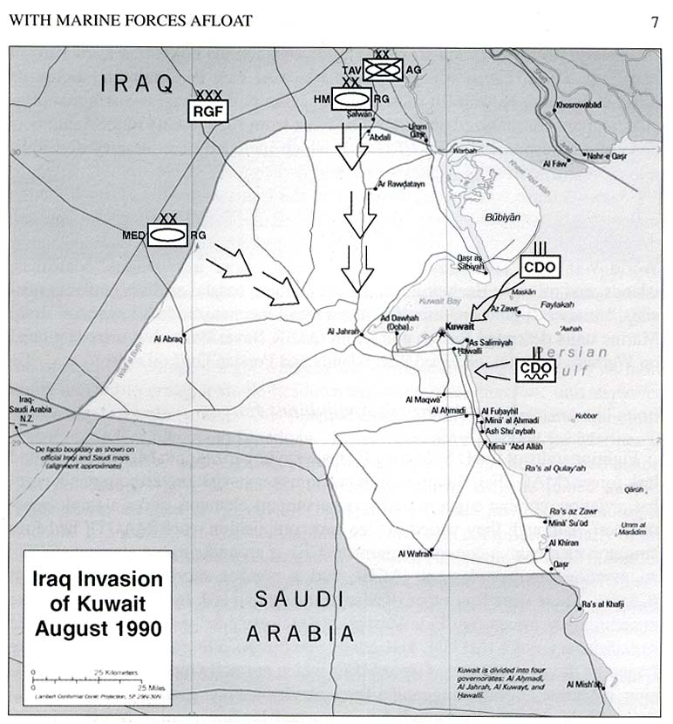

Slide 18
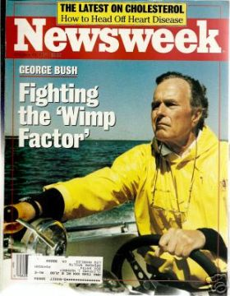

Slide 19
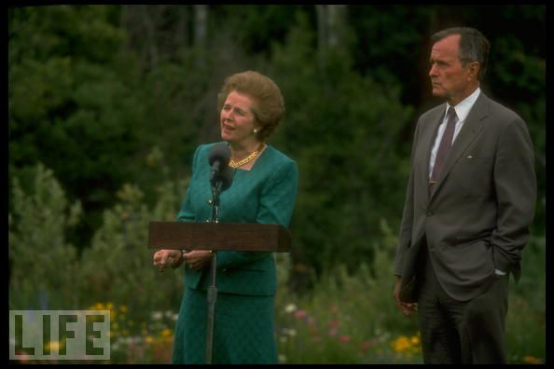

Slide 20
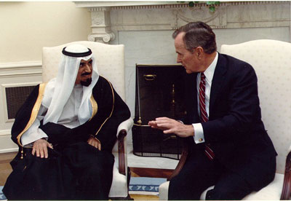
Notes:
Bush and emir of kuwait

Slide 21
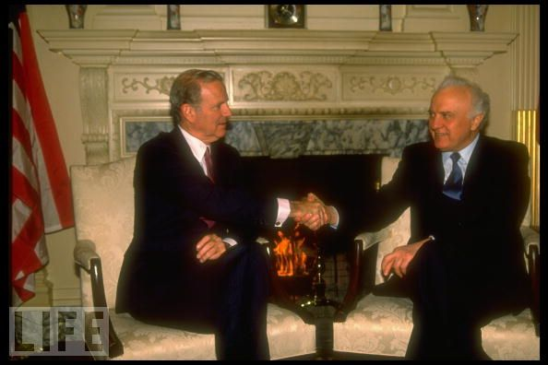

Slide 22
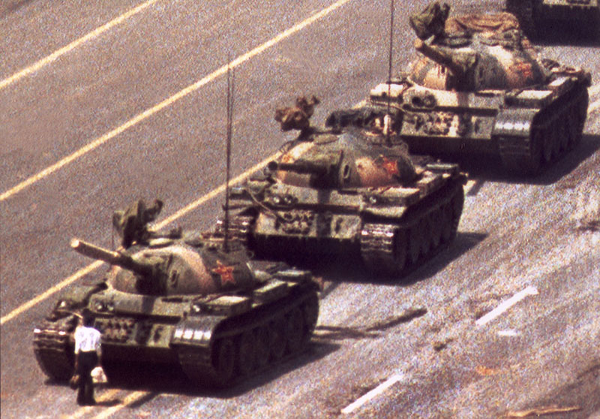

Slide 23
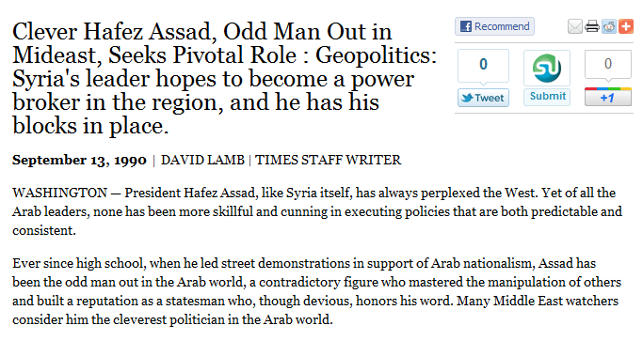

Slide 24
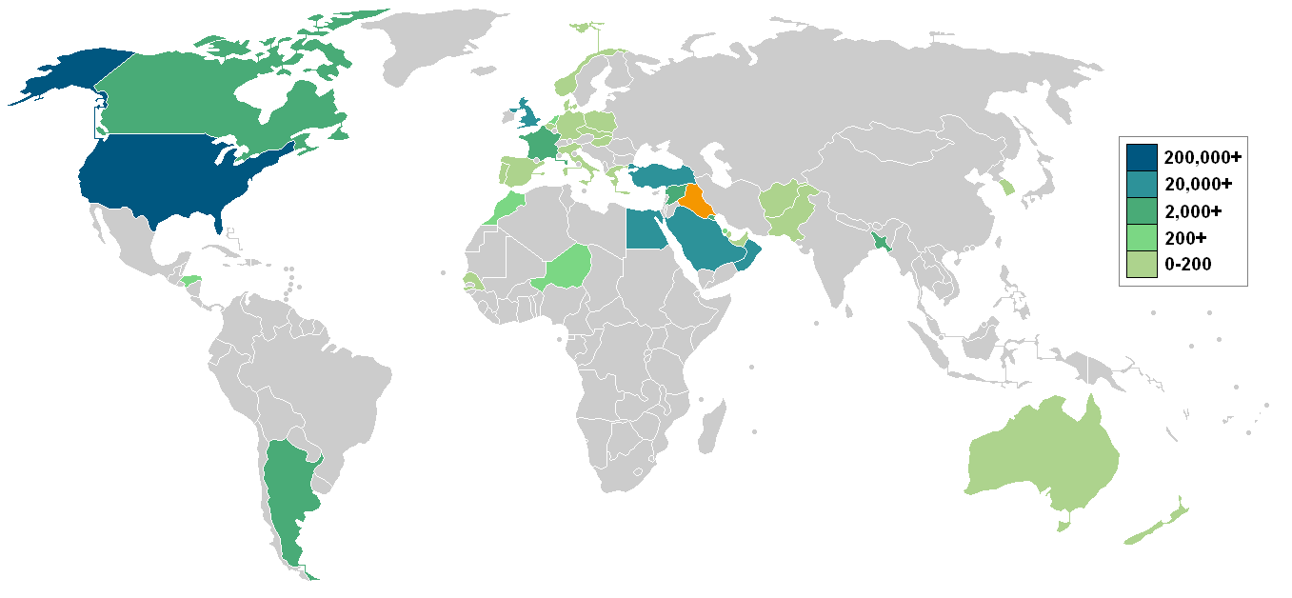

Slide 25
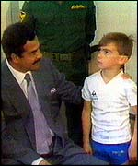

Slide 26
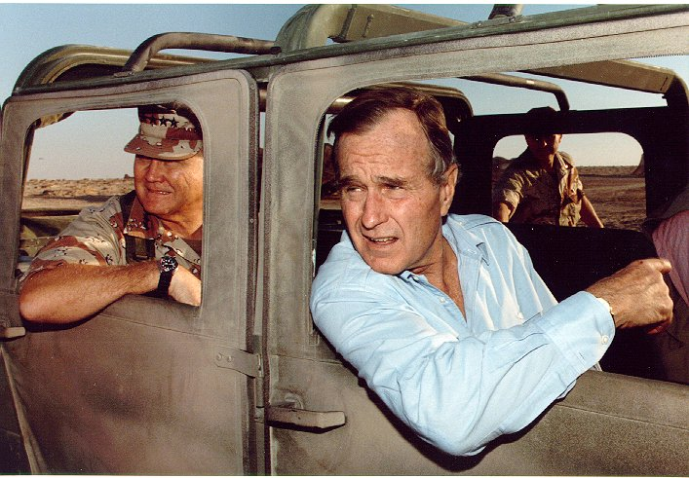

Slide 27
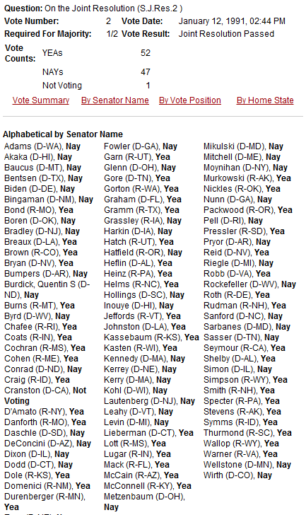

Slide 28
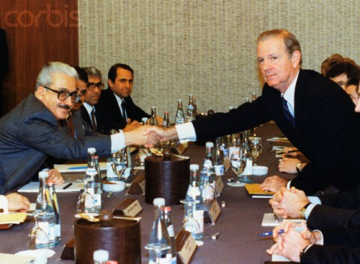

Slide 29
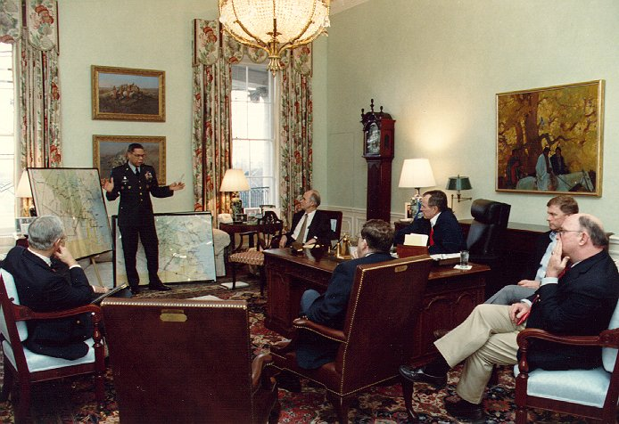

Slide 30
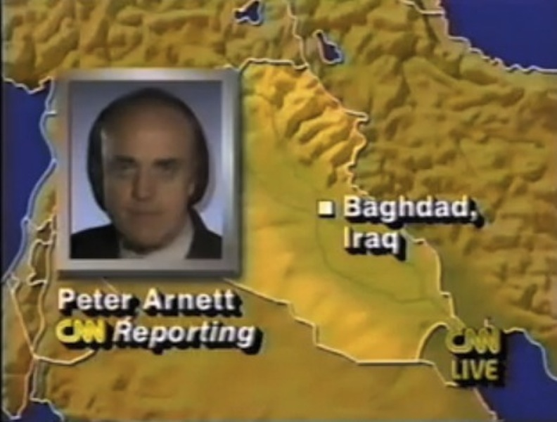

Slide 31
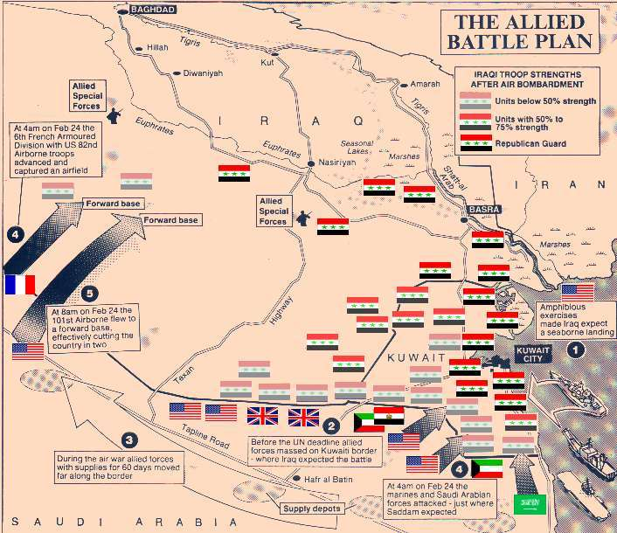

Slide 32
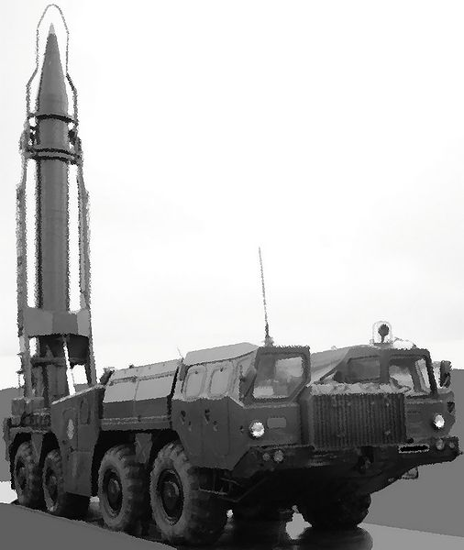
Notes:
scud

Slide 33
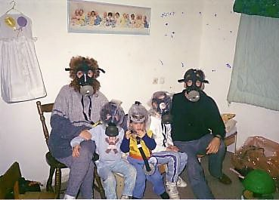
Notes:
Israeli family

Slide 34
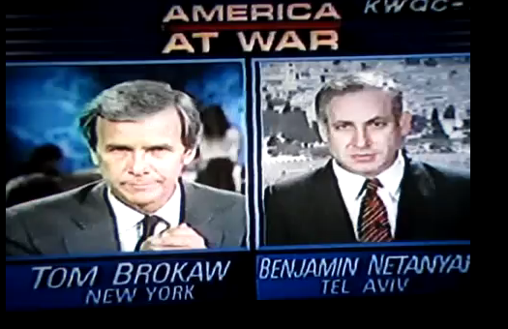

Slide 35
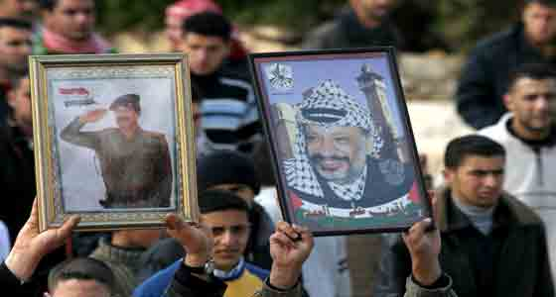

Slide 36
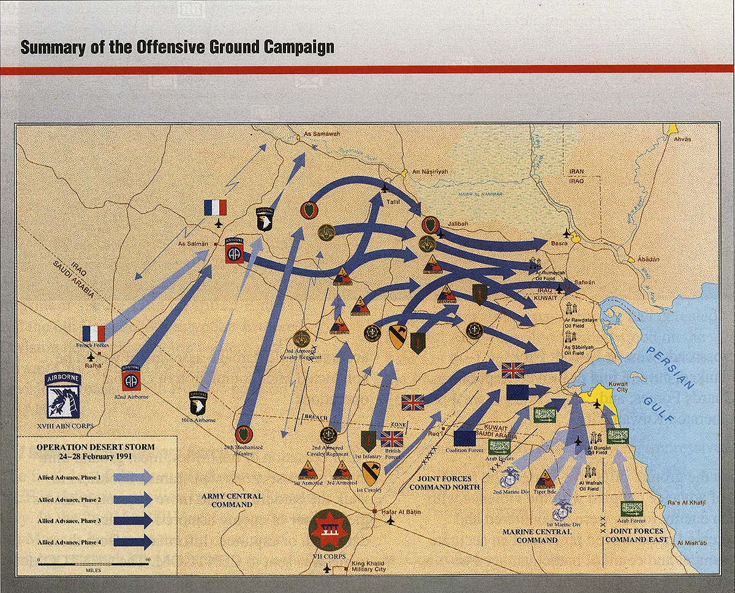

Slide 37
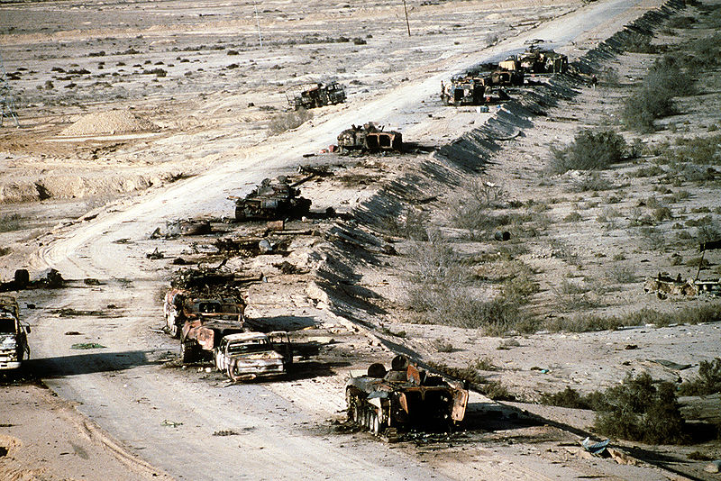

Slide 38
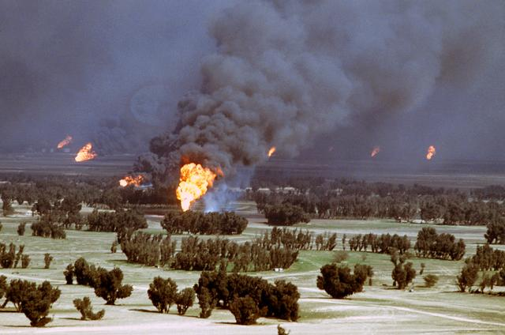

Slide 39
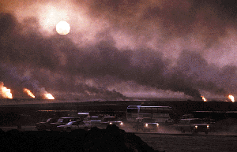

Slide 40
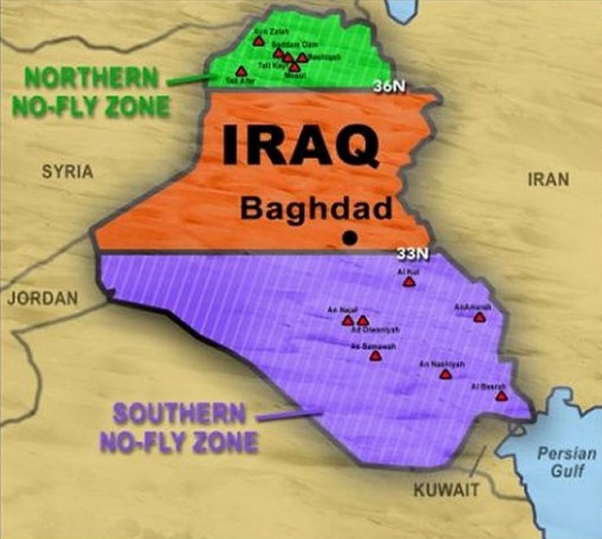

Slide 41
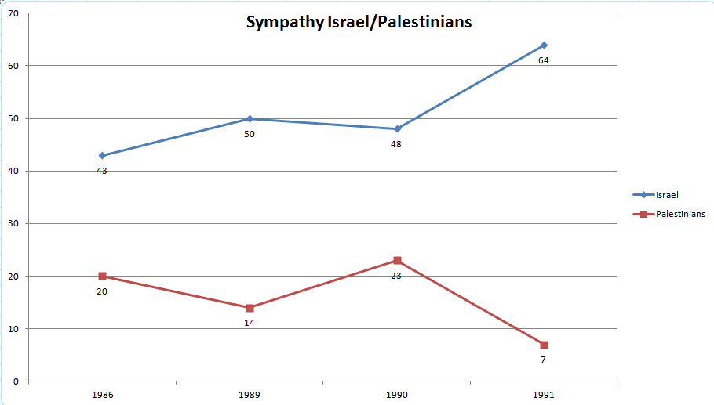

Slide 42
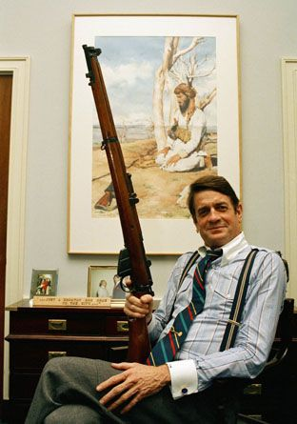

Slide 43
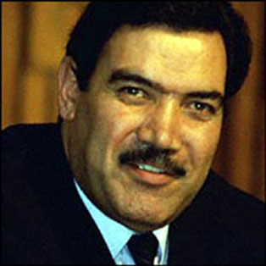
Notes:
Mohammed najibullah—3b sov aid 1990

Slide 44
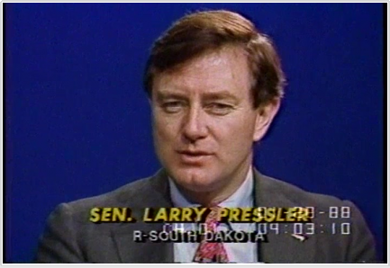
Notes:
Pressler am.==no aid to countries that secry of state cant certify arent developing nuc bomb

Slide 45
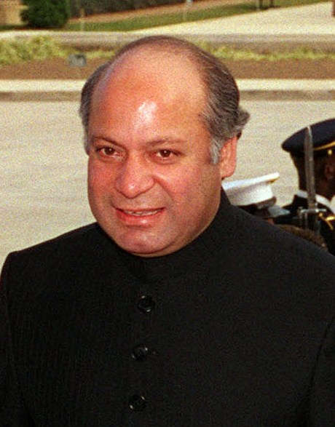
Notes:
Nawaz sharif

Slide 46
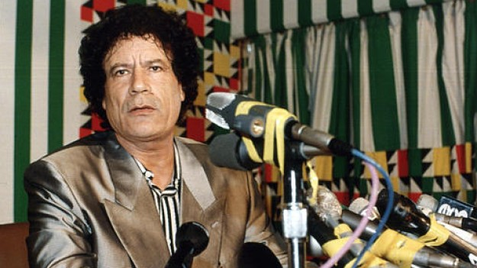

Slide 47
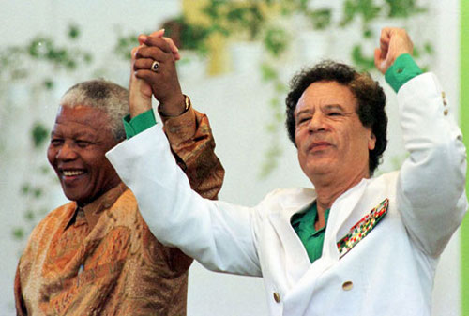

Slide 48
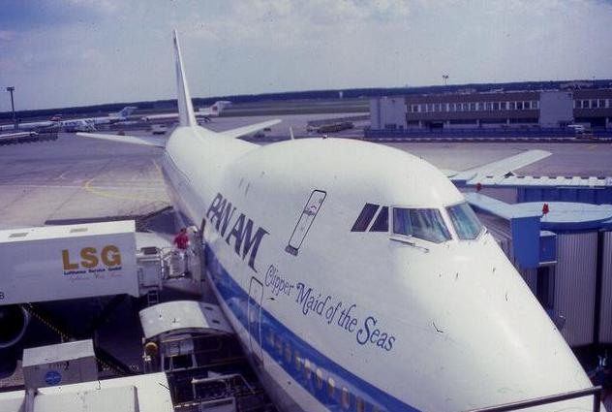

Slide 49
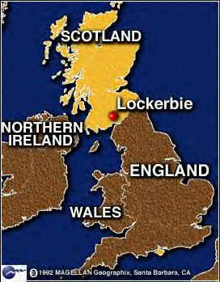

Slide 50
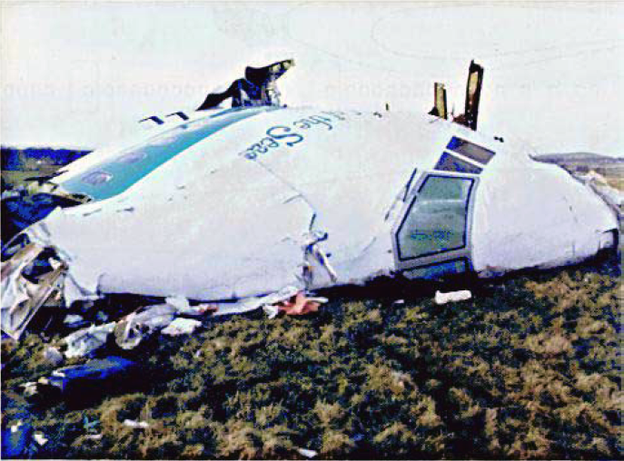

Slide 51
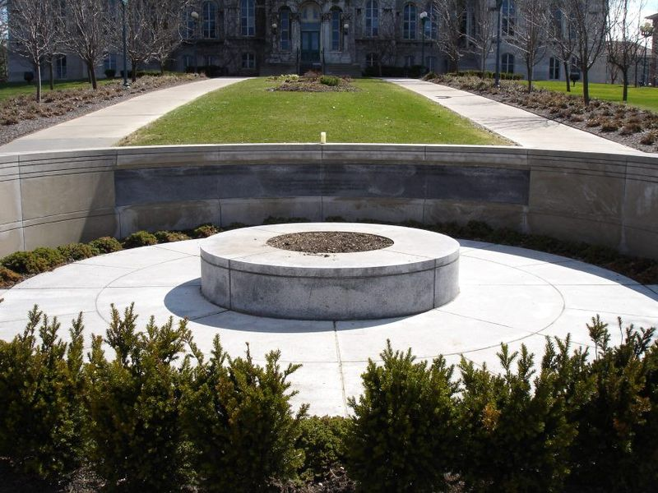
Notes:
Syracuse memorial—35 students coming home after semester abroad

Slide 52
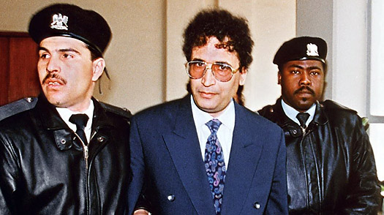
Notes:
Abdel Basset al-Megrahi

