Slide 1


Slide 2
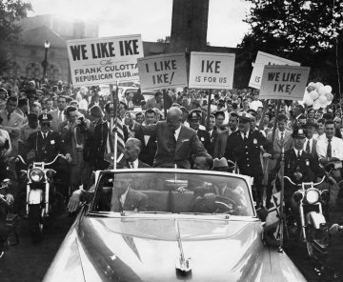

Slide 3


Slide 4
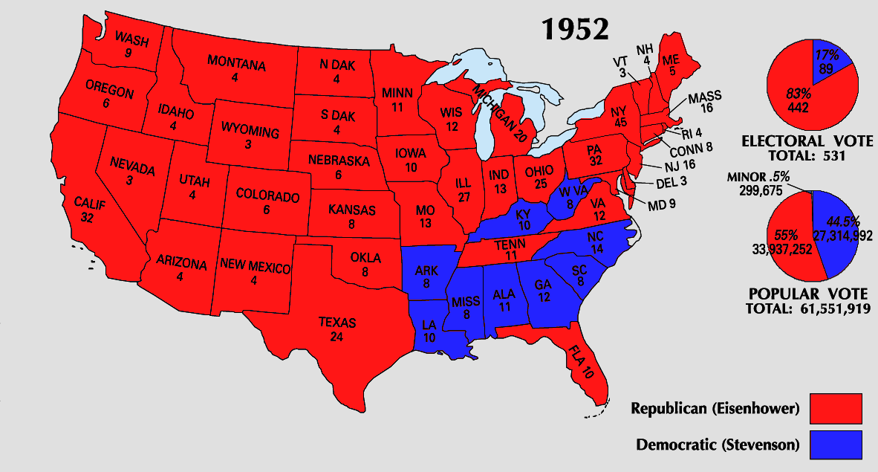

Slide 5


Slide 6
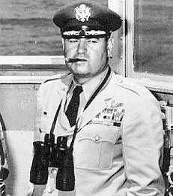
Notes:
lemay

Slide 7

Notes:
Allen dulles

Slide 8

Notes:
Abadan refinery

Slide 9
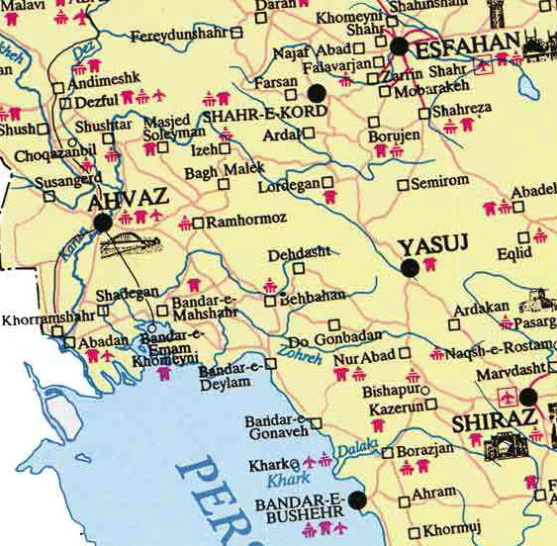

Slide 10
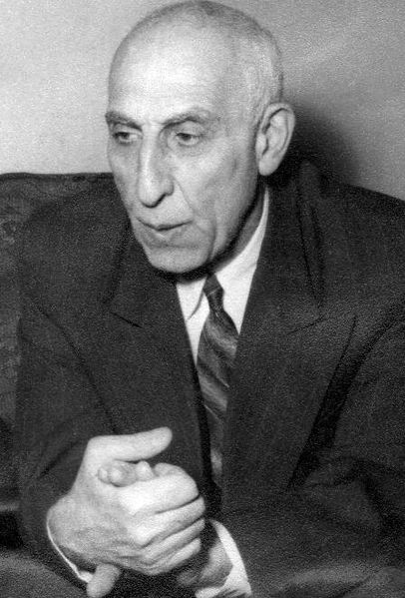
Notes:
mossadeq

Slide 11
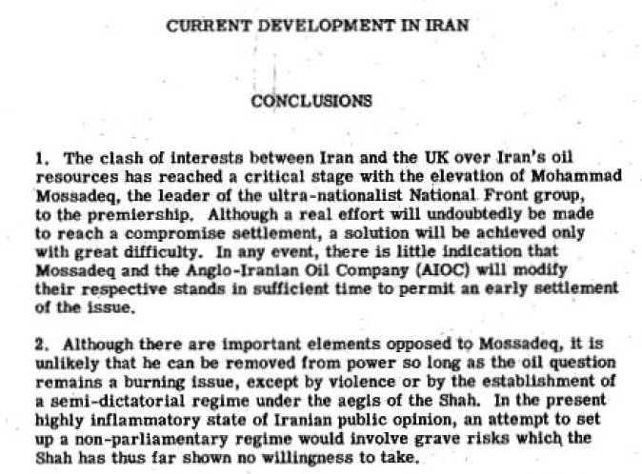
Notes:
1951 analysis

Slide 12
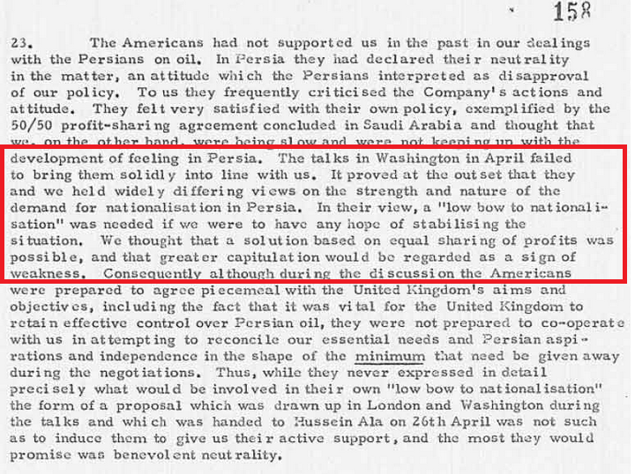
Notes:
Bri memo, 1951

Slide 13
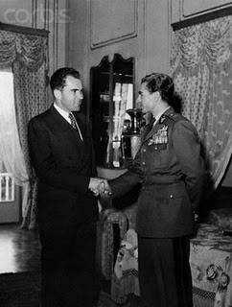

Slide 14
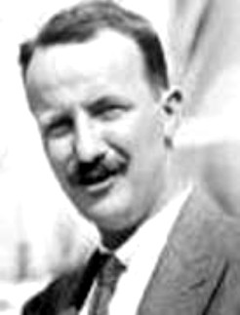
Notes:
Kermit roosevelt 9grandson TR)

Slide 15
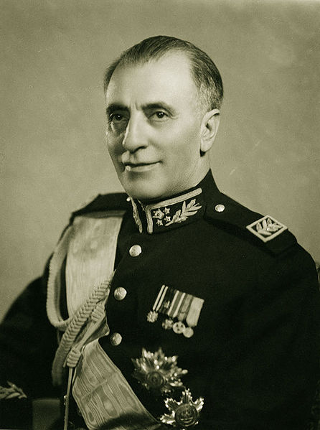
Notes:
Gen’l zahedi

Slide 16
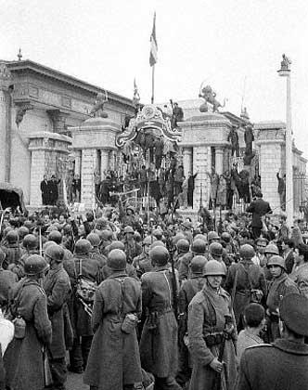
Notes:
Soldiers surrounding parliament

Slide 17
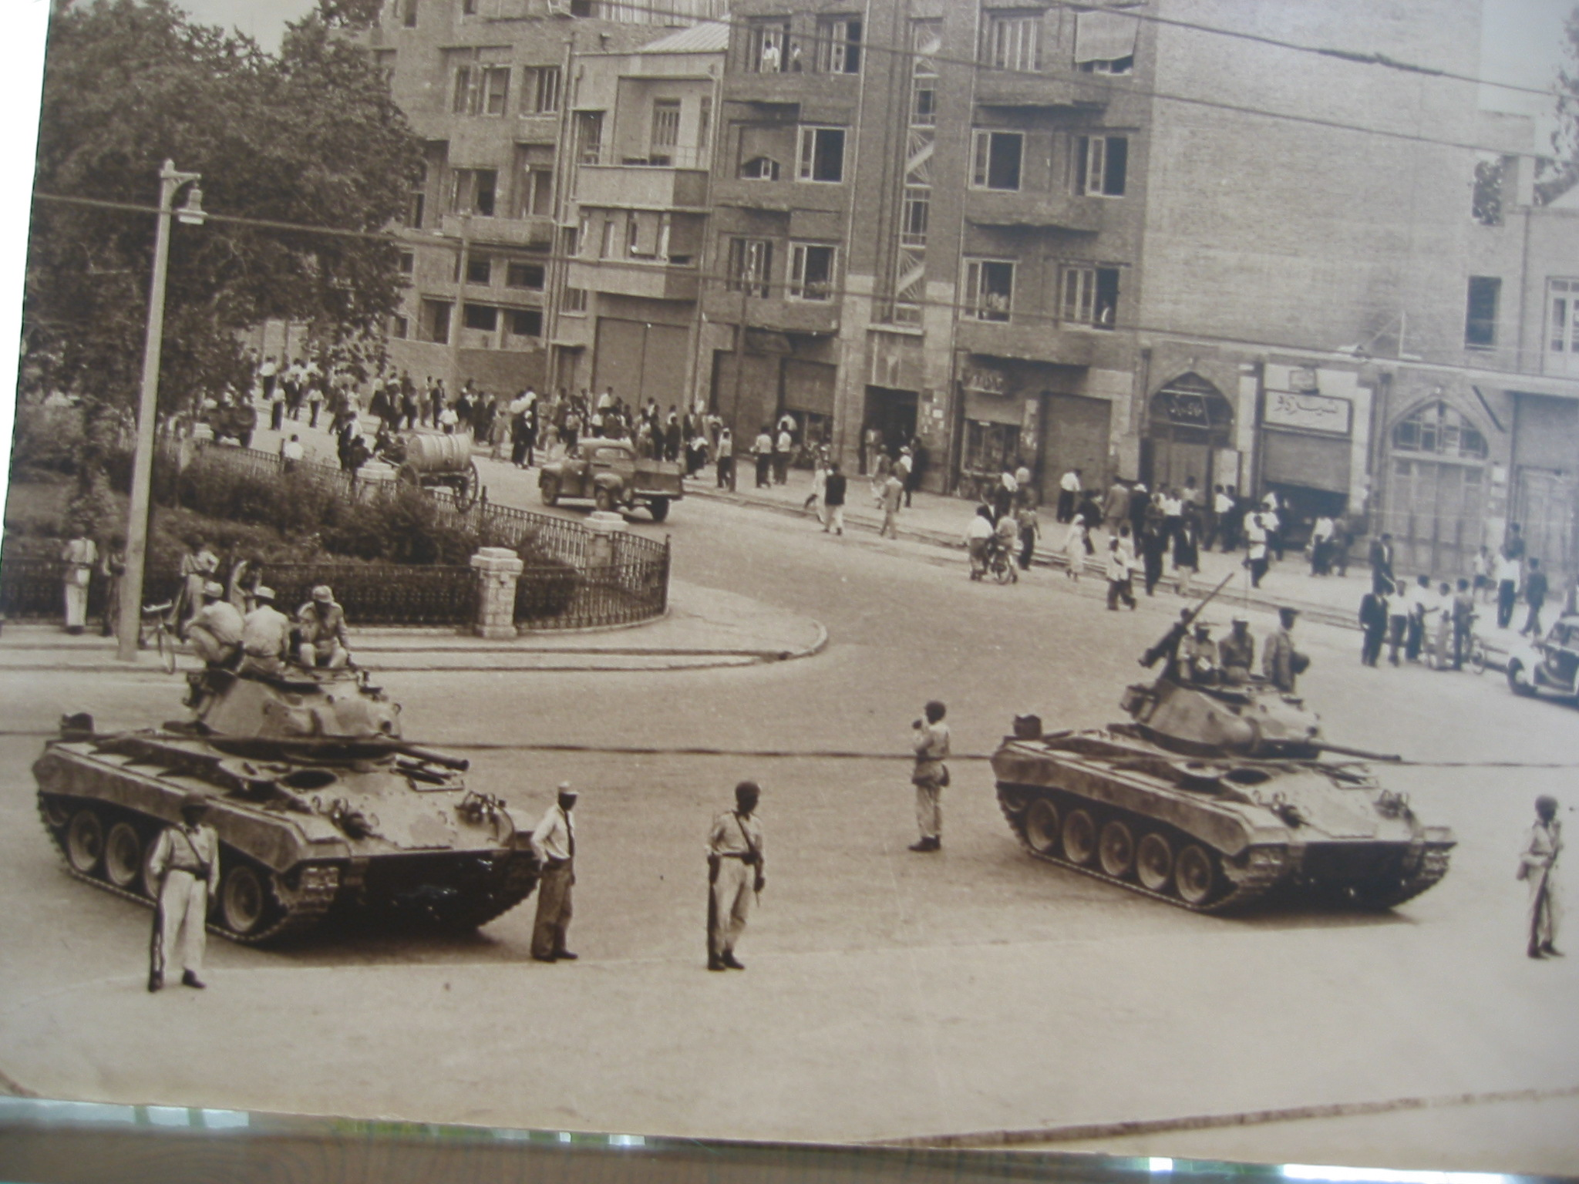

Slide 18
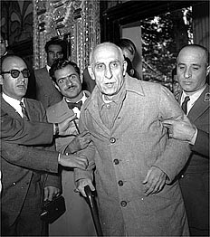

Slide 19
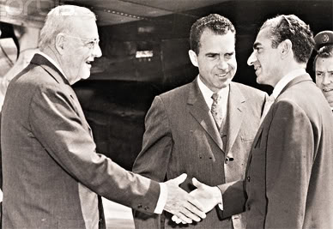

Slide 20
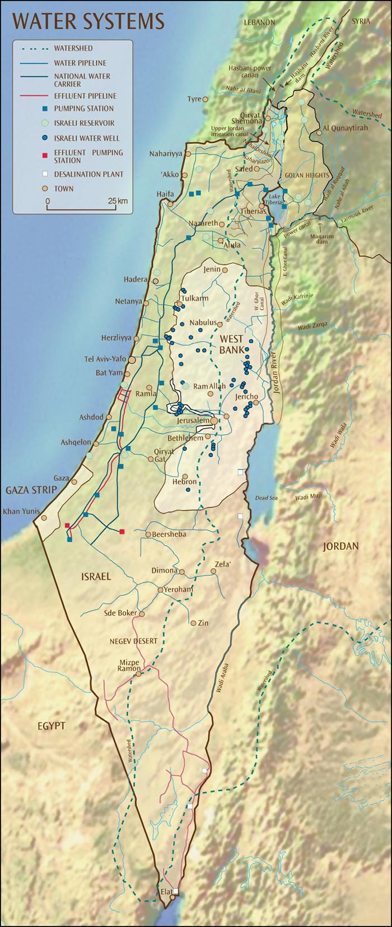

Slide 21
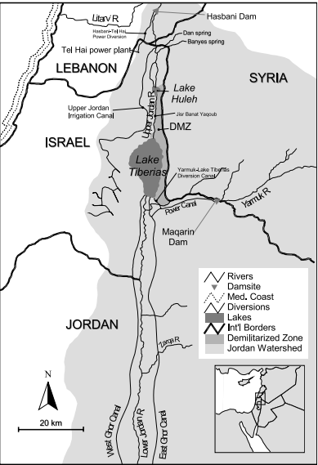

Slide 22
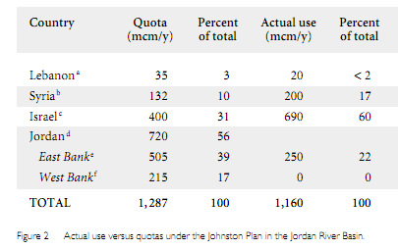

Slide 23
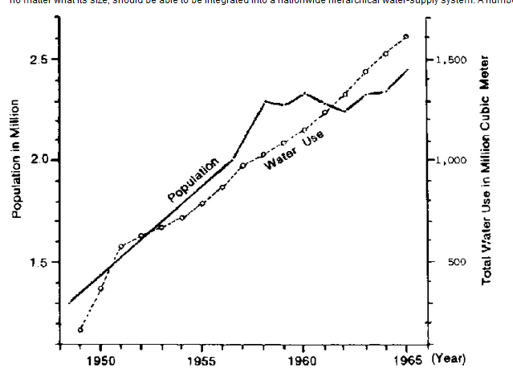

Slide 24
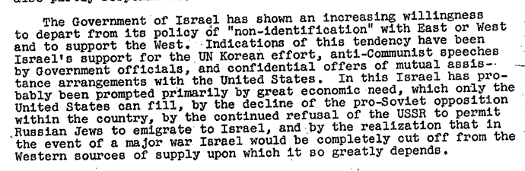
Notes:
Sd memo, 1951

Slide 25
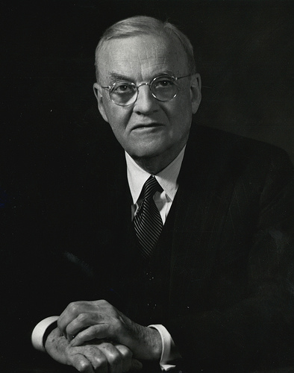

Slide 26
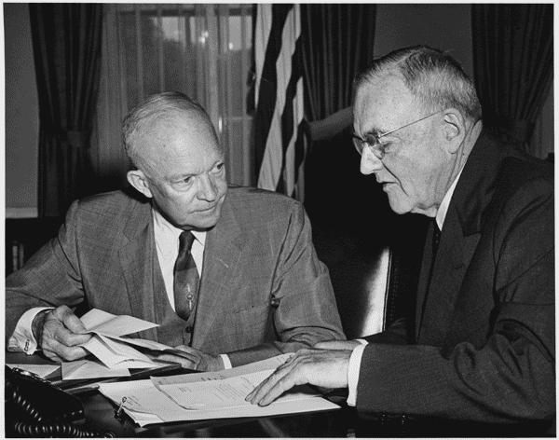

Slide 27
Dulles 1955 Council on Foreign Relations address
The tragic plight of 900,000 Arab refugees
The “pall of fear” of Israeli expansion and eventual Arab retaliation
The lack of fixed, permanent boundaries

Slide 28
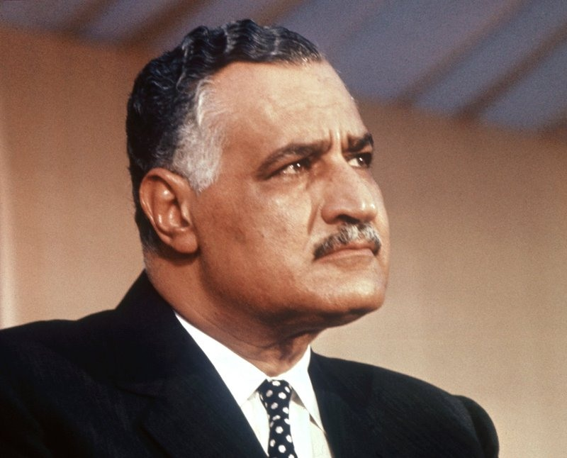

Slide 29
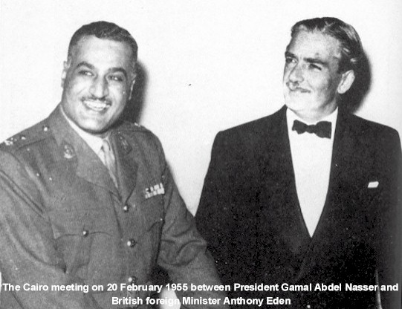

Slide 30

Notes:
Aswan dam

Slide 31
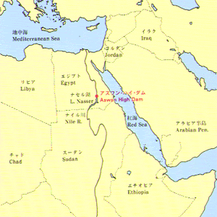

Slide 32
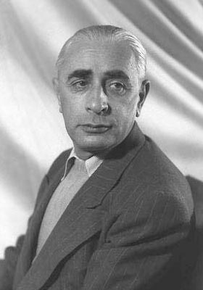
Notes:
Pinhas lavon

Slide 33
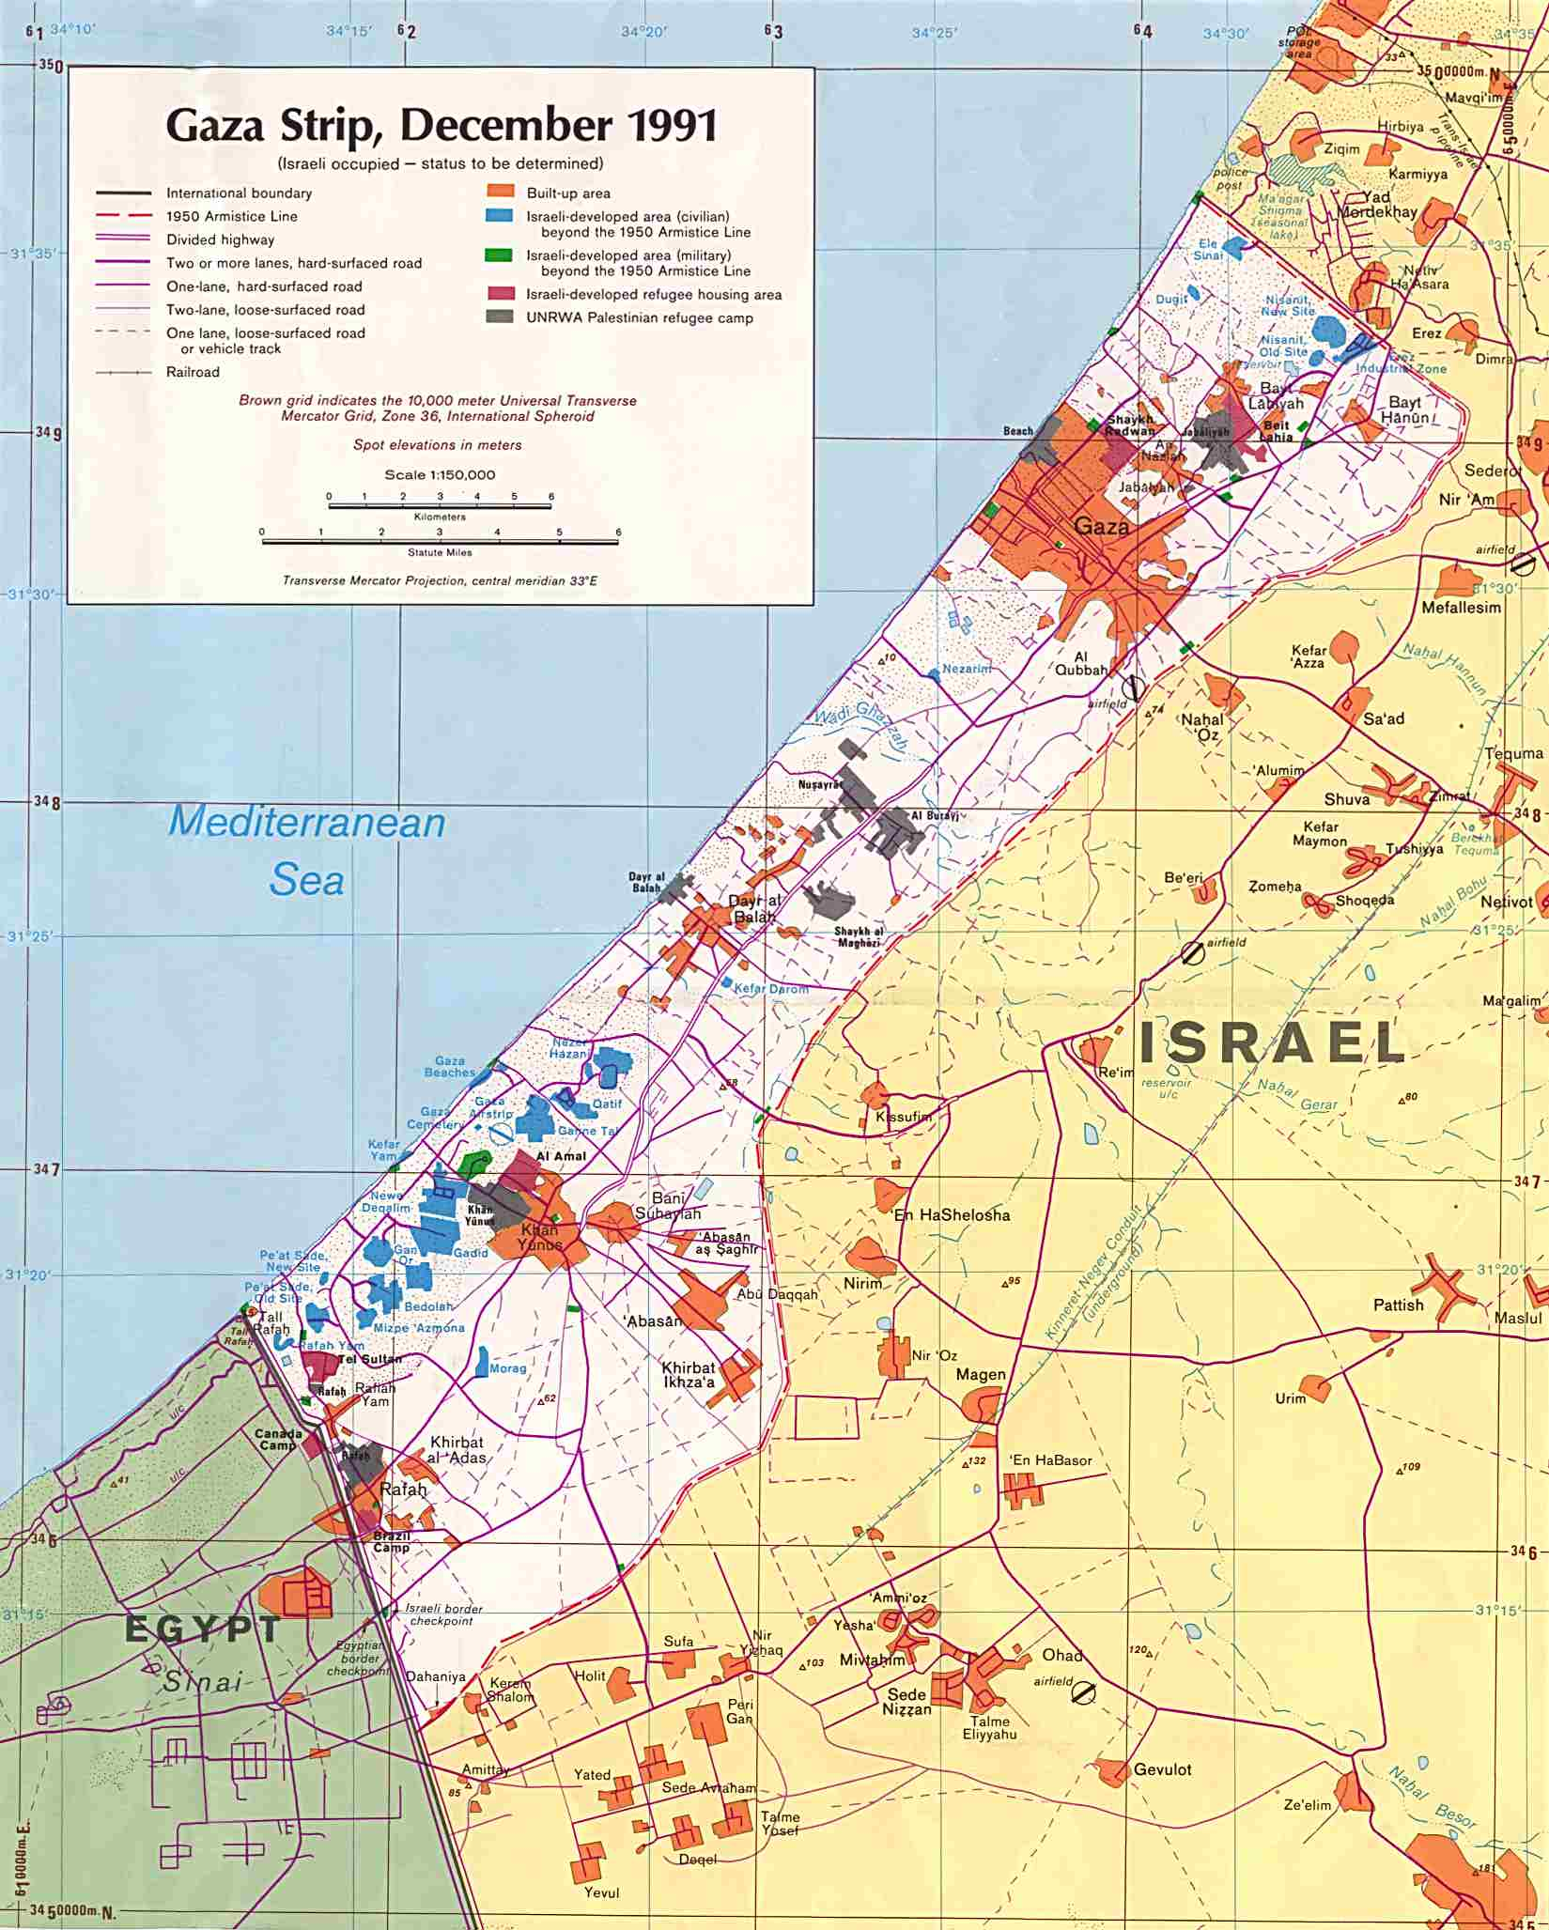

Slide 34
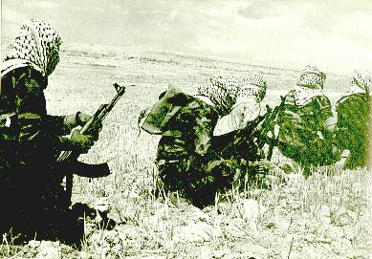
Notes:
fedayeen

Slide 35
United Nations Security Council Resolution 106
March 29, 1955
The Security Council,
Noting that the Egyptian-Israel Mixed Armistice Commission on 6 March 1955 determined that a "re-arranged and planned attack ordered by Israel authorities" was "committed by Israel regular army forces against the Egyptian regular army force" in the Gaza Strip on 28 February 1955,
Condemns this attack as a violation of the cease-fire provisions of Security Council resolution 54 (1948) and as inconsistent with the obligations of the parties under the General Armistice Agreement between Egypt and Israel and under the United Nations Charter;
2. Calls again upon Israel to take all necessary measures to prevent such actions;
3. Expresses its conviction that the maintenance of the General Armistice Agreement is threatened by any deliberate violation of that Agreement by one of the parties to it, and that no progress towards the return of permanent peace in Palestine can be made unless the parties comply strictly with their obligations under the General Armistice Agreement and the cease-fire provisions of its resolution 54 (1948).

Slide 36
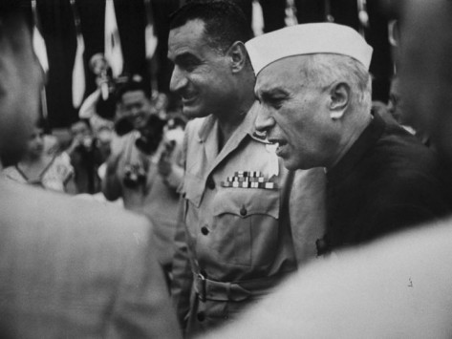
Notes:
Nasser & Nehru at Bandung

Slide 37
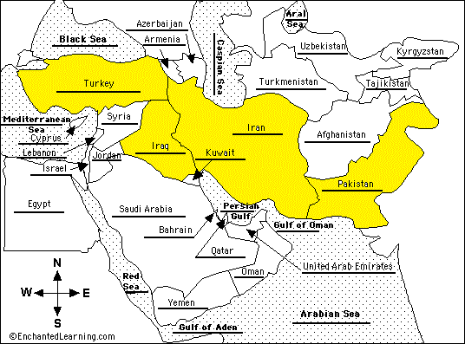

Slide 38
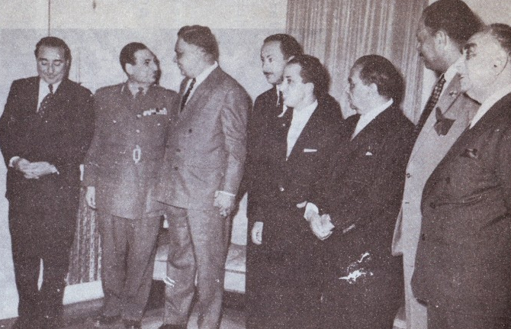
Notes:
Baghdad pact

Slide 39

Notes:
Adnan al-malki

Slide 40
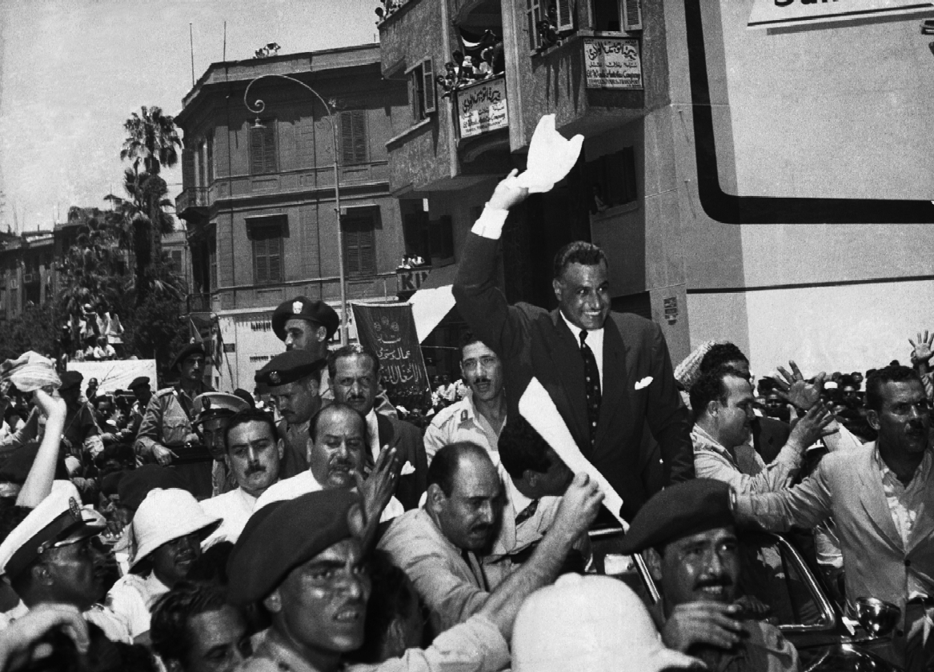
Notes:
Nasser following nationalization

Slide 41


Slide 42
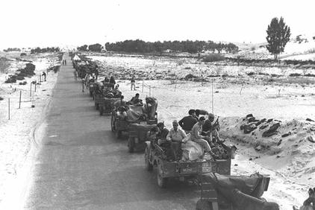

Slide 43
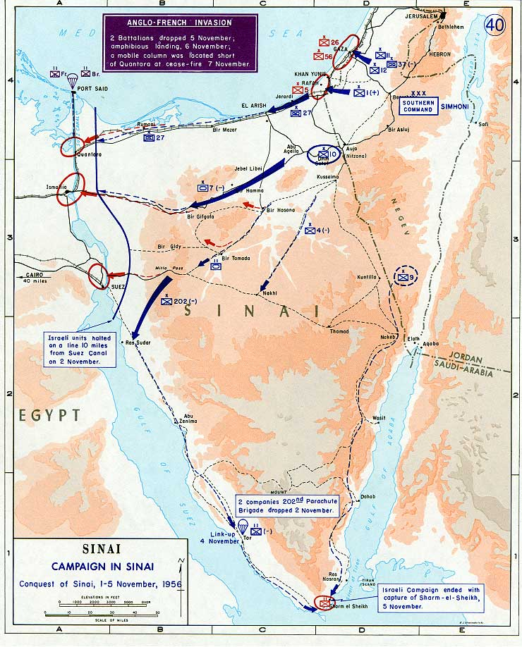

Slide 44
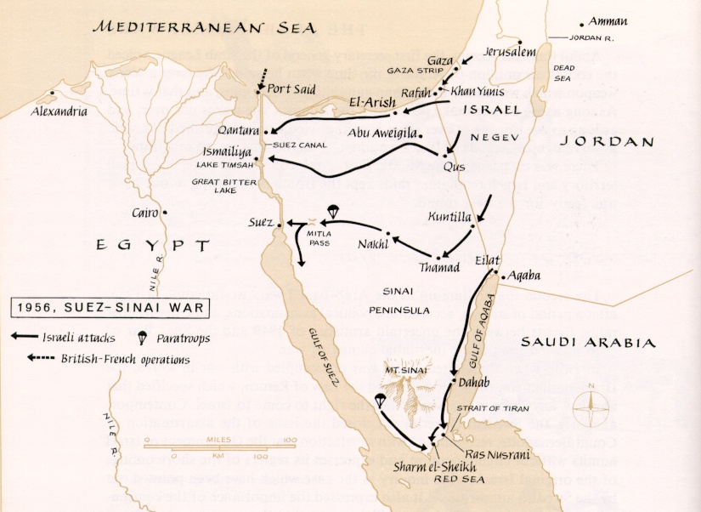

Slide 45
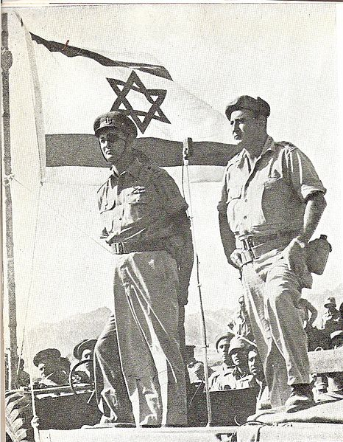
Notes:
Dayan at sharm el-shek

Slide 46


Slide 47


Slide 48


Slide 49


Slide 50


Slide 51
President Eisenhower to Prime Minister Ben-Gurion
November 7, 1956:
Dear Mr. Prime Minister:
… Statements attributed to your Government to the effect that Israel does not intend to withdraw from Egyptian territory, as requested by the United Nations, have been called to my attention. I must say frankly, Mr. Prime Minister, that the United States views these reports, if true, with deep concern. Any such decision by the Government of Israel would seriously undermine the urgent efforts being made by the United Nations to restore peace in the Middle East, and could not but bring about the condemnation of Israel as a violator of the principles as well as the directives of the United Nations.
It is our belief that as a matter of highest priority peace should be restored and foreign troops, except for United Nations forces, withdrawn from Egypt, after which new and energetic steps should be undertaken within the framework of the United Nations to solve the basic problems which have given rise to the present difficulty. The United States has tabled in the General Assembly two resolutions designed to accomplish the latter purposes, and hopes that they will be acted upon favorably as soon as the present emergency has been dealt with.
… It would be a matter of the greatest regret to all my countrymen if Israeli policy on a matter of such grave concern to the world should in any way impair the friendly cooperation between our two countries.

