Slide 1
Griswold v. Connecticut (1965)
The First Amendment has a penumbra where privacy is protected from governmental intrusion. In like context, we have protected forms of "association" that are not political in the customary sense, but pertain to the social, legal, and economic benefit of the members . . .
Specific guarantees in the Bill of Rights have penumbras, formed by emanations from those guarantees that help give them life and substance. Various guarantees create zones of privacy. The right of association contained in the penumbra of the First Amendment is one, as we have seen. The Third Amendment, in its prohibition against the quartering of soldiers "in any house" in time of peace without the consent of the owner, is another facet of that privacy. The Fourth Amendment explicitly affirms the "right of the people to be secure in their persons, houses, papers, and effects, against unreasonable searches and seizures." The Fifth Amendment, in its Self-Incrimination Clause, enables the citizen to create a zone of privacy which government may not force him to surrender to his detriment. The Ninth Amendment provides: "The enumeration in the Constitution, of certain rights, shall not be construed to deny or disparage others retained by the people."

Slide 2
Miranda v. Arizona (1965)—White dissent
In some unknown number of cases, the Court’s rule will return a killer, a rapist or other criminal to the streets and to the environment which produced him, to repeat his crime whenever it pleases him. As a consequence, there will not be a gain, but a loss, in human dignity. The real concern is not the unfortunate consequences of this new decision on the criminal law as an abstract, disembodied series of authoritative proscriptions, but the impact on those who rely on the public authority for protection, and who, without it, can only engage in violent self-help with guns, knives and the help of their neighbors similarly inclined. There is, of course, a saving factor: the next victims are uncertain, unnamed and unrepresented in this case.

Slide 3
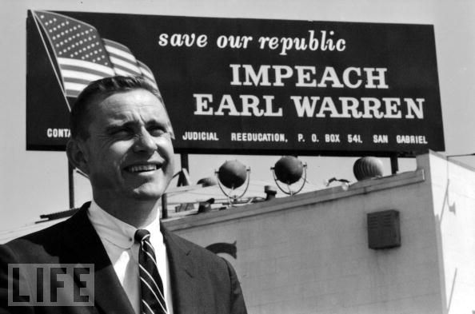

Slide 4
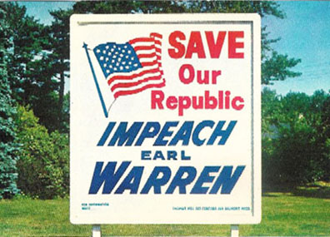

Slide 5
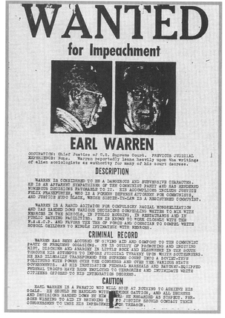

Slide 6
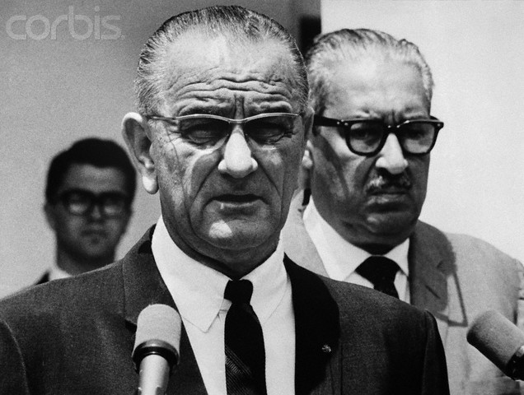

Slide 7
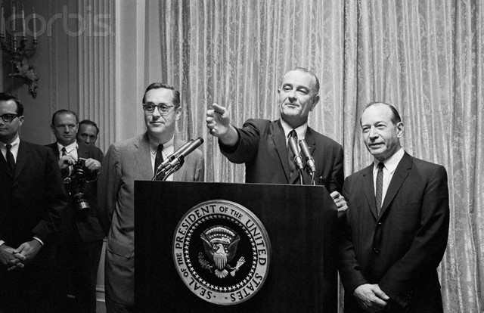

Slide 8
President Johnson: How are you going to rate these people—one, two, three, four, five?
Fortas: I—
President Johnson: From the standpoint of my practical problem, and what I may want to do here on all the other things. I’ve got geography, I’ve got the Senate, I’ve got these philosophies, I’ve got to have sure votes.
I want continuity, I want a little age—look at this not from your standpoint.
Fortas: Well—
President Johnson: Look at it from my standpoint, of knowing me as you know me, and what I want. I want somebody that I’ll always be proud of his vote. That’s the first thing. I may not be proud of his opinion, but I want to be proud of the side he was on. He may not be as eloquent as Hugo Black, or you, or somebody. But I want to be damn sure he votes right. That’s the first thing.

Slide 9
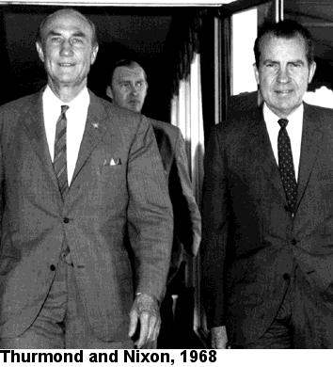

Slide 10
George Smathers: Now, you get a real nut like Strom Thurmond, who up until this point hadn’t really made much sense . . . there are just enough people who will fall for a line like this, that it worries me, very much. And they’ve invited Abe back to talk about it, and I just think that—frankly, my first reaction is that he just ought not to come. And just see . . .
And my other reaction is at the moment—[Michigan senator] Phil [Hart] went to see the movie. I said, “I’m not going to see the damn movie, because I want to be in a position to say, as far as I’m concerned, I don’t look at any kind of goddamned pornographic stuff. It’s all over the streets, and always has been. And it’s a man’s choice. And I choose not to look at it. But others may choose to look at it. And if a fella wants to look at it, why, the Court’s voted that he can. That’s a matter of choice.
I don’t look at it. I haven’t seen it, so I’m not passing judgment on whether or not this is the kind of thing that should be shown around, or shouldn’t. Now, Phil’s view was that probably you should see it. And he didn’t think it was so bad, although when he told me that, “I’ve seen many just like that, and I’m sure most every fella just has, everyone belonging to sort of a man’s club.”
President Johnson: [The President chuckles.] Mm.

Slide 11
Smathers: But anyway, they were all, seemed to be pretty well shook up by it—not all of ‘em. [Arkansas senator] John [McClellan, a very conservative Democrat] was, but Phil Hart wasn’t. John was preaching, and ranting and raving about how this kind of thing was ruining the life of his grandchildren, and everybody else. He wanted a long time to look into this, and he was going to look into it very deeply.
President Johnson: He ought to go see this Graduates [sic]. [Chuckles.]
Smathers: That’s right. Well, anyway, the only thing I was able to get, the contribution I was able to make, was that this was technically the use of the one week, so that could not be asked for again. And I finally got that established that John was really . . .
President Johnson: Well, will you vote on it next Wednesday?
Smathers: So, we’re due to vote on it next Wednesday.
President Johnson: Well, won’t they filibuster it?
Smathers: Yeah. They’re going to filibuster it again.
President Johnson: In the committee?!
Smathers: In the committee. That’s what I think is going to happen—they’re going to filibuster it in the committee.

Slide 12
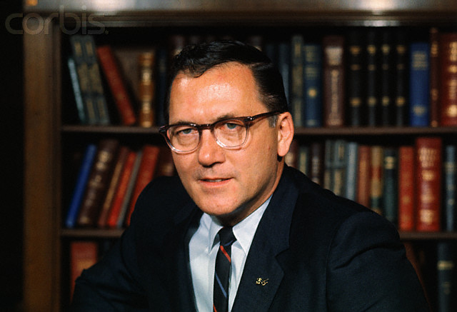
Notes:
griffin

Slide 13
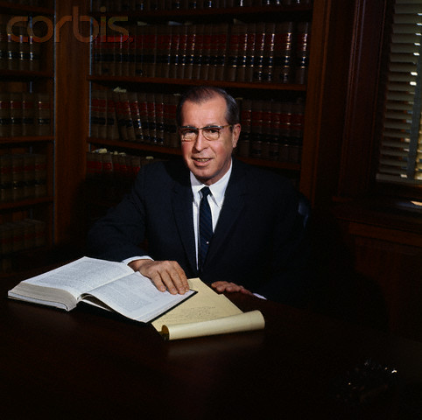

Slide 14
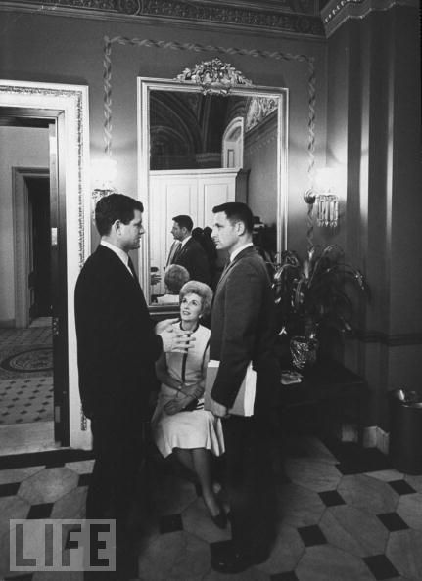
Notes:
Emk and bayh

Slide 15
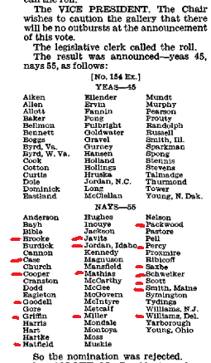

Slide 16
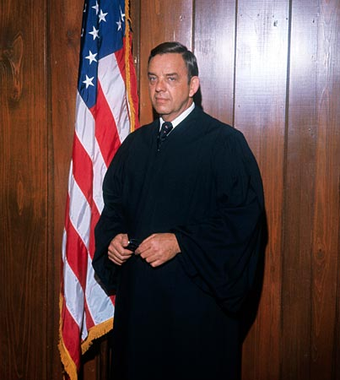
Notes:
carswell

Slide 17
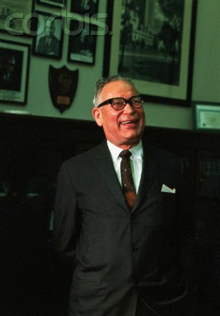
Notes:
hruska

Slide 18
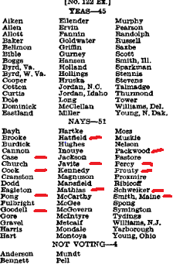

Slide 19
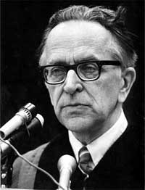

Slide 20
President Nixon: Now, on the other thing, John, on the second one, if it comes: can I urge you to try to examine everything to see if you can find a Catholic—a good Catholic?
John Mitchell: You want another [Justice William] Brennan?
President Nixon: No, Christ no! That’s what I mean. I mean—
Mitchell: You know, you went down—the Eisenhower administration went down that track before, you know . . .
President Nixon: And they got Brennan, I know. But you don’t have an honest Italian, do you?
Mitchell: [Chuckles.] God, they’re awful hard to find.
President Nixon: A Pole?
Mitchell: Uh . . .
President Nixon: No.
Mitchell: [California attorney and future Reagan AG] William French Smith—he isn’t one, is he?
President Nixon: Oh, Christ, no. He’s a Protestant.
Mitchell: WASP.
President Nixon: Rich and everything else.
Mitchell: All right.
President Nixon: Well, take a look at the Catholics, will you?

Slide 21
[Break.]
Mitchell: Do you think that’s a good line to take?
President Nixon: I do. Politically, we are going to gain a lot more from a Catholic. Look, the Protestants will just figure—if he’s a conservative, a Catholic conservative’s better than a Protestant conservative. We really need that—
Mitchell: Well, they’re more engrained, I’m sure.
President Nixon: Yeah. The point is, it’ll mean more to the Catholics—that’s my point—than it will to the Protestants. The Protestants expect to have things. The Catholics don’t.
Mitchell: When are you going to fill that Jewish seat on the Supreme Court?
President Nixon: Well, about . . . after I die. [Mitchell laughs.] You know and I know, there aren’t any.
Mitchell: There are no conservatives, I’ll say that.
President Nixon: Never.

Slide 22
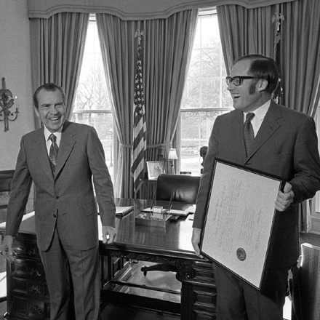

Slide 23
President Nixon: Let me ask you this: I just got Dick in here, Dick Moore—
John Mitchell: Yeah.
President Nixon: —a minute ago. And I may reevaluate. He comes down very hard on your man Rehnquist. He just thinks that, you know, second in his class at Stanford, was clerk to Robert Jackson, and then from your account apparently conservative.
Mitchell: Absolutely.
President Nixon: And would make a brilliant justice. Would you agree?
Mitchell: Yes, sir.
President Nixon: What would the country say about him? He sure is qualified, isn’t he?
Mitchell: I would believe so. I don’t think there’s any question about it. It’s an opinion expressed by Ed Walsh when we were talking about this. From his point of view, he certainly would.
[Break.]
President Nixon: Well, people all think so highly of the guy—he must have a helluva lot on the ball.
Mitchell: Oh, he’s got a tremendous legal mind, Mr. President, there isn’t any question about it. And just as solid as can be.
President Nixon: Yeah.
Mitchell: [with the President assenting] He’s made a tremendous impression upon the judiciary around here, and people on the Hill, and the ones in the Bar he’s dealt with.

Slide 24
[Break.]
President Nixon: Incidentally, what is Rehnquist? I suppose he’s a damn Protestant?
Mitchell: I’m sure of that.
President Nixon: That’s too bad.
Mitchell: He’s about as WASPish as WASPish can be.
President Nixon: Yeah, that’s too damn bad. Tell him to change his religion.
Mitchell: [laughing] All right, I’ll get him baptized this afternoon.
President Nixon: Well, baptized and castrated—no, they don’t do that. I mean, they circumci—no, that’s the Jews. Well, anyway, whatever he is, get him changed.

Slide 25
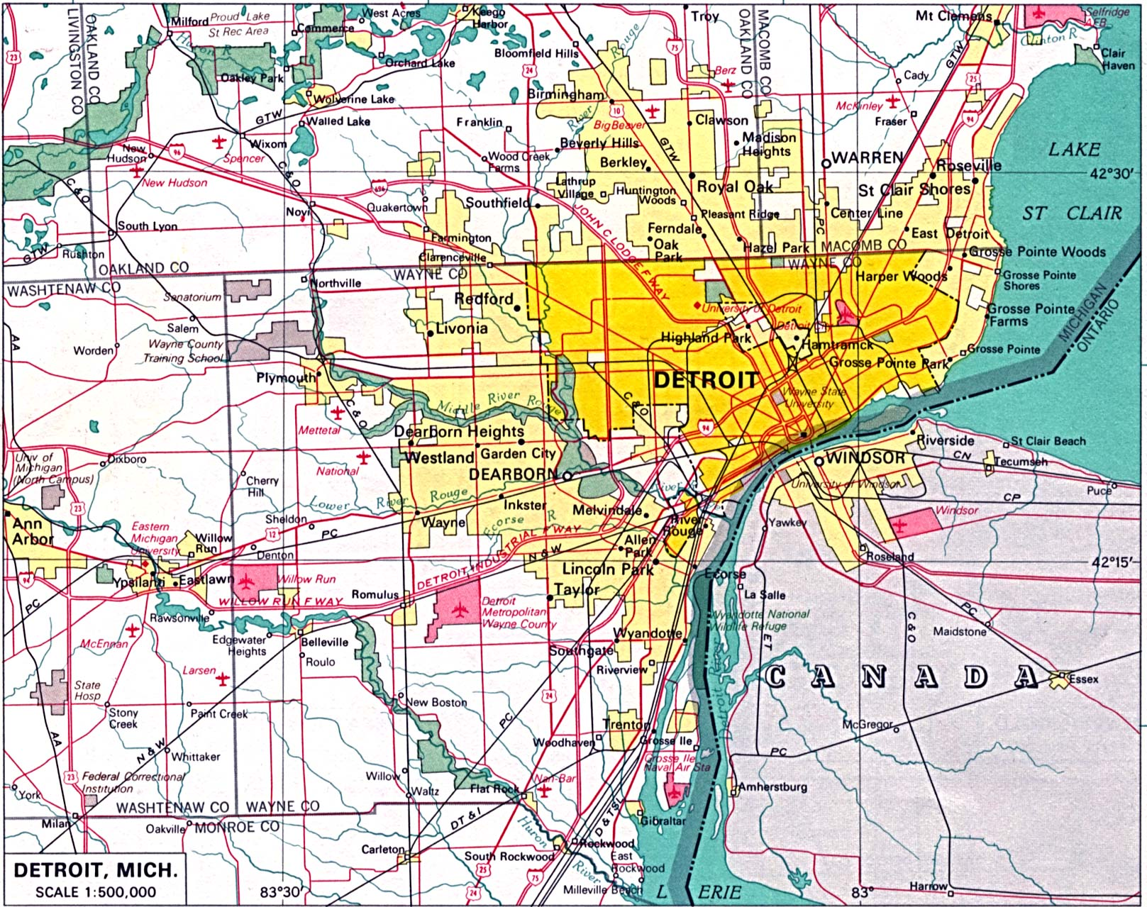

Slide 26
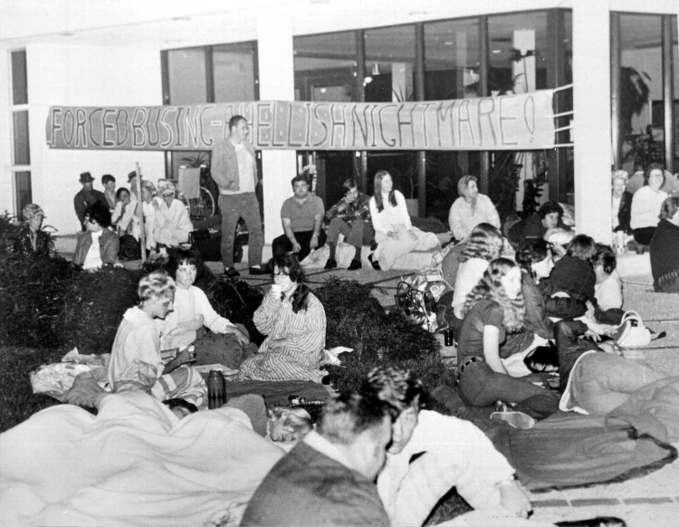

Slide 27
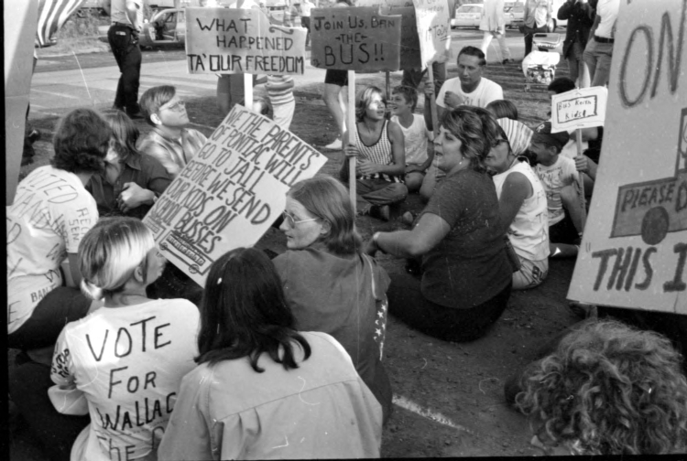

Slide 28
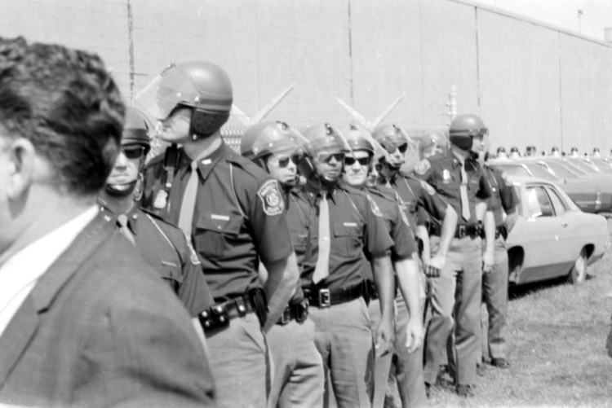

Slide 29
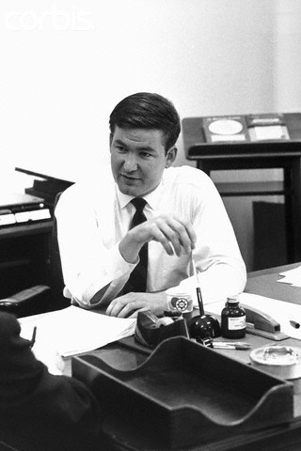

Slide 30
President Nixon: Well, I’ve basically—we’ve got to say that it’s only the extent that it is required by law—
Pat Buchanan: Right.
President Nixon: By a court order, do I think busing should be used.
Buchanan: Mm-hmm.
President Nixon: Don’t you think that’s really what you get down to?
Buchanan: Right. Right.
President Nixon: Because the line, actually, between my line and Muskie’s, is not as clear as—I mean, it’s just the way he said it. He starts at the other end. He says, “Well, I think busing is a legitimate tool—
Buchanan: Yeah.
President Nixon: And then, “but I’m against it.” I start at the other end. I say, “I’m against busing, but, if the law requires it, to the minimum extent necessary, I, of course, will not resist it.”
Buchanan: Mm-hmm.
President Nixon: Right?
Buchanan: Right.
President Nixon: It’s purely a question of tone.
Buchanan: Well, we’ve got to push Muskie’s emphasis up in the headlines; that’s the problem.

Slide 31
President Nixon: That’s right. That’s right. Yeah. It’s got to be—well, I think it probably is going to get some play in the South now—
Buchanan: I think, well, that’s something you could really move by various statements exaggerating his position, and then Muskie would come back sort of drawing it back and it raises—identifies him with it.
President Nixon: Yeah, the thing to do really is to praise him—have some civil rights people praise him for his defense of busing.
Buchanan: Mm-hmm.
President Nixon: That’s the way to really get that, you know. It’s much the better way than to have people attack him for it—
Buchanan: Mm-hmm.
President Nixon: —is to praise him for his defense of busing, see?
Buchanan: Mm-hmm. Mm-hmm.
President Nixon: And I don’t know if you’ve got any people that can do that or not. But I would think that would be very clever.
Buchanan: Mm-hmm. OK.

Slide 32
Milliken v. Bradley (1974)
The District Court and the Court of Appeals shifted the primary focus from a Detroit remedy to the metropolitan area only because of their conclusion that total desegregation of Detroit would not produce the racial balance which they perceived as desirable. Both courts proceeded on an assumption that the Detroit schools could not be truly desegregated -- in their view of what constituted desegregation -- unless the racial composition of the student body of each school substantially reflected the racial composition of the population of the metropolitan area as a whole . . .
Boundary lines may be bridged where there has been a constitutional violation calling for inter-district relief, but the notion that school district lines may be casually ignored or treated as a mere administrative convenience is contrary to the history of public education in our country. No single tradition in public education is more deeply rooted than local control over the operation of schools; local autonomy has long been thought essential both to the maintenance of community concern and support for public schools and to quality of the educational process . . .
The constitutional right of the Negro respondents residing in Detroit is to attend a unitary school system in that district. Unless petitioners drew the district lines in a discriminatory fashion, or arranged for white students residing in the Detroit District to attend schools in Oakland and Macomb Counties, they were under no constitutional duty to make provisions for Negro students to do so.

Slide 33
Milliken v. Bradley –Marshall dissent
The rights at issue in this case are too fundamental to be abridged on grounds as superficial as those relied on by the majority today. We deal here with the right of all of our children, whatever their race, to an equal start in life and to an equal opportunity to reach their full potential as citizens. Those children who have been denied that right in the past deserve better than to see fences thrown up to deny them that right in the future . . .
Desegregation is not and was never expected to be an easy task. Racial attitudes ingrained in our Nation's childhood and adolescence are not quickly thrown aside in its middle years. But just as the inconvenience of some cannot be allowed to stand in the way of the rights of others, so public opposition, no matter how strident, cannot be permitted to divert this Court from the enforcement of the constitutional principles at issue in this case. Today's holding, I fear, is more a reflection of a perceived public mood that we have gone far enough in enforcing the Constitution's guarantee of equal justice than it is the product of neutral principle of law. In the short run, it may seem to be the easier course to allow our great metropolitan areas to be divided up each into two cities -- one white, the other black -- but it is a course, I predict, our people will ultimately regret. I dissent.

Slide 34
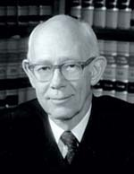

Slide 35
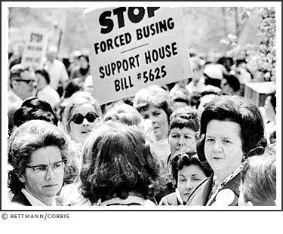

Slide 36
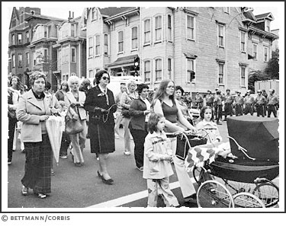

Slide 37
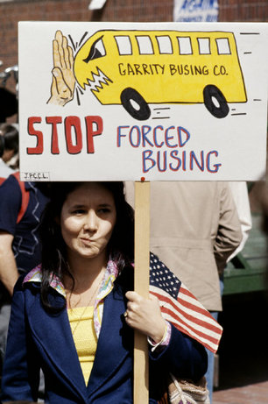

Slide 38
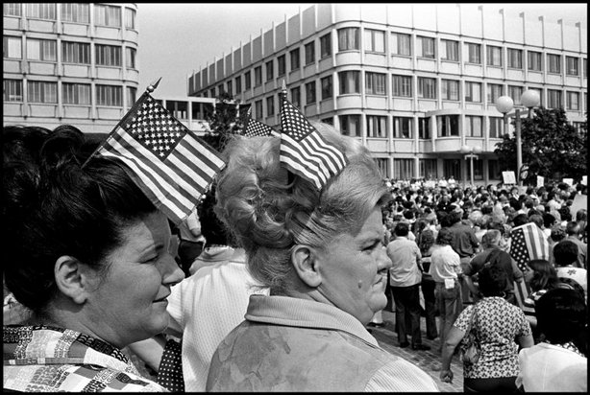

Slide 39
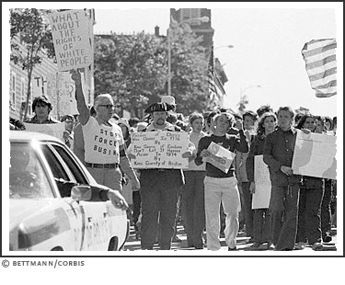

Slide 40
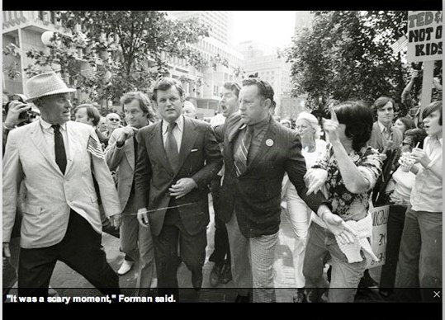

Slide 41
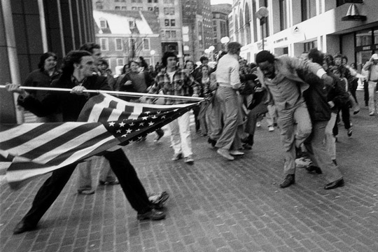

Slide 42
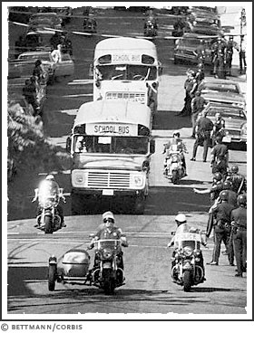

Slide 43
