Slide 1
Major Features: Civil Rights Act (1964)
Title I
Barred unequal application of voter registration requirements, but did not abolish literacy tests sometimes used to disqualify African Americans and poor white voters.
Title II
Outlawed discrimination in hotels, motels, restaurants, theaters, and all other public accommodations engaged in interstate commerce; exempted private clubs without defining "private," thereby allowing a loophole.
Title III
Encouraged the desegregation of public schools and authorized the U. S. Attorney General to file suits to force desegregation, but did not authorize busing as a means to overcome segregation based on residence.
Title IV
Authorized but did not require withdrawal of federal funds from programs which practiced discrimination.
Title V
Outlawed discrimination in employment in any business exceeding twenty five people and creates an Equal Employment Opportunities Commission to review complaints, although it lacked meaningful enforcement powers.

Slide 2
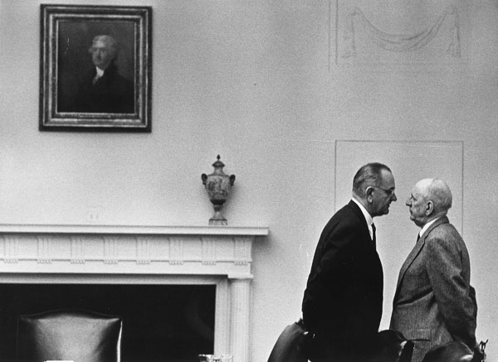

Slide 3
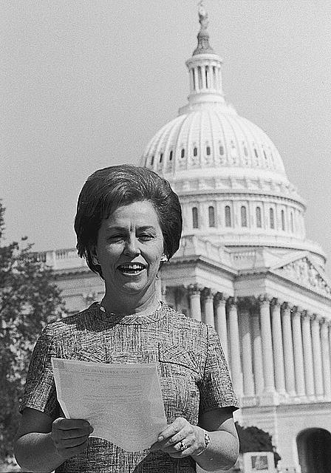

Slide 4
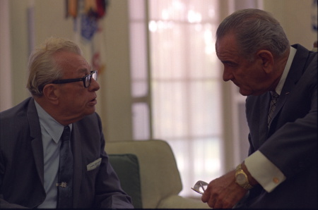

Slide 5
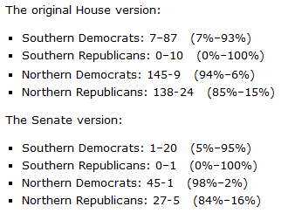

Slide 6
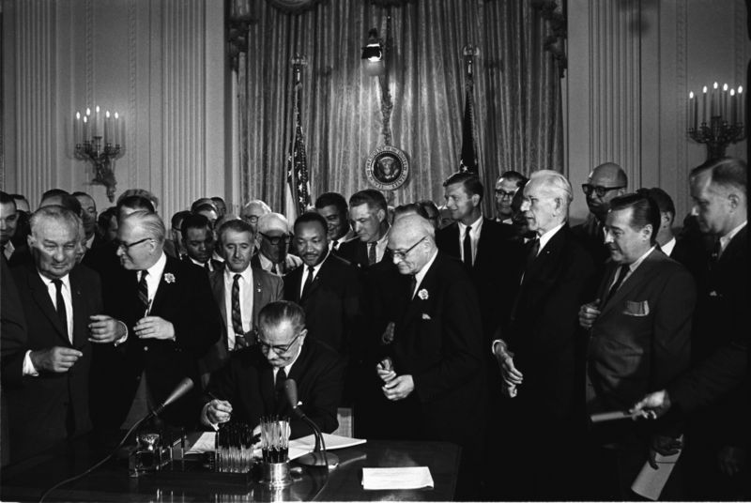

Slide 7
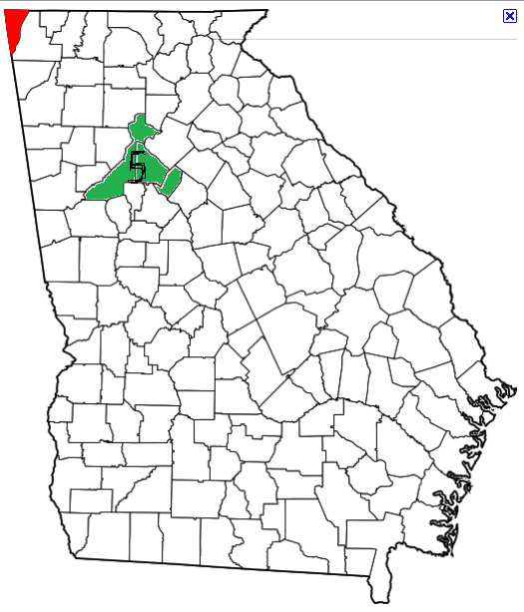
Notes:
Pop 823K, average 384K, lasi redistrict 1931

Slide 8
Wesberry v. Sanders (1964)
Other rights, even the most basic, are illusory if the right to vote is undermined. Our Constitution leaves no room for classification of people in a way that unnecessarily abridges this right. In urging the people to adopt the Constitution, Madison said in No. 57 of The Federalist:
“Who are to be the electors of the Federal Representatives? Not the rich more than the poor; not the learned more than the ignorant; not the haughty heirs of distinguished names more than the humble sons of obscure and unpropitious fortune. The electors are to be the great body of the people of the United States.”
Readers surely could have fairly taken this to mean, "one person, one vote.“
While it may not be possible to draw congressional districts with mathematical precision, that is no excuse for ignoring our Constitution's plain objective of making equal representation for equal numbers of people the fundamental goal for the House of Representatives. That is the high standard of justice and common sense which the Founders set for us.

Slide 9
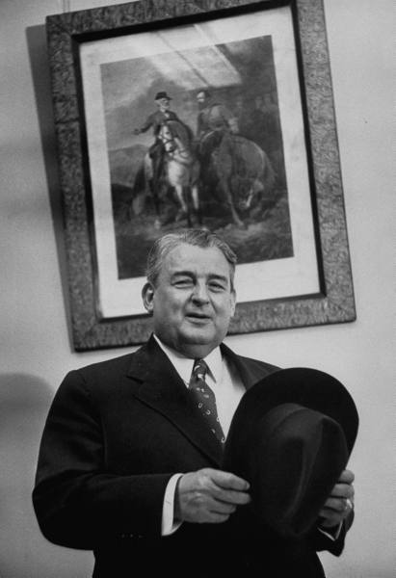
Notes:
Wm tuck

Slide 10
President Johnson: Why in the living hell they want to put it [a plank supporting the reapportionment decisions] in the platform, notify every little state. [Majority Leader] Carl Albert’s district [in Oklahoma] is put together and he’s abolished from Congress. Now who wants to do that to Carl Albert, when he’s the best instrument the liberals have for achievement in this town, since [former House Speaker] Sam Rayburn? Now, why would they want to abolish his district?
It’s not so bad if the Senate abolishes it, or the Court abolishes it. But it’s awful if he is asked—the [Democratic National] Platform Committee of which he heads—to abolish himself. That’s just cruel, inhuman punishment. Now, it looks like even a goddamned college professor could understand that.
Bill Moyers: All right.
President Johnson: Paul Douglas has got less sense than any man I know when judgment’s required. He’s always off chasing some damn balloon in the air.
Moyers: That’s right.

Slide 11
President Johnson: So . . .
Moyers: All right.
President Johnson: Bill, the pitch is this: they’re coming—the Congress hasn’t adjourned. It was due to adjourn; it didn’t adjourn. Does Dr. Douglas know that?
Moyers: I hope he does.
President Johnson: All right. Now, why didn’t they adjourn? What are they coming back for? They’re coming back to consider the Tuck bill, and the Dirksen bill, and the Mansfield bill.
Now, what they ought to do—if the liberals want a real plan of attack, [if New York Times reporter] Tony Lewis wants something to do, is get ten of them out here at a Georgetown house some night with [historian and former Kennedy aide] Arthur Schlesinger, and let ‘em all agree that one of ‘em will talk four hours and the other one will talk four hours. And that’s what they [the liberals] do best: is talk.
[Senate Majority Leader Mike] Mansfield won’t run after 6.00. They’ll do that for two weeks, and the show will be over. The Tuck bill will be dead. The Supreme Court will be riding high. That’ll be it—period. That’s simple. You don’t have to be smart to know that. Hell, I knew that before I left Johnson City. [Snorts.]

Slide 12
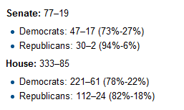

Slide 13
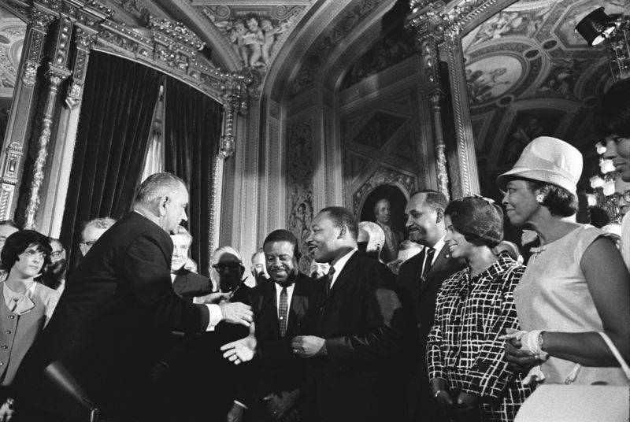

Slide 14


Slide 15
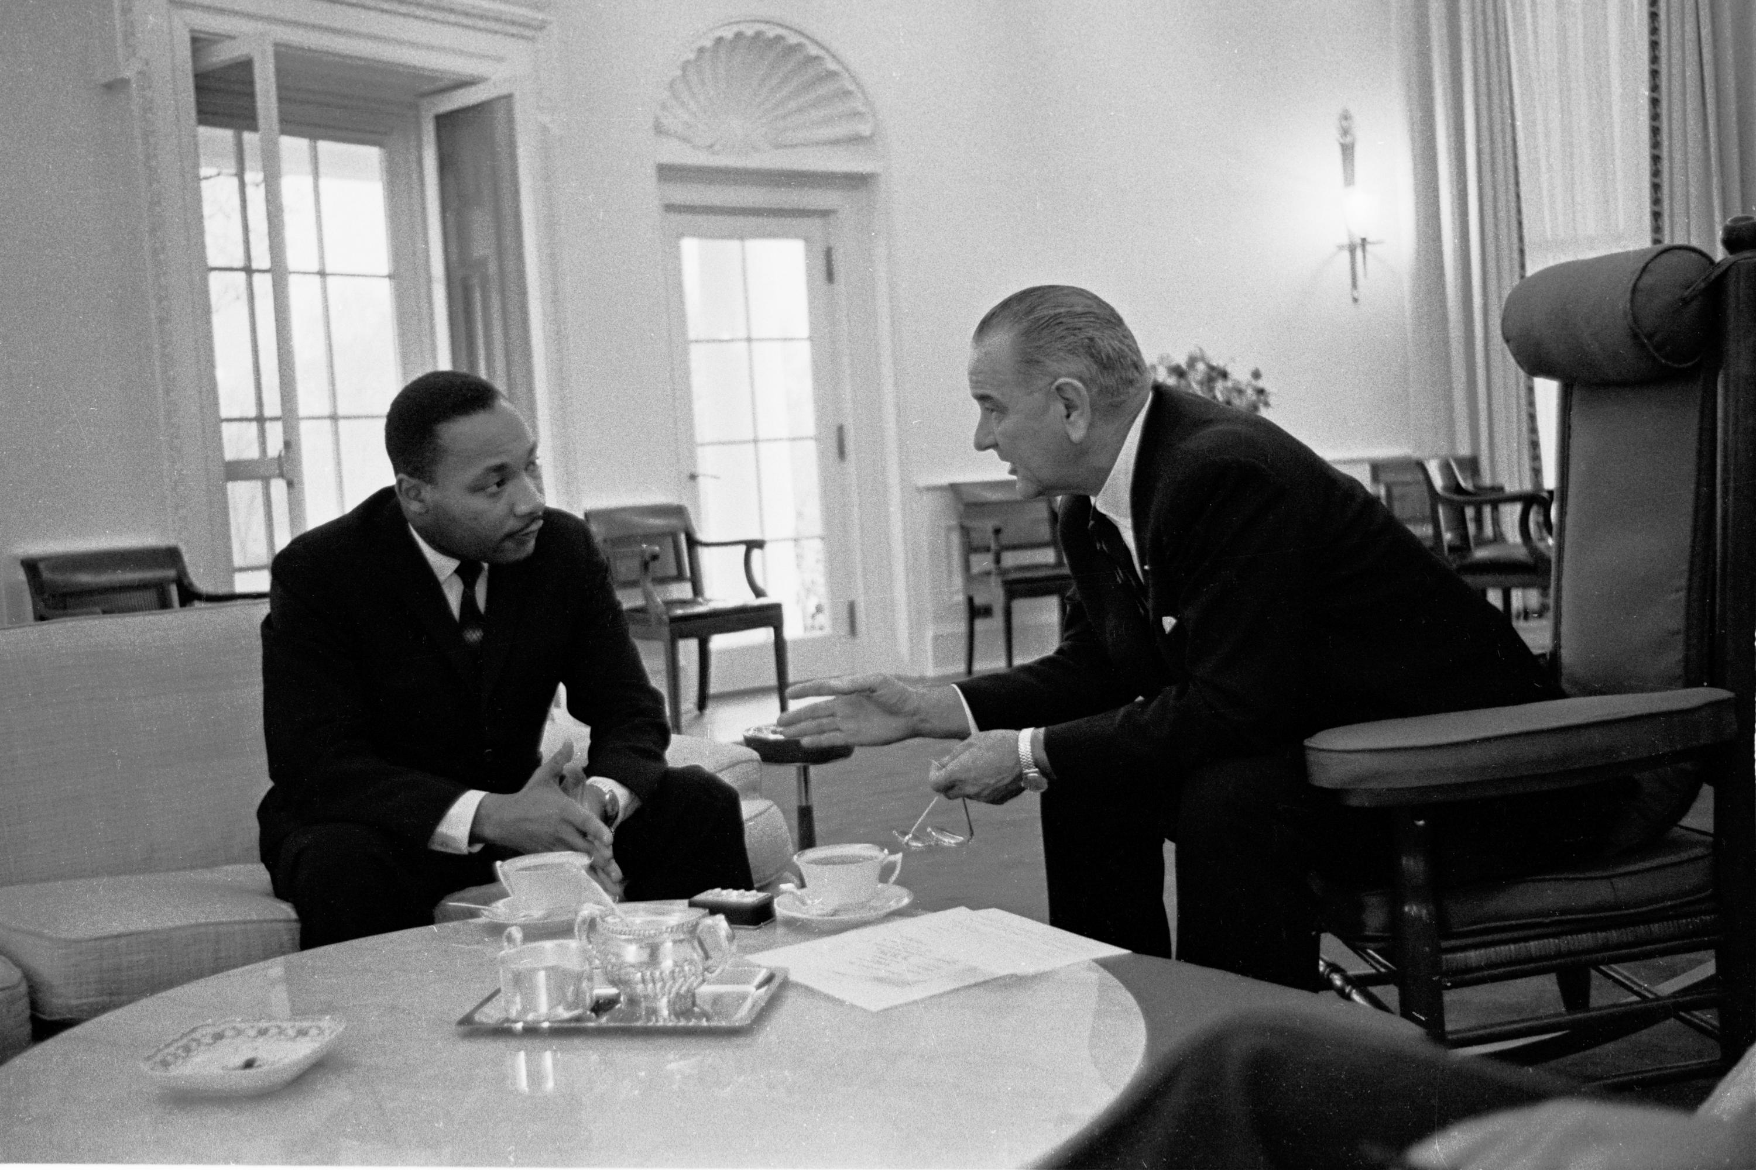

Slide 16
Martin Luther King, Jr.: It’s so important to get Negroes registered to vote in large numbers in the South, and it would be this coalition of the Negro vote and the moderate white vote that will really make the new South.
President Johnson: That’s exactly right.
I think it’s very important that we not say that we’re doing this—and we’re not doing this—just because it’s Negroes and whites. But we take the position that every person born in this country when they reach a certain age that he have a right to vote, just like he has a right to fight. And that we just extend it whether it’s a Negro, whether it’s a Mexican, or who it is.
King, Jr.: That’s right.
President Johnson: [with King assenting] And No. 2, I think that we don’t want special privilege for anybody, we want equality for all—and we can stand on that principle. But I think you can contribute a great deal by getting your leaders and you, yourself, taking very simple examples of discrimination [in voter registration]; where a man’s got to memorize a Longfellow [poem], or whether he’s got to quote the first 10 Amendments, or he’s got to tell you what Amendment 15, 16 and 17 is.
And then ask them if they know and show what happens and there are some people don’t have to do that, but when a Negro comes in he’s got to do it.

Slide 17
President Johnson: And if we can just repeat and repeat and repeat. I don’t want to follow Hitler, but he had an idea that if you just take a simple thing and repeat it often enough, even if it wasn’t true, why, people would accept it. Well, now this is true! And if you can find the worst condition that you run into in Alabama, Mississippi or Louisiana or South Carolina . . . being denied the right to cast a vote and if you just take that one illustration and get it on radio, and get it on television, and get it on — in the pulpits, get it in the meetings, get it everyplace you can. Pretty soon the fellow that didn’t do anything but drive a tractor will say, “Well, that’s not right; that’s not fair.” And then that will help us on what we going to shove through in the end.
King, Jr.: Yes, you’re exactly right about that.
President Johnson: And if we do that, we will break through as — it’ll be the greatest breakthrough of anything, not even excepting this ‘64 act. I think the greatest achievement of my administration—I think the greatest achievement in foreign policy, I said to a group yesterday, was the passage of the 1964 Civil Rights Act. But I think this will be bigger, because it’ll do things even that even that ‘64 act couldn’t do.

Slide 18
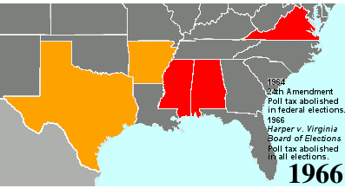

Slide 19
24th Amendment
Amendment XXIV
Section 1.
The right of citizens of the United States to vote in any primary or other election for President or Vice President, for electors for President or Vice President, or for Senator or Representative in Congress, shall not be denied or abridged by the United States or any state by reason of failure to pay any poll tax or other tax.
Section 2.
The Congress shall have power to enforce this article by appropriate legislation.

Slide 20
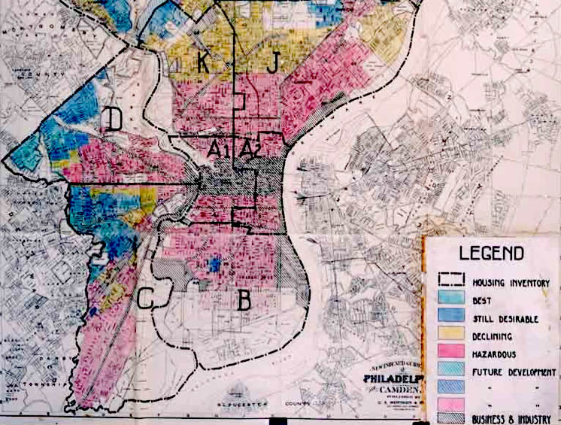

Slide 21


Slide 22
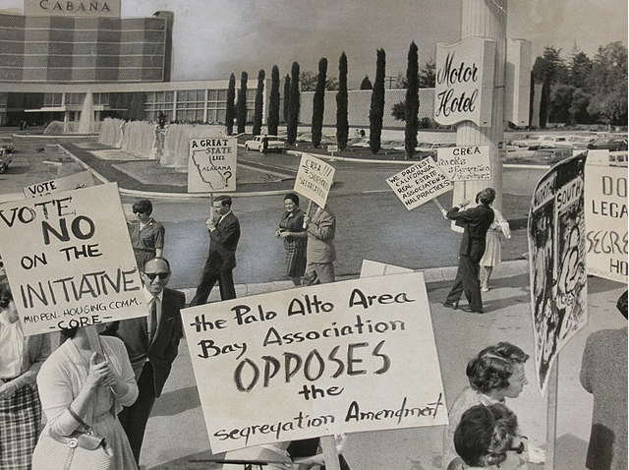

Slide 23


Slide 24
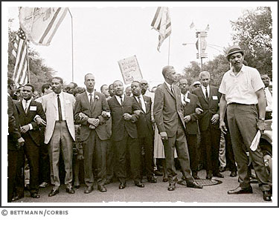
Notes:
Mlk in cgo

Slide 25
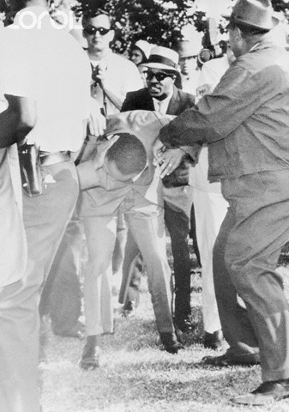
Notes:
Mlk stoned in cgo, 2468, we don’t want to integrate

Slide 26
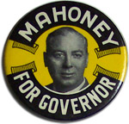
Notes:
71% white working class voters go for Mahoney

Slide 27
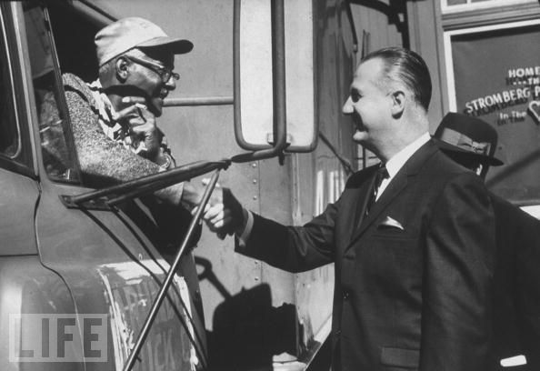

Slide 28
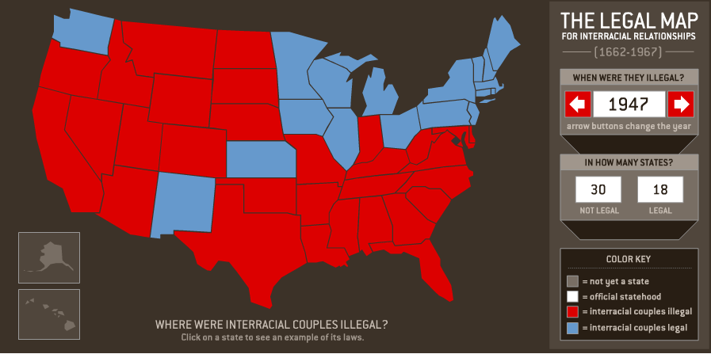

Slide 29
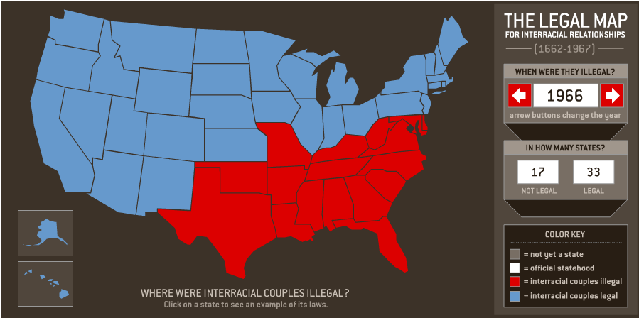

Slide 30
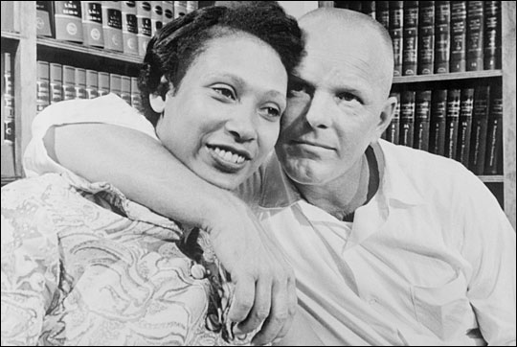

Slide 31
Section 259, Virginia criminal code (1958)
Leaving State to evade law. -- If any white person and colored person shall go out of this State, for the purpose of being married, and with the intention of returning, and be married out of it, and afterwards return to and reside in it, cohabiting as man and wife, they shall be punished as provided in § 20-59, and the marriage shall be governed by the same law as if it had been solemnized in this State. The fact of their cohabitation here as man and wife shall be evidence of their marriage.
Punishment for marriage. -- If any white person intermarry with a colored person, or any colored person intermarry with a white person, he shall be guilty of a felony and shall be punished by confinement in the penitentiary for not less than one nor more than five years.

Slide 32
Almighty God created the races, white, black, yellow, Malay, and red and placed them on separate continents, and but for the interference with his arrangement there would be no cause for such marriages. The fact that he separated the races shows that he did not intend the races to mix.
--Judge Leon Bazile (VA)
Naim v. Naim (VA Supreme Court, 1965)
“State's legitimate purposes were ‘to preserve the racial integrity of its citizens,’ and to prevent ‘the corruption of blood,’ ‘a mongrel breed of citizens,’ and ‘the obliteration of racial pride.’”

Slide 33
Loving v. Virginia (1967)
There is patently no legitimate overriding purpose independent of invidious racial discrimination which justifies this classification. The fact that Virginia prohibits only interracial marriages involving white persons demonstrates that the racial classifications must stand on their own justification, as measures designed to maintain White Supremacy. We have consistently denied the constitutionality of measures which restrict the rights of citizens on account of race. There can be no doubt that restricting the freedom to marry solely because of racial classifications violates the central meaning of the Equal Protection Clause . . .
Marriage is one of the "basic civil rights of man," fundamental to our very existence and survival. Skinner v. Oklahoma, (1942). To deny this fundamental freedom on so unsupportable a basis as the racial classifications embodied in these statutes, classifications so directly subversive of the principle of equality at the heart of the Fourteenth Amendment, is surely to deprive all the State's citizens of liberty without due process of law.
The Fourteenth Amendment requires that the freedom of choice to marry not be restricted by invidious racial discriminations. Under our Constitution, the freedom to marry, or not marry, a person of another race resides with the individual, and cannot be infringed by the State.

Slide 34
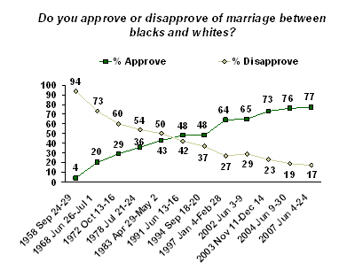

Slide 35
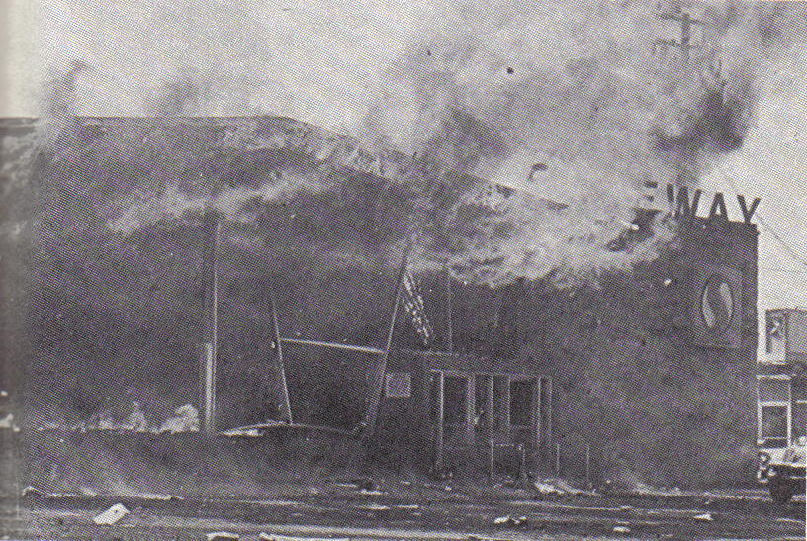

Slide 36
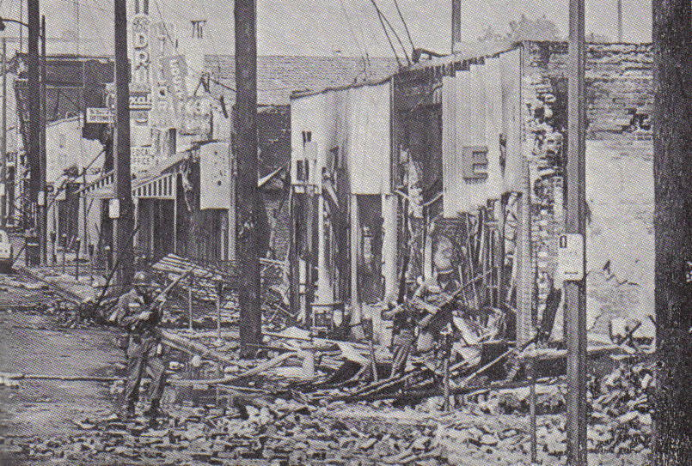

Slide 37
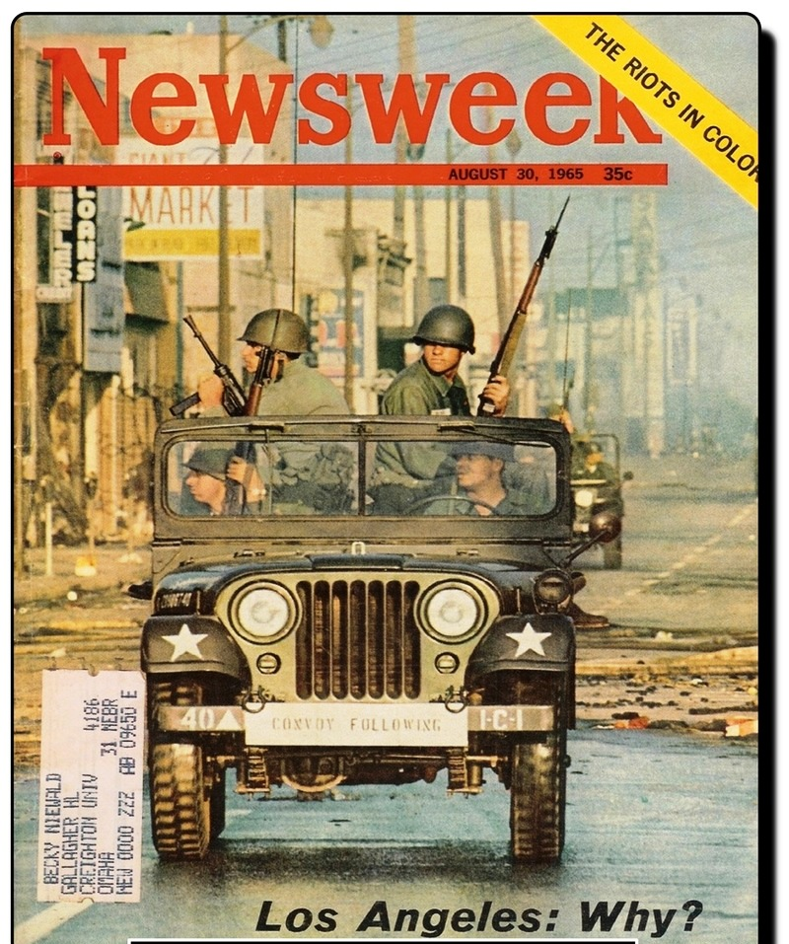

Slide 38
President Johnson: We are on powder kegs in a dozen places.
John McCone: Is that right?
President Johnson: What we’re ultimately going to have to do . . . You just have no idea of the depth of the feeling of these people [African-Americans]. You see . . . I see some of the boys [that have] worked for me that have had 2000 years of persecution [Jews] and how they suffer from it.
But these groups, they got really absolutely nothing to live for. Forty percent of ‘em are unemployed. These youngsters—they live with rats, and they’ve got no place to sleep. They start—they are all from broken homes, and illegitimate families, and all the . . . Narcotics are circulating around ‘em. And we’ve [whites] isolated them, and they are all in one area, and when they move in, why, we move out.
[Break.]
President Johnson: We’ve just got to find a way to wipe out these ghettoes.
McCone: Yeah.
President Johnson: And find someplace [for] housing, and put ‘em to work. We trained 12,000 last month, and found jobs for ‘em.

Slide 39
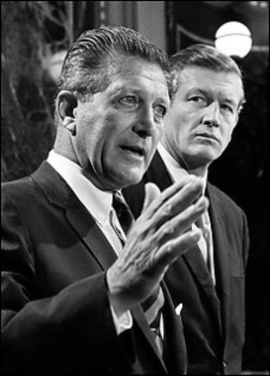
Notes:
kerner

Slide 40
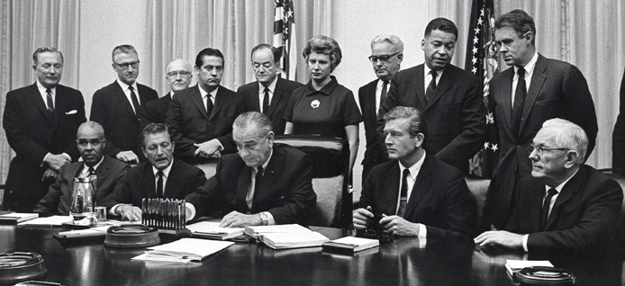

Slide 41
Kerner Commission report (1968)
This is our basic conclusion: Our nation is moving toward two societies, one black, one white—separate and unequal . . .
This deepening racial division is not inevitable. The movement apart can be reversed. Choice is still possible. Our principal task is to define that choice and to press for a national resolution.
To pursue our present course will involve the continuing polarization of the American community and, ultimately, the destruction of basic democratic values …
Segregation and poverty have created in the racial ghetto a destructive environment totally unknown to most white Americans.
What white Americans have never fully understood—but what the Negro can never forget—is that white society is deeply implicated in the ghetto. White institutions created it, white institutions maintain, and white society condones it.
It is time now to turn with all the purpose at our command to the major unfinished business of this nation. It is time to adopt strategies for action that will produce quick and visible progress. It is time to make good the promises of American democracy to all citizens—urban and rural, white and black, Spanish-surname, American Indian, and every minority group.

Slide 42
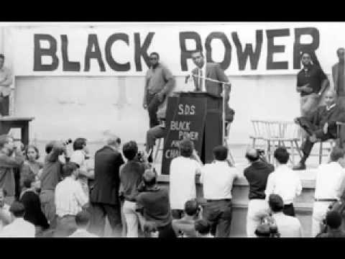

Slide 43
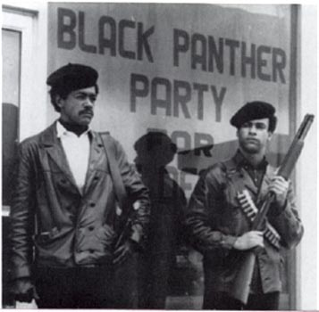

Slide 44
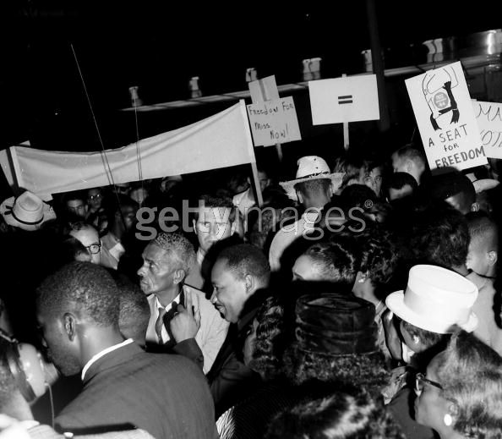

Slide 45


Slide 46
President Johnson: What’s happening is we’re doing four or five things. Number one: we’re coming in there and seating the state of Mississippi. Every damn one of them. Now, they oughtn’t to be, Carl. They oughtn’t to …
Carl Sanders: I don’t—
President Johnson: You and I just can’t survive our political modern life with these goddamned fellows down there [white Mississippi leaders] that are eating them for breakfast every morning. They’ve got to quit that. And they’ve got to let them [African-Americans] vote. And they’ve got to let them shave. And they’ve got to let them eat, and things like that. And they don’t do it.
However much we love [Democratic Senators] Jim Eastland and John Stennis, they get a governor like Ross Barnett, and he’s messing around there with [George] Wallace, and they won’t let one [black] man go in a precinct convention. We’ve got to put a stop to that, because that’s just like the old days, by God, when they wouldn’t let them go in and cast a vote of any kind.
You’ve put a stop to it in your state. But we’re going to ignore that. We’re going to say, “Hell, yes, you did it. You’re wrong. You violated the ’57 [civil rights] law, and you violated the ’60 [civil rights] law, and you violated the ’64 [civil rights] law, but we’re going to seat you—every damn one of you. [dripping with sarcasm] You lily white babies, we’re going to salute you.”

Slide 47
President Johnson: . . . Now, I’m a poor old man here that’s got a government falling on me.
In Vietnam today, I just walked out of the [National] Security Council. I’ve got [Defense Secretary Robert] McNamara coming in here at 6:00 tonight. I’m bringing [Ambassador to Vietnam] General [Maxwell] Taylor back. I’ve got Cyprus in a hell of a war.
I can’t go up there and tell those damn fellows, and argue with [Harlem congressman] Adam Clayton Powell and Martin Luther King and the fellow from Alabama—Bull Connor. They ought to try to make it as easy on me as they can, because they’ve all been in these things in their own state conventions. They’ve got problems, and they’re going to have them.
Now, this doesn’t hurt anybody. I’m for everybody taking the oath. Nobody claims they won’t do it except Mississippi and Alabama.
Sanders: That’s right, and now they say they’ll do it. They just don’t want to be singled out in writing.
President Johnson: Well, just tell them that every national committeeman has taken it, from every state, speaking for his state.
Sanders: Well, I agree with you. I—
President Johnson: Every one of them have already done it. But I don’t object. I’d come up there myself, walk out naked and take it, if it would ease Bull Connor’s pressure any.

Slide 48


Slide 49


Slide 50
Kevin Phillips on “Southern Strategy” (1970)
From now on, the Republicans are never going to get more than 10 to 20 percent of the Negro vote and they don't need any more than that... but Republicans would be shortsighted if they weakened enforcement of the Voting Rights Act. The more Negroes who register as Democrats in the South, the sooner the Negrophobe whites will quit the Democrats and become Republicans. That's where the votes are. Without that prodding from the blacks, the whites will backslide into their old comfortable arrangement with the local Democrats.

