Slide 1
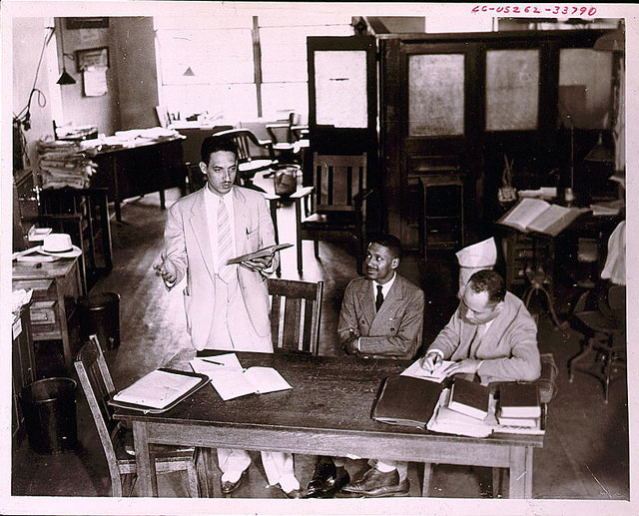

Slide 2
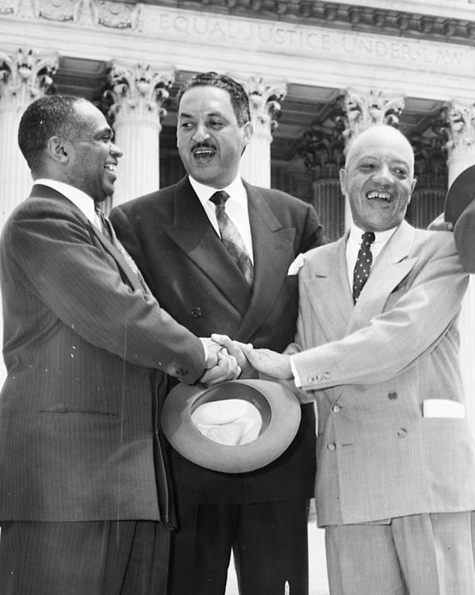

Slide 3
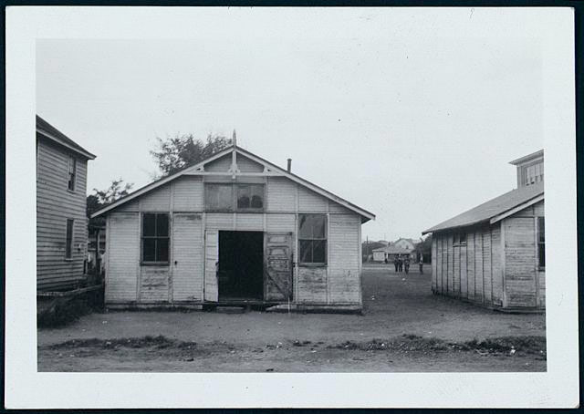

Slide 4
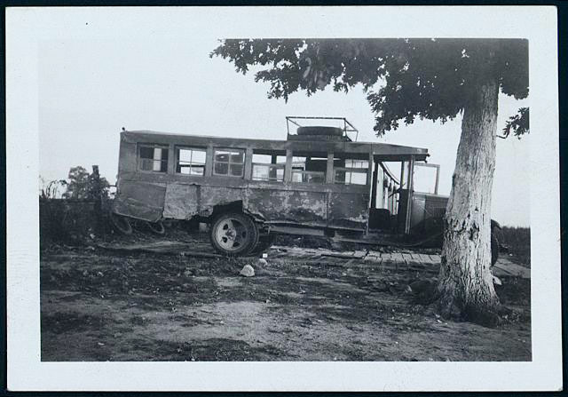

Slide 5
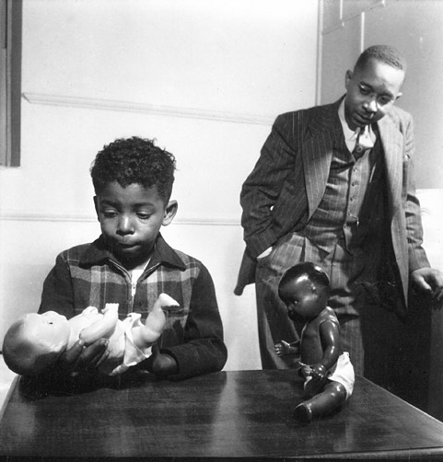

Slide 6
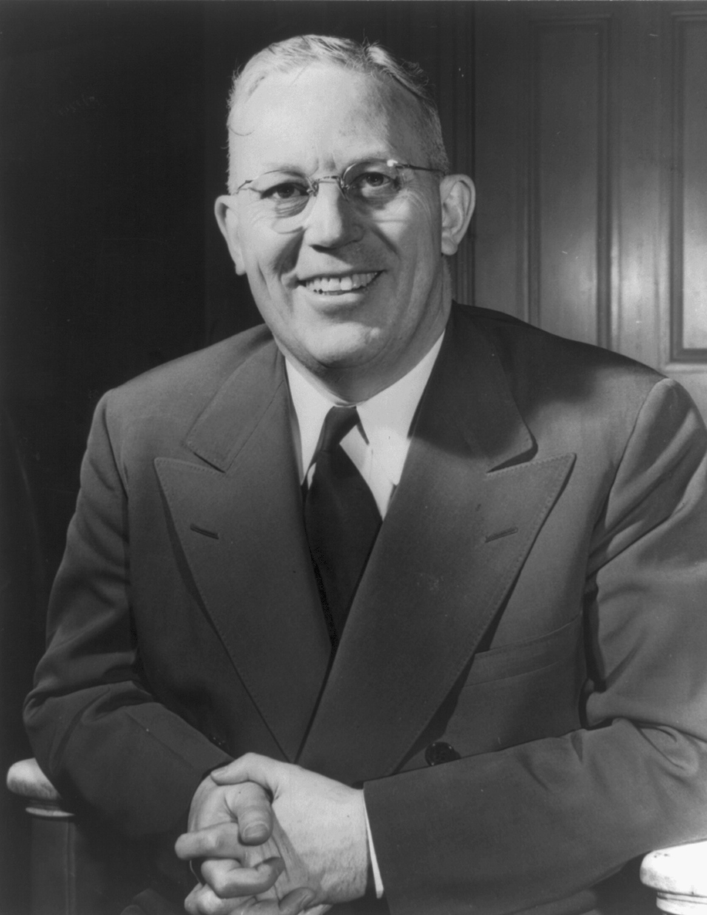

Slide 7


Slide 8
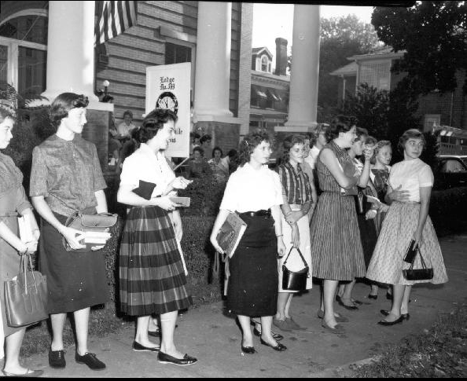

Slide 9
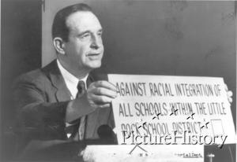

Slide 10
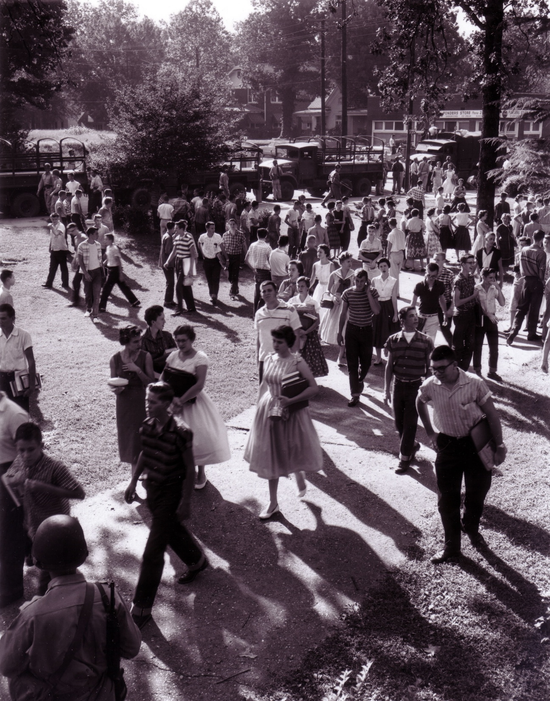

Slide 11
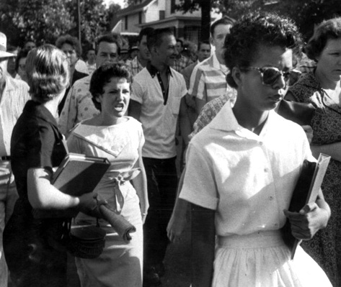

Slide 12
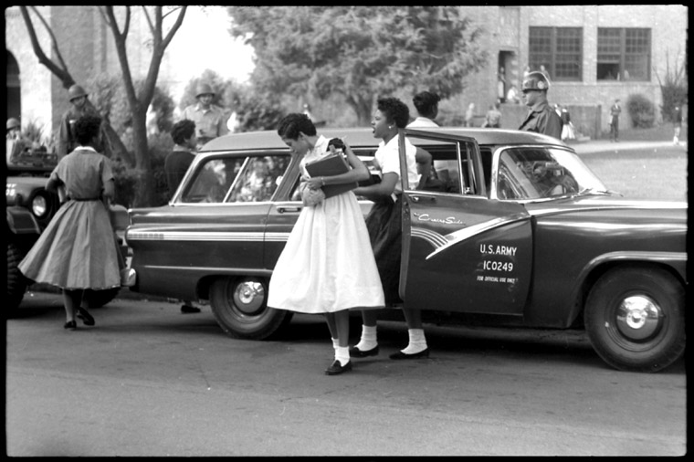

Slide 13


Slide 14
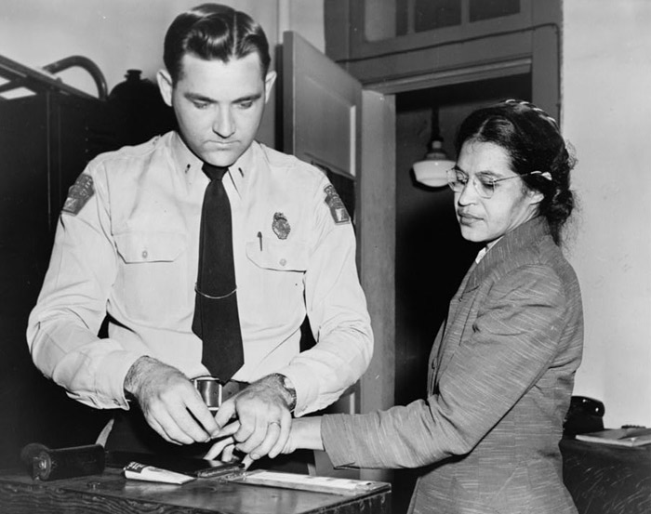

Slide 15
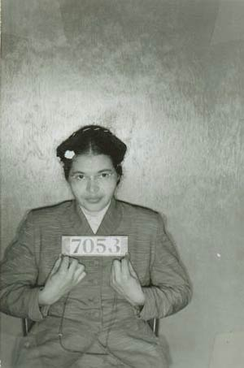

Slide 16
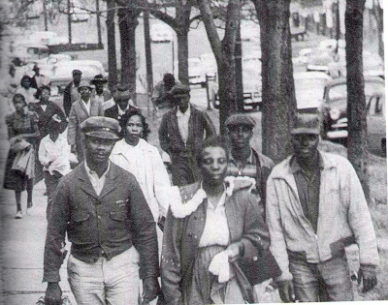

Slide 17
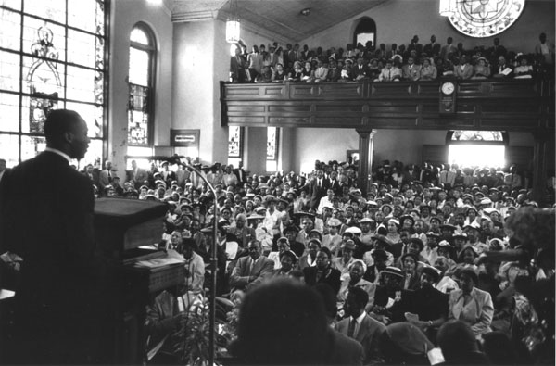

Slide 18
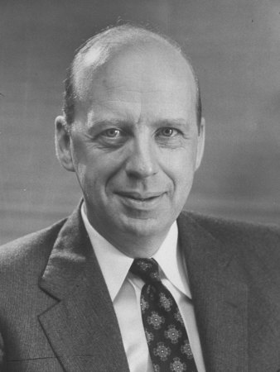
Notes:
brownell

Slide 19
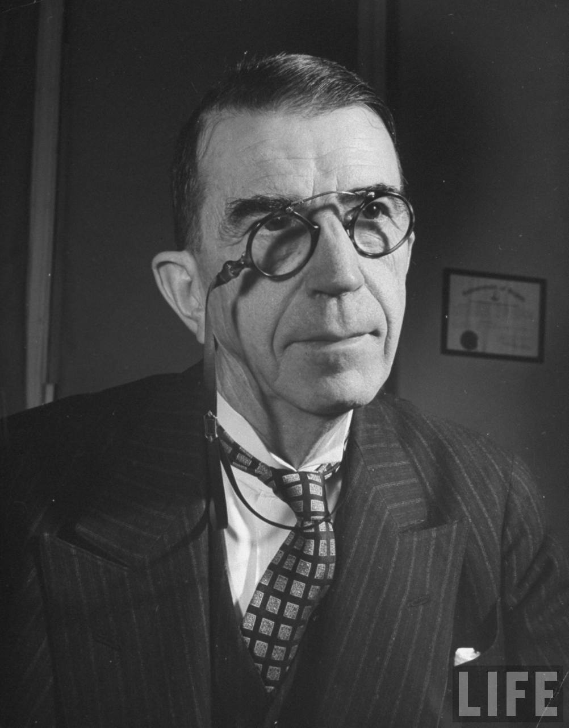

Slide 20
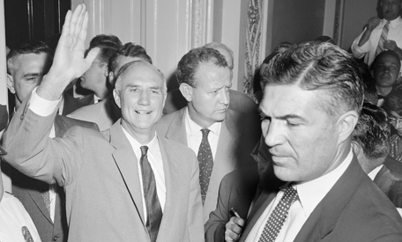

Slide 21
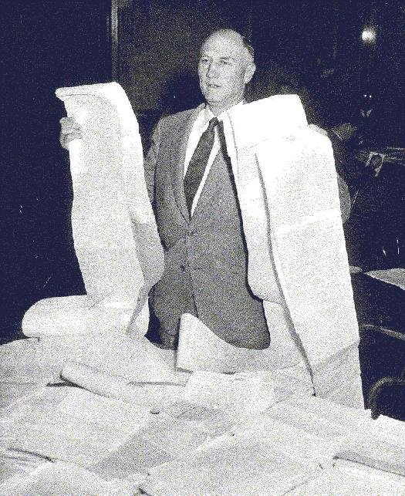

Slide 22
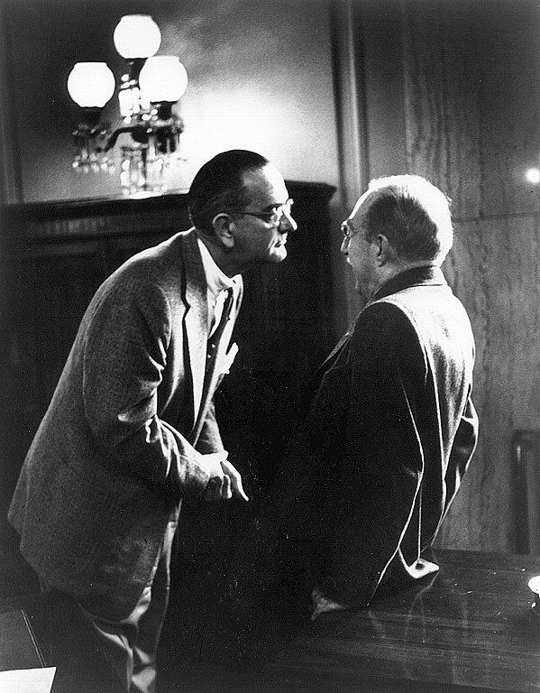

Slide 23
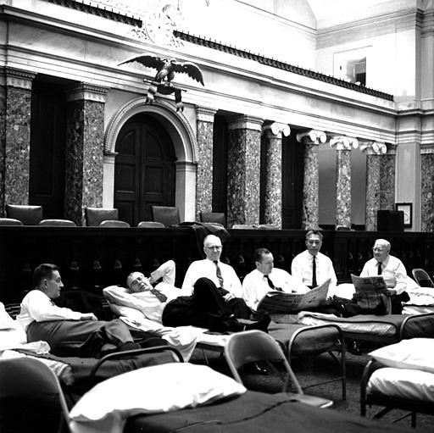

Slide 24
PART V. TO PROVIDE TRIAL BY JURY FOR PROCEEDINGS TO PUNISH CRIMINAL CONTEMPTS OF COURT GROWING OUT OF CIVIL RIGHTS CASES AND TO AMEND THE JUDICIAL CODE RELATING TO FEDERAL JURY QUALIFICATIONS.
Section 151.
All cases of criminal contempt arising under the provisions of this Act, the accused, upon conviction, shall be punished by fine or imprisonment or both: Provided however, That in case the accused is a natural person the fine to be paid shall not exceed the sum of $1,000, nor shall imprisonment exceed the term of six months: Provided Further, that in any such proceeding for criminal contempt, at the discretion of the judge, the accused may be tried with or without a jury: Provided further, however, That in the event such proceeding for a criminal contempt be tried before a judge without a jury and the sentence of the court upon conviction is a fine in excess of the sum of $30 or imprisonment in excess of forty-five days, the accused in said proceeding, upon demand therefor, shall be entitled to a trial de novo before a jury which shall conform as near as may be to the practice in other criminal cases.

Slide 25
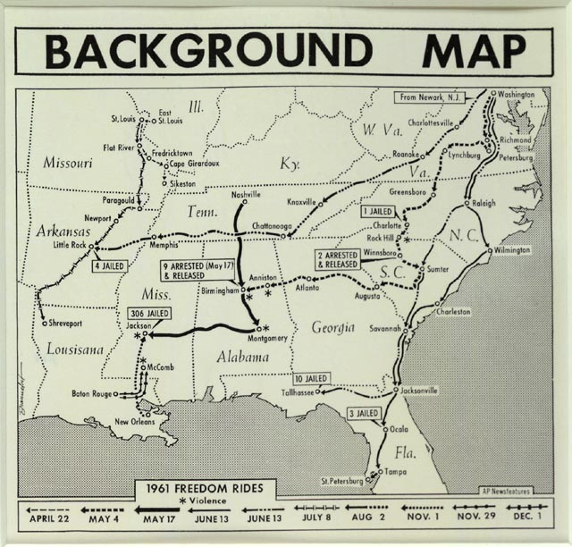

Slide 26
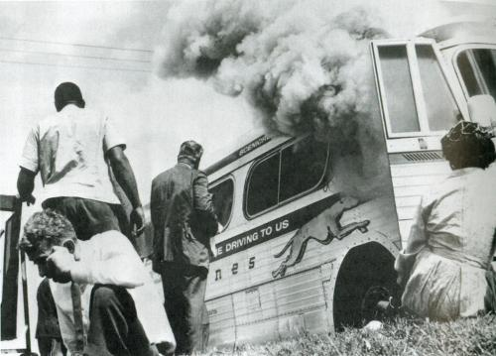

Slide 27
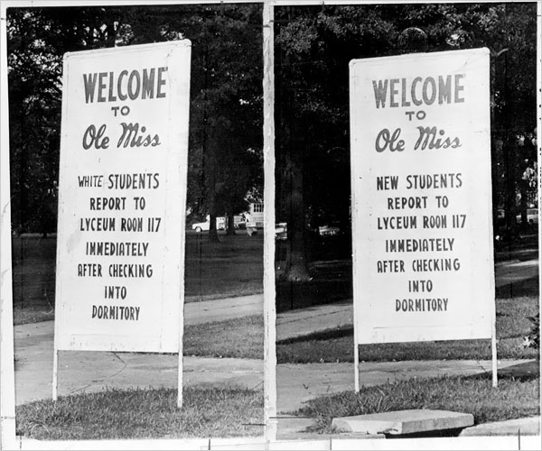

Slide 28


Slide 29
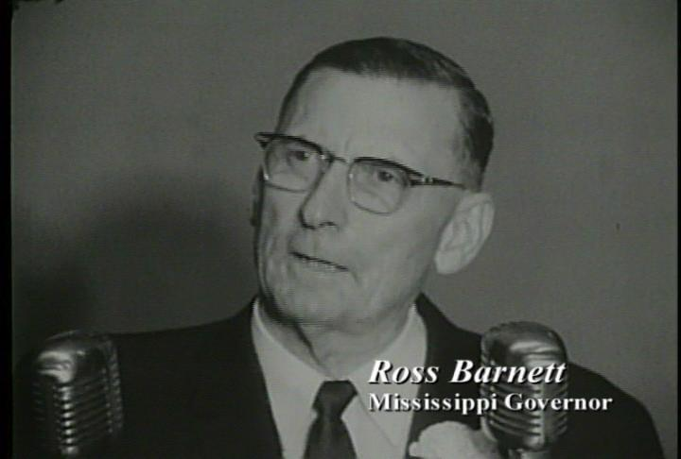

Slide 30
Robert Kennedy: I think, Governor, that the President had some questions that he wanted answers to—
Ross Barnett: Well—
Robert Kennedy: —to make his own determination.
Barnett: That’s right. He wanted to know if I would obey the orders of the court, and I told him I’d have to do some . . . study that over. That’s a serious thing.
I’ve taken an oath to abide by the laws of this state and our state constitution and the constitution of the United States. And, General, how can I violate my oath of office? How can I do that, and live with the people of Mississippi? You know, they’re expecting me to keep my word. That’s what I’m up against—
President Kennedy: Oh Governor—
Barnett: —and I don’t understand why the court wouldn’t understand that—
President Kennedy: Governor, this is the President speaking.
Barnett: Yes, sir, Mr. President.
President Kennedy: Now it’s—I know that your feeling about the law of Mississippi and the fact that you don’t want to carry out that court order.
What we really want to have from you, though, is some understanding about whether the state police will maintain law and order. We understand your feeling about the court order—
Barnett: Yes.

Slide 31
President Kennedy: —and your disagreement with it. But what we’re concerned about is how much violence there’s going to be and what kind of action we’ll have to take to prevent it. And I’d like to get assurances from you that the state police down there will take positive action to maintain law and order. Then we’ll know what we have to do.
Barnett: They’ll take positive action, Mr. President, to maintain law and order as best we can.
President Kennedy: And, now, how good is—
Barnett: We’ll have 220 highway patrolmen—
President Kennedy: Right.
Barnett: And they’ll absolutely be unarmed.
President Kennedy: Right—
Barnett: Not a one of them will be armed.
President Kennedy: Well, no—but the problem is—well, what can they do to maintain law and order and prevent the gathering of a mob and action taken by the mob? What can they do? Can they stop that?
Barnett: Well, they’ll do their best to. They’ll do everything in their power to stop it.
President Kennedy: Now, what about the suggestions made by the Attorney General in regard to not permitting people to congregate and start a mob?

Slide 32
Barnett: Well, we’ll do our best to keep ‘em from congregating, but that’s hard to do, you know.
President Kennedy: Well, just tell them to move along.
Barnett: When they start moving up on the sidewalks and different sides of the streets, what are you going to do about it?
President Kennedy: Well, now, as I understand it, Governor, you would do everything you can to maintain law and order.
Barnett: I’ll do everything in my power to maintain order—
President Kennedy: Right. Now—
Barnett: —and peace. We don’t want any shooting down here.
President Kennedy: I understand. Now, Governor, what about—can you maintain this order?
Barnett: Well, I don’t know.
President Kennedy: Yes.
Barnett: That’s what I’m worried about.
President Kennedy: I see.
Barnett: I don’t know whether I can or not.
President Kennedy: Right.
Barnett: I couldn’t have the other afternoon. [On Sept. 27, 1962, 2000 people, including students, farmers, and self-styled vigilantes, converged on Oxford to stop Meredith from registering.]

Slide 33
President Kennedy: You couldn’t have?
Barnett: There was such a mob there, it would have been impossible.
President Kennedy: I see.
Barnett: There were men in there with trucks and shotguns, and all such as that. Not a lot of ‘em, but some, we saw, and certain people were just—they were just enraged.
President Kennedy: Well, now, will you talk—
Barnett: You just don’t understand the situation down here.
President Kennedy: Well, the only thing is I got my responsibility.
Barnett: I know you do.
President Kennedy: This is not my order; I just have to carry it out. So I want to get together and try to do it with you in a way which is the most satisfactory and causes the least chance of damage to people in Mississippi. That’s my interest.
Barnett: That’s right. Would you be willing to wait awhile and let the people cool off on the whole thing?
President Kennedy: ‘Till how long?
Barnett: Couldn’t you make a statement to the effect, Mr. President, Mr. [Attorney] General, that under the circumstances existing in Mississippi, that there’ll be bloodshed; you want to protect the life of, of James Meredith and all other people? And under the circumstances at this time, it just wouldn’t be fair to him or others to try to register him—

Slide 34
President Kennedy: Well, then at what time would it be fair?
Barnett: Well, we, we could wait a—I don’t know.
President Kennedy: Yeah.
Barnett: It might be in two or three weeks, it might cool off a little.
President Kennedy: Well, would you undertake to register him in two weeks?
Barnett: Well, now, you know I can’t undertake to register him myself—
President Kennedy: I see.
Barnett: —but you all might make some progress that way, you know.
President Kennedy: [Laughs sarcastically.] Yeah. Well, we’d be faced with—unless we had your support and assurance, we’d be—
Barnett: I say I’m going to, I’m going to cooperate. I might not know when you’re going to register him, you know.
President Kennedy: I see.

Slide 35
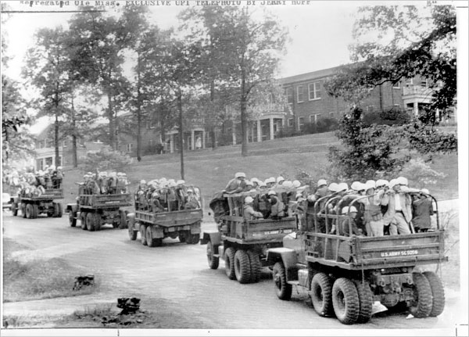

Slide 36
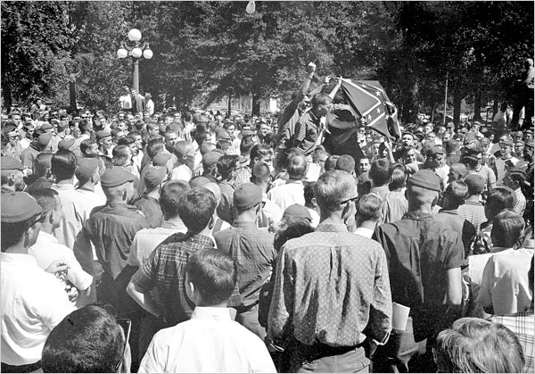

Slide 37


Slide 38


Slide 39


Slide 40
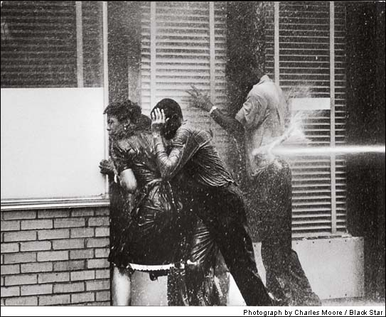

Slide 41
Martin Luther King, Jr.: Now, the real problem that we face is this: the Negro community is about to reach a breaking point. There is a great deal of frustration and despair and confusion in the Negro community, and there is this feeling of being alone and not protected.
If you walk the street, you aren’t safe. If you stay at home, you aren’t safe; there is the danger of a bomb. If you’re in church now, it isn’t safe. So that the Negro feels that everywhere he goes, if he remains stationary, he’s in danger of some physical violence.

Slide 42
Martin Luther King, Jr.: Now, this presents a real problem for those of us who find ourselves in leadership positions. Because we are preaching, at every moment, the philosophy and the method of non-violence. And I think I can say, without fear of successful contradiction, that we have been consistent at standing up for nonviolence at every point, and even with Sunday’s [the church bombing] and Monday’s [allegations of police brutality against demonstrators] developments, we continue to be firm at this point.
But more and more, we are facing the problem of our people saying, “What’s the use?”
[Break.]

Slide 43
President Kennedy: Now, it’s tough for the Negro community. On the other hand, what the Negro community is trying to do is a very important effort, which has implications all over the country. And I know that this bombing is particularly difficult.
But if you look at any—as you know—any of these struggles over a period across the world, it is a very dangerous effort. So everybody just has to keep their nerve. If the Negroes should begin to respond and shoot at whites, we lose.
I think [Alabama governor George] Wallace has lost. I heard a Southern senator with regards to civil rights say to me today, this is what I hear from him—that Wallace has made a bad mistake [in endorsing the brutal police response to the protests].

Slide 44
President Kennedy: Now if you get . . . Wallace is in a bad position. And because you gentlemen and the community have conducted yourselves in the way you have, it’s with you. And of course when the police starts going for guns, they’ll shoot some innocent people, and they’ll be white, and then that will just wipe away all this support that’s built up.
There will be no—in the beginning, you can’t get anything. I can’t do very much. Congress can’t do very much unless we keep the support of the white community throughout the country—as a country. Once that goes, then we’re pretty much really down to a racial struggle, so that I think we’ve just got to tell the Negro community that this is a very hard price which they have to pay to get this job done.

Slide 45
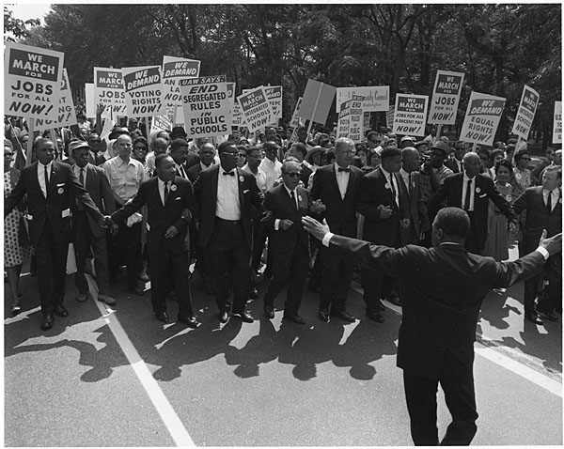

Slide 46


Slide 47
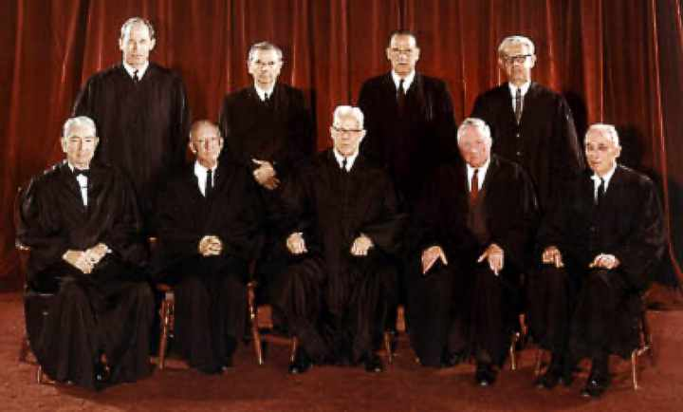

Slide 48
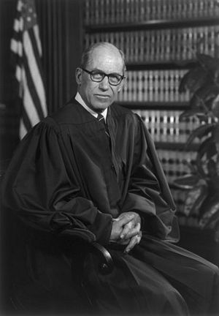
Notes:
white

Slide 49
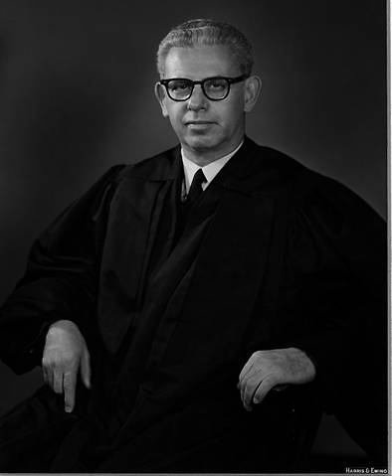

Slide 50
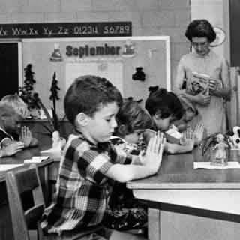

Slide 51
Regents’ prayer—New York
Almighty God, we acknowledge our dependence upon Thee, and we beg Thy blessings upon us, our parents, our teachers and our Country.

Slide 52
Engel v. Vitale (1962)
We think that, by using its public school system to encourage recitation of the Regents' prayer, the State of New York has adopted a practice wholly inconsistent with the Establishment Clause. There can, of course, be no doubt that New York's program of daily classroom invocation of God's blessings as prescribed in the Regents' prayer is a religious activity. It is a solemn avowal of divine faith and supplication for the blessings of the Almighty . . .
It has been argued that to apply the Constitution in such a way as to prohibit state laws respecting an establishment of religious services in public schools is to indicate a hostility toward religion or toward prayer. Nothing, of course, could be more wrong . . .
It is neither sacrilegious nor anti-religious to say that each separate government in this country should stay out of the business of writing or sanctioning official prayers and leave that purely religious function to the people themselves and to those the people choose to look to for religious guidance.

Slide 53
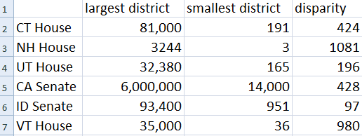
Pre- Baker v. Carr Legislative Disparities

Slide 54
Baker v. Carr (1962)—Frankfurter dissent
The Court today reverses a uniform course of decision established by a dozen cases, including one by which the very claim now sustained was unanimously rejected only five years ago. The impressive body of rulings thus cast aside reflected the equally uniform course of our political history regarding the relationship between population and legislative representation . . . Disregard of inherent limits in the effective exercise of the Court's "judicial Power" not only presages the futility of judicial intervention in the essentially political conflict of forces by which the relation between population and representation has time out of mind been, and now is, determined. It may well impair the Court's position as the ultimate organ of "the supreme Law of the Land" in that vast range of legal problems, often strongly entangled in popular feeling, on which this Court must pronounce. The Court's authority -- possessed of neither the purse nor the sword -- ultimately rests on sustained public confidence in its moral sanction. Such feeling must be nourished by the Court's complete detachment, in fact and in appearance, from political entanglements and by abstention from injecting itself into the clash of political forces in political settlements.

Slide 55
Mapp v. Ohio (1961)—Harlan dissent
In overruling the Wolf case, the Court, in my opinion, has forgotten the sense of judicial restraint which, with due regard for stare decisis, is one element that should enter into deciding whether a past decision of this Court should be overruled . . . I am bound to say that what has been done is not likely to promote respect either for the Court's adjudicatory process or for the stability of its decisions . . .
The preservation of a proper balance between state and federal responsibility in the administration of criminal justice demands patience on the part of those who might like to see things move faster among the States in this respect . . .
I think this Court can increase respect for the Constitution only if it rigidly respects the limitations which the Constitution places upon it, and respects as well the principles inherent in its own processes. In the present case, I think we exceed both, and that our voice becomes only a voice of power, not of reason.

