Slide 1
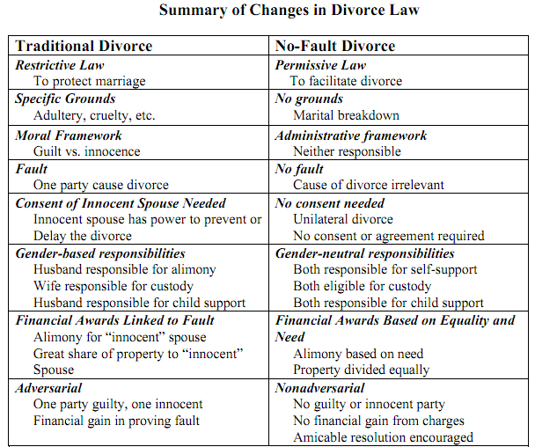

Slide 2
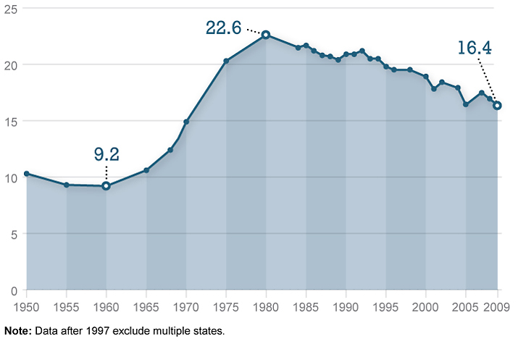

Slide 3
Roe v. Wade (1973)—Rehnquist dissent
I have difficulty in concluding, as the Court does, that the right of "privacy" is involved in this case. Texas, by the statute here challenged, bars the performance of a medical abortion by a licensed physician on a plaintiff such as Roe. A transaction resulting in an operation such as this is not "private" in the ordinary usage of that word. Nor is the "privacy" that the Court finds here even a distant relative of the freedom from searches and seizures protected by the Fourth Amendment to the Constitution . . .
The decision here to break pregnancy into three distinct terms and to outline the permissible restrictions the State may impose in each one, for example, partakes more of judicial legislation than it does of a determination of the intent of the drafters of the Fourteenth Amendment . . .
The fact that a majority of the States reflecting, after all, the majority sentiment in those States, have had restrictions on abortions for at least a century is a strong indication, it seems to me, that the asserted right to an abortion is not "so rooted in the traditions and conscience of our people as to be ranked as fundamental.” . . .
There apparently was no question concerning the validity of this provision or of any of the other state statutes when the 14th Amendment was adopted. The only conclusion possible from this history is that the drafters did not intend to have the 14th Amendment withdraw from the States the power to legislate with respect to this matter.

Slide 4


Slide 5
Hyde amendment (1976)
Public Law 111-8
H.R. 1105, Division F, Title V, General Provisions
SEC. 507. (a) None of the funds appropriated in this Act, and none of the funds in any trust fund to which funds are appropriated in this Act, shall be expended for any abortion.
(b) None of the funds appropriated in this Act, and none of the funds in any trust fund to which funds are appropriated in this Act, shall be expended for health benefits coverage that includes coverage of abortion . . .
SEC. 508. (a) The limitations established in the preceding section shall not apply to an abortion--
(1) if the pregnancy is the result of an act of rape or incest; or
(2) in the case where a woman suffers from a physical disorder, physical injury, or physical illness, including a life-endangering physical condition caused by or arising from the pregnancy itself, that would, as certified by a physician, place the woman in danger of death unless an abortion is performed.

Slide 6
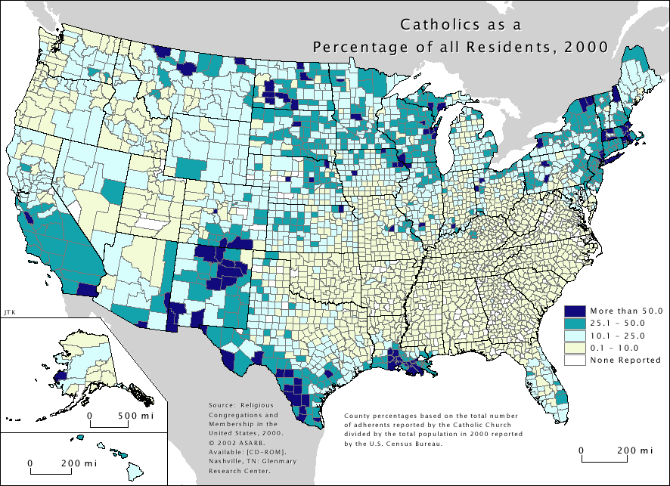

Slide 7


Slide 8


Slide 9
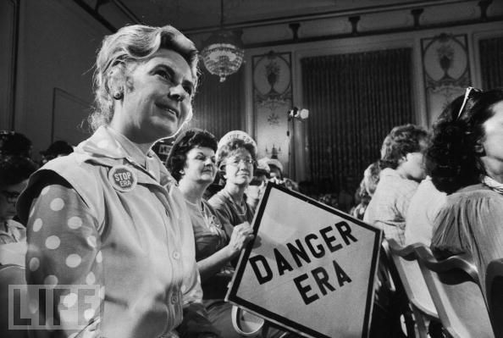

Slide 10
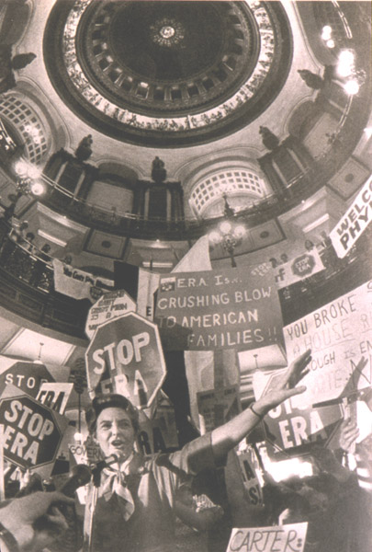

Slide 11


Slide 12


Slide 13
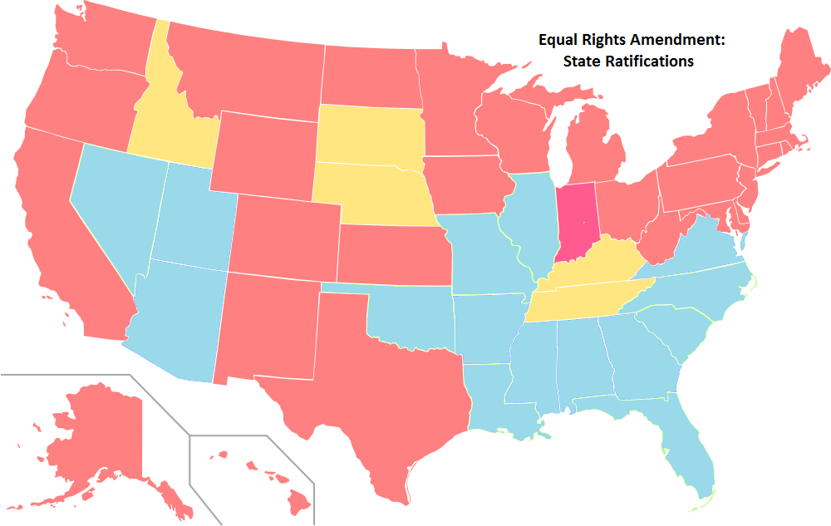

Slide 14
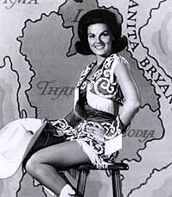

Slide 15


Slide 16
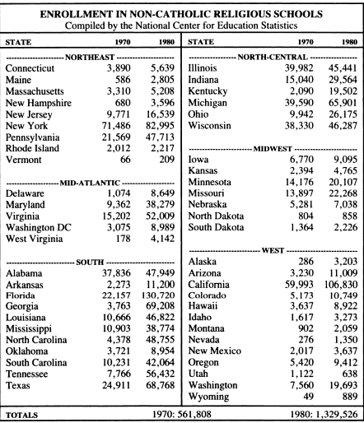

Slide 17
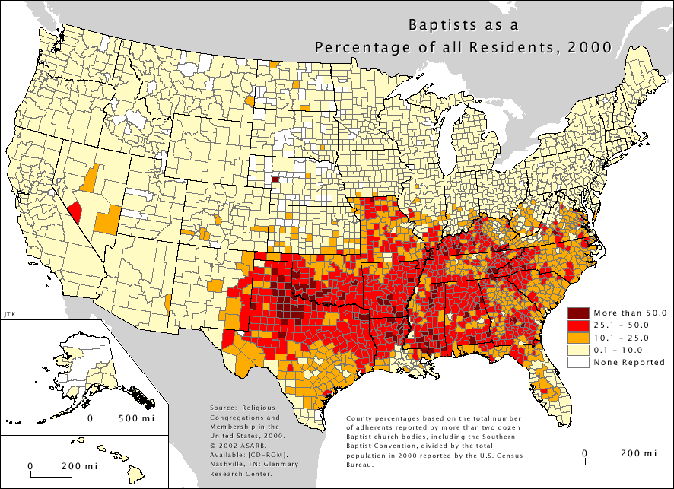

Slide 18
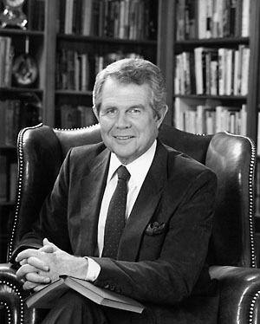

Slide 19
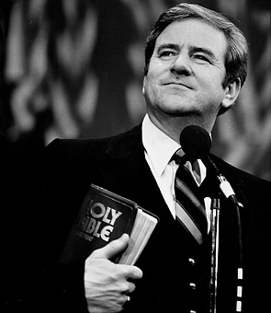

Slide 21
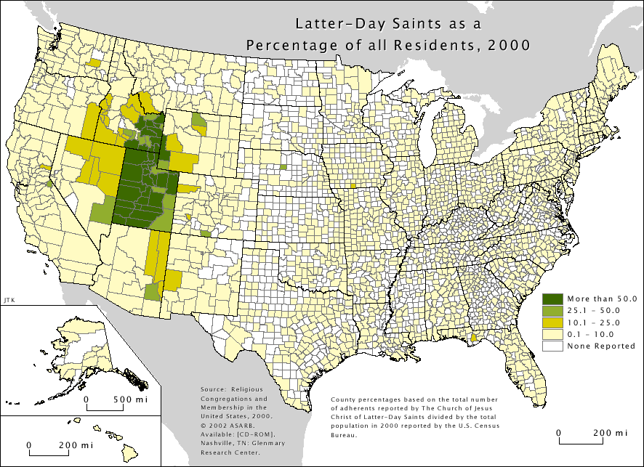

Slide 22



Slide 23
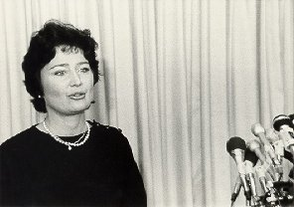
Notes:
gorsuch

Slide 24
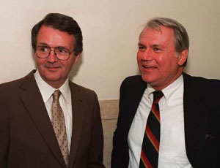

Slide 25
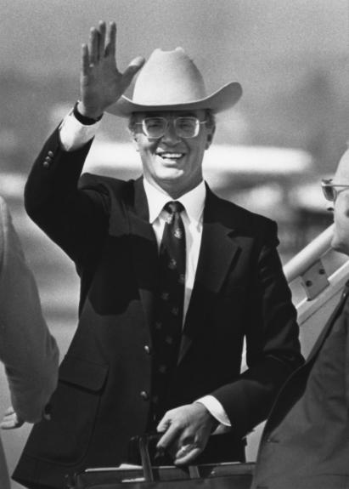

Slide 26
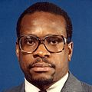

Slide 27
Reagan @ Neshoba County Fair, 1980
I believe in states' rights; I believe in people doing as much as they can for themselves at the community level and at the private level.
And I believe that we've distorted the balance of our government today by giving powers that were never intended in the constitution to that federal establishment.
And if I do get the job I'm looking for, I'm going to devote myself to trying to reorder those priorities and to restore to the states and local communities those functions which properly belong there.

Slide 28


Slide 29


Slide 30
INS v. Chadha (1983)—White dissent
The prominence of the legislative veto mechanism in our contemporary political system and its importance to Congress can hardly be overstated. It has become a central means by which Congress secures the accountability of executive and independent agencies. Without the legislative veto, Congress is faced with a Hobson's choice: either to refrain from delegating the necessary authority, leaving itself with a hopeless task of writing laws with the requisite specificity to cover endless special circumstances across the entire policy landscape, or, in the alternative, to abdicate its lawmaking function to the Executive Branch and independent agencies. To choose the former leaves major national problems unresolved; to opt for the latter risks unaccountable policymaking by those not elected to fill that role. Accordingly, over the past five decades, the legislative veto has been placed in nearly 200 statutes. The device is known in every field of governmental concern: reorganization, budgets, foreign affairs, war powers, and regulation of trade, safety, energy, the environment, and the economy . . .
The history of the legislative veto also makes clear that it has not been a sword with which Congress has struck out to aggrandize itself at the expense of the other branches -- the concerns of Madison and Hamilton. Rather, the veto has been a means of defense, a reservation of ultimate authority necessary if Congress is to fulfill its designated role under Art. I as the Nation's lawmaker.

Slide 31
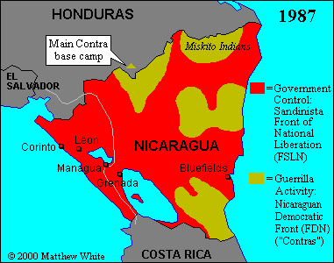

Slide 32
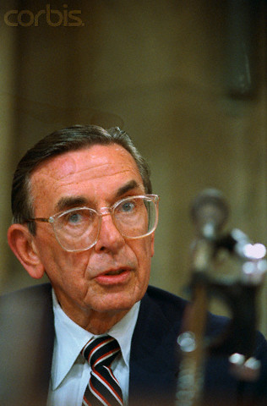

Slide 33
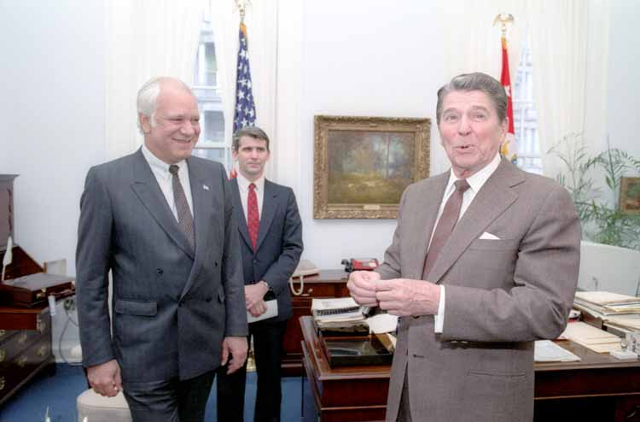

Slide 34


Slide 35
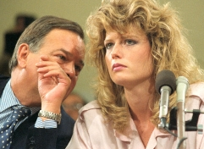

Slide 36
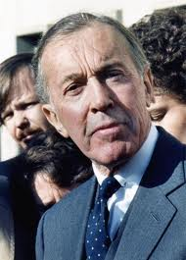

Slide 37
Morrison v. Olson (1988)—Scalia dissent
That is what this suit is about. Power. The allocation of power among Congress, the President, and the courts in such fashion as to preserve the equilibrium the Constitution sought to establish -- so that "a gradual concentration of the several powers in the same department," Federalist No. 51, p. 321 (J. Madison), can effectively be resisted. Frequently an issue of this sort will come before the Court clad, so to speak, in sheep's clothing: the potential of the asserted principle to effect important change in the equilibrium of power is not immediately evident, and must be discerned by a careful and perceptive analysis. But this wolf comes as a wolf . . .
The purpose of the separation and equilibration of powers in general, and of the unitary Executive in particular, was not merely to assure effective government but to preserve individual freedom. Those who hold or have held offices covered by the Ethics in Government Act are entitled to that protection as much as the rest of us, and I conclude my discussion by considering the effect of the Act upon the fairness of the process they receive.
Only someone who has worked in the field of law enforcement can fully appreciate the vast power and the immense discretion that are placed in the hands of a prosecutor with respect to the objects of his investigation.

