Slide 1
From and after the first day of December 1660, and from thenceforward, no goods or commodities whatsoever shall be imported into or exported out of any lands, islands, plantations or territories to his Majesty belonging or in his possession . . . but in such ships or vessels as do truly and without fraud belong only to the people of England or Ireland . . .
II. And be it enacted, That no alien or person not born within the allegiance of our sovereign lord the King, his heirs and successors . . . shall from and after the first day of February, 1661, exercise the trade of a merchant or factor in any of the said places; upon the pain of forfeiture and loss of all his goods and chattels. . . .
III. And it is further enacted, That no goods or commodities whatsoever, of the growth, production or manufacture of Africa, Asia, or America, or any part thereof . . . be imported into England, Ireland, or Wales . . . in any other ship or ships, vessel or vessels whatsoever, but in such as do truly and without fraud belong only to the people of England, Ireland or Wales. . . .
XVIII. And be it further enacted, That from and after the first day of April, 1661, no sugars, tobacco, cotton-wool, indigos, ginger, fustick, or other dying wood, of the growth, production or manufacture of any English plantations in America, Asia, or Africa, shall be shipped, carried, conveyed or transported from any of the said English plantations to any land . . . other than to such English plantations as do belong to his Majesty. . . .

Slide 2
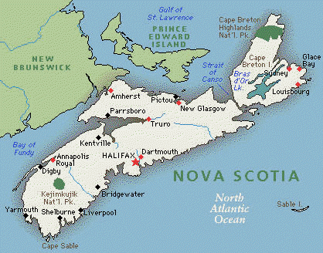

Slide 3
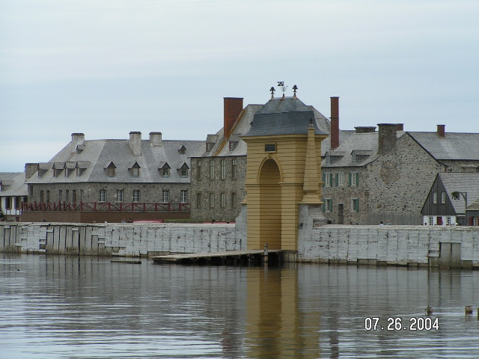

Slide 4
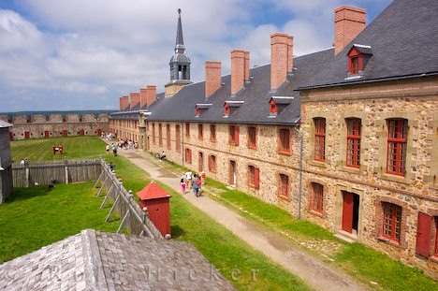

Slide 5
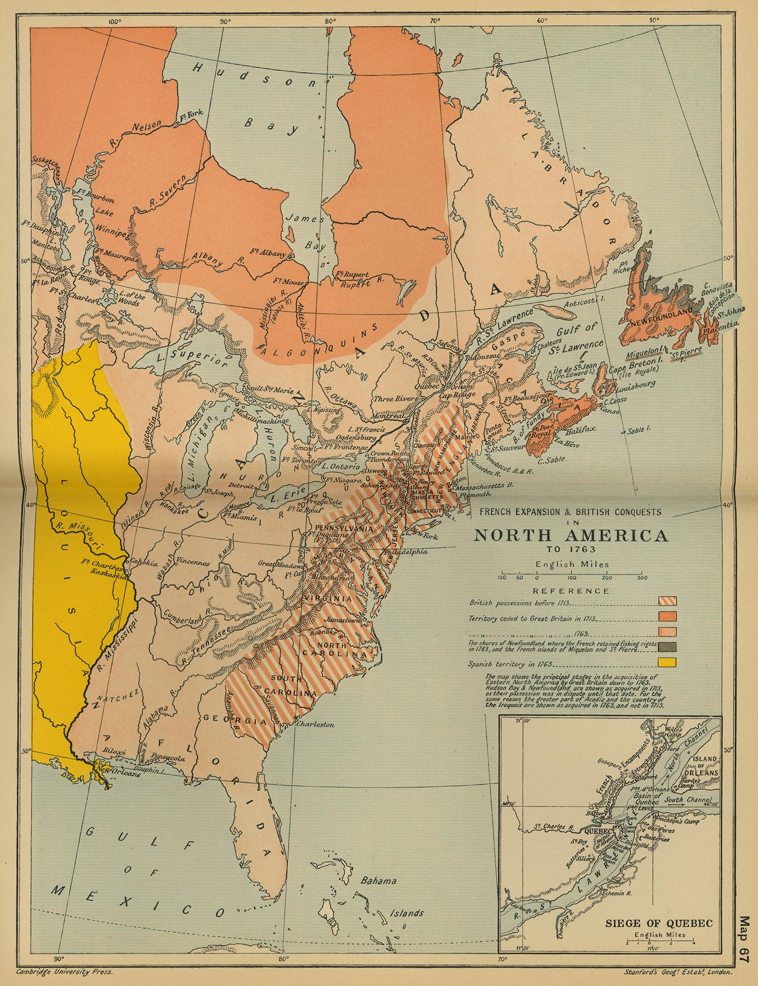

Slide 6
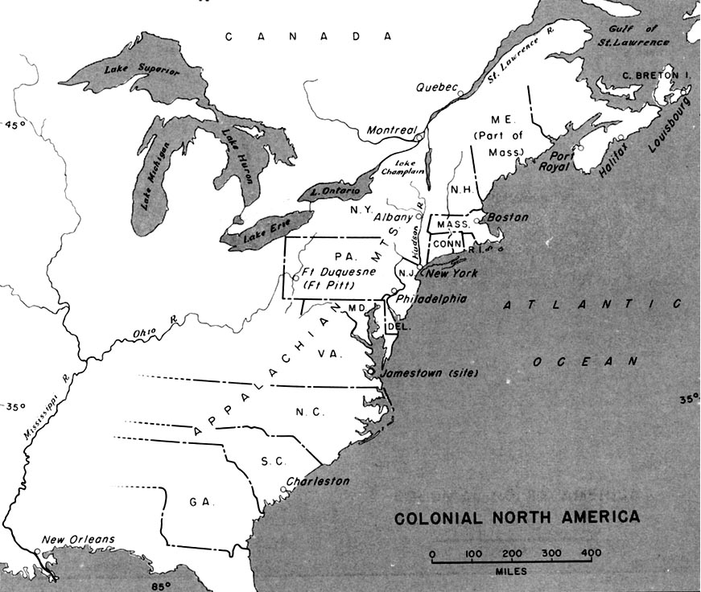

Slide 7
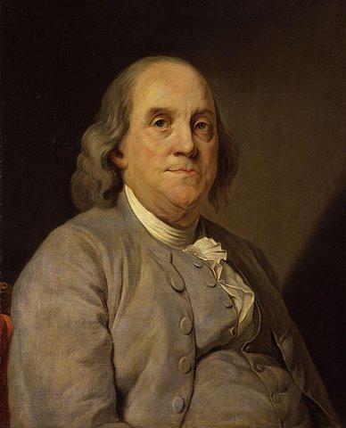

Slide 8


Slide 9


Slide 10


Slide 11



Slide 12
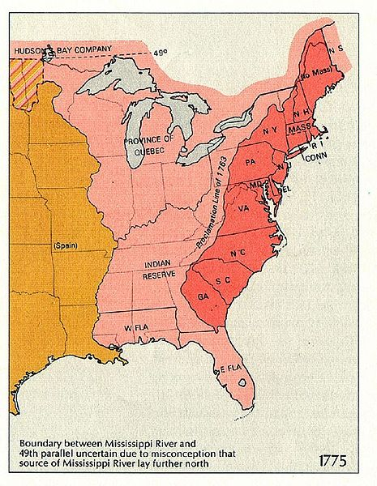

Slide 13

Notes:
Old sarum

Slide 14
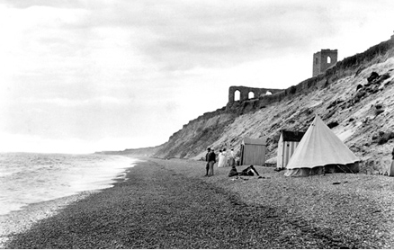
Notes:
dunwich

Slide 15


Slide 16
Whereas several of the houses of representatives in His Majesty's colonies and plantations in America have of late, against law, claimed to themselves, or to the general assemblies of the same, the sole and exclusive right of imposing duties and taxes upon His Majesty's subjects in the said colonies and plantations; and have, in pursuance of such claim, passed certain votes, resolutions, and orders derogatory to the legislative authority of Parliament, and inconsistent with the dependency of the said colonies and plantations upon the crown of Great Britain: may it therefore please Your Most Excellent Majesty that it may be declared, and be it declared by the king's Most Excellent Majesty, by and with the advice and consent of the Lords Spiritual and Temporal, and Commons, in this present Parliament assembled, and by the authority of the same, That the said colonies and plantations in America have been, are, and of right ought to be, subordinate unto, and dependent upon the imperial crown and Parliament of Great Britain; and that the king's Majesty, by and with the advice and consent of the Lords Spiritual and Temporal, and Commons, of Great Britain, in Parliament assembled, had, hath, and of right ought to have, full power and authority to make laws and statutes of sufficient force and validity to bind the colonies and people of America, subjects of the crown of Great Britain, in all cases whatsoever.
II. And be it further declared and enacted by the authority aforesaid, That all resolutions, votes, orders, and proceedings, in any of the said colonies or plantations, whereby the power and authority of the Parliament of Great Britain to make laws and statutes as aforesaid is denied, or drawn into question, are, and are hereby declared to be, utterly null and void to all intents and purposes whatsoever.

Slide 17
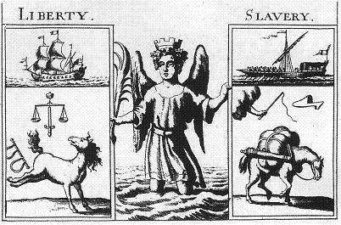

Slide 18
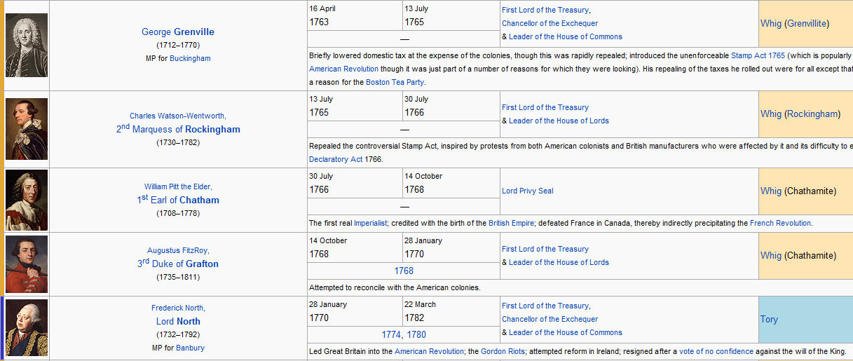

Slide 19
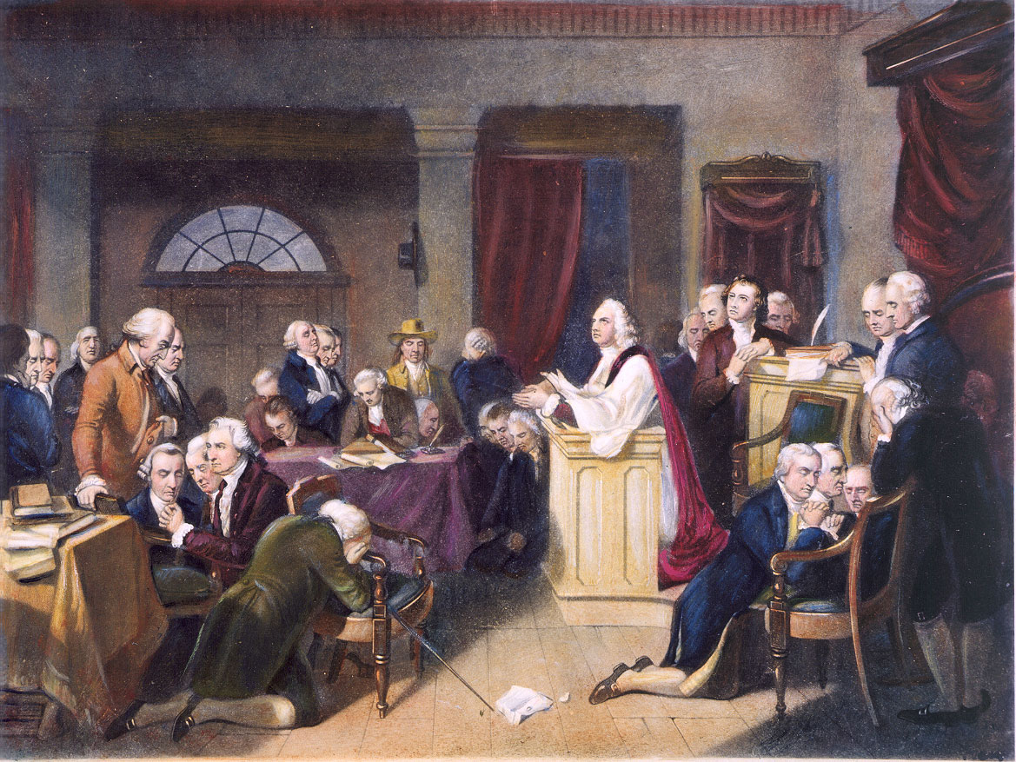

Slide 20
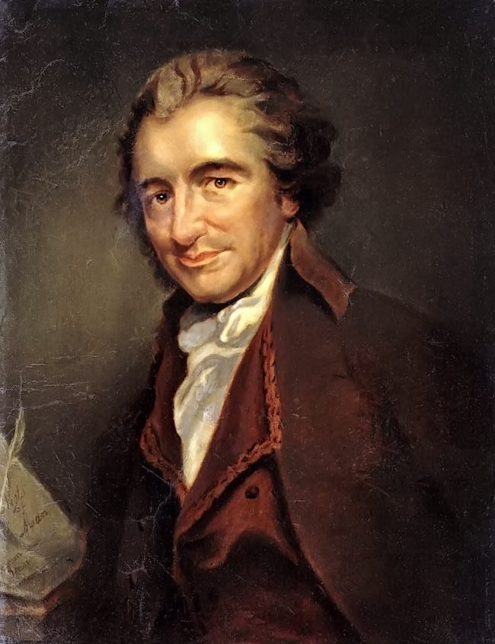

Slide 21
Small islands not capable of protecting themselves are the proper objects for kingdoms to take under their care; but there is something very absurd in supposing a continent to be perpetually governed by an island.
--------
The sun never shined on a cause of greater worth. 'Tis not the affair of a city, a country, a province, or a kingdom, but of a continent—of at least one eighth part of the habitable globe. 'Tis not the concern of a day, a year, or an age; posterity are virtually involved in the contest, and will be more or less affected, even to the end of time, by the proceedings now. Now is the seed time of continental union, faith and honor. The least fracture now will be like a name engraved with the point of a pin on the tender rind of a young oak; The wound will enlarge with the tree, and posterity read it in full grown characters.

Slide 22
There is something exceedingly ridiculous in the composition of monarchy; it first excludes a man from the means of information, yet empowers him to act in cases where the highest judgment is required.
---------------
O ye that love mankind! Ye that dare oppose, not only the tyranny, but the tyrant, stand forth! Every spot of the old world is overrun with oppression. Freedom hath been hunted round the globe. Asia, and Africa, have long expelled her — Europe regards her like a stranger, and England hath given her warning to depart. O! receive the fugitive, and prepare in time an asylum for mankind.

Slide 23
Some writers have so confounded society with government, as to leave little or no distinction between them; whereas they are not only different, but have different origins. Society is produced by our wants, and government by our wickedness; the former promotes our happiness POSITIVELY by uniting our affections, the latter NEGATIVELY by restraining our vices. The one encourages intercourse, the other creates distinctions. The first a patron, the last a punisher.
---------------------
We have every opportunity and every encouragement before us, to form the noblest purest constitution on the face of the earth. We have it in our power to begin the world over again. A situation, similar to the present, hath not happened since the days of Noah until now. The birthday of a new world is at hand, and a race of men, perhaps as numerous as all Europe contains, are to receive their portion of freedom from the event of a few months.

