Slide 1
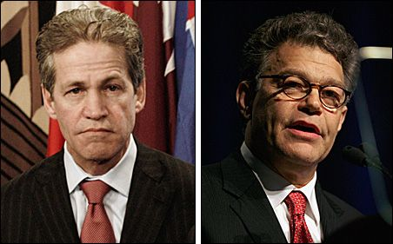

Slide 2
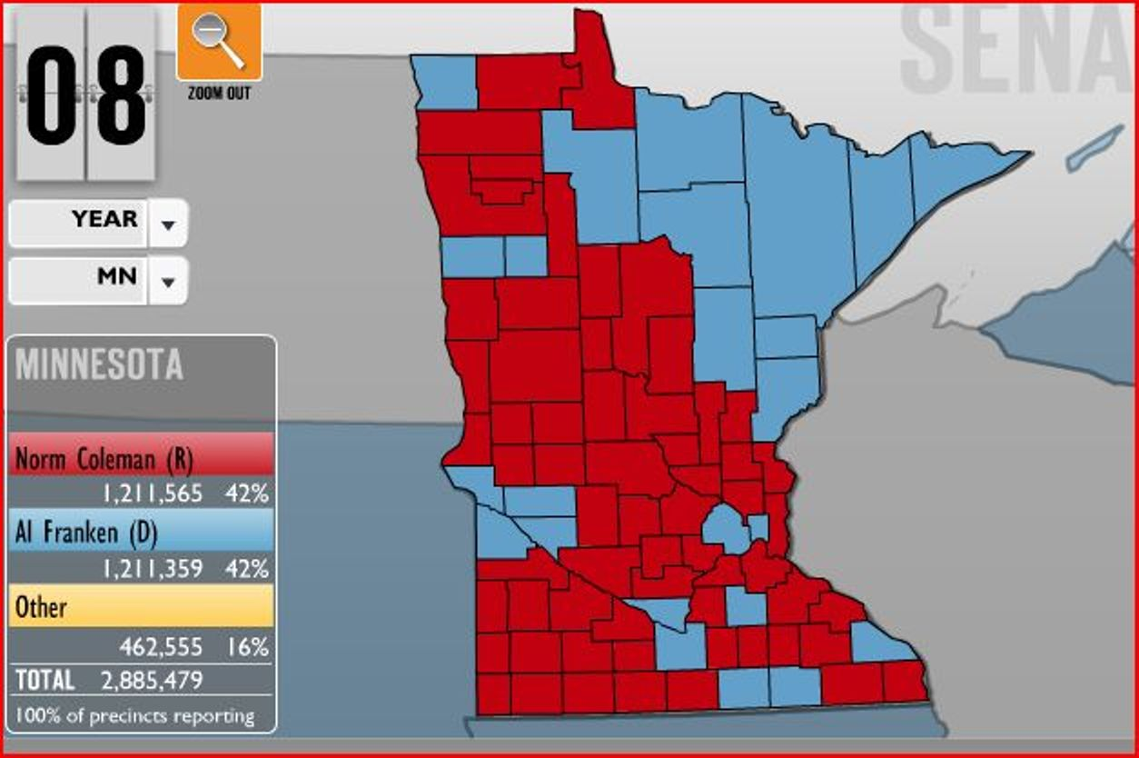

Slide 3
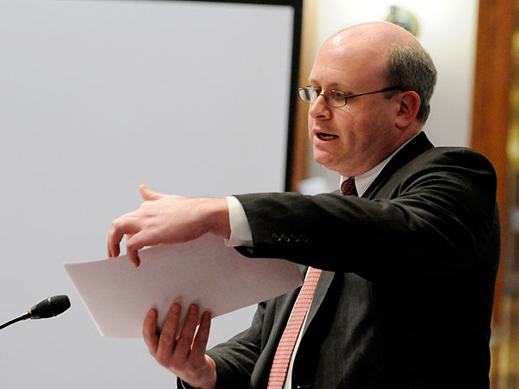

Slide 4
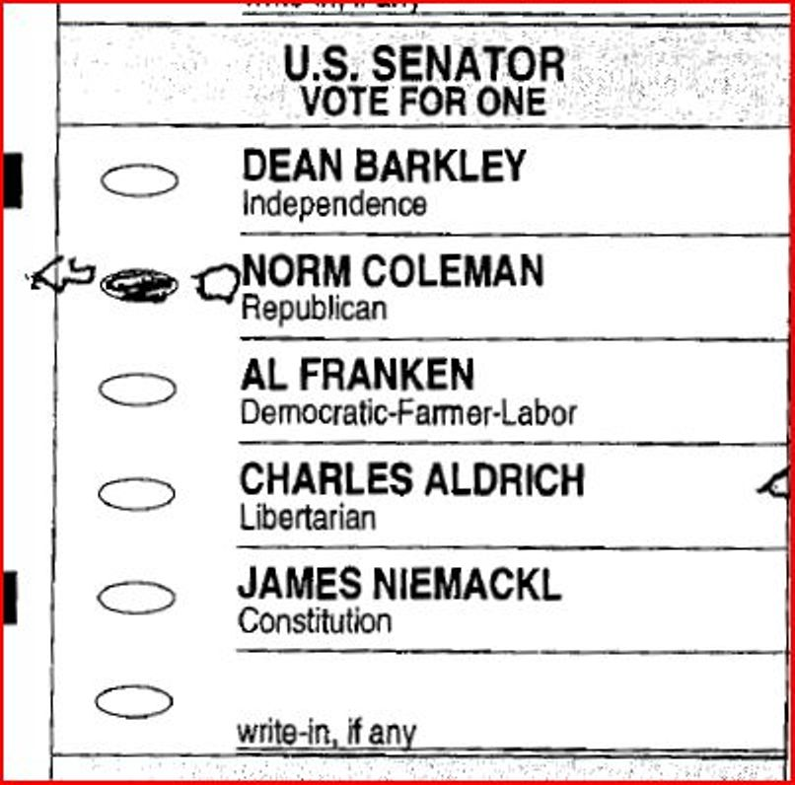

Slide 5
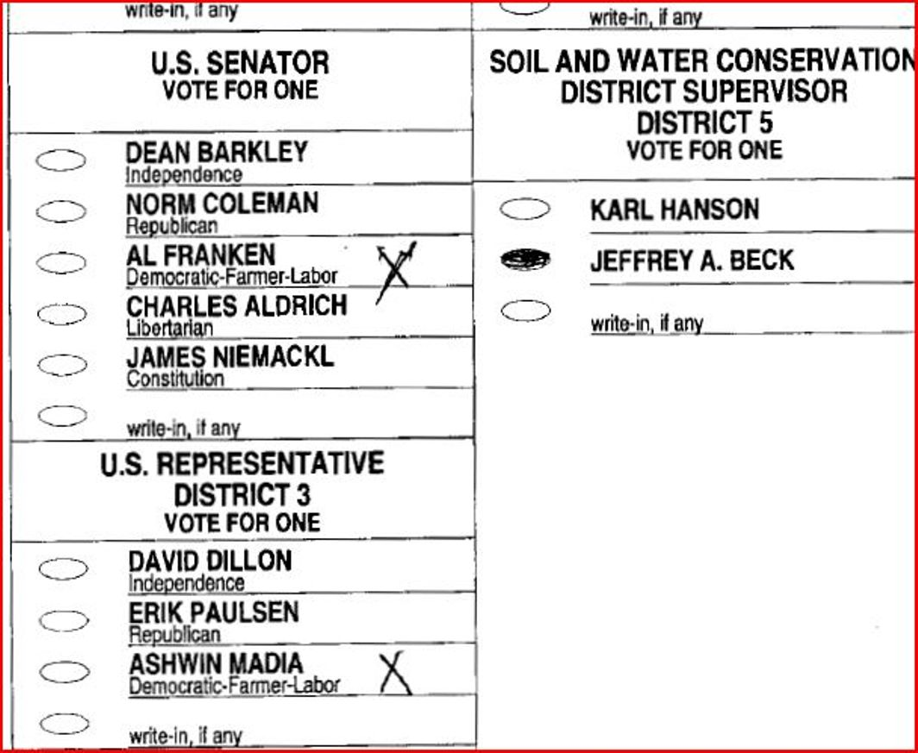

Slide 6
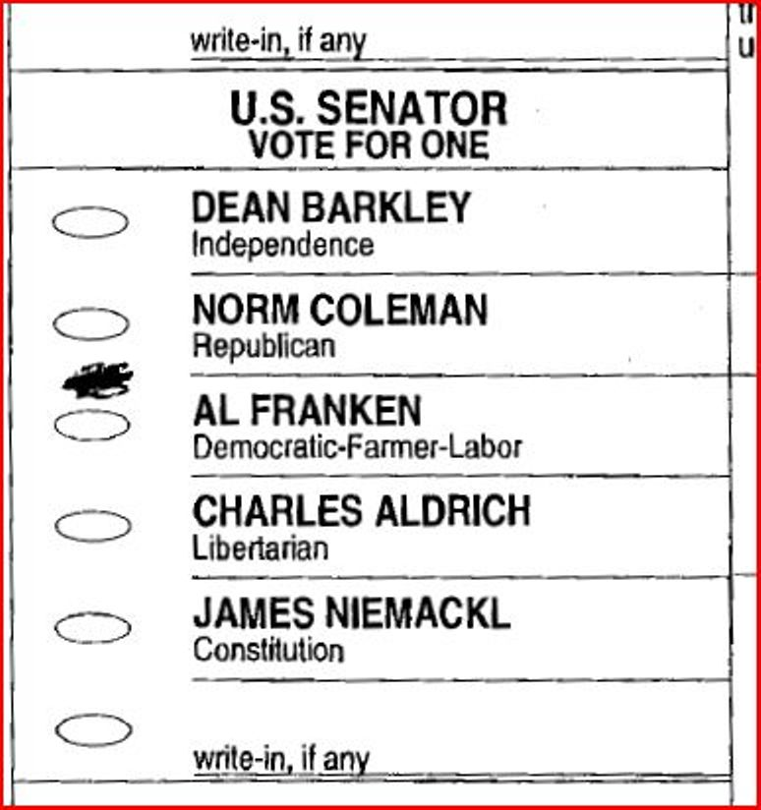

Slide 7
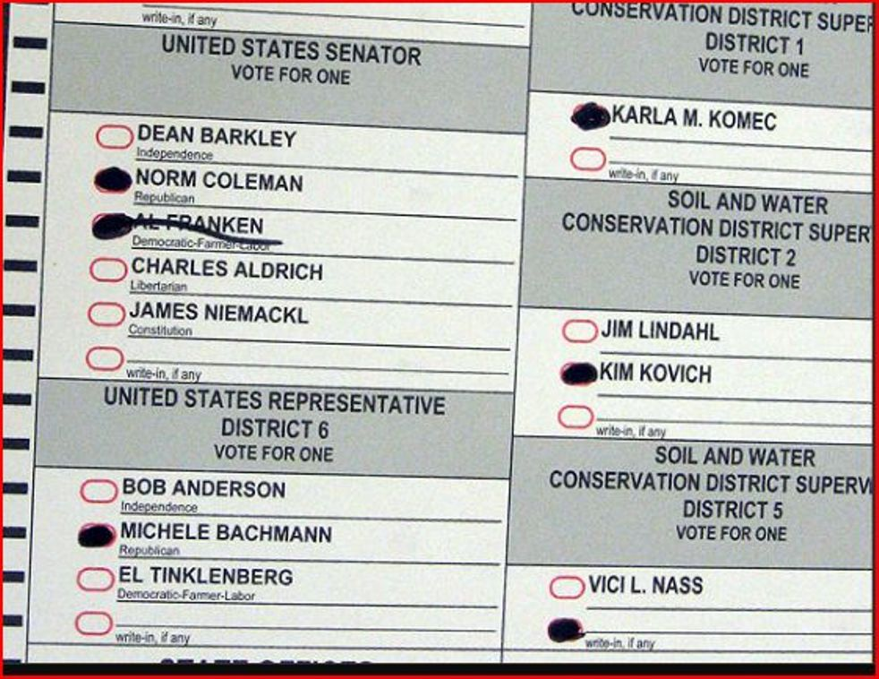

Slide 8
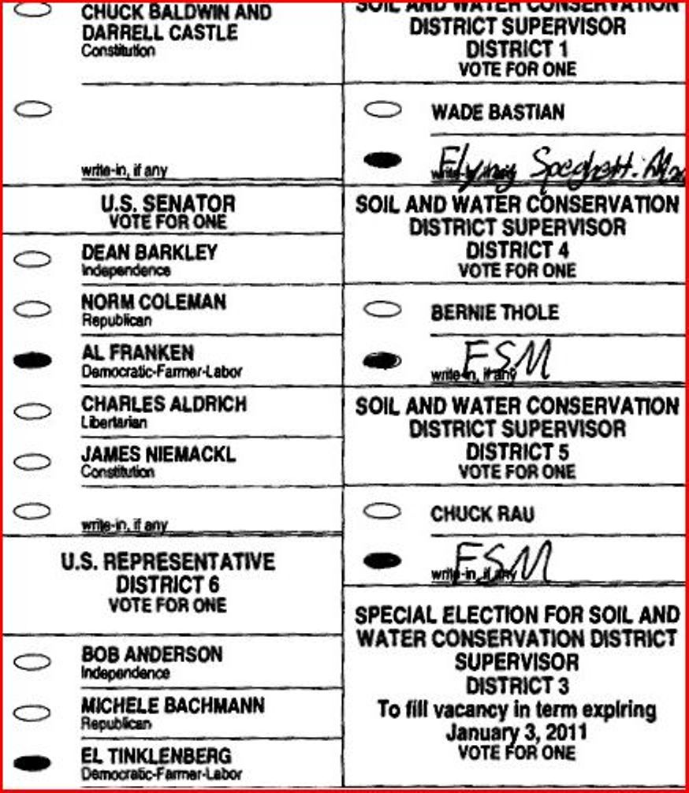

Slide 9
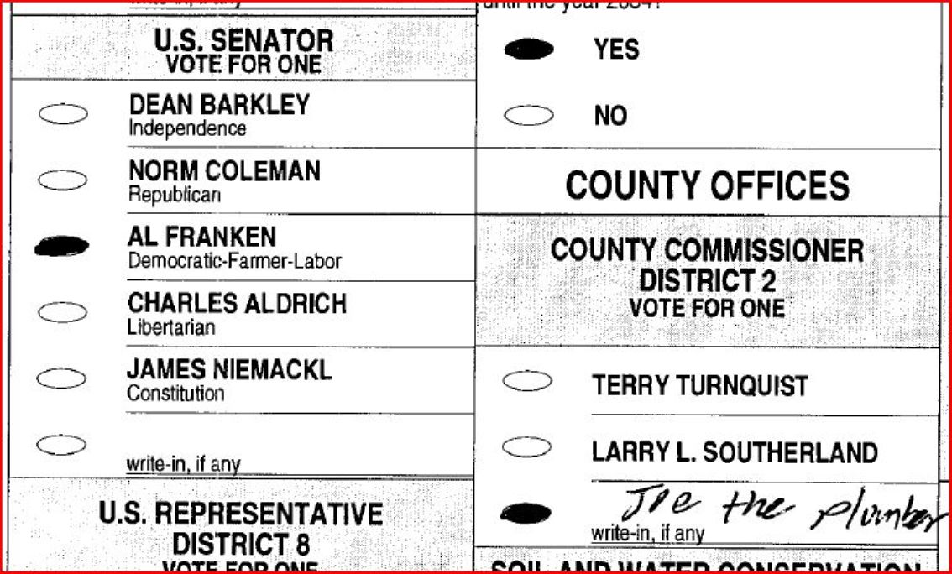

Slide 10
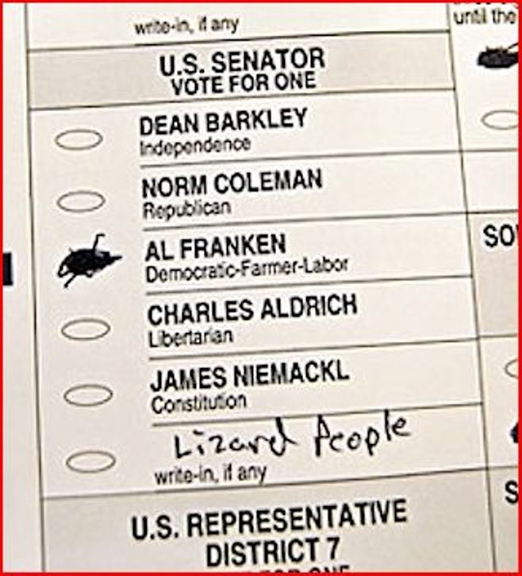

Slide 11
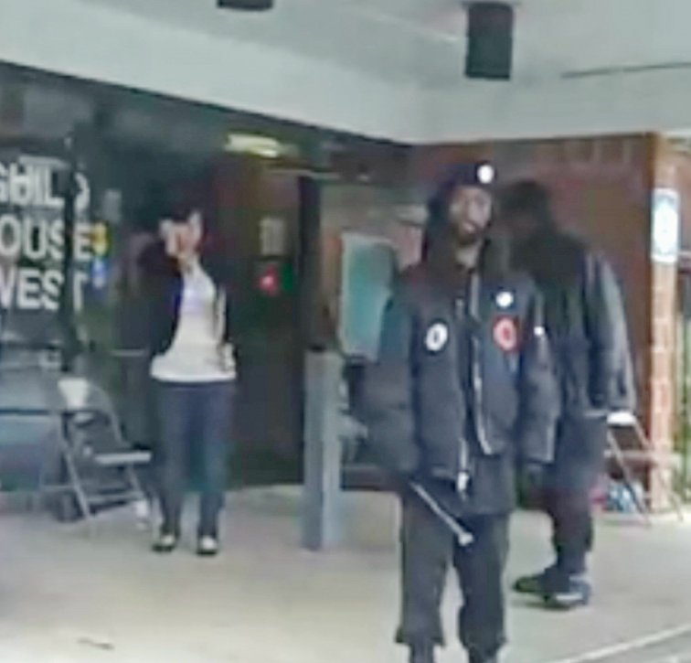

Slide 12
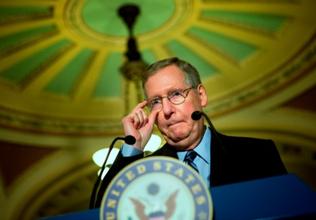

Slide 13
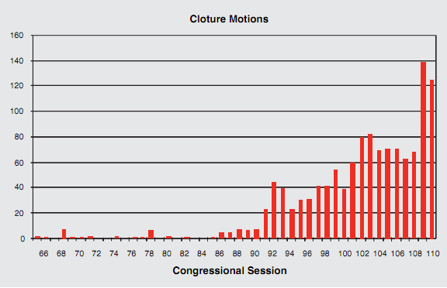

Slide 14
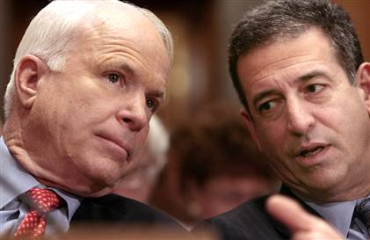

Slide 15
Citizens United v. FEC (2010)
Speech is an essential mechanism of democracy, for it is the means to hold officials accountable to the people. The right of citizens to inquire, to hear, to speak, and to use information to reach consensus is a precondition to enlightened self-government and a necessary means to protect it. The First Amendment “ ‘has its fullest and most urgent application’ to speech uttered during a campaign for political office.”…
The appearance of influence or access, furthermore, will not cause the electorate to lose faith in our democracy. By definition, an independent expenditure is political speech presented to the electorate that is not coordinated with a candidate. The fact that a corporation, or any other speaker, is willing to spend money to try to persuade voters presupposes that the people have the ultimate influence over elected officials. This is inconsistent with any suggestion that the electorate will refuse “ ‘to take part in democratic governance’ ” because of additional political speech made by a corporation or any other speaker.

Slide 16


Slide 17
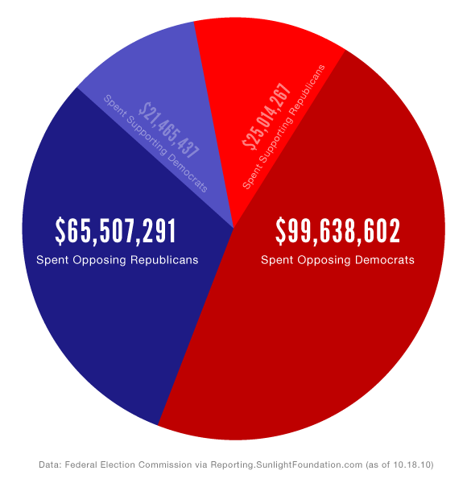

Slide 18
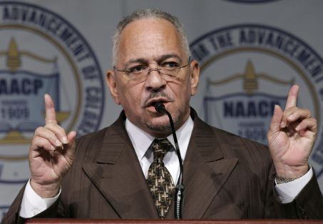

Slide 19
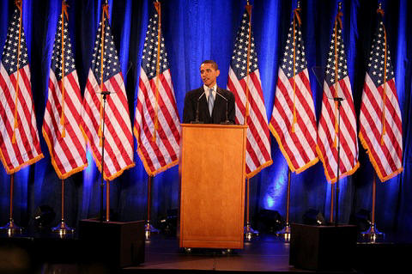

Slide 20
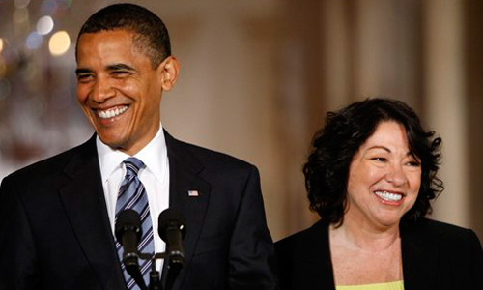

Slide 21
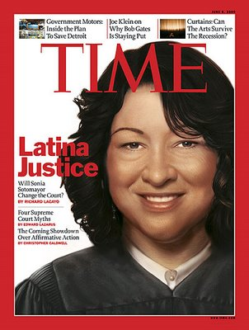

Slide 22
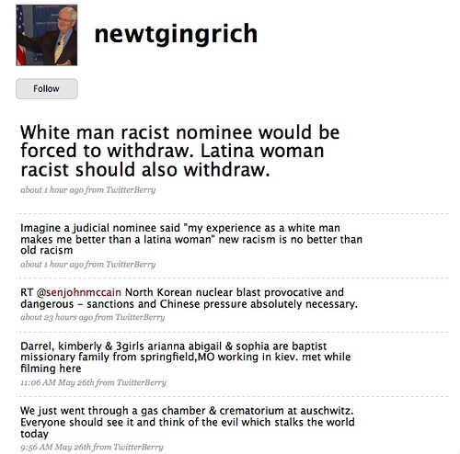

Slide 23
Ricci v. DeStefano (2009)
Whatever the City’s ultimate aim—however well intentioned or benevolent it might have seemed—the City made its employment decision because of race. The City rejected the test results solely because the higher scoring candidates were white. The question is not whether that conduct was discriminatory but whether the City had a lawful justification for its race-based action . . .
Nor do we question an employer’s affirmative efforts to ensure that all groups have a fair opportunity to apply for promotions and to participate in the process by which promotions will be made. But once that process has been established and employers have made clear their selection criteria, they may not then invalidate the test results, thus upsetting an employee’s legitimate expectation not to be judged on the basis of race. Doing so, absent a strong basis in evidence of an impermissible disparate impact, amounts to the sort of racial preference that Congress has disclaimed, and is antithetical to the notion of a workplace where individuals are guaranteed equal opportunity regardless of race.

Slide 24
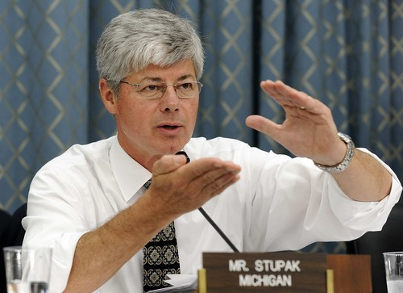

Slide 25
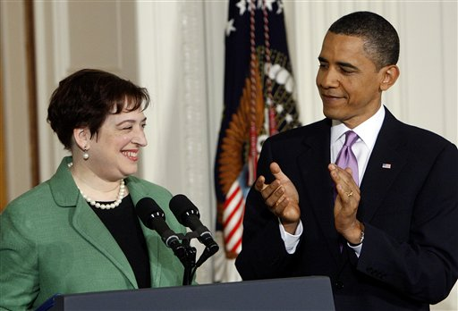

Slide 26
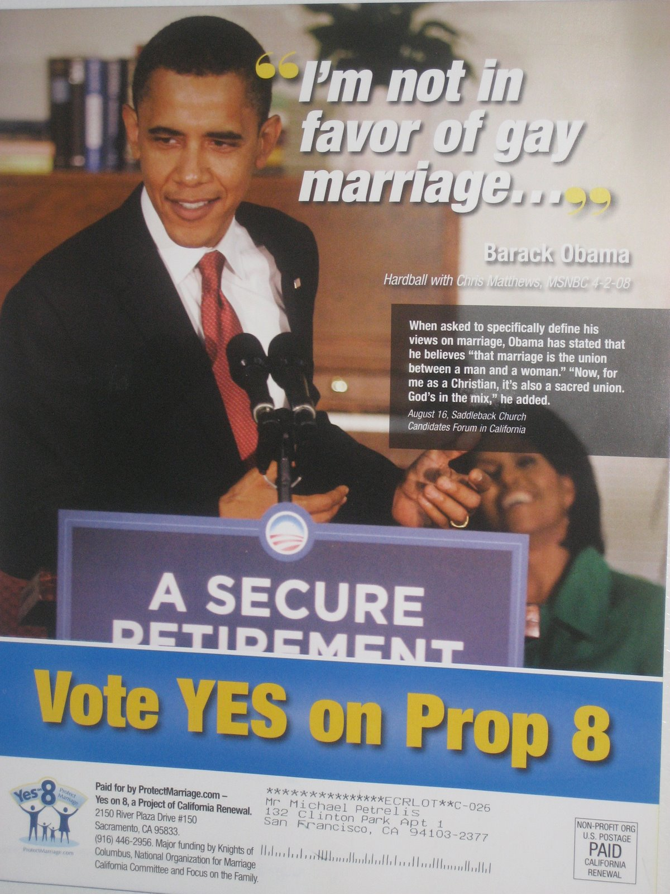

Slide 27
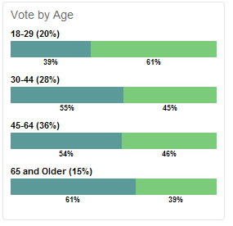

Slide 28
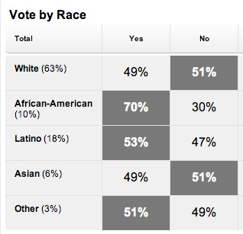

Slide 29


Slide 30
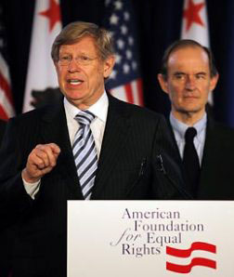

Slide 31
Perry v. Schwarzenegger (2010)
Proposition 8 cannot withstand any level of scrutiny under the equal protection clause, as excluding same-sex couples from marriage is simply not rationally related to a legitimate state interest…
Proponents’ argument that tradition prefers opposite-sex couples to same-sex couples equates to the notion that opposite-sex relationships are simply better than same-sex relationships. Tradition alone cannot legitimate this purported interest.
Many of the purported interests identified by the proponents [of Proposition 8] are nothing more than a fear or unarticulated dislike of same-sex couples.

Slide 32
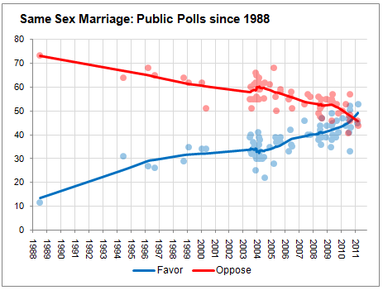

Slide 33
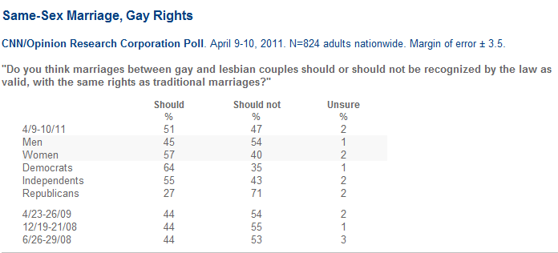

Slide 34
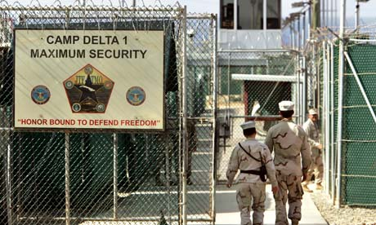

Slide 35
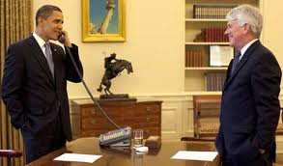

Slide 36
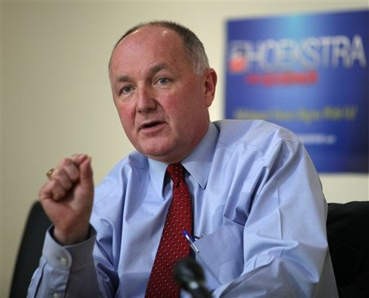

Slide 37


