Slide 1

Notes:
breckenridge

Slide 2
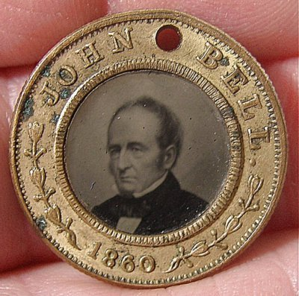

Slide 3


Slide 4
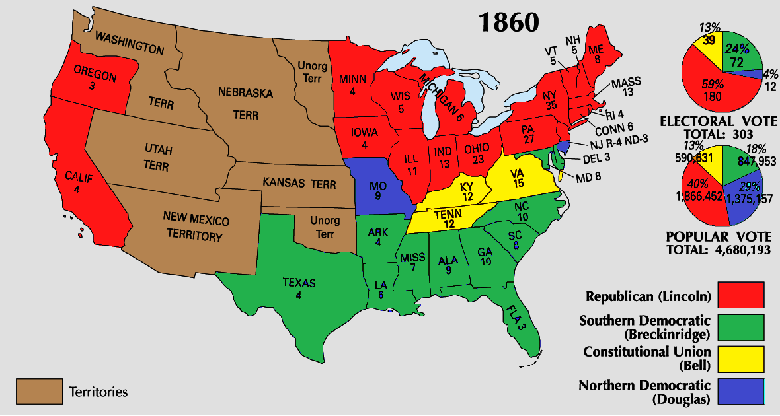

Slide 5
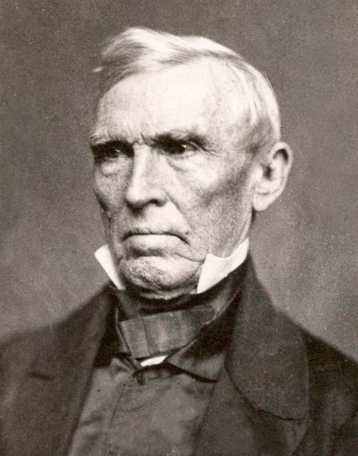
Notes:
crittenden

Slide 6
ARTICLE I.
In all the territory of the United States now held, or hereafter acquired, situated north of latitude 36° 30', slavery or involuntary servitude, except as a punishment for crime, is prohibited while such territory shall remain under territorial government. In all the territory south of said line of latitude, slavery of the African race is hereby recognized as existing, and shall not be interfered with by Congress …
ARTICLE II.
Congress shall have no power to abolish slavery in places under its exclusive jurisdiction, and situate within the limits of States that permit the holding of slaves.
ARTICLE III.
Congress shall have no power to abolish slavery within the District of Columbia, so long as it exists in the adjoining States of Virginia and Maryland, or either, nor without the consent of the inhabitants, nor without just compensation first made to such owners of slaves as do not consent to such abolishment. Nor shall Congress at any time prohibit officers of the Federal Government, or members of Congress, whose duties require them to be in said District, from bringing with them their slaves, and holding them as such, during the time their duties may require them to remain there, and afterward taking them from the District.
ARTICLE VI.
No future amendment of the Constitution shall affect the five preceding articles; nor the third paragraph of the second section of the first article of the Constitution, nor the third paragraph of the second section of the fourth article of said Constitution and no amendment shall be made to the Constitution which shall authorize or give to Congress any power to abolish or interfere with slavery in any of the States by whose laws it is, or may be allowed or permitted.

Slide 7


Slide 8
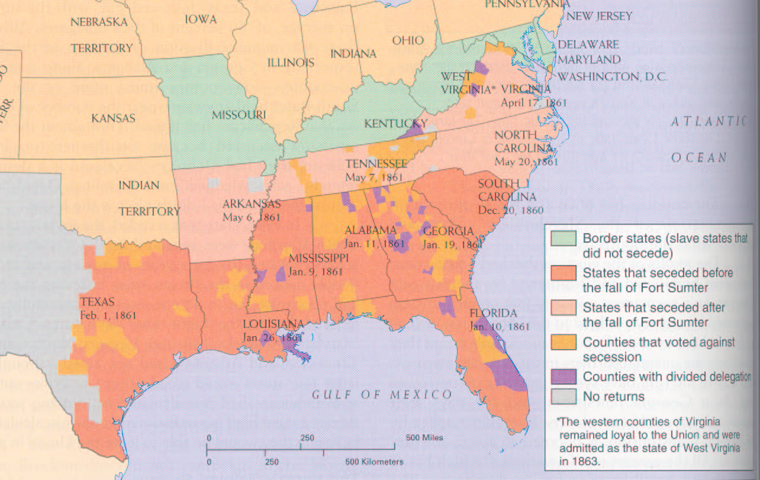

Slide 9
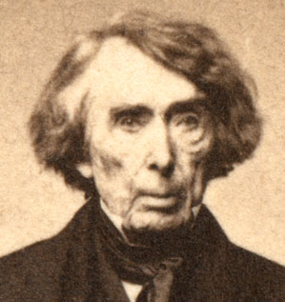

Slide 10
The case, then, is simply this: A military officer residing in Pennsylvania issues an order to arrest a citizen of Maryland, upon vague and indefinite charges, without any proof, so far as appears. Under this order his house is entered in the night; he is seized as a prisoner, and conveyed to Fort McHenry, and there kept in close confinement. And when a habeas corpus is served on the commanding officer, requiring him to produce the prisoner before a Justice of the Supreme Court, in order that he may examine into the legality of the imprisonment, the answer of the officer is that he is authorized by the President to suspend the writ of habeas corpus at his discretion, and, in the exercise of that discretion, suspends it in this case, and on that ground refuses obedience to the writ . . .
With such provisions in the Constitution, expressed in language too clear to be misunderstood by any one, I can see no ground whatever for supposing that the President, in any emergency or in any state of things, can authorize the suspension of the privilege of the writ of habeas corpus, or arrest a citizen, except in aid of the judicial power. He certainly does not faithfully execute the laws if he takes upon himself legislative power by suspending the writ of habeas corpus and the judicial power, also, by arresting and imprisoning a person without due process of law. . .
The Government of the United States is one of delegated and limited powers. It derives it existence and authority altogether from the Constitution, and neither of its branches--executive, legislative or judicial--can exercise any of the powers of government beyond those specified and granted.

Slide 11
Lincoln order to Gen. Winfield Scott: (2 July 1861)
The COMMANDING GENERAL, ARMY OF THE UNITED STATES: You are engaged in suppressing an insurrection against the laws of the United States. If at any point on or in the vicinity of any military line which is now or which shall be used between the city of New York and the city of Washington you find resistance which renders it necessary to suspend the writ of habeas corpus for the public safety, you personally, or through the officer in command at the point where resistance occurs, are authorized to suspend that writ.

Slide 12
Lincoln, 4 July 1861 special session message
Soon after the first call for militia it was considered a duty to authorize the Commanding General in proper cases, according to his discretion, to suspend the privilege of the writ of habeas corpus . . . The legality and propriety of what has been done under it are questioned, and the attention of the country has been called to the proposition that one who is sworn to "take care that the laws be faithfully executed" should not himself violate them . .. .The whole of the laws which were required to be faithfully executed were being resisted and failing of execution in nearly one-third of the States. Must they be allowed to finally fail of execution, even had it been perfectly clear that by the use of the means necessary to their execution some single law, made in such extreme tenderness of the citizen's liberty that practically it relieves more of the guilty than of the innocent, should to a very limited extent be violated? To state the question more directly, Are all the laws but one to go unexecuted, and the Government itself go to pieces lest that one be violated? Even in such a case, would not the official oath be broken if the Government should be overthrown when it was believed that disregarding the single law would tend to preserve it?

Slide 13
Lincoln, 4 July 1861 special session message
This issue embraces more than the fate of these United States. It presents to the whole family of man the question whether a constitutional republic, or democracy--a government of the people by the same people--can or can not maintain its territorial integrity against its own domestic foes. It presents the question whether discontented individuals, too few in numbers to control administration according to organic law in any case, can always, upon the pretenses made in this case, or on any other pretenses, or arbitrarily without any pretense, break up their government, and thus practically put an end to free government upon the earth. It forces us to ask, Is there in all republics this inherent and fatal weakness? Must a government of necessity be too strong for the liberties of its own people, or too weak to maintain its own existence?

Slide 14
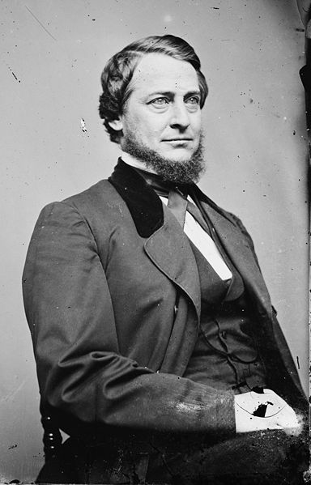
Notes:
vallandingham

Slide 15
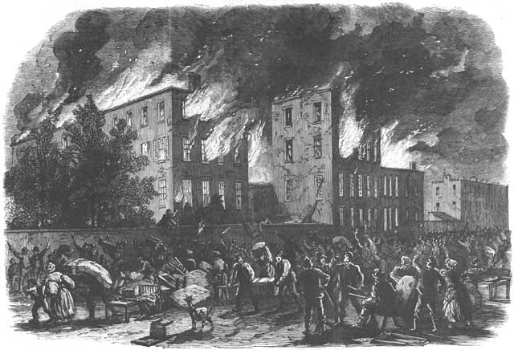
Notes:
Nyc draft riots

Slide 16
Homestead Act (1862)
Any person who is the head of a family, or who has arrived at the age of twenty-one years, and is a citizen of the United States, or who shall have filed his declaration of intention to become such, as required by the naturalization laws of the United States, and who has never borne arms against the United States Government or given aid and comfort to its enemies, shall, from and after the first January, eighteen hundred and. sixty-three, be entitled to enter one quarter section or a less quantity of unappropriated public lands, upon which said person may have filed a preemption claim, or which may, at the time the application is made, be subject to preemption at one dollar and twenty-five cents, or less, per acre; or eighty acres or less of such unappropriated lands, at two dollars and fifty cents per acre, to be located in a body, in conformity to the legal subdivisions of the public lands, and after the same shall have been surveyed.
Passes House, 107-16; Senate 33-7.

Slide 17
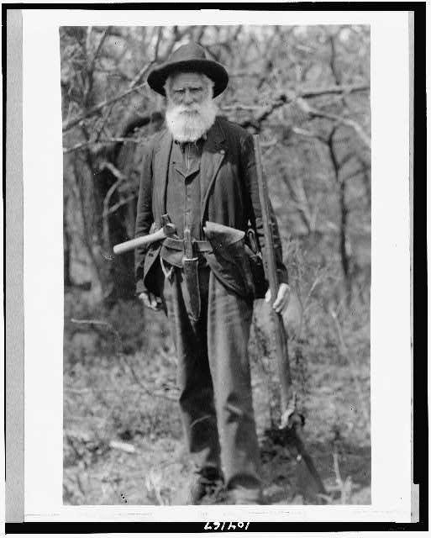
Notes:
Daniel Freeman, Nebraska, first homesteader, 1863

Slide 18
Morrill Land-Grant College Act (1862)
All moneys derived from the sale of the lands aforesaid by the States to which the lands are apportioned, and from the sales of land scrip hereinbefore provided for, shall be invested in stocks of the United States, or of the States, or some other safe stocks, yielding not less than five per centum upon the par value of said stocks; and that the moneys so invested shall constitute a perpetual fund, the capital of which shall remain forever undiminished, (except so far as may be provided in section fifth of this act,) and the interest of which shall be inviolably appropriated, by each State which may take and claim the benefit of this act, to the endowment, support, and maintenance of at least one college where the leading object shall be, without excluding other scientific and classical studies, and including military tactics, to teach such branches of learning as are related to agriculture and the mechanic arts, in such manner as the legislatures of the States may respectively prescribe, in order to promote the liberal and practical education of the industrial classes in the several pursuits and professions in life.
Passes House, 90-25, Senate 32-7.

Slide 19
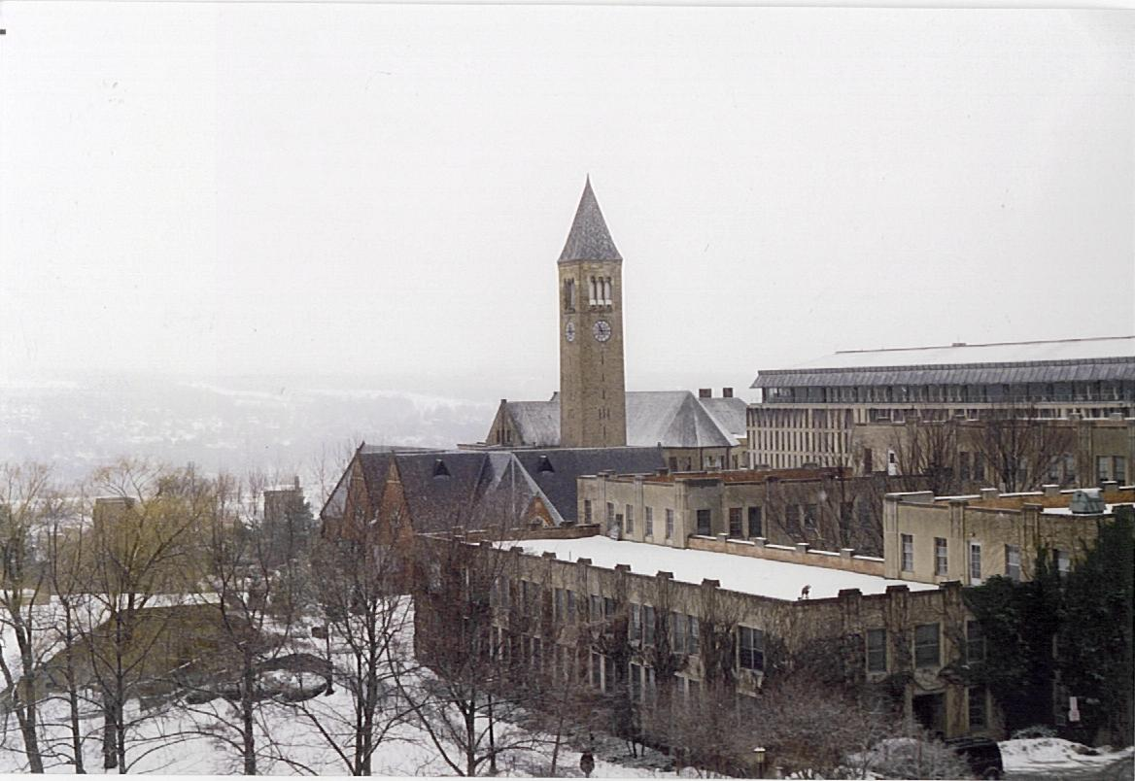
Notes:
69 univs total

Slide 20
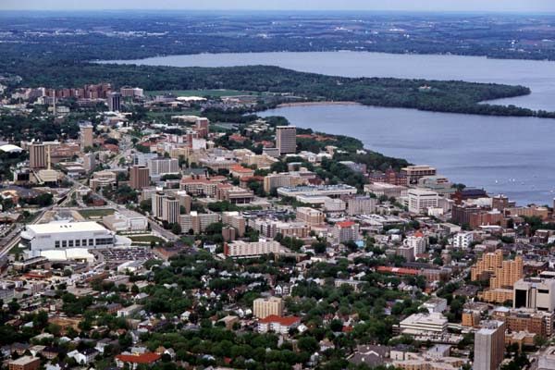

Slide 21
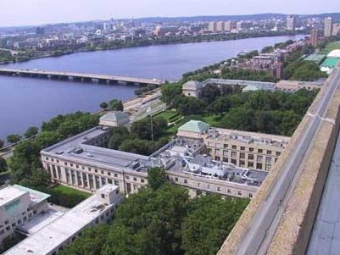

Slide 22
Pacific RR Act (1862)
The right of way through the public lands be, and the same is hereby, granted to said company for the construction of said railroad and telegraph line; and the right, power, and authority is hereby given to said company to take from the public lands adjacent to the line of said road, earth, stone, timber, and other materials for the construction thereof; said right of way is granted to said railroad to the extent of two hundred feet in width on each side of said railroad where it may pass over the public lands, including all necessary grounds for stations, buildings, workshops, and depots, machine shops, switches, side tracks, turntables, and, water stations. The United States shall extinguish as rapidly as may be the Indian titles to all lands falling under the operation of this act and required for the said right of way and; grants hereinafter made.

Slide 23
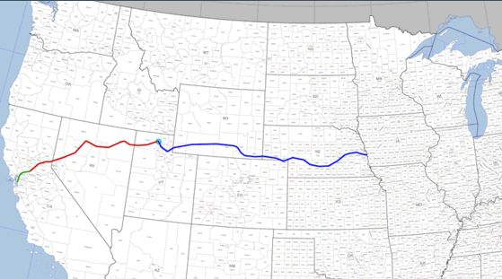

Slide 24
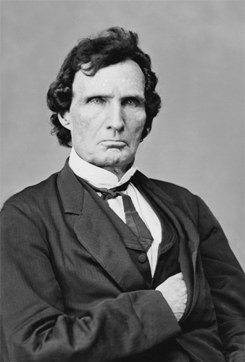
Notes:
Thaddeus stevens

Slide 25
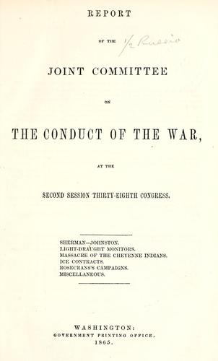

Slide 26
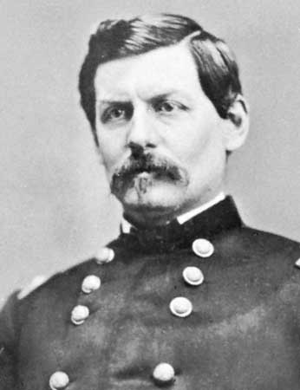
Notes:
mcclellan

Slide 27


Slide 28
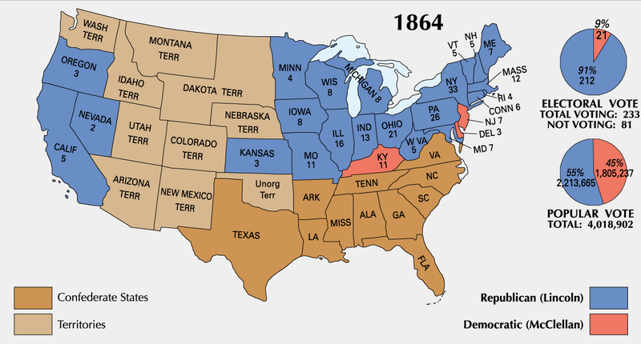

Slide 29
Prize Cases (1862)
[Plaintiffs] contend also that insurrection is the act of individuals, and not of a government or sovereignty; that the individuals engaged are subjects of law. That confiscation of their property can be effected only under a municipal law. That, by the law of the land, such confiscation cannot take place without the conviction of the owner of some offence, and finally that . . . the Constitution and Laws of the United States are still operative over persons in all the States for punishment, as well as protection.
This argument . . . assumes that where a civil war exists, the party belligerent claiming to be sovereign cannot, for some unknown reason, exercise the rights of belligerents, although the revolutionary party may. Being sovereign, he can exercise only sovereign rights over the other party. The insurgent may be killed on the battlefield or by the executioner; his property on land may be confiscated under the municipal law; but the commerce on the ocean, which supplies the rebels with means to support the war, cannot be made the subject of capture under the laws of war, because it is "unconstitutional!!!" Now it is a proposition never doubted that the belligerent party who claims to be sovereign may exercise both belligerent and sovereign rights. Treating the other party as a belligerent and using only the milder modes of coercion which the law of nations has introduced to mitigate the rigors of war cannot be a subject of complaint by the party to whom it is accorded as a grace or granted as a necessity.

Slide 30
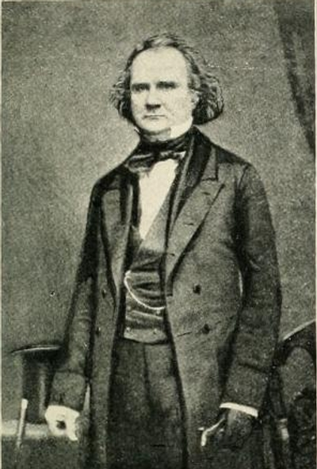
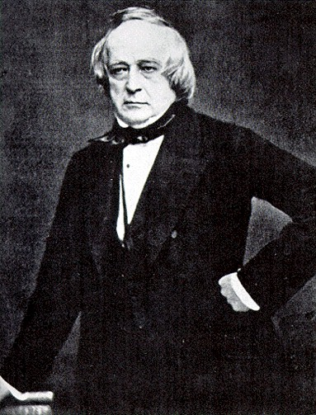
Notes:
Mason, slidell—trent affair

Slide 31

Notes:
Salmon chase

Slide 32
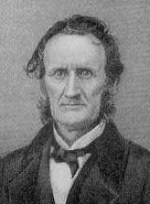
Notes:
Lambdin Milligan

Slide 33
Ex parte Milligan (1866)
It is claimed that martial law covers with its broad mantle the proceedings of this military commission. The proposition is this: that, in a time of war, the commander of an armed force . . . has the power, within the lines of his military district, to suspend all civil rights and their remedies and subject citizens, as well as soldiers to the rule of his will, and, in the exercise of his lawful authority, cannot be restrained except by his superior officer or the President of the United States.
If this position is sound to the extent claimed, then, when war exists, foreign or domestic, and the country is subdivided into military departments for mere convenience, the commander of one of them can, if he chooses, within his limits, on the plea of necessity, with the approval of the Executive, substitute military force for and to the exclusion of the laws, and punish all persons as he thinks right and proper, without fixed or certain rules.
The statement of this proposition shows its importance, for, if true, republican government is a failure, and there is an end of liberty regulated by law. Martial law established on such a basis destroys every guarantee of the Constitution, and effectually renders the "military independent of and superior to the civil power" -- the attempt to do which by the King of Great Britain was deemed by our fathers such an offence that they assigned it to the world as one of the causes which impelled them to declare their independence. Civil liberty and this kind of martial law cannot endure together; the antagonism is irreconcilable, and, in the conflict, one or the other must perish.

Slide 34
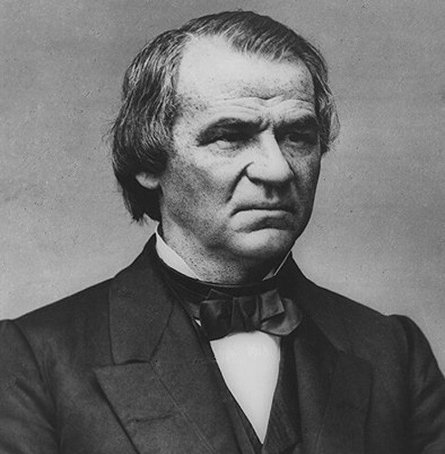

Slide 35
13th Amendment
Section 1. Neither slavery nor involuntary servitude, except as a punishment for crime whereof the party shall have been duly convicted, shall exist within the United States, or any place subject to their jurisdiction.
Section 2. Congress shall have power to enforce this article by appropriate legislation.

Slide 36
Texas Black Code
That from and after the passage of this act, every Railroad Company heretofore incorporated, or which may hereafter be incorporated, by the Legislature of this State, shall be required to attach to each passenger train run by said Company, one car for the special accommodation of Freedmen . . .
That all laws and parts of laws relating to persons lately held as slaves, or free persons of color, contrary to, or in conflict with, the provisions of this act [that ensure non-discrimination], be and the same are herby repealed; Provided, nevertheless, that nothing herein shall be so construed as to repeal any law prohibiting the inter-marriage of the white and black races, nor to permit any other than white men to serve on juries, hold office, vote at any election, State, county, or municipal; Provided, further, that nothing herein contained shall be so construed as to allow them to testify, except in such cases and manner as is prescribed in the Constitution of the State . . .
That every able-bodied free white male inhabitant of this State between the ages of eighteen and forty-five years, shall be liable to perform military duty . . . .

Slide 37
