Slide 1


Slide 2
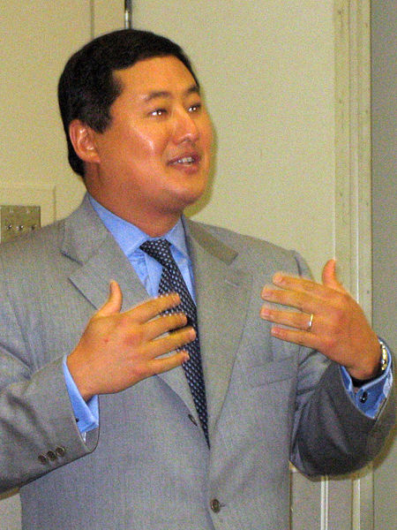

Slide 3
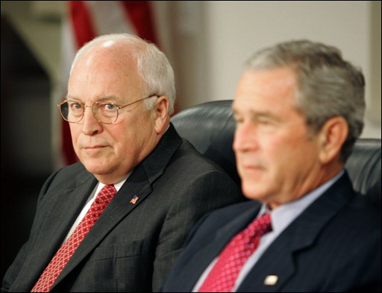

Slide 4
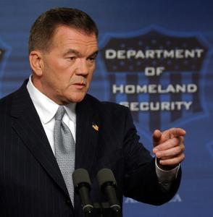

Slide 5
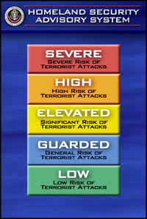

Slide 6
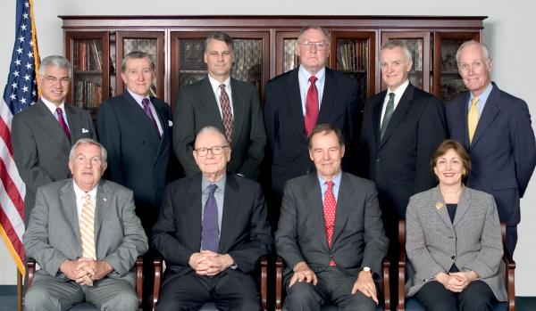

Slide 7


Slide 8
9-11 Commission Recommendations
The U.S. border security system should be integrated into a larger network of screening points that includes our transportation system and access to vital facilities, such as nuclear reactors. The President should direct the Department of Homeland Security to lead the effort to design a comprehensive screening system, addressing common problems and setting common standards with systemwide goals in mind. Extending those standards among other governments could dramatically strengthen America and the world's collective ability to intercept individuals who pose catastrophic threats.
Lead responsibility for directing and executing paramilitary operations, whether clandestine or covert, should shift to the Defense Department. There it should be consolidated with the capabilities for training, direction, and execution of such operations already being developed in the Special Operations Command.
The president should lead the government-wide effort to bring the major national security institutions into the information revolution. He should coordinate the resolution of the legal, policy, and technical issues across agencies to create a "trusted information network.“
Congressional oversight for intelligence -- and counterterrorism -- is now dysfunctional. Congress should address this problem. We have considered various alternatives: A joint committee on the old model of the Joint Committee on Atomic Energy is one. A single committee in each house of Congress, combining authorizing and appropriating authorities, is another.

Slide 9
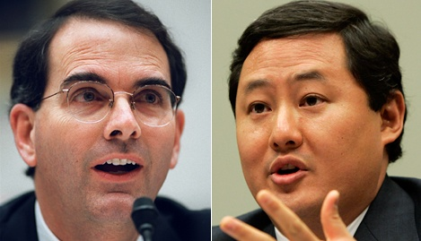

Slide 10
We have explained the scope of the President's Commander-in Chief power. In those opinions, we explained that the text, structure and history of the Constitution establish that the Founders entrusted the President with the primary responsibility, and therefore the power, to protect the security of the United States…
The structure of the Constitution demonstrates that any power traditionally understood as pertaining to the executive -which includes the conduct of warfare and the defense of the nation-unless expressly assigned to Congress, is vested in the President…
Ordinary federal criminal statutes do not apply to the properly-authorized interrogation of enemy combatants by the United States Armed Forces during an armed conflict…
Even if these [anti-torture] statutes were misconstrued to apply to persons acting at the direction of the President during the conduct of war, the Department of Justice could not enforce this law or any of the other criminal statutes applicable to the special maritime and territorial jurisdiction against federal officials acting pursuant to the President's constitutional authority to direct a war.

Slide 11
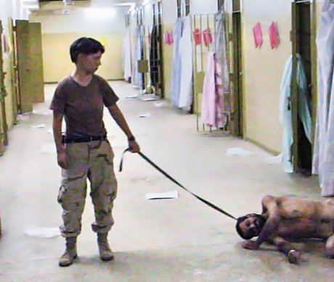

Slide 12
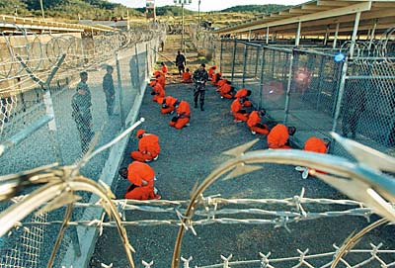

Slide 13


Slide 14
Hamdi v. Rumsfeld (2004)
Striking the proper constitutional balance here is of great importance to the Nation during this period of ongoing combat. But it is equally vital that our calculus not give short shrift to the values that this country holds dear or to the privilege that is American citizenship. It is during our most challenging and uncertain moments that our Nation’s commitment to due process is most severely tested; and it is in those times that we must preserve our commitment at home to the principles for which we fight abroad…
We therefore hold that a citizen-detainee seeking to challenge his classification as an enemy combatant must receive notice of the factual basis for his classification, and a fair opportunity to rebut the Government’s factual assertions before a neutral decisionmaker…
In so holding, we necessarily reject the Government’s assertion that separation of powers principles mandate a heavily circumscribed role for the courts in such circumstances. Indeed, the position that the courts must forgo any examination of the individual case and focus exclusively on the legality of the broader detention scheme cannot be mandated by any reasonable view of separation of powers, as this approach serves only to condense power into a single branch of government. We have long since made clear that a state of war is not a blank check for the President when it comes to the rights of the Nation’s citizens.

Slide 15
Hamdan v. Rumsfeld (2006)
At a minimum, the Government must make a substantial showing that the crime for which it seeks to try a defendant by military commission is acknowledged to be an offense against the law of war. That burden is far from satisfied here. The crime of “conspiracy” has rarely if ever been tried as such in this country by any law-of-war military commission not exercising some other form of jurisdiction, and does not appear in either the Geneva Conventions or the Hague Conventions—the major treaties on the law of war . . .
The charge’s shortcomings are not merely formal, but are indicative of a broader inability on the Executive’s part here to satisfy the most basic precondition—at least in the absence of specific congressional authorization—for establishment of military commissions: military necessity. . . .
In undertaking to try Hamdan and subject him to criminal punishment, the Executive is bound to comply with the Rule of Law that prevails in this jurisdiction.

Slide 16
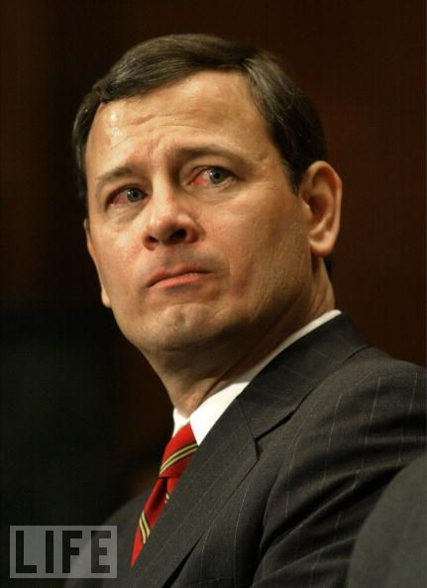

Slide 17
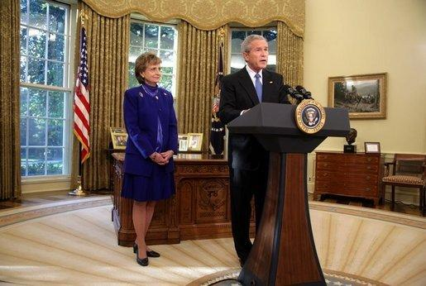

Slide 18
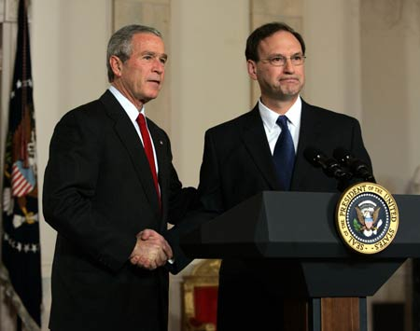

Slide 19
Goodridge v. Dept. of Public Health (MA, 2003)
Marriage is a vital social institution. The exclusive commitment of two individuals to each other nurtures love and mutual support; it brings stability to our society. For those who choose to marry, and for their children, marriage provides an abundance of legal, financial, and social benefits. In return it imposes weighty legal, financial, and social obligations. The question before us is whether, consistent with the Massachusetts Constitution, the Commonwealth may deny the protections, benefits, and obligations conferred by civil marriage to two individuals of the same sex who wish to marry. We conclude that it may not. The Massachusetts Constitution affirms the dignity and equality of all individuals. It forbids the creation of second class citizens. In reaching our conclusion we have given full deference to the arguments made by the Commonwealth. But it has failed to identify any constitutionally adequate reason for denying civil marriage to same-sex couples…
The "marriage is procreation" argument singles out the one unbridgeable difference between same-sex and opposite-sex couples, and transforms that difference into the essence of legal marriage. Like "Amendment 2" to the Constitution of Colorado, which effectively denied homosexual persons equality under the law and full access to the political process, the marriage restriction impermissibly "identifies persons by a single trait and then denies them protection across the board." Romer v. Evans, (1996). In so doing, the State's action confers an official stamp of approval on the destructive stereotype that same-sex relationships are inherently unstable and inferior to opposite-sex relationships and are not worthy of respect.

Slide 20
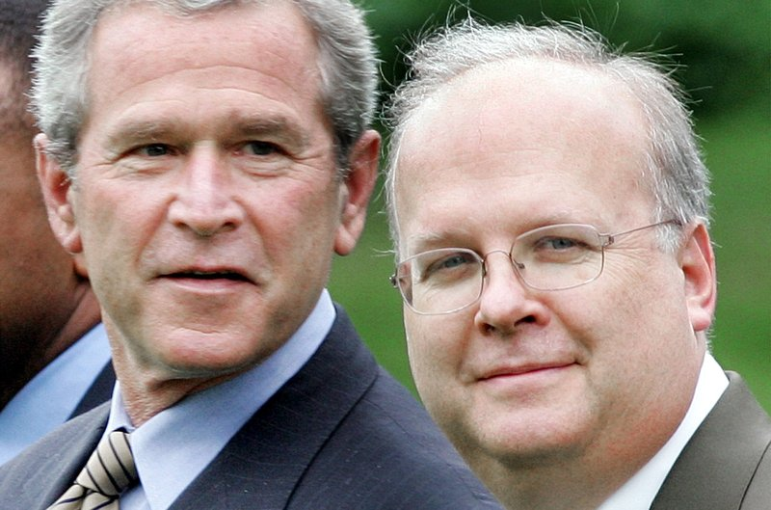

Slide 21
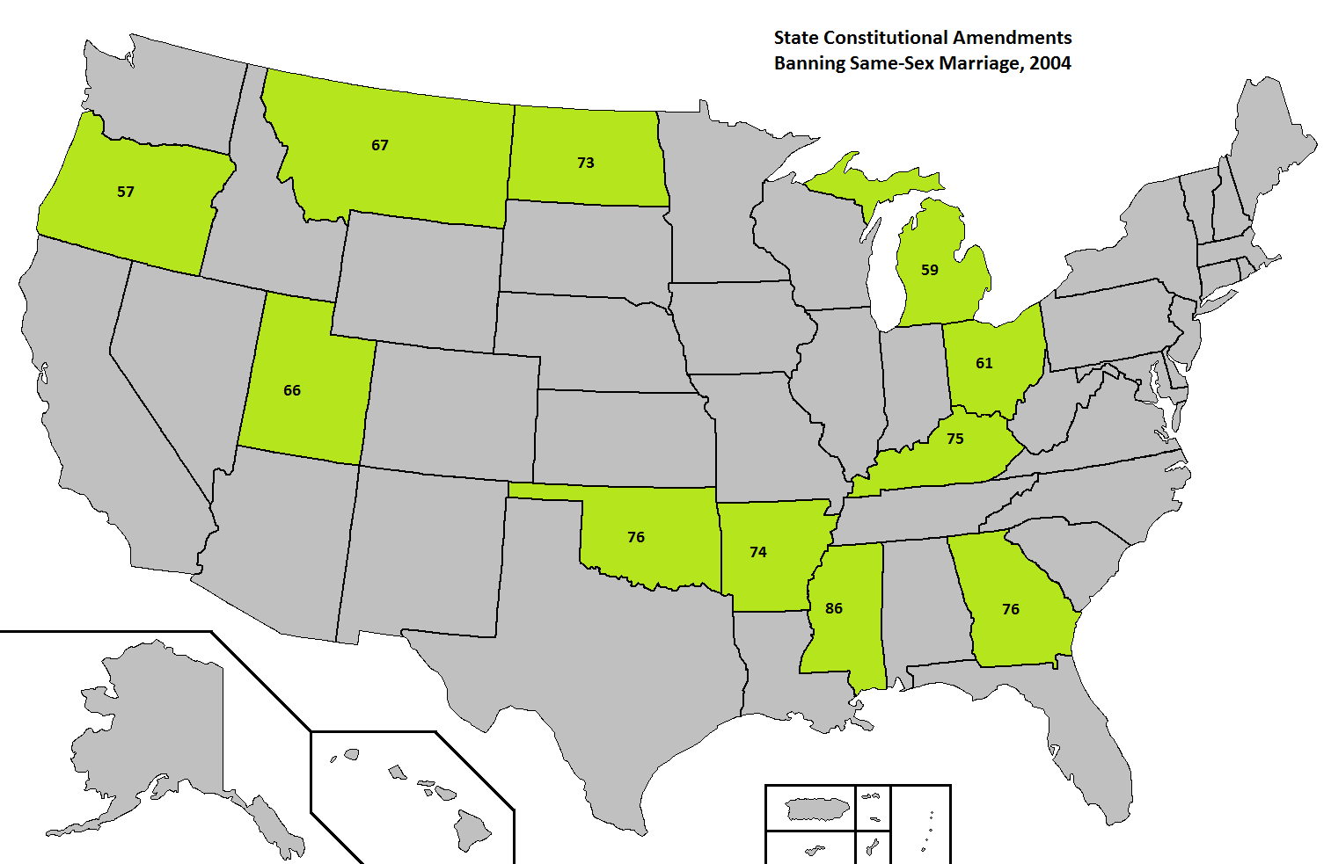

Slide 22
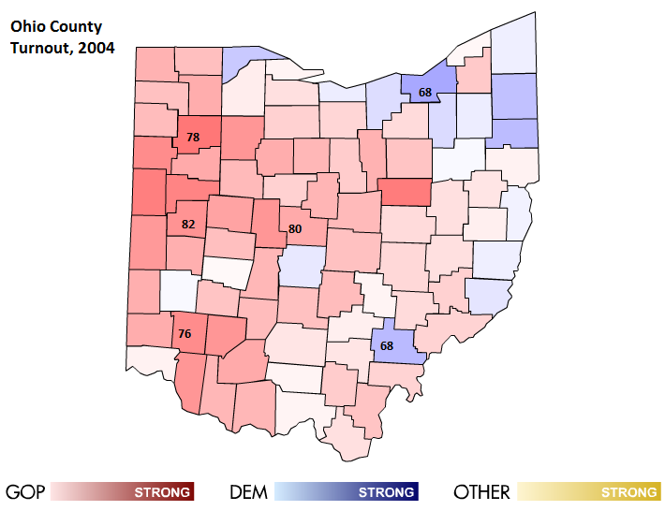
Notes:
Shelby, Warren, VanWert, and Delaware Counties; Bush gets 71% in Shelby

Slide 23
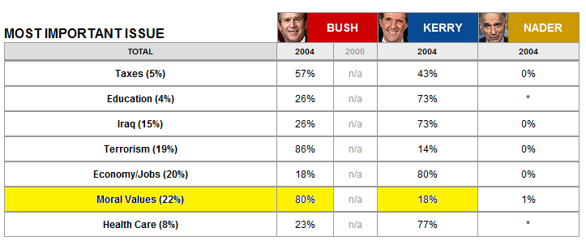

Slide 24


Slide 25
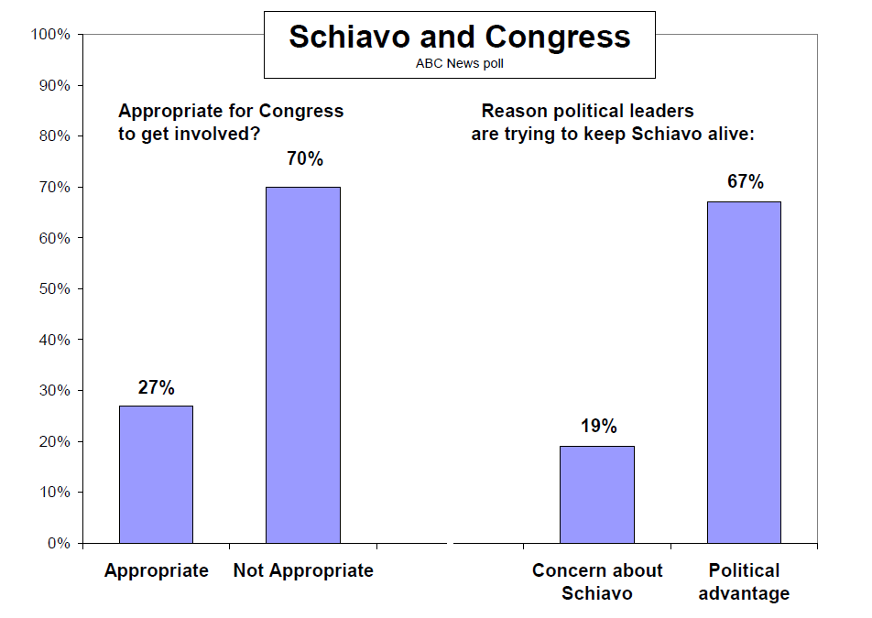

Slide 26
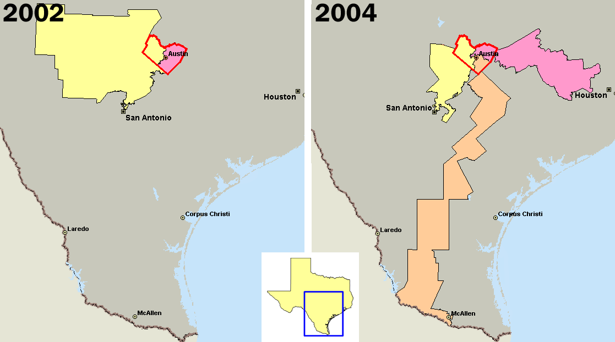

Slide 27
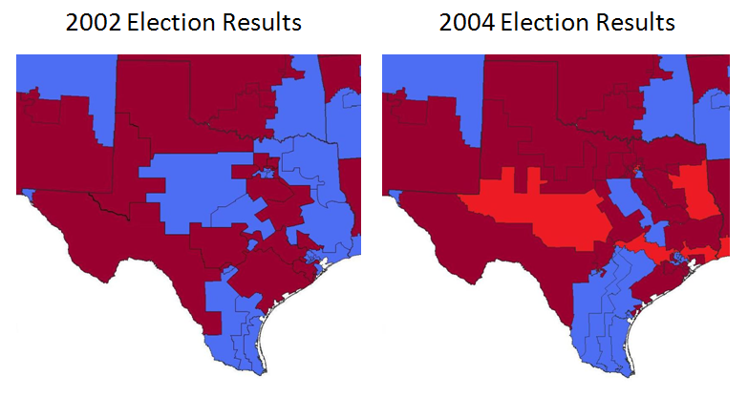

Slide 28
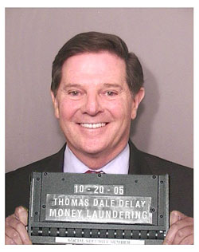

Slide 29
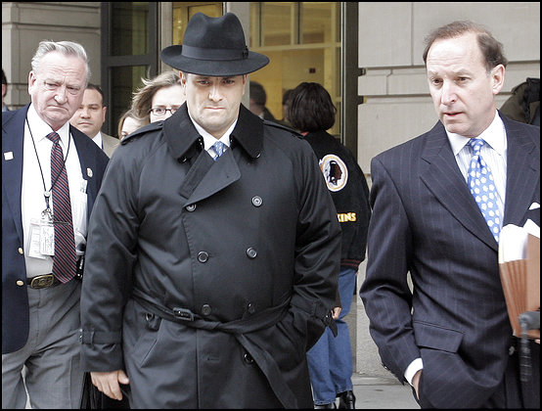

Slide 30


Slide 31


Slide 32
