Slide 1
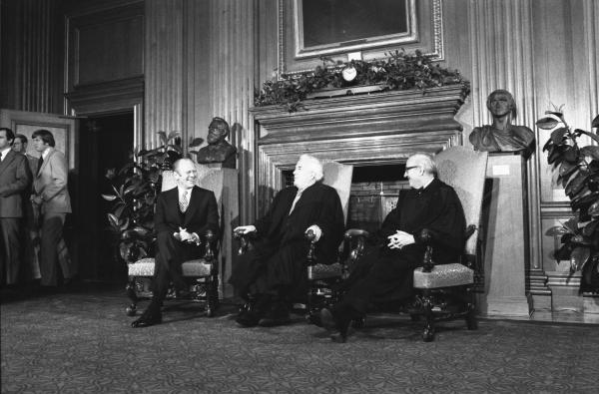

Slide 2
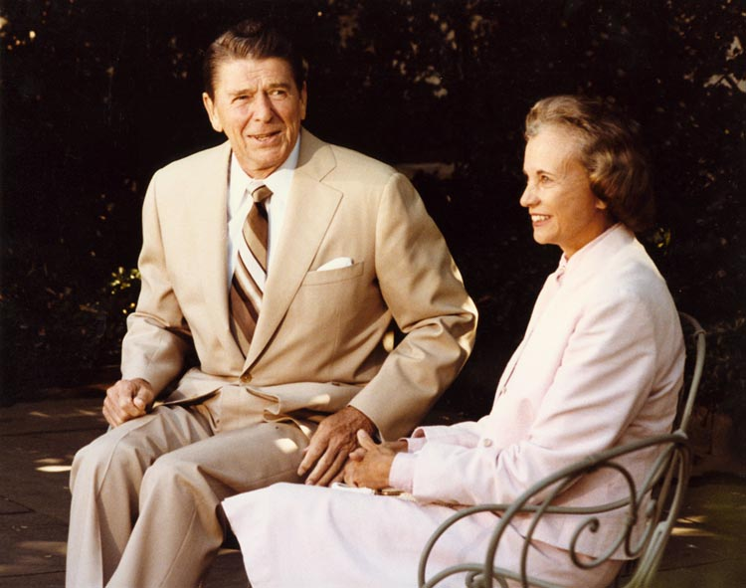

Slide 3
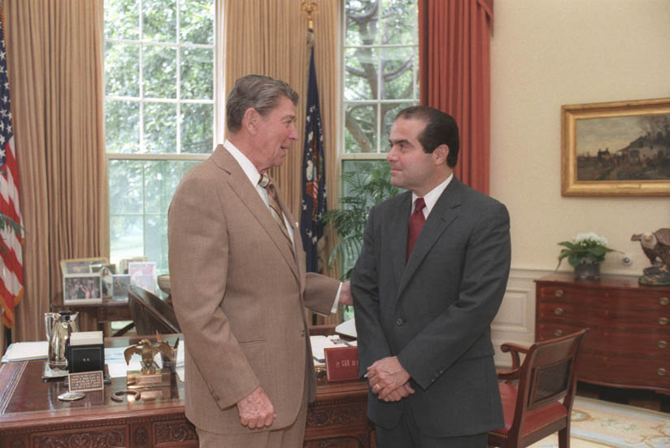

Slide 4
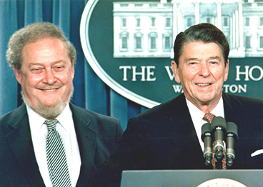

Slide 5
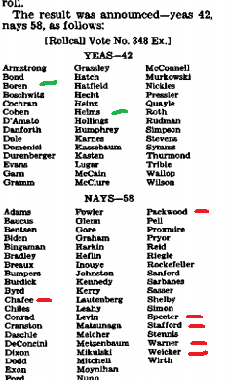

Slide 6
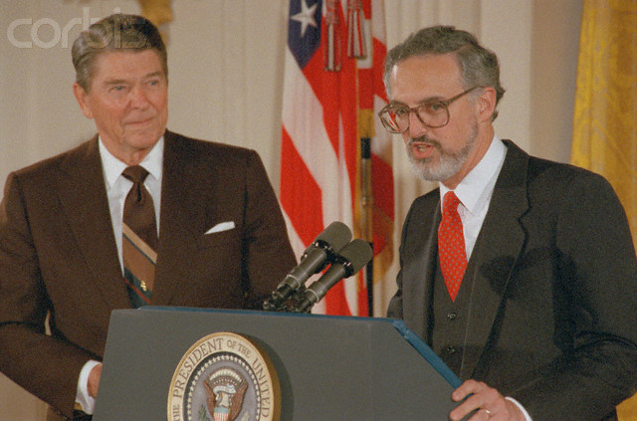

Slide 7
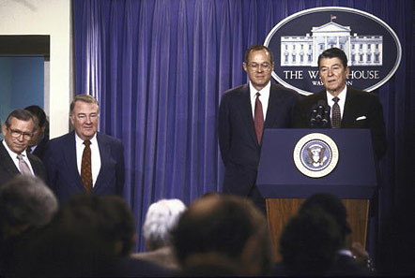

Slide 8
McCloskey v. Kemp (1987)—Brennan dissent
At the time our Constitution was framed 200 years ago this year, blacks “had for more than a century before been regarded as beings of an inferior order, and altogether unfit to associate with the white race, either in social or political relations; and so far inferior that they had no rights which the white man was bound to respect.”
Dred Scott v. Sandford, (1857). Only 130 years ago, this Court relied on these observations to deny American citizenship to blacks. Ibid. A mere three generations ago, this Court sanctioned racial segregation, stating that "[i]f one race be inferior to the other socially, the Constitution of the United States cannot put them upon the same plane." Plessy v. Ferguson, (1896).
We cannot pretend that, in three decades, we have completely escaped the grip of a historical legacy spanning centuries . . .
The Court's decision today will not change what attorneys in Georgia tell other Warren McCleskeys about their chances of execution. Nothing will soften the harsh message they must convey, nor alter the prospect that race undoubtedly will continue to be a topic of discussion. McCleskey's evidence will not have obtained judicial acceptance, but that will not affect what is said on death row. However many criticisms of today's decision may be rendered, these painful conversations will serve as the most eloquent dissents of all.

Slide 9
Texas v. Johnson (1989)—Brennan majority opinion
Texas argues that its interest in preserving the flag as a symbol of nationhood and national unity survives this close analysis . . . the State's claim is that it has an interest in preserving the flag as a symbol of nationhood and national unity, a symbol with a determinate range of meanings. According to Texas, if one physically treats the flag in a way that would tend to cast doubt on either the idea that nationhood and national unity are the flag's referents or that national unity actually exists, the message conveyed thereby is a harmful one, and therefore may be prohibited.
If there is a bedrock principle underlying the First Amendment, it is that the government may not prohibit the expression of an idea simply because society finds the idea itself offensive or disagreeable . . .
We are tempted to say, in fact, that the flag's deservedly cherished place in our community will be strengthened, not weakened, by our holding today. Our decision is a reaffirmation of the principles of freedom and inclusiveness that the flag best reflects, and of the conviction that our toleration of criticism such as Johnson's is a sign and source of our strength . . .
The way to preserve the flag's special role is not to punish those who feel differently about these matters. It is to persuade them that they are wrong.

Slide 10
Texas v. Johnson —Rehnquist dissent
The American flag, then, throughout more than 200 years of our history, has come to be the visible symbol embodying our Nation. It does not represent the views of any particular political party, and it does not represent any particular political philosophy. The flag is not simply another "idea" or "point of view" competing for recognition in the marketplace of ideas. Millions and millions of Americans regard it with an almost mystical reverence, regardless of what sort of social, political, or philosophical beliefs they may have. I cannot agree that the First Amendment invalidates the Act of Congress, and the laws of 48 of the 50 States, which make criminal the public burning of the flag . . .
The Court concludes its opinion with a regrettably patronizing civics lecture, presumably addressed to the Members of both Houses of Congress, the members of the 48 state legislatures that enacted prohibitions against flag burning, and the troops fighting under that flag in Vietnam who objected to its being burned.

Slide 11
Allegheny County v. Pennsylvania ACLU (1989)—Kennedy dissent
The majority holds that the County of Allegheny violated the Establishment Clause by displaying a creche in the county courthouse, because the "principal or primary effect" of the display is to advance religion . . . This view of the Establishment Clause reflects an unjustified hostility toward religion, a hostility inconsistent with our history and our precedents . . .
It cannot be disputed that government, if it chooses, may participate in sharing with its citizens the joy of the holiday season, by declaring public holidays, installing or permitting festive displays, sponsoring celebrations and parades, and providing holiday vacations for its employees . . .
The approach adopted by the majority contradicts important values embodied in the Clause. Obsessive, implacable resistance to all but the most carefully scripted and secularized forms of accommodation requires this Court to act as a censor, issuing national decrees as to what is orthodox and what is not. What is orthodox, in this context, means what is secular; the only Christmas the State can acknowledge is one in which references to religion have been held to a minimum. The Court thus lends its assistance to an Orwellian rewriting of history as many understand it.

Slide 12
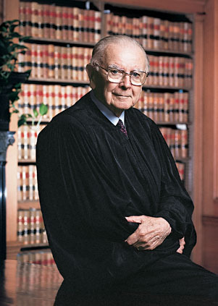

Slide 13
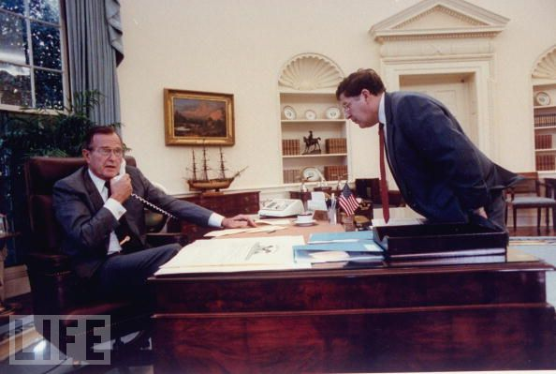

Slide 14
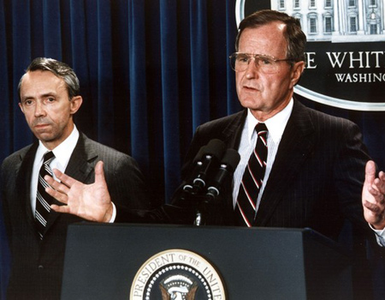

Slide 15

Molly Yard, president of National Organization of Women:
“Are you prepared to deny freedom to women? Are you prepared to deny reproductive health to women? Are you prepared for lawlessness, and for the death of your daughters and your granddaughters? I tremble for this country if you confirm David Souter. But most of all I tremble for the women of America and their families.”

Slide 16
Planned Parenthood v. Casey (1992)—Scalia dissent
Applying the rational basis test, I would uphold the Pennsylvania statute in its entirety. I must, however, respond to a few of the more outrageous arguments in today's opinion, which it is beyond human nature to leave unanswered. I shall discuss each of them under a quotation from the Court's opinion to which they pertain . . .
" Liberty finds no refuge in a jurisprudence of doubt. "
Ante, at 1.
One might have feared to encounter this august and sonorous phrase in an opinion defending the real Roe v. Wade, rather than the revised version fabricated today by the authors of the joint opinion. The shortcomings of Roe did not include lack of clarity: Virtually all regulation of abortion before the third trimester was invalid. But to come across this phrase in the joint opinion--which calls upon federal district judges to apply an "undue burden" standard as doubtful in application as it is unprincipled in origin--is really more than one should have to bear . . .
To the extent I can discern any meaningful content in the "undue burden" standard as applied in the joint opinion, it appears to be that a State may not regulate abortion in such a way as to reduce significantly its incidence.

Slide 17
Planned Parenthood –Scalia dissent (cont.)
" While we appreciate the weight of the arguments . . . that Roe should be overruled, the reservations any of us may have in reaffirming the central holding of Roe are outweighed by the explication of individual liberty we have given combined with the force of stare decisis. "
Ante, at 11.
The Court's reliance upon stare decisis can best be described as contrived. It insists upon the necessity of adhering not to all of Roe, but only to what it calls the "central holding." It seems to me that stare decisis ought to be applied even to the doctrine of stare decisis, and I confess never to have heard of this new, keep what you want and throw away the rest version. I wonder whether, as applied to Marbury v. Madison, (1803), for example, the new version of stare decisis would be satisfied if we allowed courts to review the constitutionality of only those statutes that (like the one in Marbury) pertain to the jurisdiction of the courts

Slide 18
There is a poignant aspect to today's opinion. Its length, and what might be called its epic tone, suggest that its authors believe they are bringing to an end a troublesome era in the history of our Nation and of our Court. "It is the dimension" of authority, they say, to "cal[l] the contending sides of national controversy to end their national division by accepting a common mandate rooted in the Constitution." Ante, at 24.
There comes vividly to mind a portrait by Emanuel Leutze that hangs in the Harvard Law School: Roger Brooke Taney, painted in 1859, the 82d year of his life, the 24th of his Chief Justiceship, the second after his opinion in Dred Scott. He is all in black, sitting in a shadowed red armchair, left hand resting upon a pad of paper in his lap, right hand hanging limply, almost lifelessly, beside the inner arm of the chair. He sits facing the viewer, and staring straight out. There seems to be on his face, and in his deep set eyes, an expression of profound sadness and disillusionment. Perhaps he always looked that way, even when dwelling upon the happiest of thoughts. But those of us who know how the lustre of his great Chief Justiceship came to be eclipsed by Dred Scott cannot help believing that he had that case--its already apparent consequences for the Court, and its soon to be played out consequences for the Nation--burning on his mind. I expect that two years earlier he, too, had thought himself "call[ing] the contending sides of national controversy to end their national division by accepting a common mandate rooted in the Constitution."

Slide 19
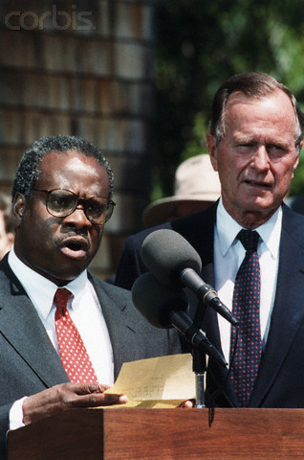

Slide 20
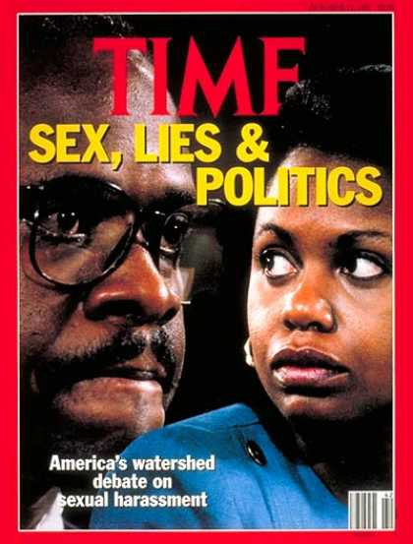

Slide 21
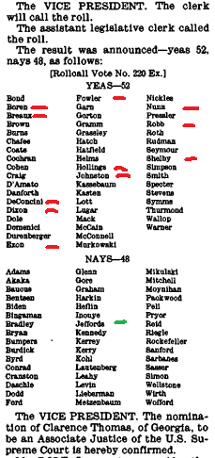

Slide 22


Slide 23
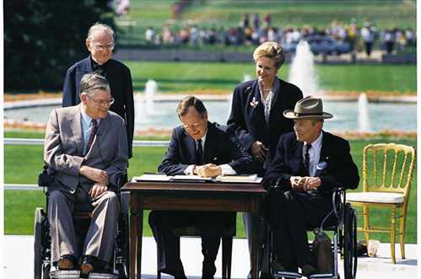

Slide 24
ADA
Employment (Title I): Businesses must provide reasonable accommodations to protect the rights of individuals with disabilities in all aspects of employment. Possible changes may include restructuring jobs, altering the layout of workstations, or modifying equipment. Employment aspects may include the application process, hiring, wages, benefits, and all other aspects of employment. Medical examinations are highly regulated.
Public Services (Title II): Public services, which include state and local government instrumentalities, the National Railroad Passenger Corporation, and other commuter authorities, cannot deny services to people with disabilities or deny participation in programs or activities that are available to people without disabilities. In addition, public transportation systems, such as public transit buses, must be accessible to individuals with disabilities.
Public Accommodations (Title III): All new construction and modifications must be accessible to individuals with disabilities. For existing facilities, barriers to services must be removed if readily achievable. Public accommodations include facilities such as restaurants, hotels, grocery stores, retail stores, etc., as well as privately owned transportation systems.
Telecommunications (Title IV): Telecommunications companies offering telephone service to the general public must have telephone relay service to individuals who use telecommunication devices for the deaf (TTYs) or similar devices.

