Slide 1
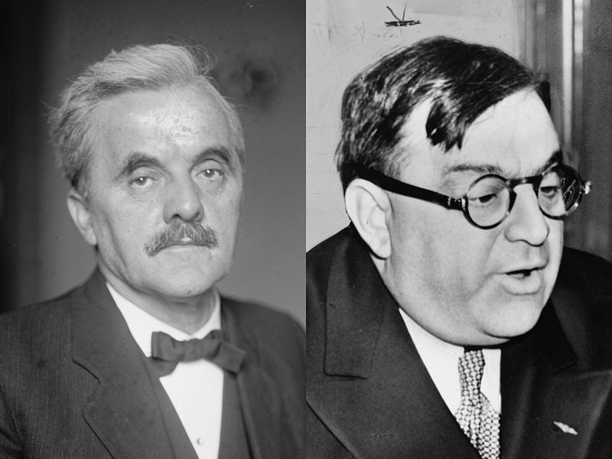

Slide 2
Norris-LaGuardia Act (1932)
--prohibits federal courts from enforcing “yellow dog" contracts
--bars federal courts from issuing injunctions against:
(*) joining or organizing a union, or assembling for union purposes;
(*) striking or refusing to work, or advising others to strike or organize;
(*) publicizing acts of a labor dispute; and
(*) providing lawful legal aid to persons participating in a labor dispute.

Slide 3


Slide 4
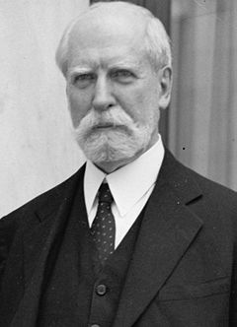
Notes:
hughes

Slide 5
Schecter Poultry Co. v. United States (1935)
It is not the province of the Court to consider the economic advantages or disadvantages of such a centralized system. It is sufficient to say that the Federal Constitution does not provide for it. Our growth and development have called for wide use of the commerce power of the federal government in its control over the expanded activities of interstate commerce and in protecting that commerce from burdens, interferences, and conspiracies to restrain and monopolize it. But the authority of the federal government may not be pushed to such an extreme as to destroy the distinction, which the commerce clause itself establishes, between commerce 'among the several States' and the internal concerns of a state.

Slide 6


Slide 7
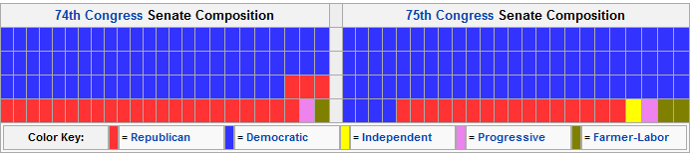
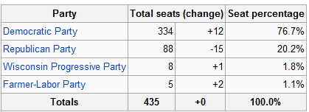
1936 Congressional Election Results

Slide 8
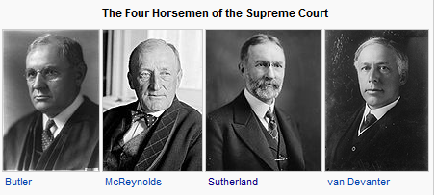

Slide 9
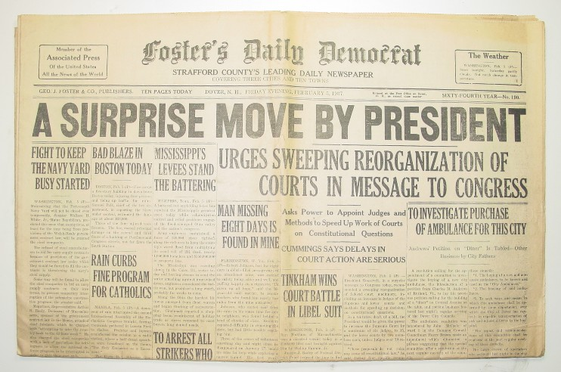

Slide 10
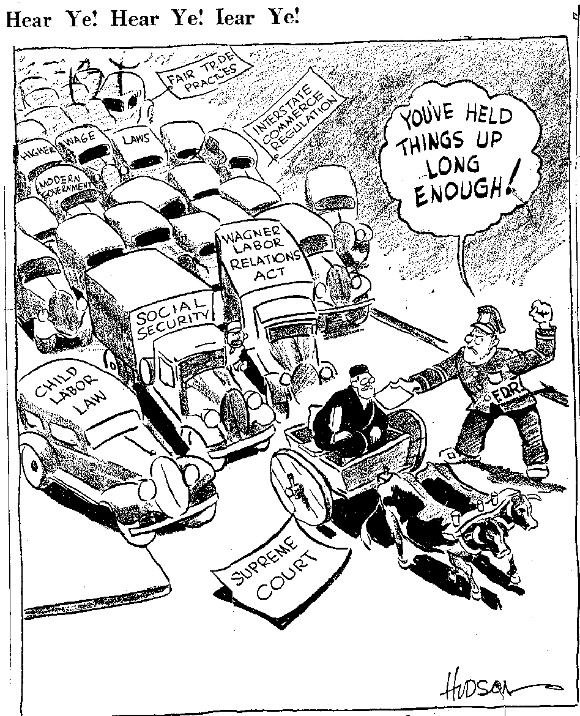

Slide 11
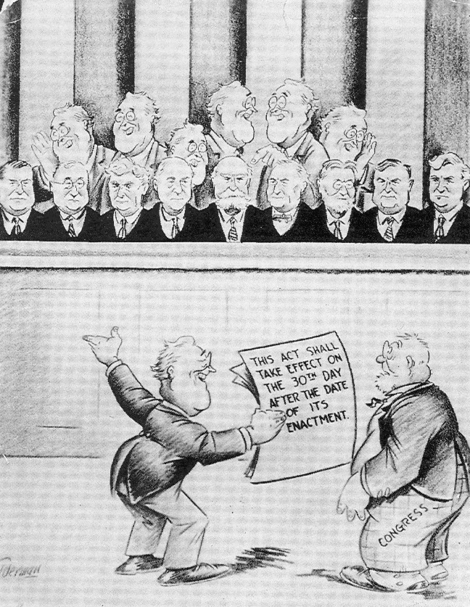

Slide 12
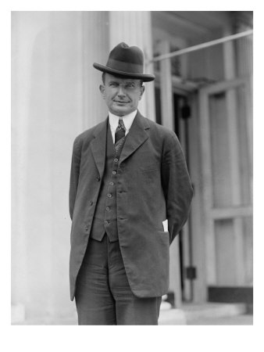
Notes:
wheeler

Slide 13
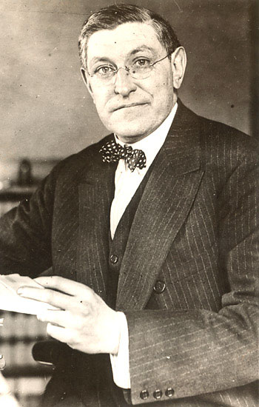

Slide 14
West Coast Hotel v. Parrish (1937)
The constitutional provision invoked is the due process clause of the Fourteenth Amendment governing the states, as the due process clause invoked in the Adkins Case governed Congress. In each case the violation alleged by those attacking minimum wage regulation for women is deprivation of freedom of contract. What is this freedom? The Constitution does not speak of freedom of contract. It speaks of liberty and prohibits the deprivation of liberty without due process of law. In prohibiting that deprivation, the Constitution does not recognize an absolute and uncontrollable liberty. Liberty in each of its phases has its history and connotation. But the liberty safeguarded is liberty in a social organization which requires the protection of law against the evils which menace the health, safety, morals, and welfare of the people. Liberty under the Constitution is thus necessarily subject to the restraints of due process, and regulation which is reasonable in relation to its subject and is adopted in the interests of the community is due process . . .
We think that the views thus expressed are sound and that the decision in the Adkins Case was a departure from the true application of the principles governing the regulation by the state of the relation of employer and employed.

Slide 15
West Coast Hotel—Sutherland dissent
Coming, then, to a consideration of the Washington statute, it first is to be observed that it is in every substantial respect identical with the statute involved in the Adkins Case. Such vices as existed in the latter are present in the former. And if the Adkins Case was properly decided, as we who join in this opinion think it was, it necessarily follows that the Washington statute is invalid . . .
Finally, it may be said that a statute absolutely fixing wages in the various industries at definite sums and forbidding employers and employees from contracting for any other than those designated would probably not be thought to be constitutional. It is hard to see why the power to fix minimum wages does not connote a like power in respect of maximum wages. And yet, if both powers be exercised in such a way that the minimum and the maximum so nearly approach each other as to become substantially the same, the right to make any contract in respect of wages will have been completely abrogated.

Slide 16
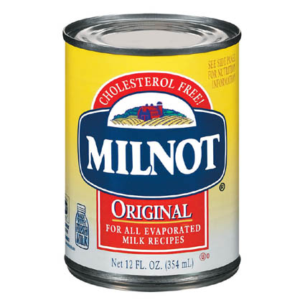

Slide 17
United States v. Carolene Products Co. (1938)
. . . we might rest decision wholly on the presumption of constitutionality. But affirmative evidence also sustains the statute . . .
Congress is free to exclude from interstate commerce articles whose use in the states for which they are destined it may reasonably conceive to be injurious to the public health, morals or welfare . . . or which contravene the policy of the state of their destination.

Slide 18
Carolene Products
^{4.} There may be narrower scope for operation of the presumption of constitutionality when legislation appears on its face to be within a specific prohibition of the Constitution, such as those of the first ten amendments, which are deemed equally specific when held to be embraced within the Fourteenth.
It is unnecessary to consider now whether legislation which restricts those political processes which can ordinarily be expected to bring about repeal of undesirable legislation is to be subjected to more exacting judicial scrutiny under the general prohibitions of the Fourteenth Amendment than are most other types of legislation . . .
Nor need we enquire whether similar considerations enter into the review of statutes directed at particular religious, or national, or racial minorities: whether prejudice against discrete and insular minorities may be a special condition, which tends seriously to curtail the operation of those political processes ordinarily to be relied upon to protect minorities, and which may call for a correspondingly more searching judicial inquiry.

Slide 19
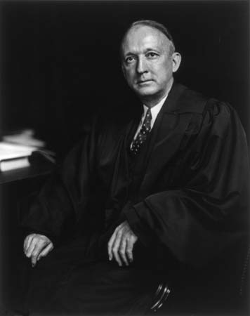
Notes:
Hugo black

Slide 20
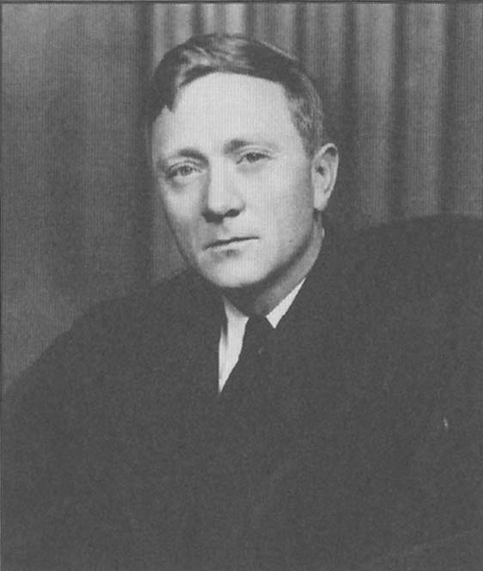
Notes:
douglas

Slide 21
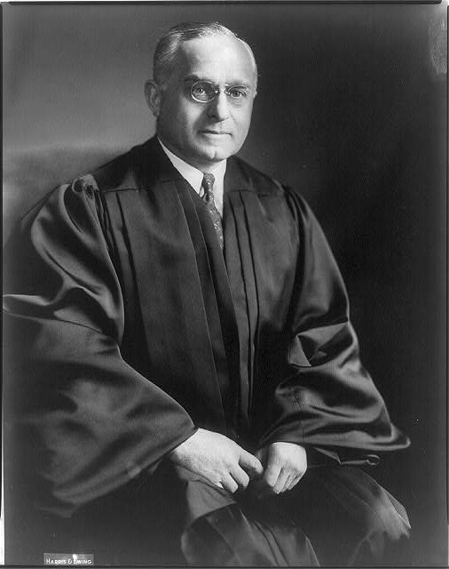
Notes:
F’frter

Slide 22
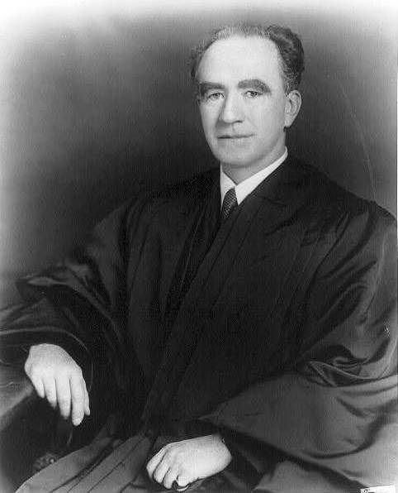
Notes:
murphy

Slide 23
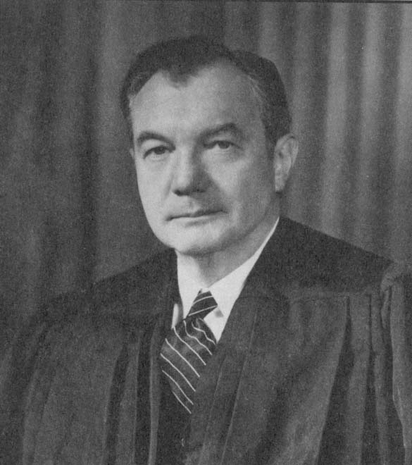
Notes:
jackson

Slide 24
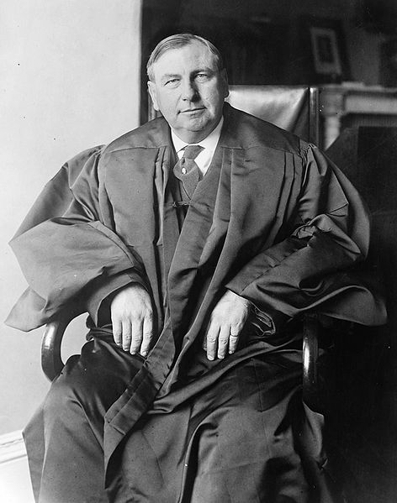
Notes:
stone

Slide 25
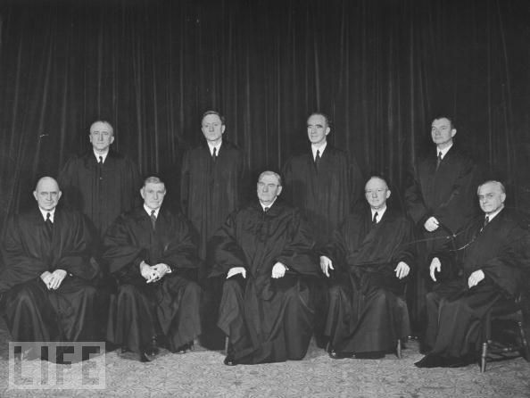

Slide 26
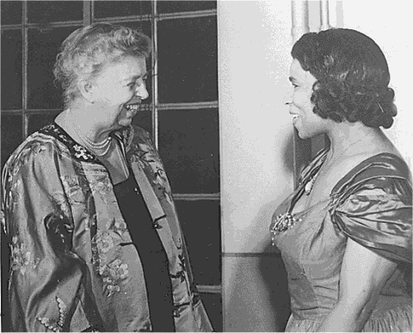

Slide 27


Slide 28
Article X
The Members of the League undertake to respect and preserve as against external aggression the territorial integrity and existing political independence of all Members of the League. In the case of any such aggression or in case of any threat or danger of such aggression the Council shall advise upon the means by which this obligation shall be fulfilled.

Slide 29
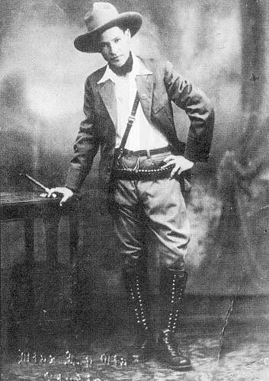

Slide 30
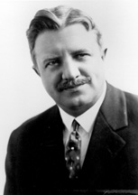

Slide 31
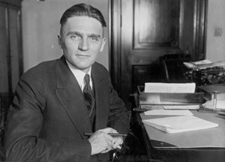

Slide 32
U.S. v. Curtiss-Wright Export Co. (1936)
Not only is the federal power over external affairs in origin and essential character different from that over internal affairs, but participation in the exercise of the power is significantly limited. In this vast external realm, with its important, complicated, delicate and manifold problems, the President alone has the power to speak or listen as a representative of the nation. He makes treaties with the advice and consent of the Senate; but he alone negotiates. Into the field of negotiation the Senate cannot intrude, and Congress itself is powerless to invade it.

Slide 33
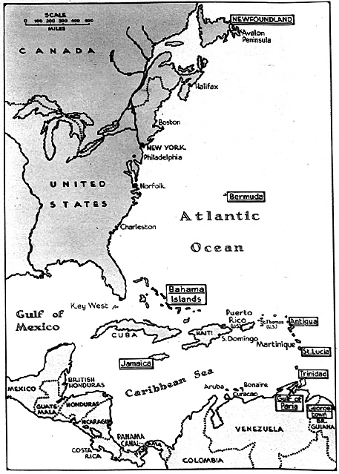

Slide 34
