Slide 1
SEC. 9. And be it further enacted, That the district courts shall have, exclusively of the courts of the several States, cognizance of all crimes and offences that shall be cognizable under the authority of the United States, committed within their respective districts, or upon the high seas; where no other punishment than whipping, not exceeding thirty stripes, a fine not exceeding one hundred dollars, or a term of imprisonment not exceeding six months, is to be inflicted; and shall also have exclusive original cognizance of all civil causes of admiralty and maritime jurisdiction, including all seizures under laws of impost, navigation or trade of the United States, where the seizures are made, on waters which are navigable from the sea by vessels of ten or more tons burthen, within their respective districts as well as upon the high seas; saving to suitors, in all cases, the right of a common law remedy, where the common law is competent to give it; and shall also have exclusive original cognizance of all seizures on land, or other waters than as aforesaid, made, and of all suits for penalties and forfeitures incurred, under the laws of the United States. And shall also have cognizance, concurrent with the courts of the several States, or the circuit courts, as the case may be, of all causes where an alien sues for a tort only in violation of the law of nations or a treaty of the United States. And shall also have cognizance, concurrent as last mentioned, of all suits at common law where the United States sue, and the matter in dispute amounts, exclusive of costs, to the sum or value of one hundred dollars. And shall also have jurisdiction exclusively of the courts of the several States, of all suits against consuls or vice-consuls, except for offences above the description aforesaid. And the trial of issues in fact, in the district courts, in all causes except civil causes of admiralty and maritime jurisdiction, shall be by jury.

Slide 2
SEC. 25. And be it further enacted, That a final judgment or decree in any suit, in the highest court of law or equity of a State in which a decision in the suit could be had, where is drawn in question the validity of a treaty or statute of, or an authority exercised under the United States, and the decision is against their validity; or where is drawn in question the validity of a statute of, or an authority exercised under any State, on the ground of their being repugnant to the constitution, treaties or laws of the United States, and the decision is in favour of such their validity, or where is drawn in question the construction of any clause of the constitution, or of a treaty, or statute of, or commission held under the United States, and the decision is against the title, right, privilege or exemption specially set up or claimed by either party, under such clause of the said Constitution, treaty, statute or commission, may be re-examined and reversed or affirmed in the Supreme Court of the United States upon a writ of error, the citation being signed by the chief justice, or judge or chancellor of the court rendering or passing the judgment or decree complained of, or by a justice of the Supreme Court of the United States, in the same manner and under the same regulations, and the writ shall have the same effect, as if the judgment or decree complained of had been rendered or passed in a circuit court, and the proceeding upon the reversal shall also be the same, except that the Supreme Court, instead of remanding the cause for a final decision as before provided, may at their discretion, if the cause shall have been once remanded before, proceed to a final decision of the same, and award execution. But no other error shall be assigned or regarded as a ground of reversal in any such case as aforesaid, than such as appears on the face of the record, and immediately respects the before mentioned questions of validity or construction of the said constitution, treaties, statutes, commissions, or authorities in dispute.

Slide 3
SEC. 34. And be it further enacted, That the laws of the several states, except where the constitution, treaties or statutes of the United States shall otherwise require or provide, shall be regarded as rules of decision in trials at common law in the courts of the United States in cases where they apply.

Slide 4
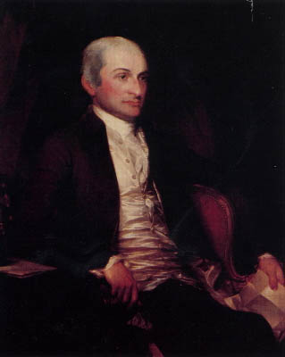

Slide 5
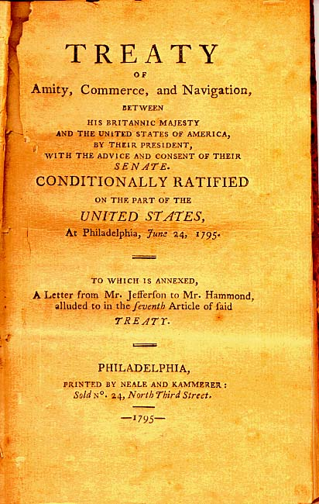

Slide 6
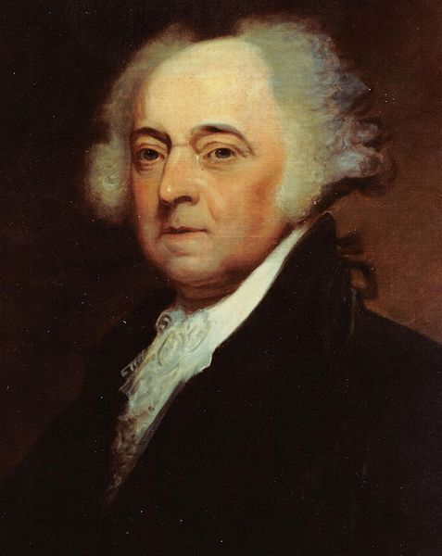

Slide 7
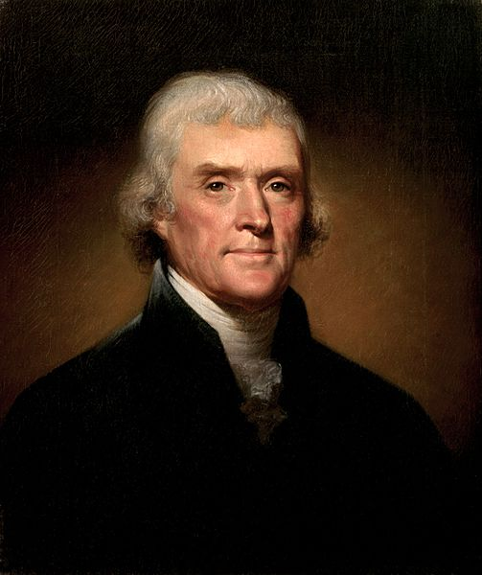

Slide 8
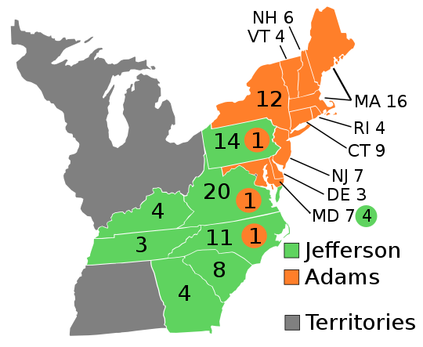

Slide 9
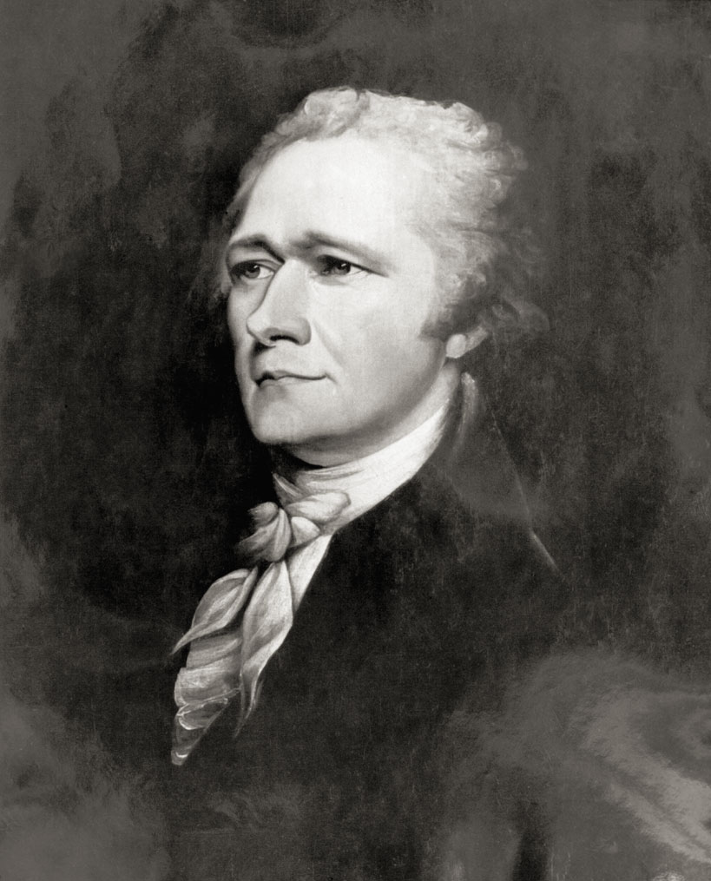

Slide 10
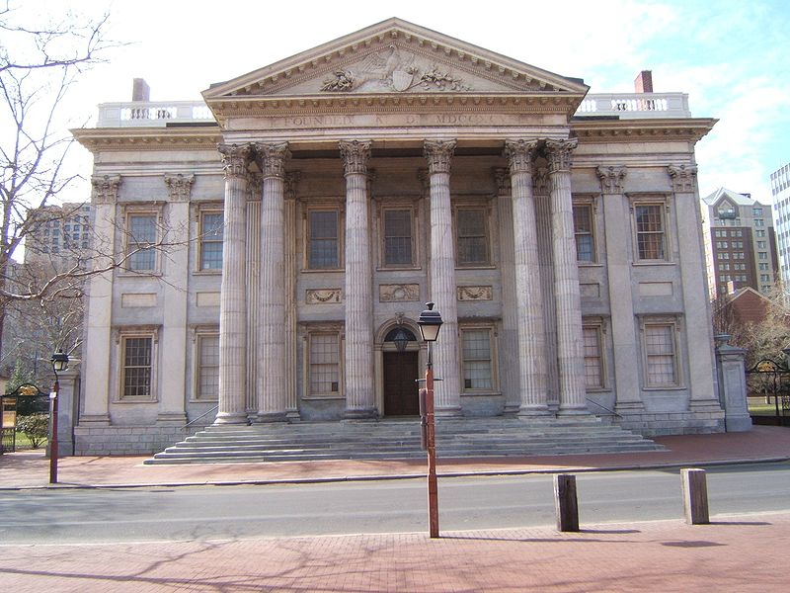
Notes:
Bank of us--philly

Slide 11
SEC. 2. And be it farther enacted, That if any person shall write, print, utter or publish, or shall cause or procure to be written, printed, uttered or published, or shall knowingly and willingly assist or aid in writing, printing, uttering or publishing any false, scandalous and malicious writing or writings against the government of the United States, or either house of the Congress of the United States, or the President of the United States, with intent to defame the said government, or either house of the said Congress, or the said President, or to bring them, or either of them, into contempt or disrepute; or to excite against them, or either or any of them, the hatred of the good people of the United States, or to stir up sedition within the United States, or to excite any unlawful combinations therein, for opposing or resisting any law of the United States, or any act of the President of the United States, done in pursuance of any such law, or of the powers in him vested by the constitution of the United States, or to resist, oppose, or defeat any such law or act, or to aid, encourage or abet any hostile designs of any foreign nation against United States, their people or government, then such person, being thereof convicted before any court of the United States having jurisdiction thereof, shall be punished by a fine not exceeding two thousand dollars, and by imprisonment not exceeding two years.

Slide 12
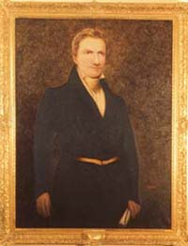
Notes:
Matthew lyon

Slide 13
Kentucky Resolution (Jefferson)
1. Resolved, That the several States composing, the United States of America, are not united on the principle of unlimited submission to their general government; but that, by a compact under the style and title of a Constitution for the United States, and of amendments thereto, they constituted a general government for special purposes — delegated to that government certain definite powers, reserving, each State to itself, the residuary mass of right to their own self-government; and that whensoever the general government assumes undelegated powers, its acts are unauthoritative, void, and of no force: that to this compact each State acceded as a State, and is an integral part, its co-States forming, as to itself, the other party: that the government created by this compact was not made the exclusive or final judge of the extent of the powers delegated to itself; since that would have made its discretion, and not the Constitution, the measure of its powers; but that, as in all other cases of compact among powers having no common judge, each party has an equal right to judge for itself, as well of infractions as of the mode and measure of redress.

Slide 14
3. Resolved, That it is true as a general principle, and is also expressly declared by one of the amendments to the Constitutions, that “the powers not delegated to the United States by the Constitution, our prohibited by it to the States, are reserved to the States respectively, or to the people”; and that no power over the freedom of religion, freedom of speech, or freedom of the press being delegated to the United States by the Constitution, nor prohibited by it to the States, all lawful powers respecting the same did of right remain, and were reserved to the States or the people: that thus was manifested their determination to retain to themselves the right of judging how far the licentiousness of speech and of the press may be abridged without lessening their useful freedom, and how far those abuses which cannot be separated from their use should be tolerated, rather than the use be destroyed . . . That, therefore, the act of Congress of the United States, passed on the 14th day of July, 1798, intituled “An Act in addition to the act intituled An Act for the punishment of certain crimes against the United States,” which does abridge the freedom of the press, is not law, but is altogether void, and of no force.

Slide 15
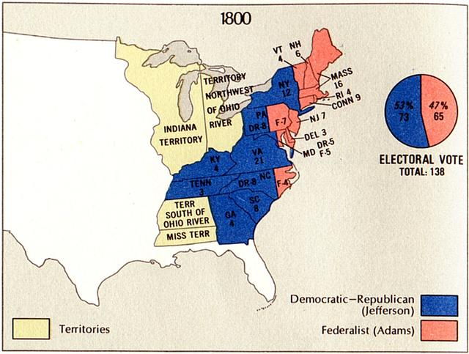

Slide 16
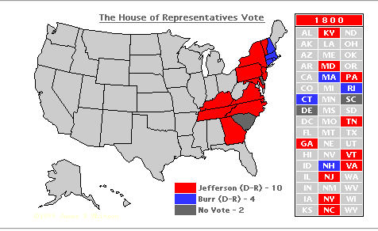

Slide 17
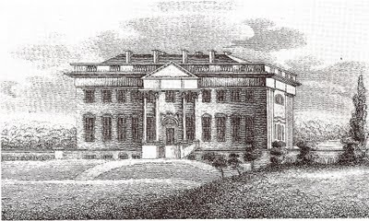
Notes:
Jefferson white house

Slide 18
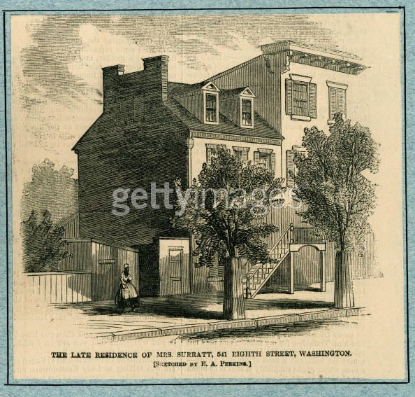
Notes:
boardinghouse

Slide 19
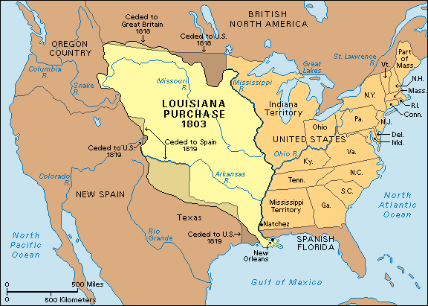

Slide 20


Slide 21
12th amendment: The Electors shall meet in their respective states, and vote by ballot for President and Vice-President, one of whom, at least, shall not be an inhabitant of the same state with themselves; they shall name in their ballots the person voted for as President, and in distinct ballots the person voted for as Vice-President, and they shall make distinct lists of all persons voted for as President, and of all persons voted for as Vice-President and of the number of votes for each, which lists they shall sign and certify, and transmit sealed to the seat of the government of the United States, directed to the President of the Senate;
The President of the Senate shall, in the presence of the Senate and House of Representatives, open all the certificates and the votes shall then be counted;
The person having the greatest Number of votes for President, shall be the President, if such number be a majority of the whole number of Electors appointed; and if no person have such majority, then from the persons having the highest numbers not exceeding three on the list of those voted for as President, the House of Representatives shall choose immediately, by ballot, the President. But in choosing the President, the votes shall be taken by states, the representation from each state having one vote; a quorum for this purpose shall consist of a member or members from two-thirds of the states, and a majority of all the states shall be necessary to a choice. And if the House of Representatives shall not choose a President whenever the right of choice shall devolve upon them, before the fourth day of March next following, then the Vice-President shall act as President, as in the case of the death or other constitutional disability of the President.

Slide 22


Slide 23
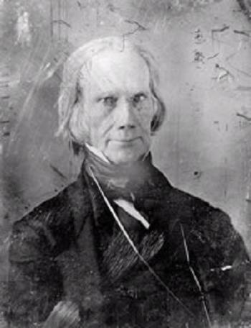

Slide 24
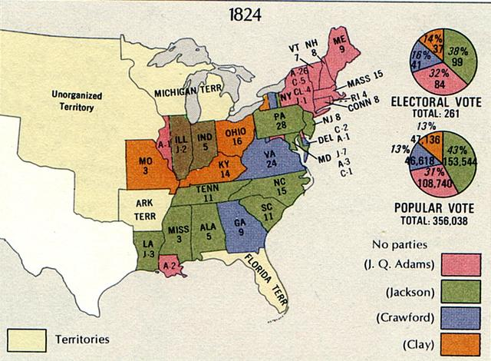

Slide 25
