Slide 1


Slide 2


Slide 3
ADA
Employment (Title I): Businesses must provide reasonable accommodations to protect the rights of individuals with disabilities in all aspects of employment. Possible changes may include restructuring jobs, altering the layout of workstations, or modifying equipment. Employment aspects may include the application process, hiring, wages, benefits, and all other aspects of employment. Medical examinations are highly regulated.
Public Services (Title II): Public services, which include state and local government instrumentalities, the National Railroad Passenger Corporation, and other commuter authorities, cannot deny services to people with disabilities or deny participation in programs or activities that are available to people without disabilities. In addition, public transportation systems, such as public transit buses, must be accessible to individuals with disabilities.
Public Accommodations (Title III): All new construction and modifications must be accessible to individuals with disabilities. For existing facilities, barriers to services must be removed if readily achievable. Public accommodations include facilities such as restaurants, hotels, grocery stores, retail stores, etc., as well as privately owned transportation systems.
Telecommunications (Title IV): Telecommunications companies offering telephone service to the general public must have telephone relay service to individuals who use telecommunication devices for the deaf (TTYs) or similar devices.

Slide 4










Slide 5
Planned Parenthood v. Casey (1992)—Scalia dissent
Applying the rational basis test, I would uphold the Pennsylvania statute in its entirety. I must, however, respond to a few of the more outrageous arguments in today's opinion, which it is beyond human nature to leave unanswered. I shall discuss each of them under a quotation from the Court's opinion to which they pertain . . .
"Liberty finds no refuge in a jurisprudence of doubt. "
Ante, at 1.
One might have feared to encounter this august and sonorous phrase in an opinion defending the real Roe v. Wade, rather than the revised version fabricated today by the authors of the joint opinion. The shortcomings of Roe did not include lack of clarity: Virtually all regulation of abortion before the third trimester was invalid. But to come across this phrase in the joint opinion--which calls upon federal district judges to apply an "undue burden" standard as doubtful in application as it is unprincipled in origin--is really more than one should have to bear . . .
To the extent I can discern any meaningful content in the "undue burden" standard as applied in the joint opinion, it appears to be that a State may not regulate abortion in such a way as to reduce significantly its incidence.

Slide 6
Planned Parenthood –Scalia dissent (cont.)
"While we appreciate the weight of the arguments . . . that Roe should be overruled, the reservations any of us may have in reaffirming the central holding of Roe are outweighed by the explication of individual liberty we have given combined with the force of stare decisis."
Ante, at 11.
The Court's reliance upon stare decisis can best be described as contrived. It insists upon the necessity of adhering not to all of Roe, but only to what it calls the "central holding." It seems to me that stare decisis ought to be applied even to the doctrine of stare decisis, and I confess never to have heard of this new, keep what you want and throw away the rest version. I wonder whether, as applied to Marbury v. Madison, (1803), for example, the new version of stare decisis would be satisfied if we allowed courts to review the constitutionality of only those statutes that (like the one in Marbury) pertain to the jurisdiction of the courts.

Slide 7
There is a poignant aspect to today's opinion. Its length, and what might be called its epic tone, suggest that its authors believe they are bringing to an end a troublesome era in the history of our Nation and of our Court. "It is the dimension" of authority, they say, to "cal[l] the contending sides of national controversy to end their national division by accepting a common mandate rooted in the Constitution." Ante, at 24.
There comes vividly to mind a portrait by Emanuel Leutze that hangs in the Harvard Law School: Roger Brooke Taney, painted in 1859, the 82d year of his life, the 24th of his Chief Justiceship, the second after his opinion in Dred Scott. He is all in black, sitting in a shadowed red armchair, left hand resting upon a pad of paper in his lap, right hand hanging limply, almost lifelessly, beside the inner arm of the chair. He sits facing the viewer, and staring straight out. There seems to be on his face, and in his deep set eyes, an expression of profound sadness and disillusionment. Perhaps he always looked that way, even when dwelling upon the happiest of thoughts. But those of us who know how the lustre of his great Chief Justiceship came to be eclipsed by Dred Scott cannot help believing that he had that case--its already apparent consequences for the Court, and its soon to be played out consequences for the Nation--burning on his mind. I expect that two years earlier he, too, had thought himself "call[ing] the contending sides of national controversy to end their national division by accepting a common mandate rooted in the Constitution."

Slide 8


Slide 9

"I looked at those 14 men [on the Senate Judiciary Committee] and I thought, These are not the people I want running my life and my children's and grandchildren's lives."

Slide 10


Slide 11


Slide 12


Slide 13
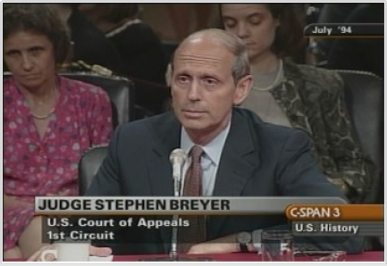

Slide 14
Meritor Savings Bank v. Vinson (1986)
In sum, we hold that a claim of "hostile environment" sex discrimination is actionable under Title VII.
Plaintiffs with hostile work environment claims must prove that the challenged conduct:
Was severe OR pervasive,
Created a hostile or abusive working environment,
Was unwelcome, and
Was based on the plaintiff’s gender

Slide 15


Slide 16


Slide 17
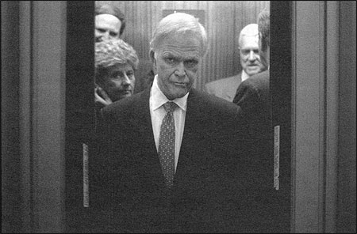

Slide 18


Slide 19
Partial-Birth Abortion Ban Act of 1995
Subjects any physician who knowingly performs a partial-birth abortion in or affecting interstate or foreign commerce to a fine or imprisonment for not more than two years or both, except where such an abortion is necessary to save the life of a mother endangered by a physical disorder, illness, or injury, provided that no other medical procedure would suffice. Defines: (1) "partial-birth abortion" as an abortion in which the person
performing the abortion partially vaginally delivers a living fetus before killing the fetus and completing the delivery . . .
Permits the father (if married to the mother at the time she receives a partial-birth abortion procedure) and (if the mother has not attained the age of 18 at the time of the abortion) the maternal grandparents to obtain, through a civil action, relief which would include money damages for all psychological and physical injuries and statutory damages equal to three times the cost of the partial-birth abortion, unless the pregnancy resulted from the plaintiff's criminal conduct or the plaintiff consented to the abortion.
Passed House, 283-149
Passed Senate, 54-44
Vetoed by Pres. Clinton

Slide 20
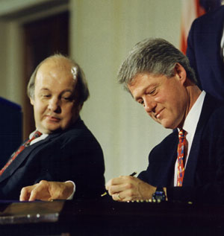

Slide 21

Notes:
Assault weapon ban

Slide 22


Slide 23
United States v. Lopez (1995)
We start with first principles. The Constitution creates a Federal Government of enumerated powers . . .
But even these modern era [1937-41] precedents which have expanded congressional power under the Commerce Clause confirm that this power is subject to outer limits . . .
Even Wickard, which is perhaps the most far reaching example of Commerce Clause authority over intrastate activity, involved economic activity in a way that the possession of a gun in a school zone does not . . .
To uphold the Government's contentions here, we would have to pile inference upon inference in a manner that would bid fair to convert congressional authority under the Commerce Clause to a general police power of the sort retained by the States. Admittedly, some of our prior cases have taken long steps down that road, giving great deference to congressional action. The broad language in these opinions has suggested the possibility of additional expansion, but we decline here to proceed any further. To do so would require us to conclude that the Constitution's enumeration of powers does not presuppose something not enumerated, and that there never will be a distinction between what is truly national and what is truly local. This we are unwilling to do.

Slide 24
Printz v. United States (1997)
The Framers' experience under the Articles of Confederation had persuaded them that using the States as the instruments of federal governance was both ineffectual and provocative of federal state conflict . . .
Residual state sovereignty was also implicit, of course, in the Constitution's conferral upon Congress of not all governmental powers, but only discrete, enumerated ones, Art. I, §8, which implication was rendered express by the Tenth Amendment's assertion that "[t]he powers not delegated to the United States by the Constitution, nor prohibited by it to the States, are reserved to the States respectively, or to the people."
Congress cannot compel the States to enact or enforce a federal regulatory program. Today we hold that Congress cannot circumvent that prohibition by conscripting the State's officers directly. The Federal Government may neither issue directives requiring the States to address particular problems, nor command the States' officers, or those of their political subdivisions, to administer or enforce a federal regulatory program. It matters not whether policymaking is involved, and no case by case weighing of the burdens or benefits is necessary; such commands are fundamentally incompatible with our constitutional system of dual sovereignty.

Slide 25
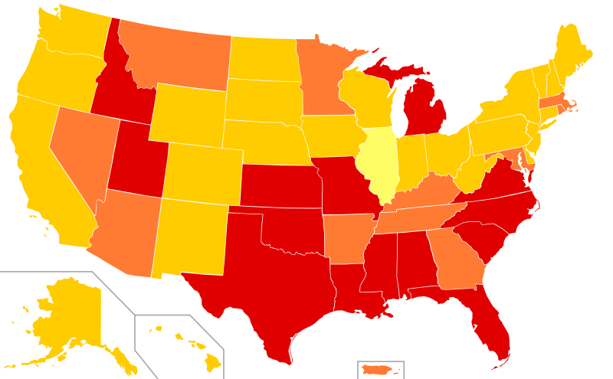


Slide 26
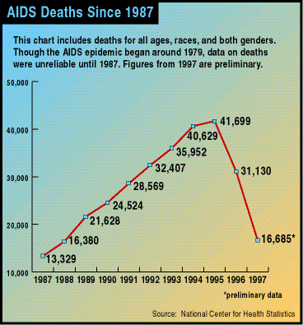

Slide 27
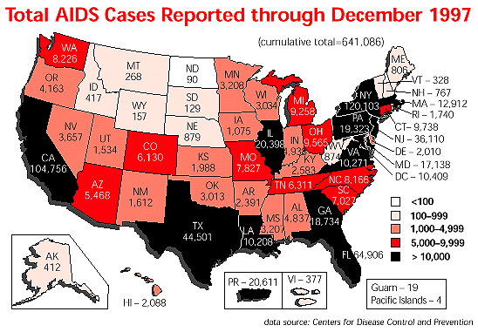

Slide 28
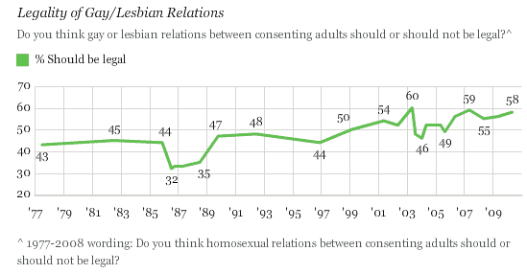

Slide 29
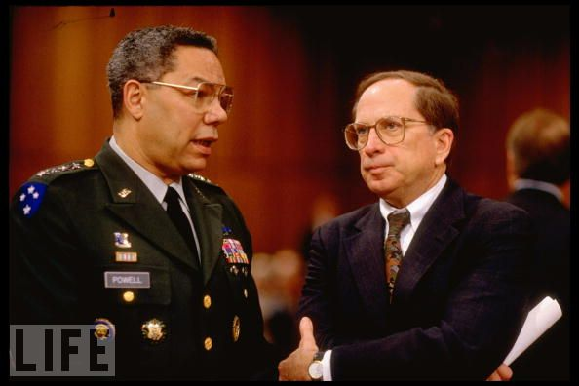

Slide 30
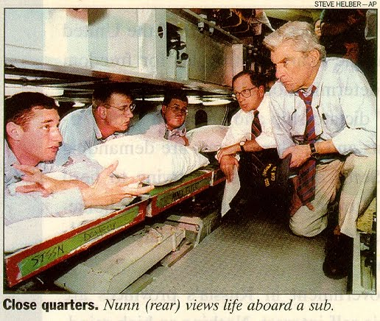

Slide 31


Slide 32
Defense of Marriage Act (1996)
Section 2. Powers reserved to the states
No State, territory, or possession of the United States, or Indian tribe, shall be required to give effect to any public act, record, or judicial proceeding of any other State, territory, possession, or tribe respecting a relationship between persons of the same sex that is treated as a marriage under the laws of such other State, territory, possession, or tribe, or a right or claim arising from such relationship.
Section 3. Definition of marriage
In determining the meaning of any Act of Congress, or of any ruling, regulation, or interpretation of the various administrative bureaus and agencies of the United States, the word 'marriage' means only a legal union between one man and one woman as husband and wife, and the word 'spouse' refers only to a person of the opposite sex who is a husband or a wife.
Passed House, 342-67
Passed Senate, 85-14

Slide 33
Amendment 2—Colorado (1992)
No Protected Status Based on Homosexual, Lesbian, or Bisexual Orientation.
Neither the State of Colorado, through any of its branches or departments, nor any of its agencies, political subdivisions, municipalities or school districts, shall enact, adopt or enforce any statute, regulation, ordinance or policy whereby homosexual, lesbian or bisexual orientation, conduct, practices or relationships shall constitute or otherwise be the basis of or entitle any person or class of persons to have or claim any minority status, quota preferences, protected status or claim of discrimination. This Section of the Constitution shall be in all respects self-executing.

Slide 34



Slide 35
Romer v. Evans (1996)
Amendment 2 fails, indeed defies, even this conventional [rational basis] inquiry. First, the amendment has the peculiar property of imposing a broad and undifferentiated disability on a single named group, an exceptional and, as we shall explain, invalid form of legislation. Second, its sheer breadth is so discontinuous with the reasons offered for it that the amendment seems inexplicable by anything but animus toward the class that it affects; it lacks a rational relationship to legitimate state interests…
Amendment 2 … is at once too narrow and too broad. It identifies persons by a single trait and then denies them protection across the board. The resulting disqualification of a class of persons from the right to seek specific protection from the law is unprecedented in our jurisprudence . . .
We must conclude that Amendment 2 classifies homosexuals not to further a proper legislative end but to make them unequal to everyone else. This Colorado cannot do. A State cannot so deem a class of persons a stranger to its laws.

Slide 36
Lawrence v. Texas (2003)
It must be acknowledged, of course, that the Court in Bowers was making the broader point that for centuries there have been powerful voices to condemn homosexual conduct as immoral. The condemnation has been shaped by religious beliefs, conceptions of right and acceptable behavior, and respect for the traditional family. For many persons these are not trivial concerns but profound and deep convictions accepted as ethical and moral principles to which they aspire and which thus determine the course of their lives. These considerations do not answer the question before us, however. The issue is whether the majority may use the power of the State to enforce these views on the whole society through operation of the criminal law . . .
Bowers was not correct when it was decided, and it is not correct today. It ought not to remain binding precedent. Bowers v. Hardwick should be and now is overruled….
Had those who drew and ratified the Due Process Clauses of the Fifth Amendment or the Fourteenth Amendment known the components of liberty in its manifold possibilities, they might have been more specific. They did not presume to have this insight. They knew times can blind us to certain truths and later generations can see that laws once thought necessary and proper in fact serve only to oppress. As the Constitution endures, persons in every generation can invoke its principles in their own search for greater freedom.

Slide 37
Lawrence v. Texas —Scalia dissent
Texas Penal Code Ann. §21.06(a) (2003) undoubtedly imposes constraints on liberty. So do laws prohibiting prostitution, [and] recreational use of heroin. . .
The Texas statute undeniably seeks to further the belief of its citizens that certain forms of sexual behavior are “immoral and unacceptable,” Bowers, supra, at 196--the same interest furthered by criminal laws against fornication, bigamy, adultery, adult incest, bestiality, and obscenity . . .
Today’s opinion is the product of a Court, which is the product of a law-profession culture, that has largely signed on to the so-called homosexual agenda, by which I mean the agenda promoted by some homosexual activists directed at eliminating the moral opprobrium that has traditionally attached to homosexual conduct…
Many Americans do not want persons who openly engage in homosexual conduct as partners in their business, as scoutmasters for their children, as teachers in their children’s schools, or as boarders in their home. They view this as protecting themselves and their families from a lifestyle that they believe to be immoral and destructive.

Slide 38
Lawrence v. Texas —more Scalia
Today’s opinion dismantles the structure of constitutional law that has permitted a distinction to be made between heterosexual and homosexual unions, insofar as formal recognition in marriage is concerned. If moral disapprobation of homosexual conduct is “no legitimate state interest” for purposes of proscribing that conduct, ante, at 18; and if, as the Court coos (casting aside all pretense of neutrality), “[w]hen sexuality finds overt expression in intimate conduct with another person, the conduct can be but one element in a personal bond that is more enduring,”ante, at 6; what justification could there possibly be for denying the benefits of marriage to homosexual couples exercising “[t]he liberty protected by the Constitution,” ibid.? Surely not the encouragement of procreation, since the sterile and the elderly are allowed to marry. This case “does not involve” the issue of homosexual marriage only if one entertains the belief that principle and logic have nothing to do with the decisions of this Court. Many will hope that, as the Court comfortingly assures us, this is so.

Slide 39


Slide 40


Slide 41
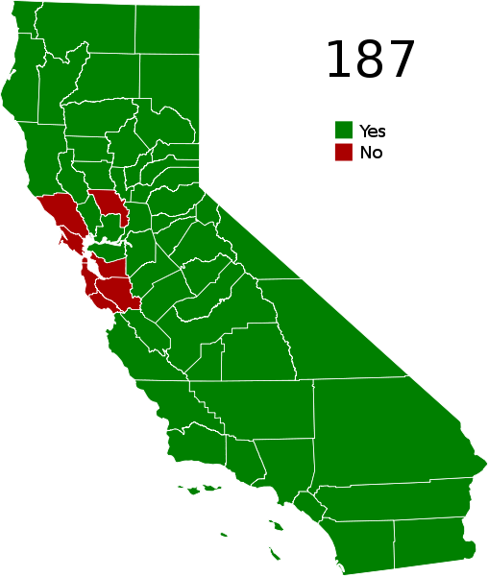

Slide 42


Slide 43
