Slide 1
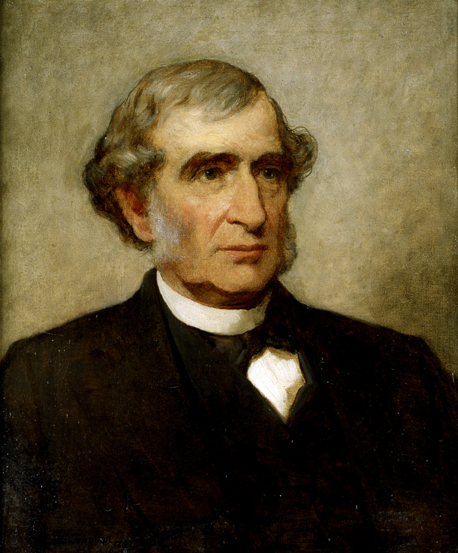
Morrill Act (1862)
Sale of federal public land for the “maintenance of at least one college where the leading object shall be, without excluding other scientific and classical studies and including military tactics, to teach such branches of learning as are related to agriculture and the mechanic arts, in such manner as the legislatures of the States may respectively prescribe, in order to promote the liberal and practical education of the industrial classes in the several pursuits and professions in life.”

Slide 2
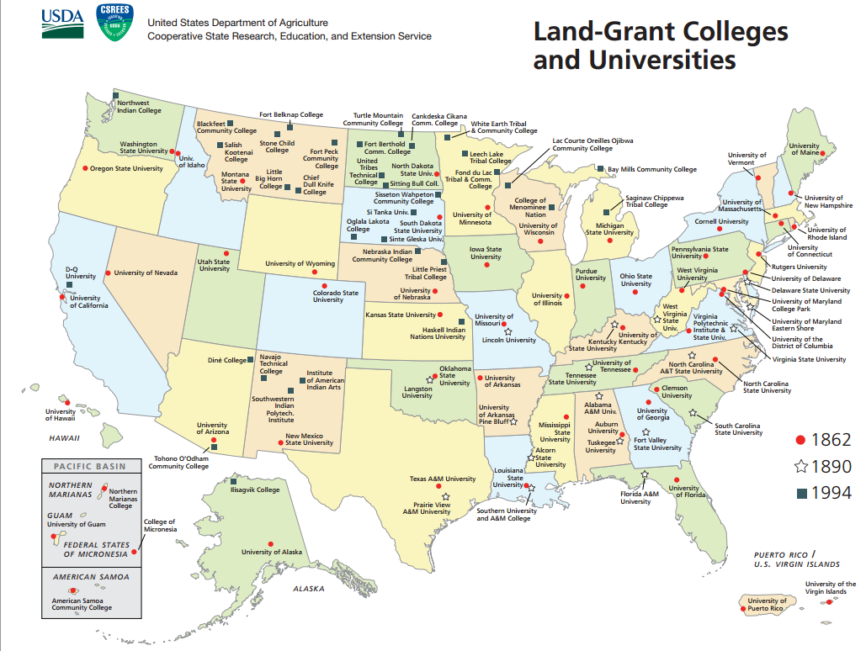

Slide 3
The mission of the University of Michigan is to serve the people of Michigan and the world through preeminence in creating, communicating, preserving and applying knowledge, art, and academic values, and in developing leaders and citizens who will challenge the present and enrich the future…
To create a brilliant future for the University of Illinois in which the students, faculty and staff thrive and the citizens of Illinois, the nation and the world benefit…
Santa Clara University will educate citizens and leaders of competence, conscience, and compassion and cultivate knowledge and faith to build a more humane, just, and sustainable world…
We [at James Madison University] are a community committed to preparing students to be educated and enlightened citizens who lead productive and meaningful lives.

Slide 4
As the public liberal arts college for the state of Maine, the University of Maine at Farmington prepares students for engaged citizenship…
The University [of Maine at Presque Isle] affirms, as central to its mission, commitment to . . . public service which promotes the well-being of the State’s citizenry.
It is hoped that [Colby] students will become critical and imaginative thinkers who are . . . willing to assume leadership roles as students and citizens.
Through its undergraduate, graduate, and professional programs, USM faculty members educate future leaders in the liberal arts and sciences, engineering and technology, health and social services, education, business, law, and public service.
The unevenness of American secondary education, the diversity of student backgrounds and the demands of college-level work and effective citizenship all require that [Bowdoin] College enable students to master essential quantitative and writing skills and skills of oral communication, with the guidance of faculty, other professionals and qualified student peers.

Slide 5
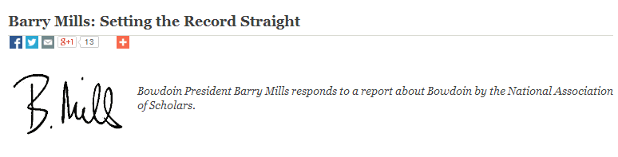
“We [at Bowdoin] are also committed to preparing our students to become global citizens in a global economy and for careers that call for critical thinking, judgment, and principled leadership.”
http://www.bowdoindailysun.com/2013/04/barry-mills-setting-the-record-straight/

Slide 6
As the public liberal arts college for the state of Maine, the University of Maine at Farmington prepares students for engaged citizenship…
The University [of Maine at Presque Isle] affirms, as central to its mission, commitment to . . . public service which promotes the well-being of the State’s citizenry.
It is hoped that [Colby] students will become critical and imaginative thinkers who are . . . willing to assume leadership roles as students and citizens.
Through its undergraduate, graduate, and professional programs, USM faculty members educate future leaders in the liberal arts and sciences, engineering and technology, health and social services, education, business, law, and public service.

Slide 7
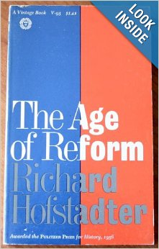
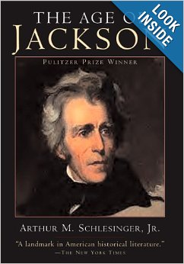

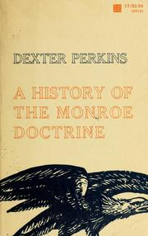

Slide 8
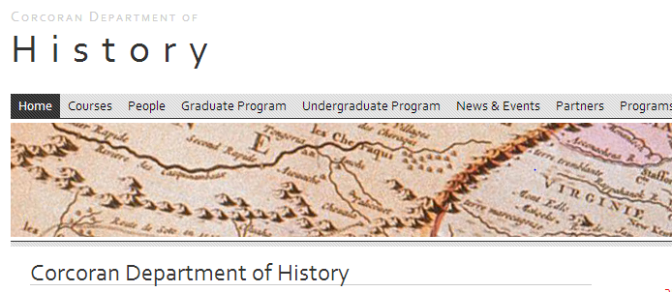



Slide 9

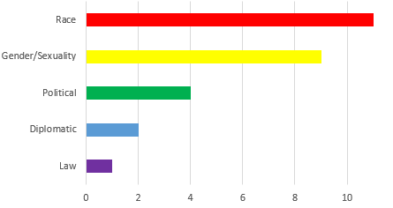
African American cultural, U.S. South, Black resistance and protest in the 20th century, African Diaspora
North American religion, African American religious and intellectual history in the 20th century
American religious history; Immigration; Race and ethnicity; Mesooamerican/Latin; American/Afro-Latino and Asian American religions;
20th-century United States; African American; African diaspora; Women and gender; Black feminism(s); Black Power; Social movements
Global environmental history; History and sociology of science, focusing on 20th century environmental and human sciences; International organizations and international development; U.S. and the World

Slide 10
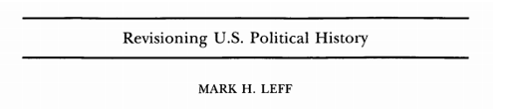
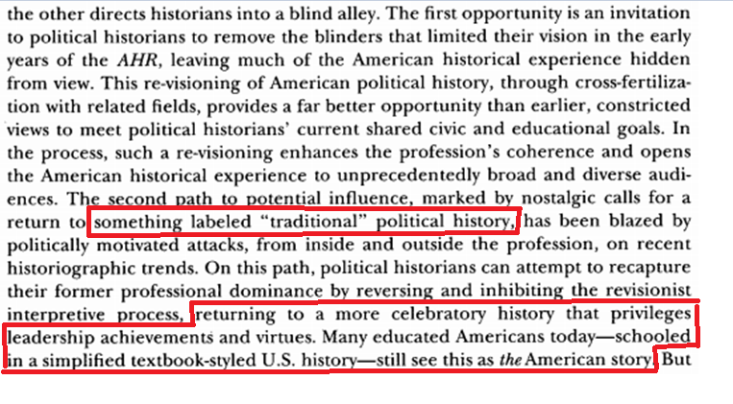

Slide 11
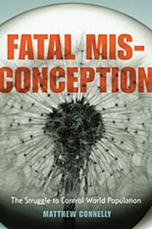


Slide 12



Slide 13

“The 22 to 0 ratio of Democrats to Republicans made sense to Gordon, who said on Wednesday ‘about two thirds of Johnson County are Democrats. The UI policy says not to discriminate; it does not say we should be going out and getting diversity . . . We do not know if an applicant belongs to the Republican Party, the American Civil Liberties Union, the Black Panthers or the Loyal Order of Water Buffalo.’”
--Colin Gordon
“To participate politically here, you have to be a Democrat, [Hanley] said, noting that most local public officials are Democrats . . . ‘I don't think there is a downside [to having no Republicans in the department]. If it is a downside, then it would be a downside to have states to be so-called blue or so-called red. It would be casting a pall on the democratic system where people are free to choose.’”
--Sarah Hanley

Slide 14
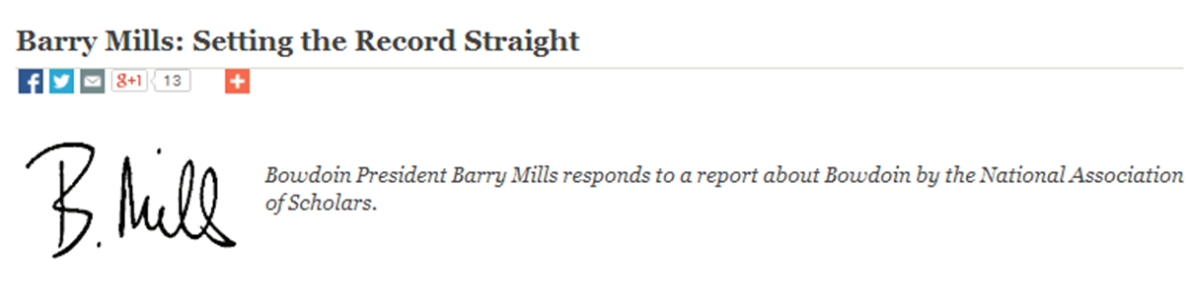
“At Bowdoin, we know students interested in history have already studied American history in high school…”
http://www.bowdoindailysun.com/2013/04/barry-mills-setting-the-record-straight/

Slide 15

U.S. Social Movements in the 1960s and 1970s
Daring to Be Bad
Like a Hurricane
Chicanismo
Brown-Eyed Children of the Sun
The Black Panther Party Reconsidered
Cultural Politics & Social Movements
Enriqueta Vasquez & the Chicano Movement
Lakota Woman
Revolution in the Air
Americans’ Empires
“Americans’ participation in a world structured by colonialism . . . [through] the premise that the traditional historiography avoids confronting the myriad institutional, intellectual, imaginary, and everyday ways in which Americans participated in a broader world that was shaped by colonial empires, from before the American Revolution of 1776 to the present.”

Slide 16
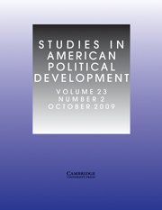
“Beyond these [History offerings], our government and legal studies department offers important courses on the American presidency, Congress, the U.S. Constitution, and other areas in the fields of American government and political theory. As our community knows, government is currently—and has long been—the most popular major at Bowdoin, and it is nearly impossible for these students to graduate from Bowdoin without having read the Federalist Papers at least once.”

Slide 17
Maine Social Studies Learning Goals
Explain that the study of government includes the structures, functions, institutions, and forms of government and the relationship of government to citizens in the United States and in other regions of the world.
Evaluate current issues by applying democratic ideals and constitutional principles of government in the United States, including checks and balances,
federalism, and consent of the governed as put forth in founding documents.
Describe the purpose, structures, and processes of the American political system.
Explain the relationship between constitutional and legal rights, and civic duties and responsibilities in a constitutional democracy.
Evaluate the relationship between the government and the individual as evident in the United States Constitution, the Bill of Rights, and landmark court cases.
--http://www.maine.gov/doe/socialstudies/documents/ss102207.pdf

Slide 18
New York Social Studies Learning Standards
Students will use a variety of intellectual skills to demonstrate their understanding of the necessity for establishing governments; the governmental system of the United States and other nations; the United States Constitution; the basic civic values of American constitutional democracy; and the roles, rights, and responsibilities of citizenship, including avenues of participation.
Investigate how the United States’ democratic principles have influenced the constitutions and governments of other nations; view this sharing as a two-way exchange, with the United States influencing and being influenced by other nations.
Analyze important debates in American history (e.g., ratification of the United States Constitution, abolition of slavery, regulation of big business, restrictions on immigration, the New Deal legislation, women’s suffrage, United States involvement in foreign affairs and wars), focusing on the opposing positions and
the historical evidence used to support these positions.
Analyze key Supreme Court decisions (e.g., Marbury v. Madison, McCulloch v. Maryland, Dred Scott v. Sanford, Plessy v. Ferguson, Brown v. Board of Education of Topeka, Miranda v. Arizona, and Roe v. Wade) in terms of the ongoing struggle to
realize democratic ideals; explore how these decisions embody constitutional civic values and the evolution and application of constitutional values within American political, economic, and social life.

Slide 19
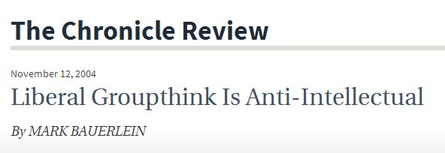
. . . The final social pattern is the Law of Group Polarization. That law, as Cass R. Sunstein, a professor of political science and of jurisprudence at the University of Chicago, has described, predicts that when like-minded people deliberate as an organized group, the general opinion shifts toward extreme versions of their common beliefs . . . The simple trappings of deliberation make academics think that they’ve reached an opinion through reasoned debate -- instead of, in part, through an irrational social dynamic. The opinion takes on the status of a norm. Extreme views appear to be logical extensions of principles that everyone more or less shares, and extremists gain a larger influence than their numbers merit. If participants left the enclave, their beliefs would moderate, and they would be more open to the beliefs of others. But with the conferences, quarterlies, and committee meetings suffused with extreme positions, they're stuck with abiding by the convictions of their most passionate brethren.

Slide 20
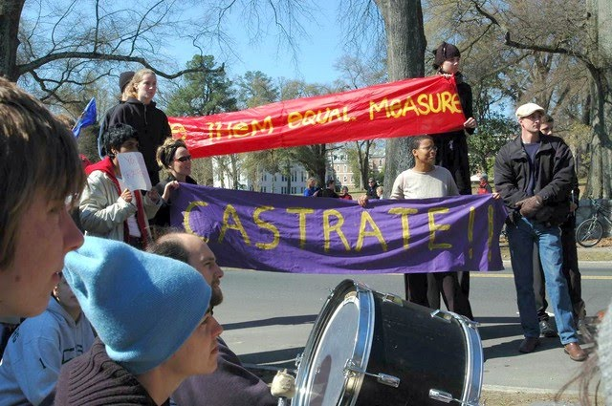
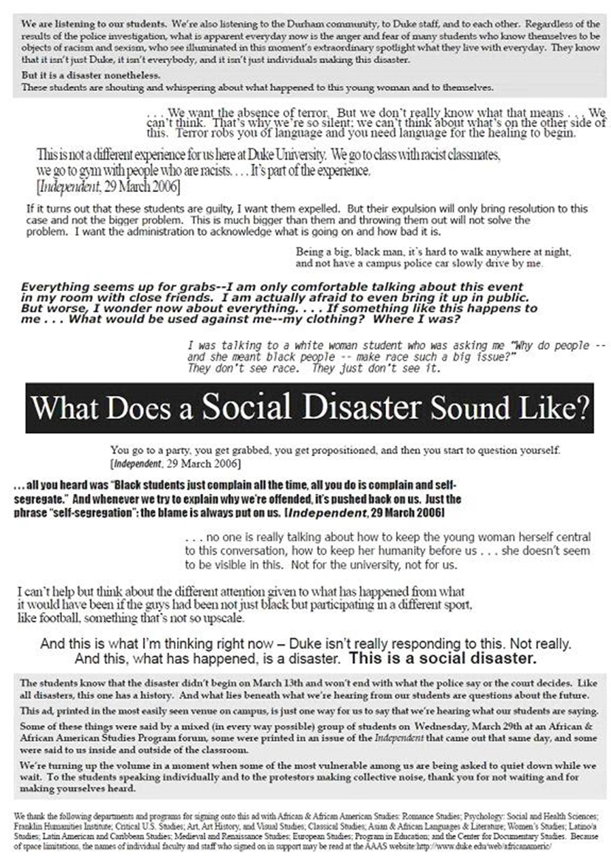
“To the protesters making collective noise, thank you for not waiting and for making yourselves heard.”
--Group of 88 statement, 6 April 2006
(ten days after above protest)

Slide 21

Sex and race have been intertwined since the beginning of American history. They remain so today, throughout America and here at Duke. The events that occurred on Buchanan Boulevard two weeks ago are part of a deep and troubling history.
Racism has always constituted the original sin of our democracy. Slavery, and then Jim Crow, systematically contradicted our commitment to the equality of all citizens. Race also stood as a primary source of power for those whites with privilege…
Sex and race have always interacted in a vicious chemistry of power, privilege, and control. Emmett Till was brutalized and lynched in Mississippi in 1954 [sic, 1955] for allegedly speaking with too easy familiarity to a white woman storekeeper…
What has all this to do with America today, and with Duke? Among other things, it helps to put into context what occurred in Durham two weeks ago. The mixture of race and sex that transpired on Buchanan Boulevard is not new.
--William Chafe, 31 March 2006

Slide 22
Whereas the American Studies Association is committed to the pursuit of social justice…
Whereas the United States plays a significant role in enabling the Israeli occupation of Palestine and the expansion of illegal settlements and the Wall in violation of international law…
Whereas . . . Israeli institutions of higher learning are a party to Israeli state policies that violate human rights and negatively impact the working conditions of Palestinian scholars and students;
… In keeping with the spirit of its previous statements supports the right of students and scholars to intellectual freedom and to political dissent as citizens and scholars…
It is resolved that the American Studies Association (ASA) endorses and will honor the call of Palestinian civil society for a boycott of Israeli academic institutions.

Slide 23
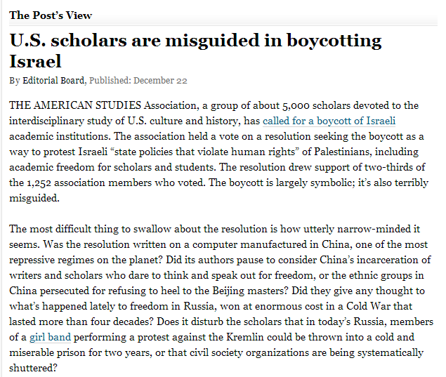
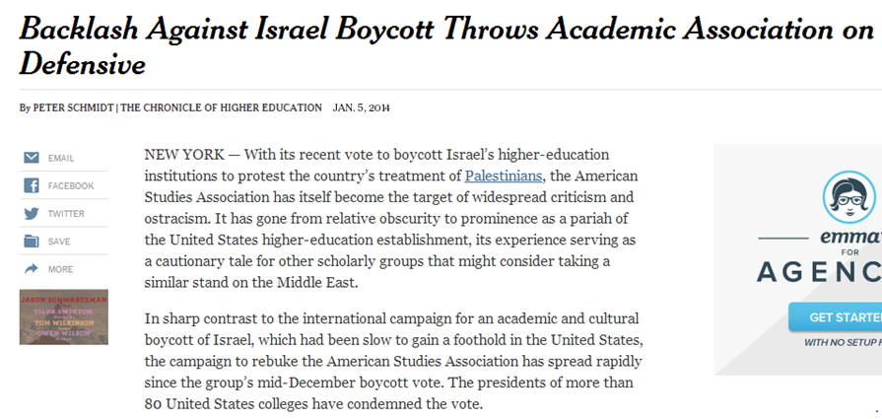

Slide 24

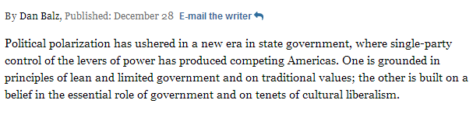
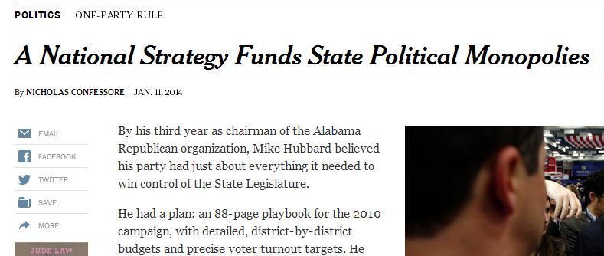

Slide 25
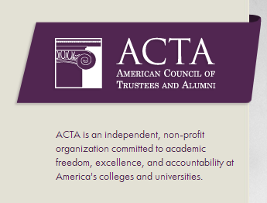

Slide 26

